Slide 1
God’s Plan
Christian Morality
Document #: TX001805

Slide 2
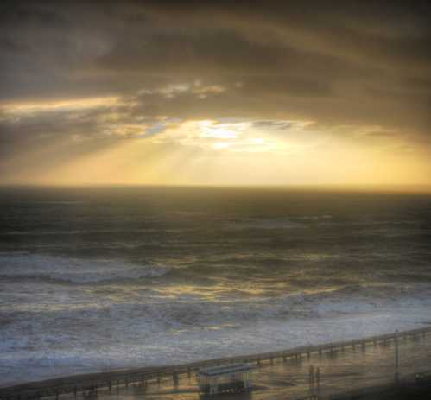
Through the process of justification, God’s grace frees us from sin and sanctifies us, that is, makes us holy.
Image in public domain

Slide 3
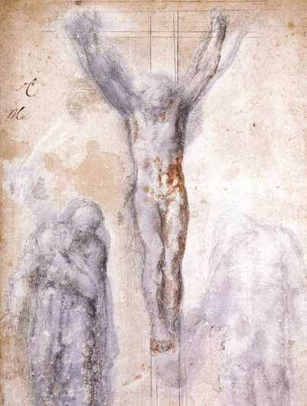
Through Christ’s obedient sacrifice, our original holiness, lost with Original Sin, is restored.
Image in public domain

Slide 4
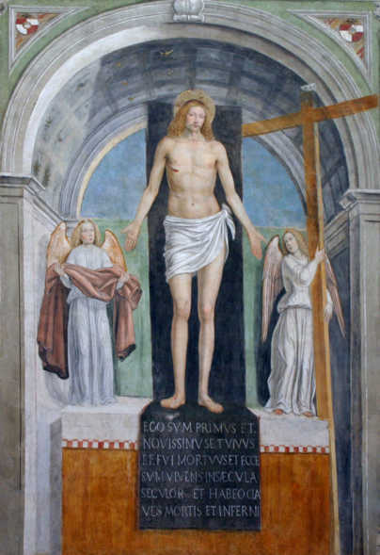
Through the Paschal Mystery—that is, through Christ’s life, suffering, death, and Resurrection—we are once again in harmony with God and with one another.
Image in public domain

Slide 5
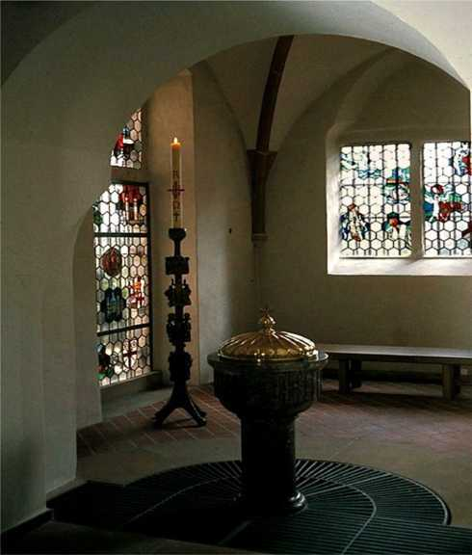
Through our Baptism we
unite ourselves with Christ’s Passion and
share in his death
and Resurrection.
Image in public domain

Slide 6

Our justification begins with conversion.
Image in public domain

Slide 7
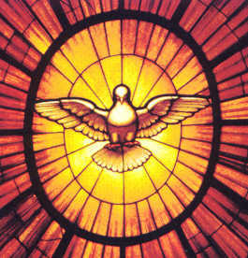
We are prompted by the grace of the Holy Spirit to turn toward God and away from sin.
Image in public domain

Slide 8
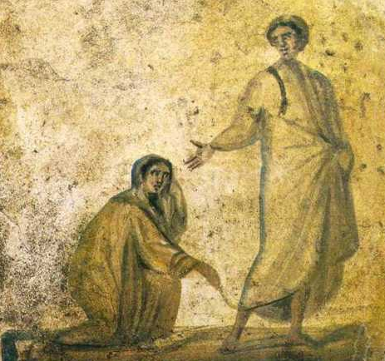
In the process of justification, we are freed from sin, we are reconciled with God, and the desire to become more like Christ grows stronger.
Image in public domain

Slide 9
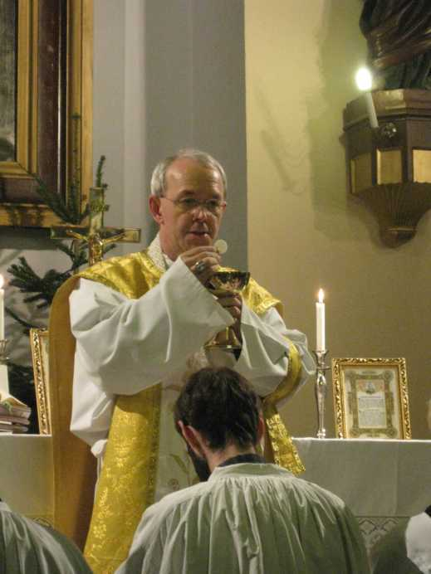
This desire is nourished by God’s grace, especially through the Sacraments of the Church.
Image in public domain

Slide 10
As the process of justification reaches its end, we are sanctified, that is, we are made holy.
Image in public domain

Slide 11
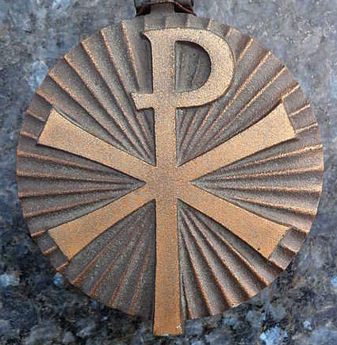
God’s plan for how we are to live is revealed in the mystery of Christ’s life and teaching and through his suffering, death, and Resurrection.
Image in public domain

