Slide 1
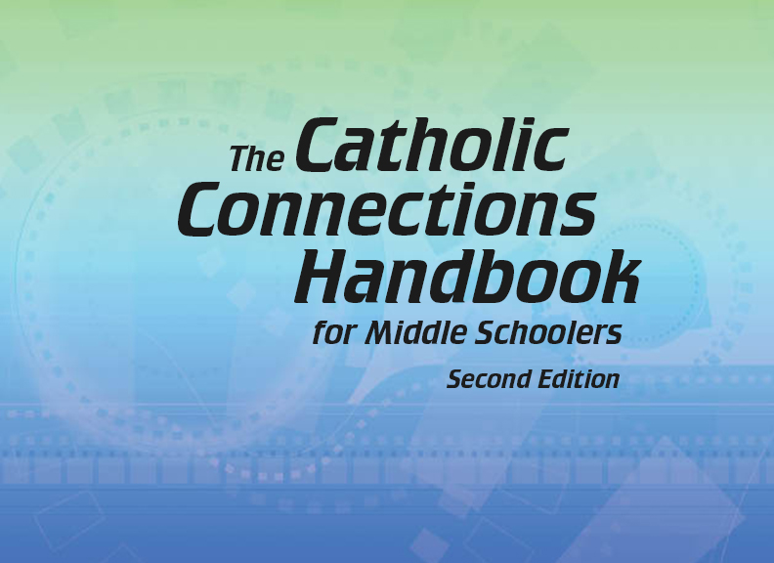
Document #: TX005837

Slide 2
Prayer and Church History
Chapter 50
The Lord’s Prayer: A Prayer for All Time

Slide 3
Chapter Summary
The Lord’s Prayer is made up of a series of petitions asking God for his help.
The number of petitions is seven, a sacred number in ancient times.
The more we understand the meaning of each petition, the more we understand what we are asking for when we pray the Lord’s Prayer.

Slide 4
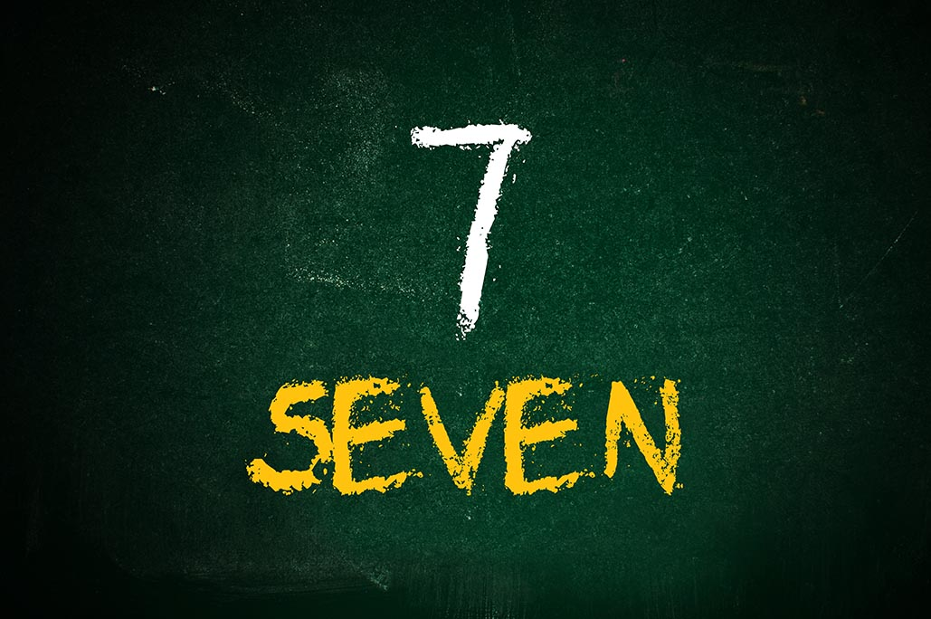
Introduction and “Seven Petitions” (Handbook, pages 544–546)
In the ancient world, the number seven represented a perfect number and is reflected in the perfect prayer, the Lord’s Prayer.
© ignor.stevanovic/Shutterstock.com

Slide 5
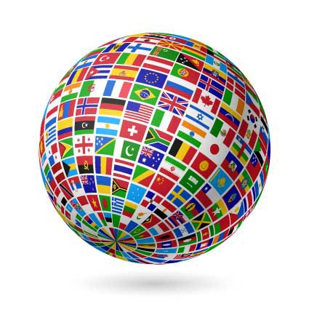
Seven Petitions: Whose Father?
Before we begin the seven petitions, we address God as Father. We pray, “Our Father,” because God’s love extends to all people.
“Who art in heaven” does not refer to a faraway place, but a state of being close to God.
© Alhovik/Shutterstock.com

Slide 6
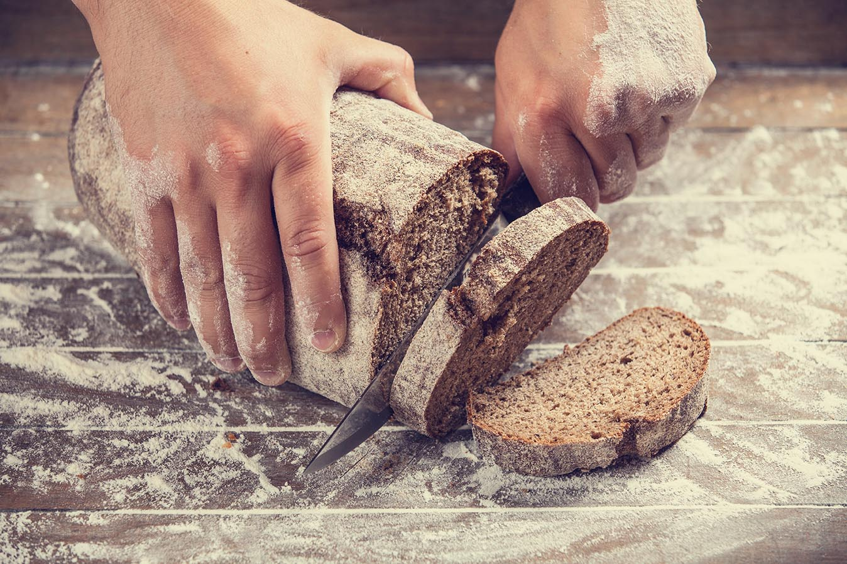
Petitions 1–4 (Handbook, pages 546–549)
The first three petitions focus on God; the last four petitions focus on our human needs.
© Masson/Shutterstock.com

Slide 7
1) Hallowed Be Thy Name
Think, Pair, Share
Join with a partner, consider these questions, and share your responses with your group.
What does “hallowed” mean?
Think about your speech and text. How can you “keep holy” God’s name and use it reverently? What can you avoid doing?
© www.BillionPhotos.com/Shutterstock.com

Slide 8
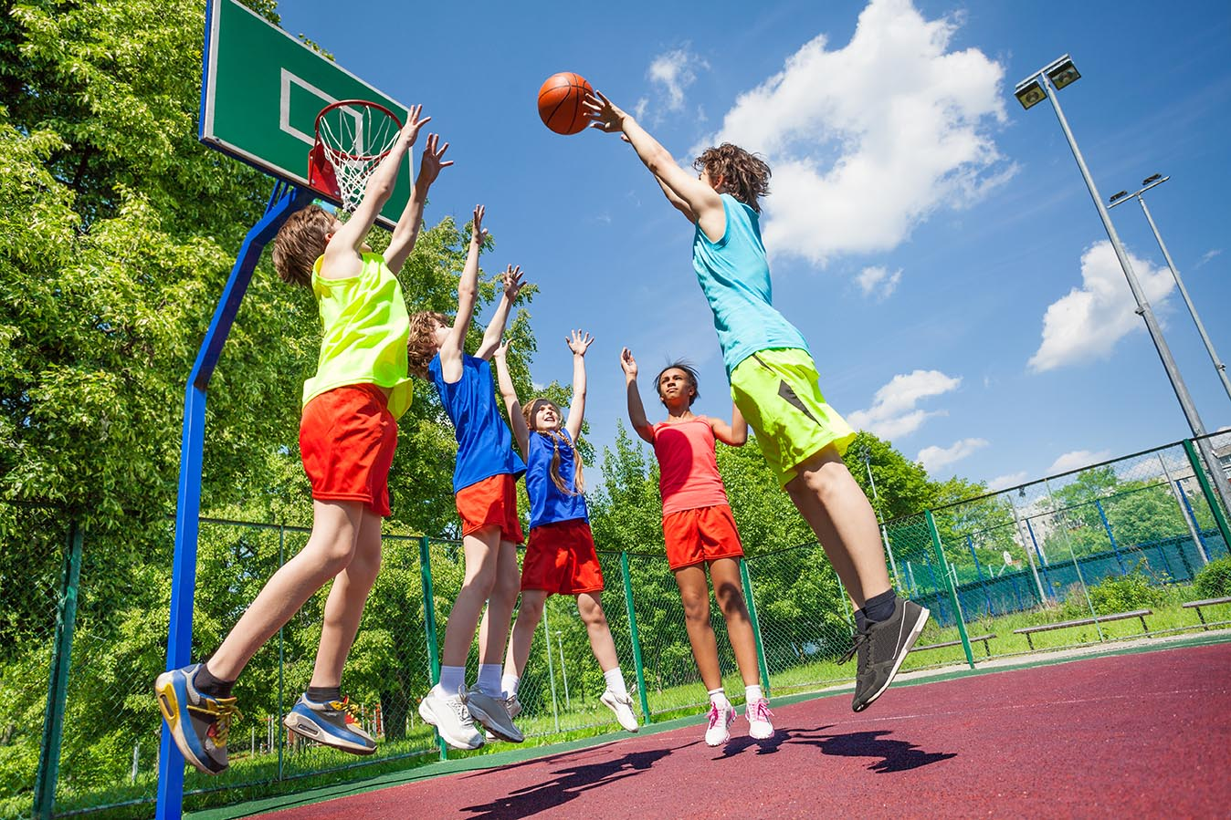
2) Thy Kingdom Come
Now join with a new partner.
Consider:
What can you do today to help God’s kingdom of peace, justice, and love come into your home? your school? your time with friends?
Share your responses with your group.
© Sergey Novikov / Shutterstock.com

Slide 9
3) Thy Will Be Done on Earth as It Is in Heaven
Change partners again! Consider and share:
What is God’s will for you today?
Name some things you expect to do, and plan to do them with love for God, yourself, and others.
© slonme/Shutterstock.com

Slide 10
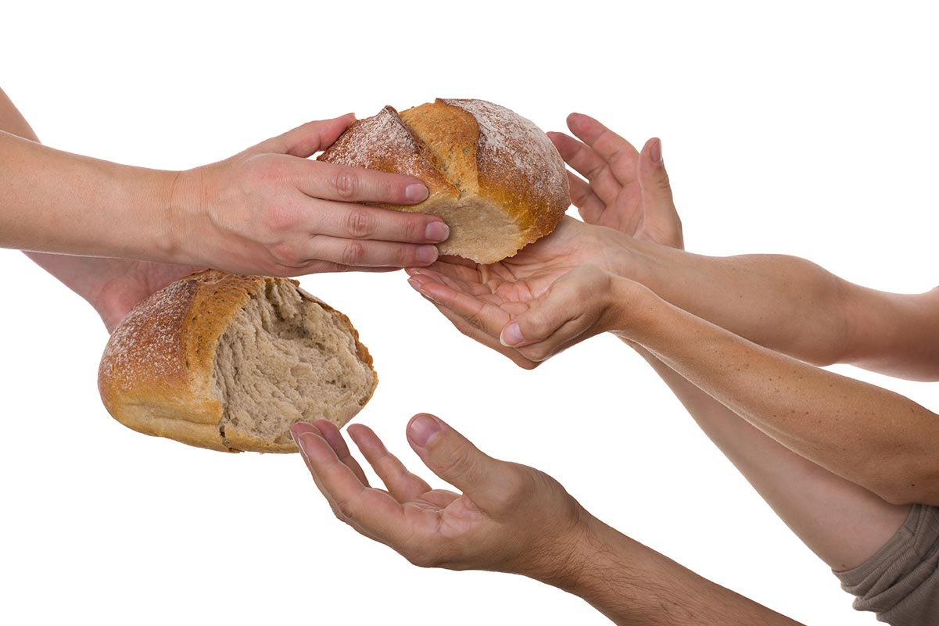
4) Give Us This Day Our Daily Bread
Join with a new partner.
Consider and share:
What is “our daily bread”? Not just mine, but ours, everyone’s, all over the world. How can we help those who are hungry?
“Our daily bread” can also mean the Eucharist, when Jesus comes to us under the appearances of bread and wine.
© Tibanna79/Shutterstock.com

Slide 11
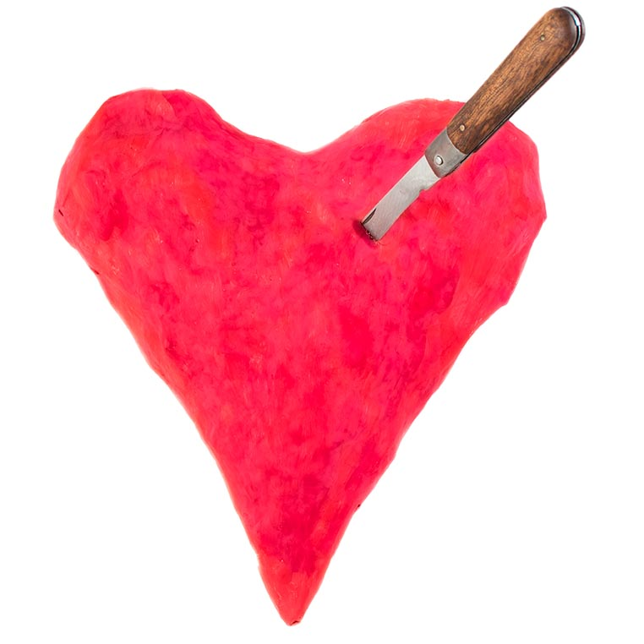
Petition 5 (Handbook, pages 550–551)
In order to fully receive God’s love and forgiveness, we must be willing to forgive one another.
So we pray, “Forgive us our trespasses, as we forgive those who trespass against us.”
© SergeiKazakov/Shutterstock.com

Slide 12
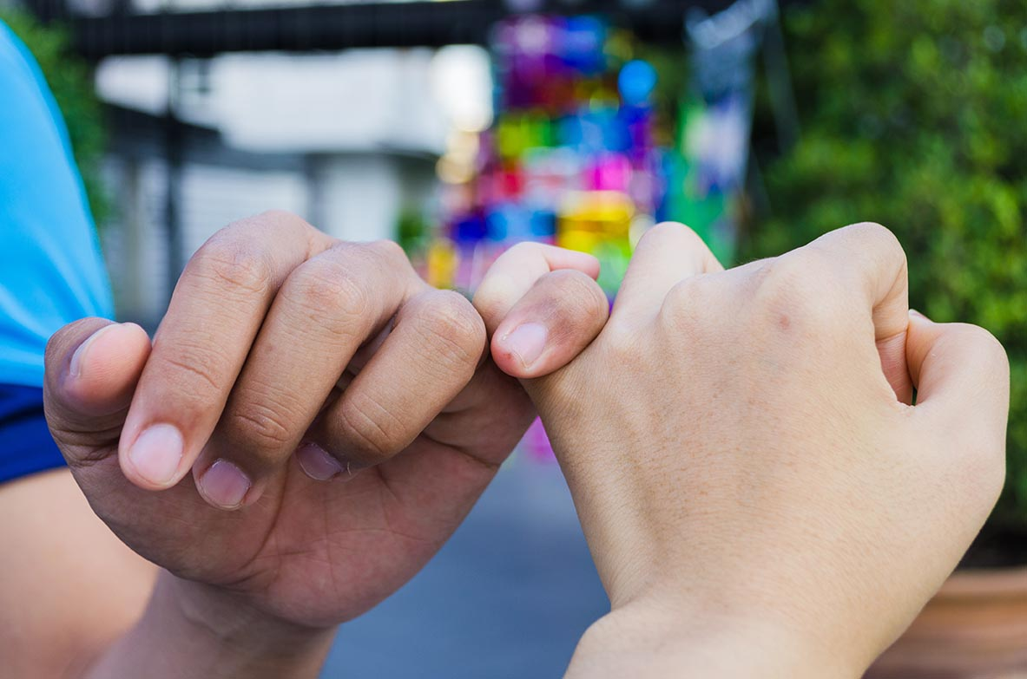
Trespasses Hurt
“To trespass” is to invade someone’s space, to trample on someone’s feelings in some way.
“To trespass” is another way of saying “to sin.”
Trespasses hurt. Sin hurts. Stop the hurt and make things right.
© Papavarin Karnjanaranya / Shutterstock.com

Slide 13
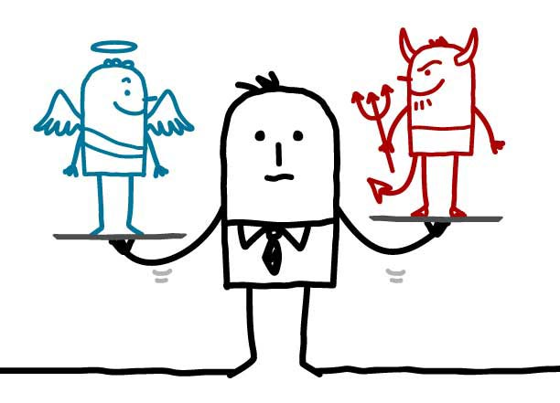
Petitions 6 and 7 (Handbook, pages 551–552)
We petition God the Father to help us resist temptation and keep us from evil.
© NLshop/Shutterstock.com

Slide 14
6) Lead Us Not into Temptation
Join with a new partner. Consider and share:
What is a temptation for middle schoolers?
What are some strategies to resist temptation? (What would you do if . . . ?)
Some ideas: Avoid persons, places, and things that may lead you astray. Think of something good and constructive to do immediately. Pray the name of Jesus and walk away.

Slide 15
7) But Deliver Us from Evil
Saint Paul wrote to the Romans, “Do not let evil defeat you; instead, conquer evil with good” (Romans 12:21).
In the icon on the next slide, Jesus, after his Resurrection, is pulling Adam and Eve into Heaven. Jesus triumphs over sin and death! And we will too!
The scriptural quotation in this presentation is from the Good News Translation® (Today’s English Version, Second Edition). Copyright © by the American Bible Society. All rights reserved. Bible text from the Good News Translation (GNT) is not to be reproduced in copies or otherwise by any means except as permitted in writing by the American Bible Society, 1865 Broadway, New York, NY 10023 (americanbible.org).

Slide 16
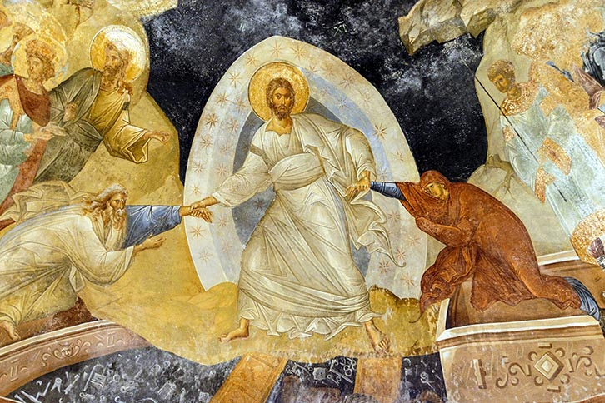
Jesus’ Victory and Ours
© steve estvank / Shutterstock.com

