Slide 1
The Apostles
The Bible Course
Document # TX001082

Slide 2

God Calls Us
How and why does God call people to follow him?
God calls us individually in a unique manner.
God calls us to follow him and to be his witnesses and share the message of the Gospel.
God has called various individuals to follow him throughout history.
God continues to call people to follow him.
© Elnur / Shutterstock
Notes:
(Note: This slide introduces the concept of being called. You might pair this presentation with a song about being called. Some examples are “We Are Called to Serve,” by Tim and Julie Smith, or “The Summons,” by John Bell [www.spiritandsong.com]. The song can be played as the students are walking into class or as part of the opening prayer for the class. You can use the initial question to start a class discussion. The four bullets below the question appear with individual clicks to allow you to present these points when you are ready. Another possibility to introduce this topic is to have the local parish priest or a local religious come and share his or her story about how he or she felt called to follow God.)

Slide 3
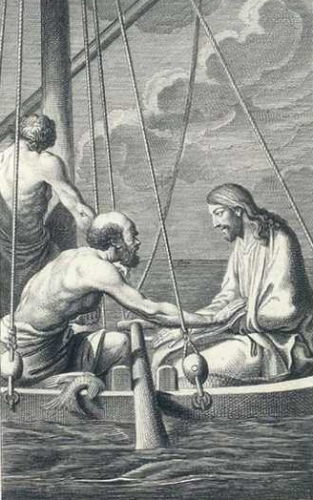
Mark 1:16–20
As he passed by the Sea of Galilee, he saw Simon and his brother Andrew casting their nets into the sea; they were fishermen. Jesus said to them, “Come after me, and I will make you fishers of men.” Then they abandoned their nets and followed him. He walked along a little farther and saw James, the son of Zebedee, and his brother John. They too were in a boat mending their nets. Then he called them. So they left their father Zebedee in the boat along with the hired men and followed him.
Image in public domain
Notes:
(Note: This particular calling of the Apostles was chosen because of the four Apostles mentioned in this text. Select a student volunteer to read the selection. Ask the students to share what they notice from the reading. Point out that the four men were in the midst of their work when Jesus called them and that they left their livelihood behind to follow Jesus.)

Slide 4
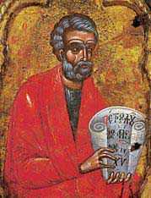
Jesus Calls Whom He Wills
Jesus called men to be his Apostles during his lifetime.
Apostle comes from the Greek word apostolos, meaning “messenger,” especially one sent on a mission.
The most notable of Jesus’ apostles are the Twelve Apostles.
Jesus called many other men and women to be his disciples in the early Church.
Image in public domain
Notes:
(Note: At the end of this presentation, it can also be noted that Jesus continues to call individuals to follow him and sends them on the mission to be his witnesses to the ends of the earth.)

Slide 5
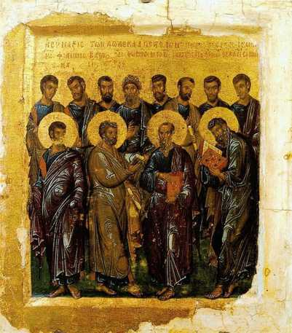
The Twelve Apostles
How many of the Twelve Apostles can you name? Take a moment and jot them down.
Let’s see how you did. The following are names of the Twelve Apostles. Add the ones you missed.
Simon (Peter)
Andrew
James, the son of Zebedee
John
Jude Thaddaeus
Philip
Bartholomew
Thomas
Matthew
James, the son of Alphaeus
Simon the Zealot
Judas
Image in public domain
Notes:
The points that follow are to come in on their own individual click—even the individual names of the Apostles.
(Note: The simple activity of naming as many Apostles as possible from memory can engage the students in a different way. If naming the Apostles is something you will want the students to be able to do for a quiz, then a suggested activity would be to divide the class into two teams and write two lists on the board of the first letters of each Apostle’s name. Then give each team a piece of chalk or a marker and have one student from each team go to the board and write the name of an Apostle using one of the first letters on their team’s list. When a name has been written, they go back to their teams and pass on the marker so the next team member can go and fill in another name, and so on. The first team to name all Twelve Apostles wins.)

Slide 6
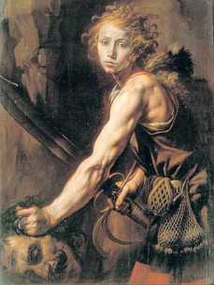
Characteristics of the Apostles
Jesus chose people who had certain characteristics to be his Apostles.
These characteristics were very similar to
those possessed by early leaders of
Israel: judges, kings, and prophets.
Some of these characteristics are:
  They were obedient to God’s will.
  They understood the need and
  purpose for divine justice.
  They were committed to ethical
  responsibility.
  They were men and women who committed themselves to God and were willing to be his voice among the people.
Image in public domain
Notes:
(Note: Earlier in this course, the students looked at the characteristics of a faith-filled person. It would be good to have the students recall the person they named or thought of whom they considered to be a faith-filled person, and ask them if the characteristics mentioned in this slide also pertain to the person they thought of.)

Slide 7
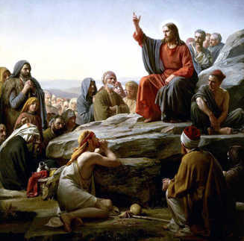
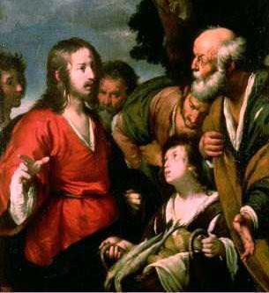
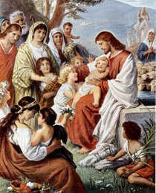
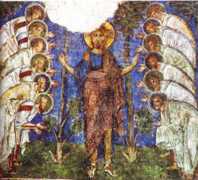
On The Job Training
Jesus provided the training necessary for following him and speaking on his behalf through the following actions:
He taught the Apostles both publicly and privately over three years.
He performed miracles in front of the Apostles.
He demonstrated through actions how the Apostles should act and treat one another.
He told the Apostles to share his message with the entire world.
Images in public domain
Notes:
(Note: You can expand on the training Jesus provided to the Apostles with the following information: He spoke to the Apostles in various forms—for example, parables, conversations, speeches, and scriptural interpretations. He performed miracles in front of the Apostles to demonstrate the depth of his power, the love of God for his people, and the power of faith to change one’s life. Jesus demonstrated through actions how the Apostles should act and treat one another throughout their lives, even after he was no longer with them.)

Slide 8
Review
God calls people to follow him and invites them to share his mission of spreading the message of the Gospel.
Jesus called twelve men to follow him as Apostles, and later called other men and women in the early Church to share in the same mission.
The people called to be Apostles possessed certain characteristics that were seen in the early leaders of Israel.
Jesus provided training for the Apostles by living with them and setting an example for them.
Notes:
(Note: This slide helps the students to review what has been covered in this class. This slide can also serve to identify any areas where the students are having difficulty grasping the concepts presented.)

