Slide 1
Learning to Navigate the Bible
Document #: TX004701
Notes:
Notes: Use this PowerPoint to teach or to review the procedures by which students may successfully navigate their way through Sacred Scripture, locating particular passages with ease. If you do use this PowerPoint, do so prior to learning experience 7.

Slide 2


Basic Divisions in Sacred Scripture
The Old Testament (sometimes called the Hebrew Scriptures)
The New Testament (sometimes called the Christian Testament)
© Dream Perfection / Shutterstock.com
Notes:
Notes: All students should have their Bibles during this presentation, so that they can begin to orient themselves to its contents.

Slide 3
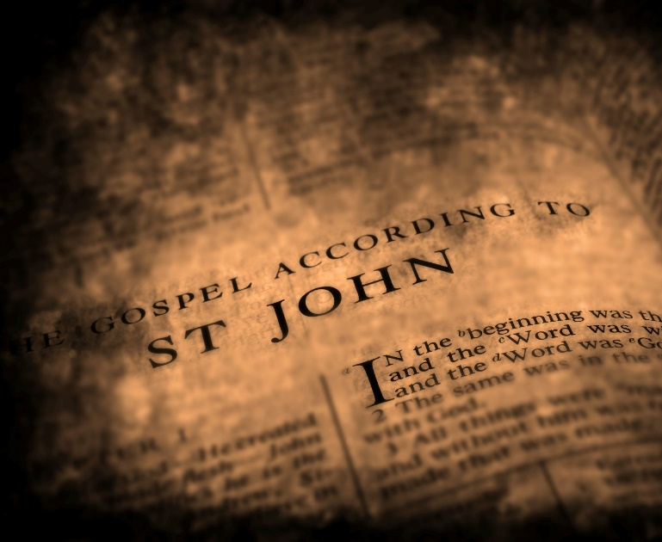
Further Divisions in Sacred Scripture
Both the Old and New Testaments are divided into sections called books.
To find a particular book, use your Bible’s table of contents.
Many Bibles also have an alphabetical list of books at the back.
© Lane V. Erickson / Shutterstock.com
Notes:
Notes: Using either the table of contents or the alphabetical listing of books, direct the students to find the beginning of the Gospel of Matthew. Explain to them that Matthew is the first book of the New Testament—therefore, everything before Matthew is the Old Testament, and everything from Matthew forward is the New Testament. If the students have print Bibles (rather than e-books), invite them to notice how much longer the Old Testament is than the New Testament.

Slide 4
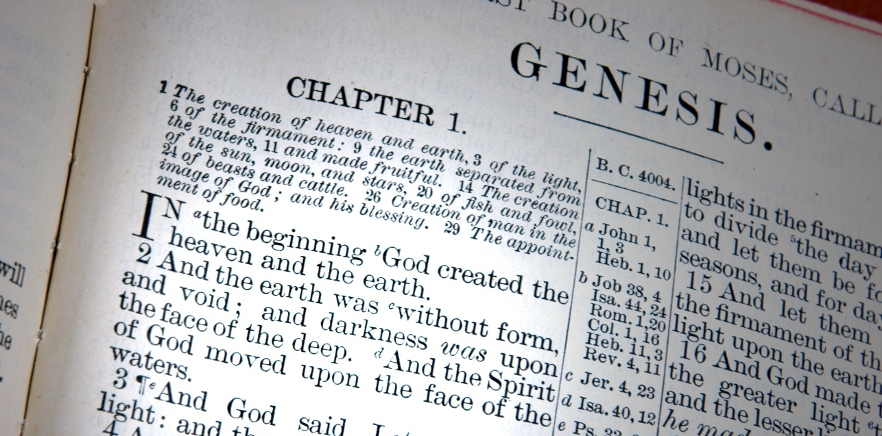
More Divisions, Still!
Each book of the Bible is divided into chapters. These are generally a page or two long—not as long as a chapter in a regular book.
Each chapter is divided into very short sections—about a sentence long—called verses.
© James E. Knopf / Shutterstock.com
Notes:
Notes: There are four biblical books that are not divided into chapters because they are very short—only one chapter long. Send your students on a little scavenger hunt to find which books these are. They are Philemon, 2 John, 3 John, and Jude.

Slide 5

Finding and Citing Biblical Passages
In referring to a biblical passage, we refer to the book, the chapter, and the verse(s)—Example: Ruth 1:16‒17.
We never use page numbers, because people may have different editions or translations of the Bible.
© justasc / Shutterstock.com
Notes:
Notes: Using the example on the slide, help the students to understand that “Ruth” refers to the book of the Bible, “1” to the chapter, and “16-17” to the verses. If you wish, have students find this passage and read it aloud.

Slide 6

Other Variations in Citations
A number is used before the name of several books to distinguish biblical books with the same name. (Example: 2 Corinthians 4:16‒18)
Reference to “a” or “b” indicates either the first or second part of a verse. (Example: Micah 6:4b)
© Rick Becker-Leckrone / Shutterstock.com
Notes:
Notes: Invite the students to locate these passages and read them aloud. This will build their practice and confidence in navigating the Bible.

Slide 7
Practice #1
Question: Besides the talking serpent in the Garden of Eden, what is the only other talking animal in the Bible?
(Numbers 22:28‒30)
Notes:
Notes: The next several slides invite the students to practice their skills in navigating through the Bible. You may wish to organize the students into pairs or teams for this part of the presentation. Also, once you verify the answer by bringing in the answer on the PowerPoint, you may wish to have a student read the passage that contains the answer out loud.

Slide 8
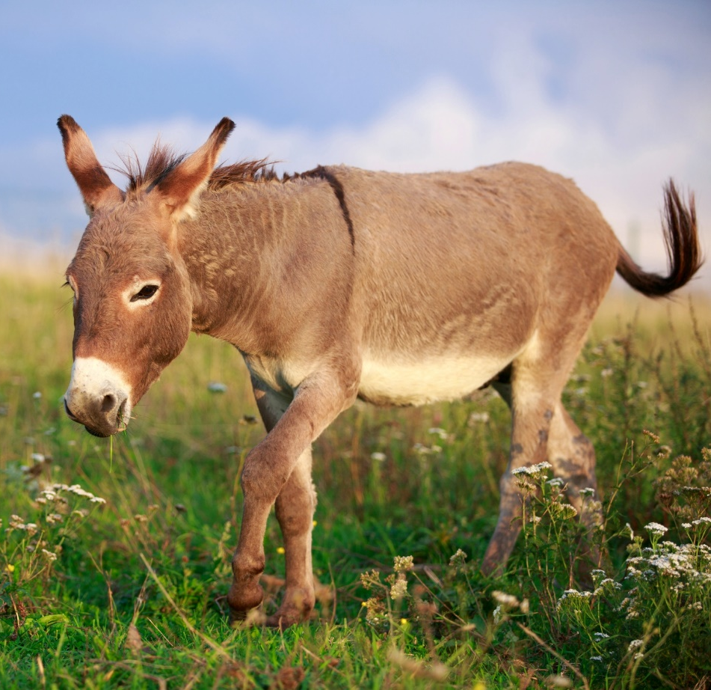
Practice #1
Answer: Balaam’s talking donkey
© DragoNika / Shutterstock.com

Slide 9
Practice #2
Question: How many people did Elisha feed with only a few loaves of bread and some corn?
(2 Kings 4:42‒44)

Slide 10
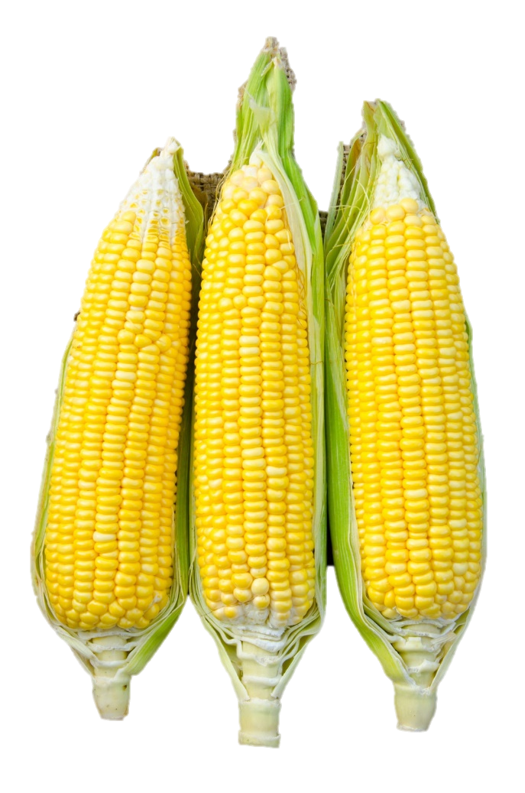
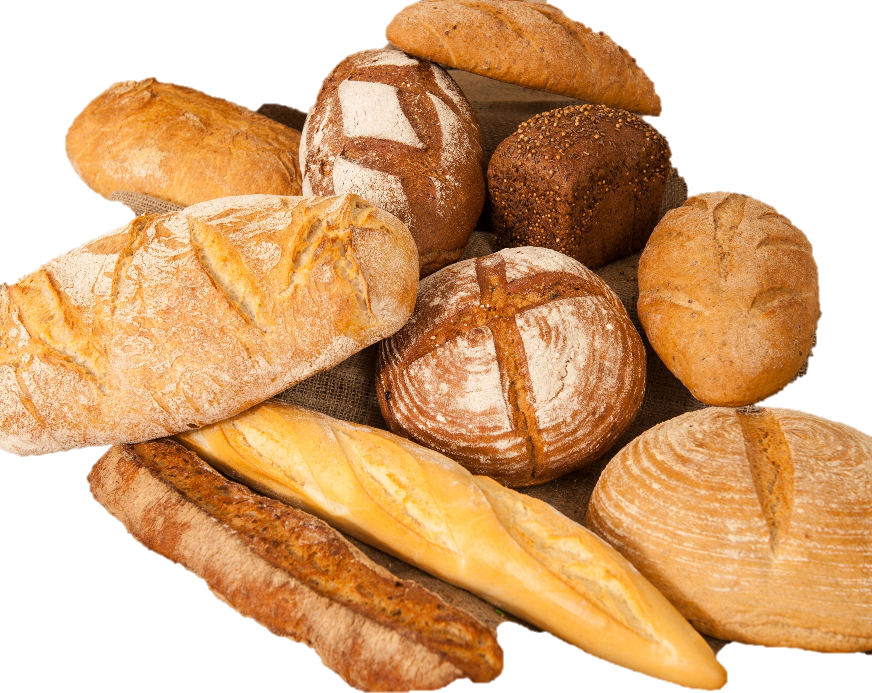
Practice #2
Answer: 100
© Gam1983 / Shutterstock.com
© Artbox / Shutterstock.com

Slide 11
Practice #3
Question: What do all three of the following verses have in common?
Psalm 2:4, 37:13, and 59:9

Slide 12

Practice #3
Answer: God laughs
© Blend Images / Shutterstock.com

Slide 13
Practice #4
Question: What does the Risen Jesus serve to his disciples for breakfast?
(John 21:12‒13)

Slide 14
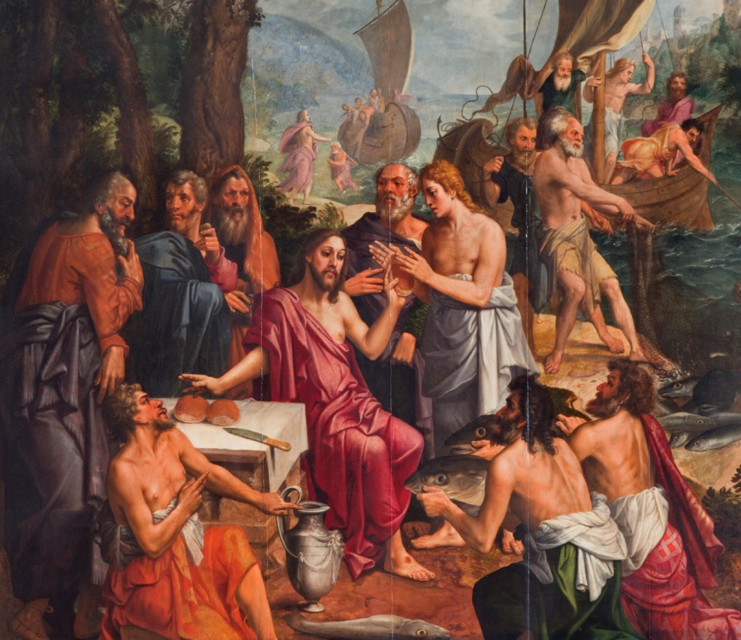
Practice #4
Answer: Bread and fish
© sedmak / iStockphoto.com

Slide 15
Practice #5
Question: Who financially provides for Jesus and his disciples?
(Luke 8:1‒3)

Slide 16
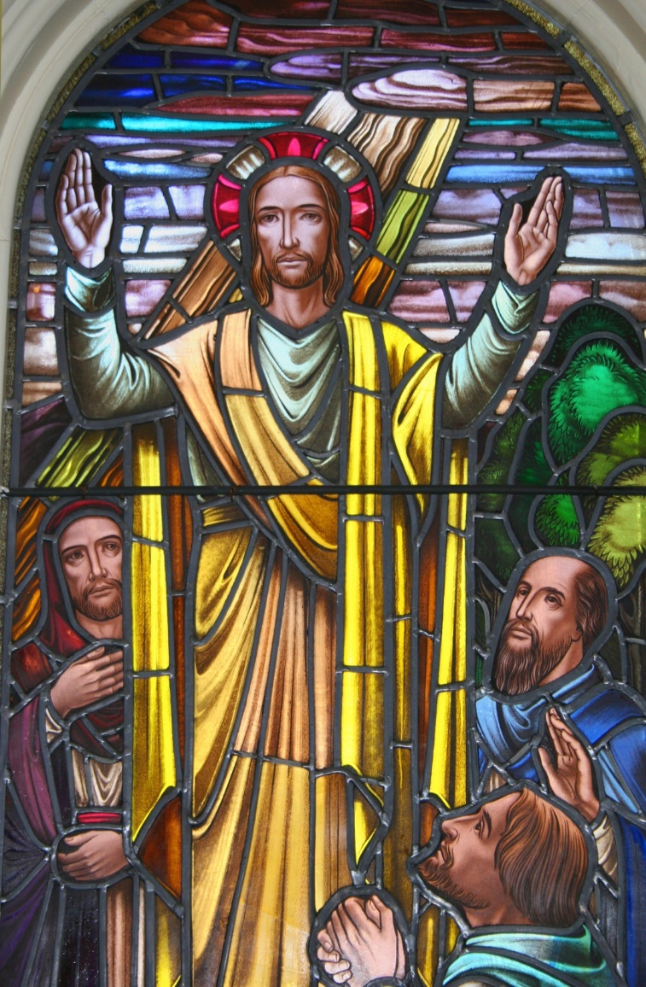
Practice #5
Answer:
Mary Magdalene, Joanna, and Susanna
© onepony / iStockphoto.com

Slide 17
Practice #6
Question: What do the four living creatures exclaim throughout the day and the night?
(Revelation 4:8b)

Slide 18
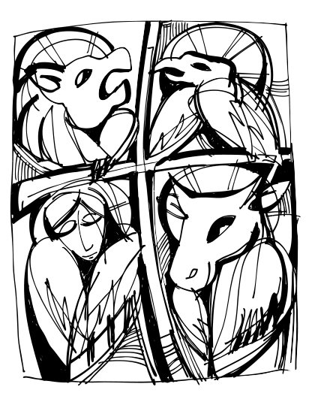
Practice #6
Answer:
Holy, holy, holy, is the Lord God Almighty, who was, and
who is, and who is to come.
© Maran Garai / Shutterstock.com
Notes:
Notes: As you conclude the presentation, affirm the students’ developing skills in navigating the Bible. Encourage them to seek help from you and/or from one another, as needed, as they continue to build these skills during the semester. Also, encourage them to use their new skills to explore the Bible on their own. As God’s Word, it is there to inspire, help, guide, and challenge us—not just in class, or at liturgy, but anytime.

