Slide 1

The Church Is Catholic
The Church: Foundations and Mission
Unit 2, Chapter 5
Document #: TX006495

Slide 2
How does the Church interact with different people and cultures?
Notes:
© binik / Shutterstock.com

Slide 3
How is the Church Catholic?
Catholic = “universal”
The Church is Catholic because
  Christ is present in her.
  Christ has sent the Church out on a mission to the whole world.
Notes:
© binik / Shutterstock.com
Notes: Help the students understand the difference between “Catholic” in reference to the Catholic Church, and “Catholic” as an adjective meaning “universal.”

Slide 4

Evangelization
What is evangelization, and who should be evangelizing?
Sharing the Good News through both words and actions
At the heart of the
Church’s mission
Everyone’s
responsibility
Notes:
© Prostock-studio / Shutterstock.com
Notes: You might consider discussing with the students the example of evangelization given on page 109 of the student book: inviting a friend to join you and your family for Sunday Mass. Is this something your students would consider doing? Why or why not? If yes, maybe role-play how that conversation might proceed. If not, what fears or obstacles would prevent them from extending an invitation like this?

Slide 5

Discuss
How have you tried to recruit others to be part of a group or community that is meaningful to you? What techniques seem to work best?

Slide 6
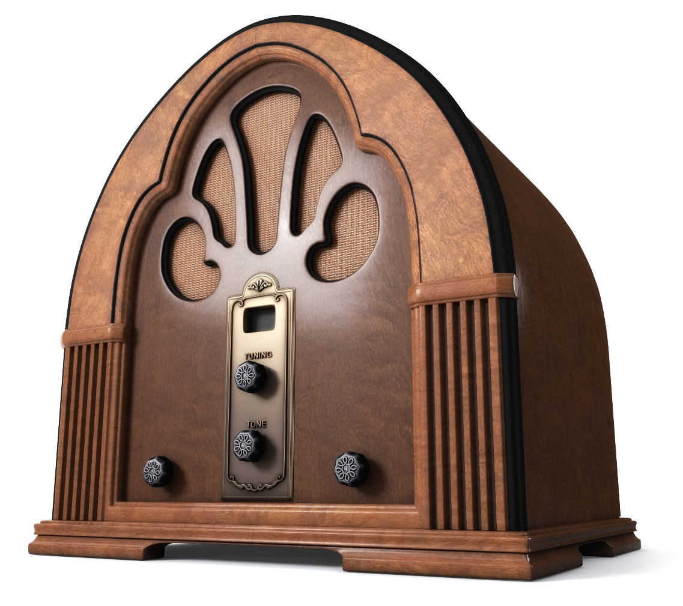
Evangelization Evolves
1930s: the radio
1950s: television
Today: internet and social media
Notes:
© jgroup / istockphoto.com
Notes: Invite the students to brainstorm ways the Church can use social media to evangelize in a more effective and compelling manner. Or ask them what they think the next “new frontier” in evangelization might be.

Slide 7
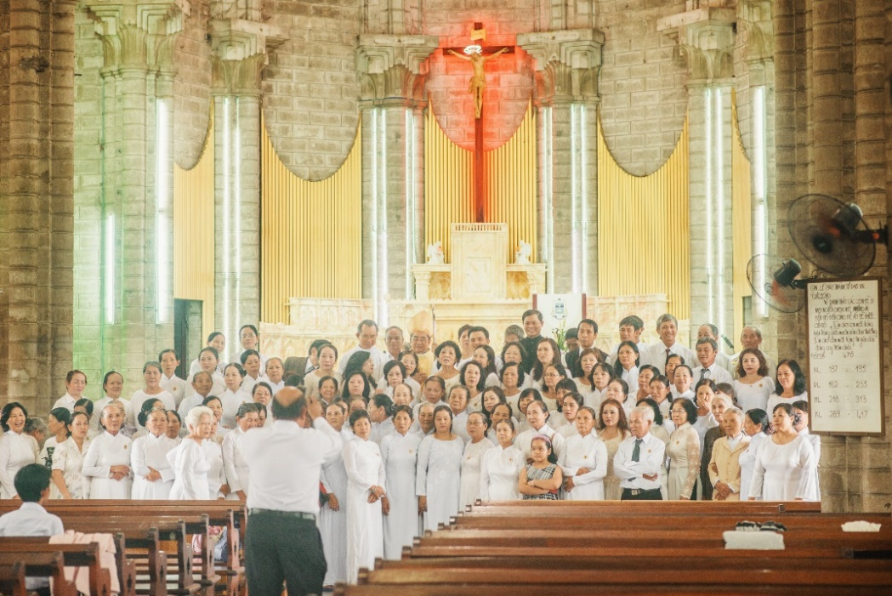
Inculturation
Inculturation is the process of making the Gospel message meaningful in different cultures.
The Gospel takes root in different societies
and cultures.
It is a two-way process:
  The Gospel
  transforms the
  culture.
  The culture
  enriches the
  Church.
Notes:
© Nevskii Dmitrii / Shutterstock.com

Slide 8
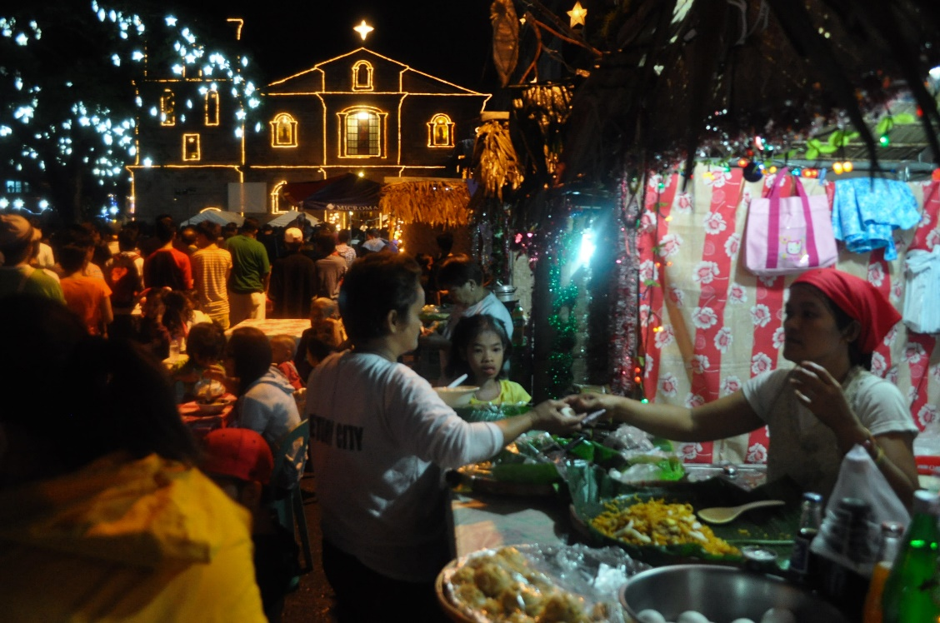
Simbang Gabi
Simbang Gabi is a Filipino cultural expression of faith.
The celebration occurs during the final nine days
of Advent.
The celebration
begins with a
pre-dawn daily
Mass, followed
by lots of food!
Notes:
© ZUMA Press, Inc. / Alamy Stock Photo
Notes: This image, taken in Manila, shows the festive breakfast that follows the early morning Mass.

Slide 9
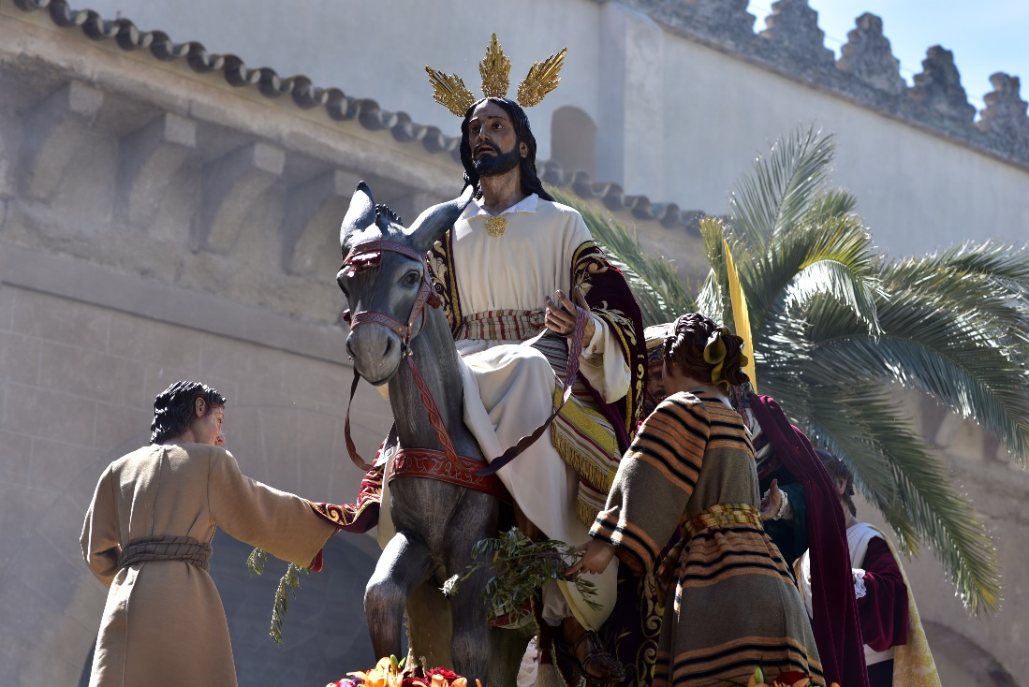
Pasos
Pasos is a Spanish cultural expression of faith:
Pasos are floats used for parades during Holy Week.
They are usually
life-sized statues
of Jesus, Mary,
and other
biblical figures.
Notes:
© akturer / Shutterstock.com
Notes: Invite the students to guess what event the paso on this slide depicts. Hopefully they will recognize it as Palm Sunday.

Slide 10
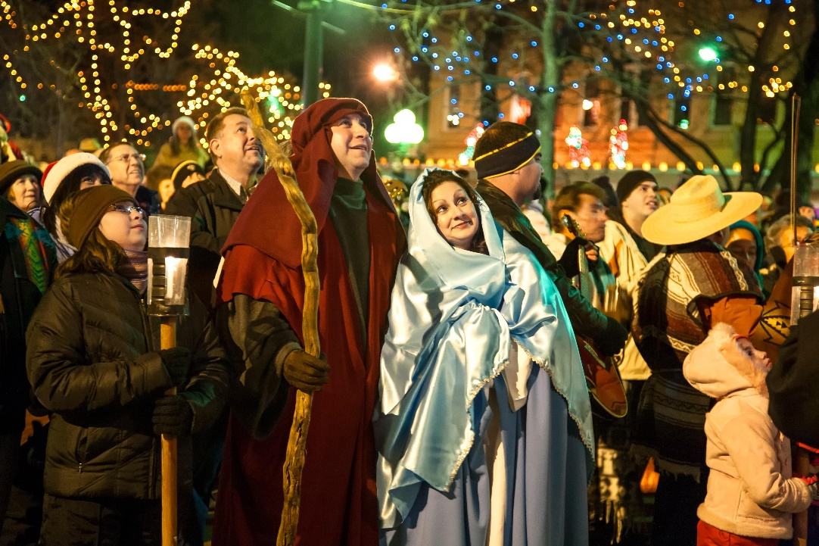
Other Cultural Expressions of Faith
Las Posadas (Latin American Advent processions)
zema (Ethiopian chant)
often see cultural
elements at
weddings,
funerals, and
other special
liturgies
Notes:
© Efrain Padro / Alamy Stock Photo
Notes: Invite the students to share their own examples of religious practices that are rooted in their family’s culture. Depending on the ethnic composition of your class, some of these practices may be mentioned in the student book; others may not be.

Slide 11
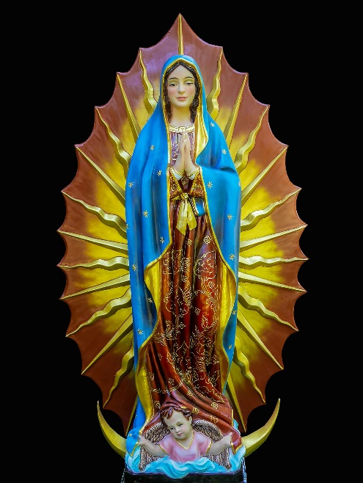
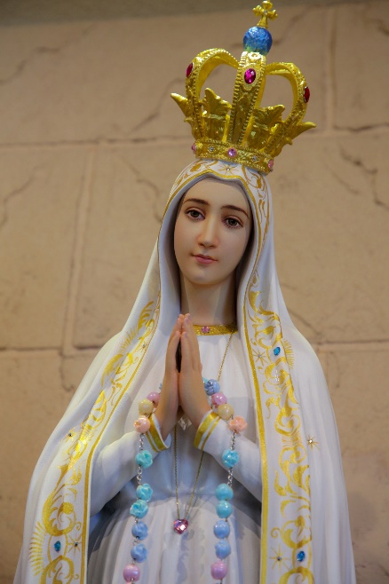
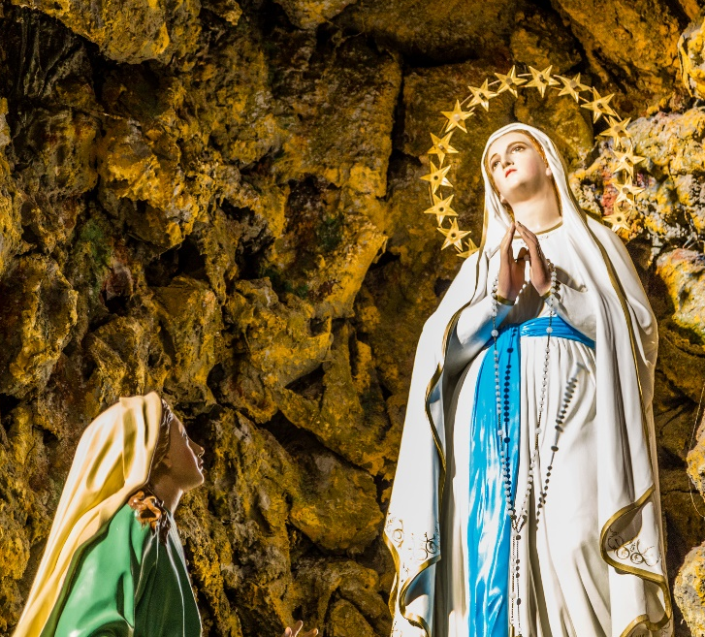
Mary in Different Cultures
Mary is sometimes portrayed in specific cultural attire, such as:
Our Lady of Guadalupe (Latin America, especially Mexico)
Our Lady of Czestochowa (Poland)
Our Lady of Montserrat (Spain)
and many others!
Notes:
© Prachaya Roekdeethaweesab / Shutterstock.com - © Ronnachit Klumchantuek / Shutterstock.com - © GoneWithTheWind / Shutterstock.com
Notes: Pose these or similar questions to the students: “Why is Mary so universally appealing? Why are so many different cultures and nations particularly devoted to her?”

