Slide 1


Document #: TX005852

Slide 2
The Prophets,
Jesus Christ, and the Holy Spirit
Chapter 14
Jesus Heals

Slide 3
Chapter Summary
Jesus’ miracles offered evidence for the truthfulness of his claim to be God.
His miraculous healings of both body and soul were special signs of the presence and power of God in human history.
Jesus provides the example and empowers his Church to continue his mission to heal, with power from the Holy Spirit.

Slide 4
Think About It!
Rate the following things from 1 to 5 based on how important they are to you (1 = not important, 5 = very important).
a grain of sand
a pet
your phone
your health
a hair on your head
your best friend’s health
your sight/ability to see
your parents’ health
the food you eat
your positive and healthy relationship with your friends
your positive and healthy relationship with your family
your positive and healthy relationship with God

Slide 5
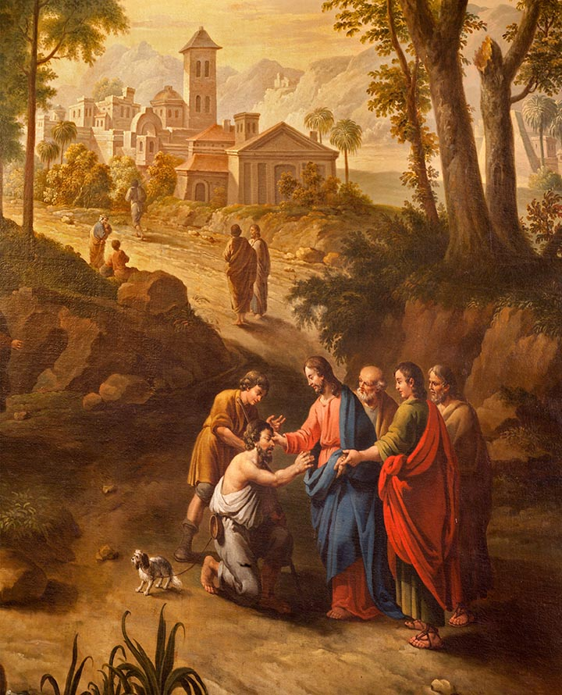
Introduction and
“Jesus Heals the Body”
(Handbook, Pages 150–153)
Jesus cured people’s illnesses and diseases out of concern for the people themselves.
Jesus helps all people regardless of their wealth or importance.
© Renata Sedmakova / Shutterstock.com

Slide 6
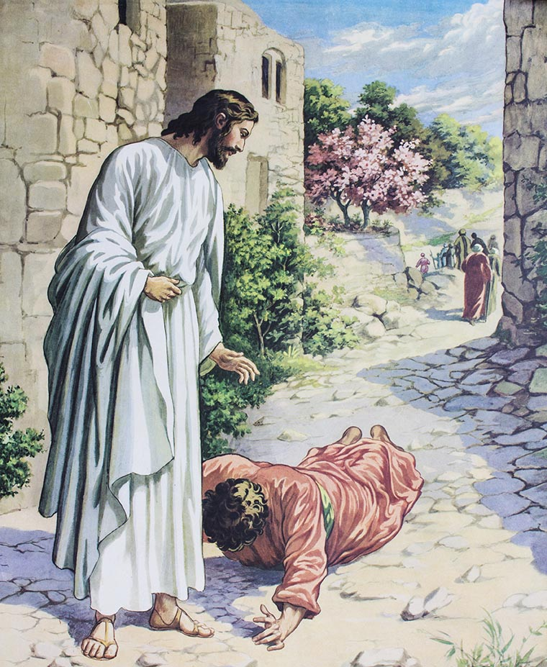
Jesus’ Healings
Jesus often linked cures to belief in him.
Jesus’ cure of the body often benefited a person’s soul.
Jesus’ main work was and is to cure spiritual evils.
© Freedom Studio / Shutterstock.com

Slide 7

“Jesus Heals the Soul” Part 1 (Handbook, Pages 153–156)
Think-Pair-Share
Think: Recall a time when
you were so nervous or
guilty that you felt physically sick.
Pair: Find a partner.
Share: Discuss your stories
with each other. What do your stories teach us about the connection between our body and our mind and soul?
© Ana Blazic Pavlovic / Shutterstock.com

Slide 8
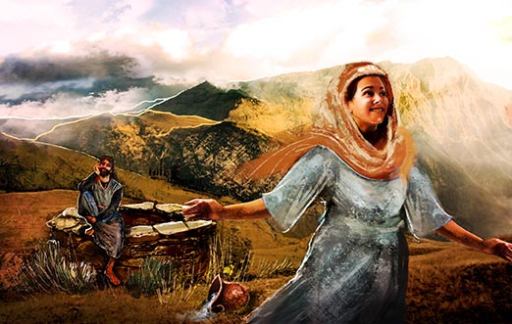
We Need Healing
We can become sick in our inner thoughts and desires—in our soul.
Jesus can cure ills of the soul like pride, doubt, and anxiety.
In the Gospels Jesus always seeks out people whose souls need healing.
© Odessa Sawyer / Saint Mary's Press

Slide 9

“Jesus Heals the Soul” Part 2 (Handbook, Pages 156–157)
Discussion Questions:
Which is more important,
physical healing or spiritual healing?
Now imagine that there is no Heaven or afterlife. Which
would you say is more important, physical healing or spiritual healing?
© albund / Shutterstock.com

Slide 10
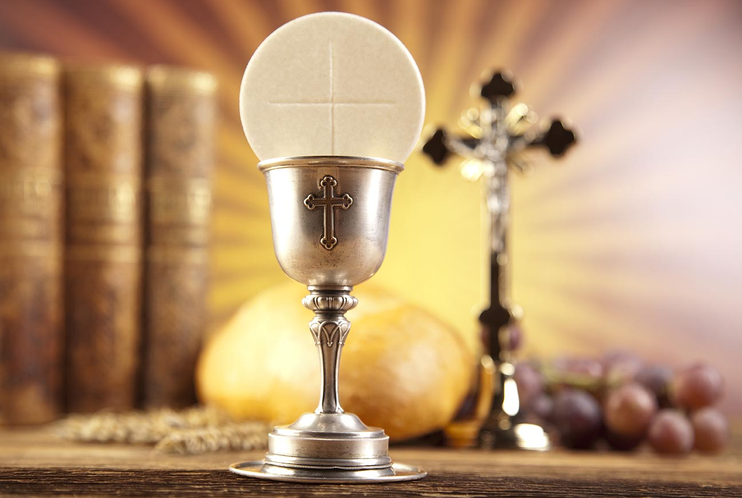
Healing and Reconciliation
Jesus’ healing of the soul
reconciles sinners by restoring
our relationships with God and
other people.
We express our repentance
and are healed by Jesus
through prayer, the Eucharist,
and acts that show our sorrow.
We are healed in a special way by the two Sacraments of Healing: the Sacrament of Penance and Reconciliation and the Sacrament of Anointing of the Sick.
© Sebastian Duda / Shutterstock.com

Slide 11

“Jesus Sends Us to Heal”
(Handbook, Pages 158–161)
Discussion Question:
What are some of the ways the Church continues the teaching, healing, and caring ministries of Jesus?
© ravipat/Shutterstock.com

Slide 12
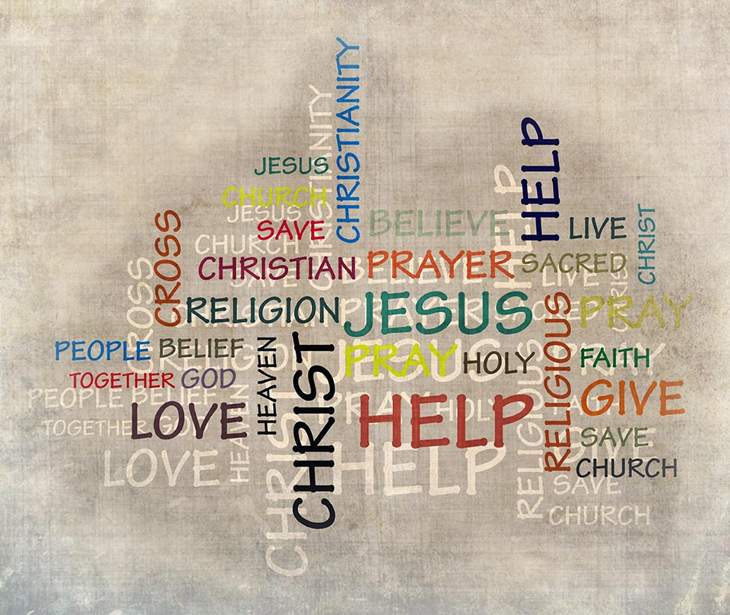
We Are Called to Heal
Jesus passed on to the
Apostles his mission to heal
the body and soul.
We do the Corporal Works
of Mercy when we give food
and drink, shelter and clothe
those in need, and visit
the sick and people in prison.
We do the Spiritual Works of Mercy
when out of love we teach, give
advice to, correct, comfort, forgive,
are patient with, and pray for others.
© effrosyni/Shutterstock.com

