Slide 1
The Mystery of Suffering
The Paschal Mystery Course
Document # TX001337
Notes:
(Notes: The notes for these slides duplicate the lecture notes in The Paschal Mystery: Christ’s Mission of Salvation teacher guide for step 3, part 8, and step 4, part 7, of unit 6. The slides provide questions for journaling.)

Slide 2
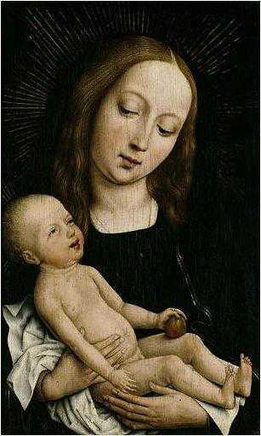
Image in public domain
Notes:
(Notes: The Incarnation was an act of solidarity God undertook for humanity’s salvation.)

Slide 3
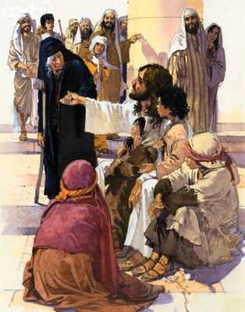
adrianpei.com
Notes:
(Notes: Solidarity is defined as “a union of one’s heart and mind with those who are poor or powerless or who face an injustice.”)

Slide 4
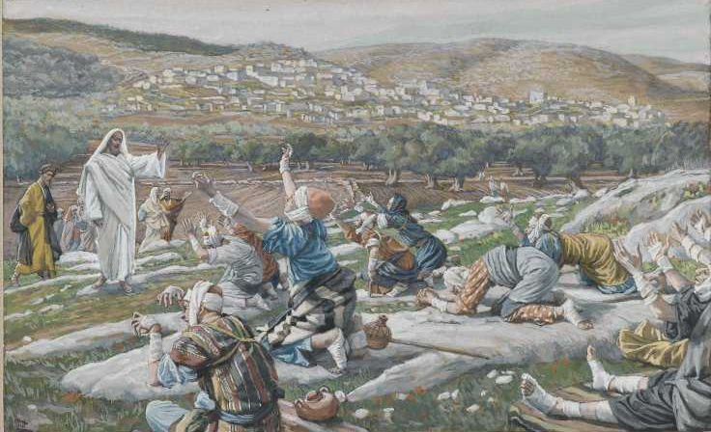
Image in public domain

Slide 5
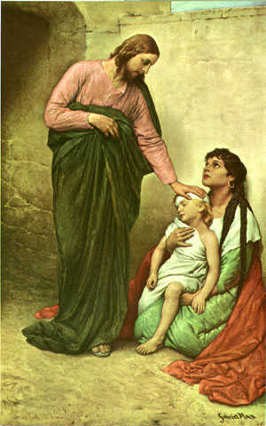
Image in public domain

Slide 6
How did Jesus demonstrate solidarity with the poor, the powerless, or those who faced injustice?

Slide 7
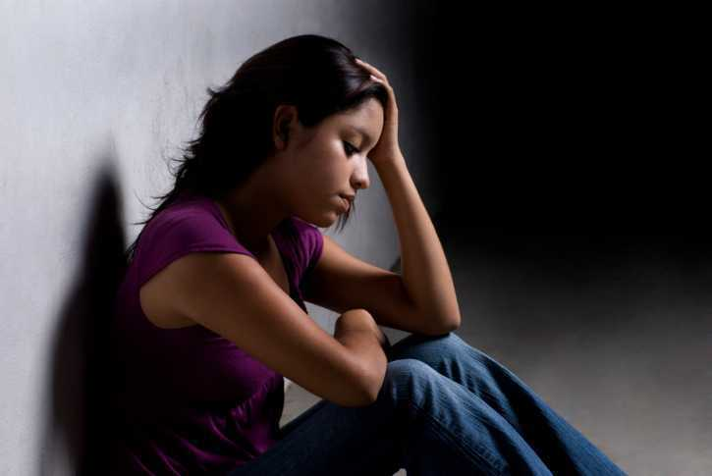
theguidanceclinic.com
Notes:
(Notes: In becoming human in the Person of Jesus, God enters into true solidarity with us: in Jesus, God shares in and sanctifies (makes holy) all the realities of our lives, including our suffering.)

Slide 8
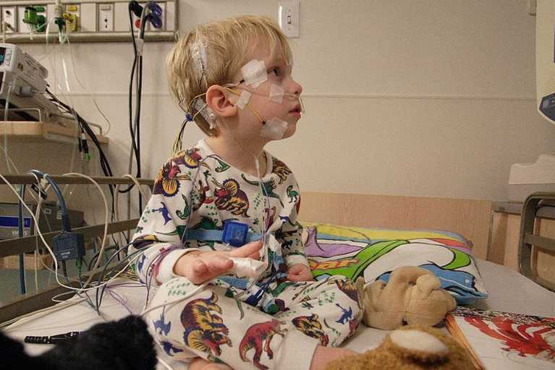
Image in public domain

Slide 9

nj.com

Slide 10
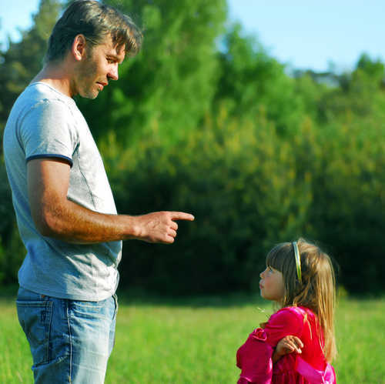
Shutterstock/BestPhoto1

Slide 11
When have you needed to know that
God was standing by you in a
time of suffering?

Slide 12
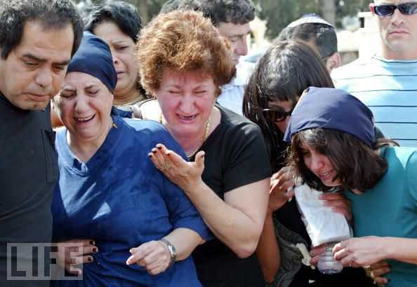
life.com
Notes:
(Notes: In Jesus, God even experiences the ultimate human suffering: death. In truly living and dying as a real human being, Jesus forever united Heaven and earth and gave us the grace of redemption.)

Slide 13
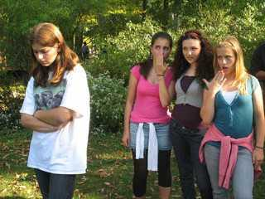
picdiggers.com
Notes:
(Notes: When we experience suffering—big or small—we can take courage and comfort in the knowledge that Jesus himself has gone before us.)

Slide 14
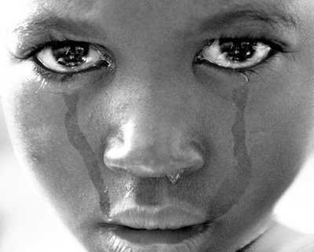
yardflex.com

Slide 15
Do you find it helpful to know that
Jesus suffered as we do?

Slide 16
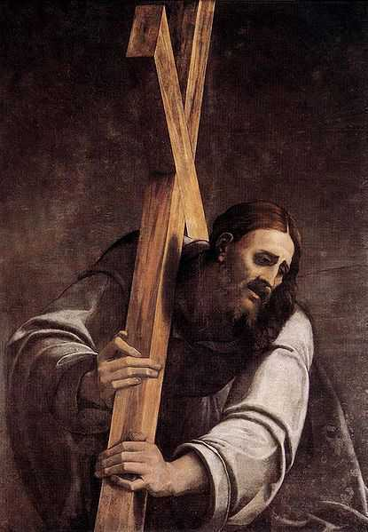
Image in public domain
Notes:
(Notes: We are called to follow the example of Jesus with a readiness to take on suffering for the good of others. This does not mean that we are to seek out suffering intentionally or try to make ourselves miserable. It does mean that we must be willing, at least sometimes, to put aside our own needs, desires, or comfort in order to be of service to others, especially those most in need.)

Slide 17
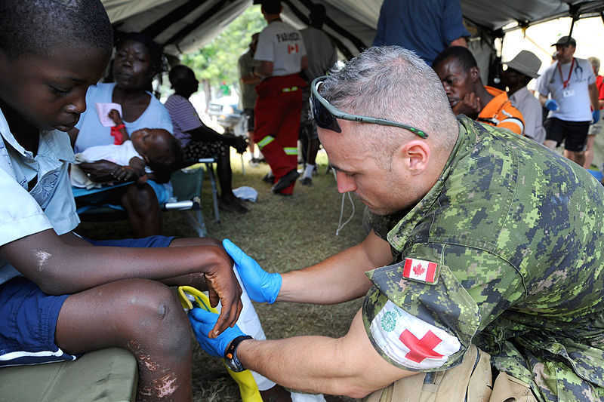
Image in public domain

Slide 18
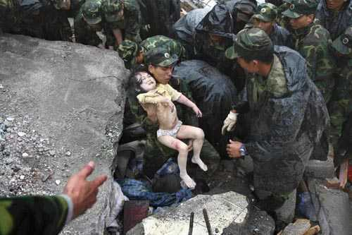
ebeijing.gov.cn

Slide 19
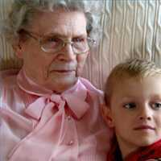
ehow.com

Slide 20
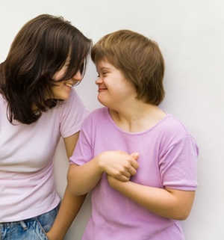
forparentsbyparents.com

Slide 21
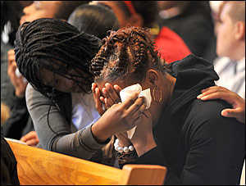
hometownannapolis.com

Slide 22
When have you been called to put aside what you wanted, or to go beyond your comfort zone, to be of service?

