Slide 1
Social Justice
The Catholic Faith Handbook for Youth, Third Edition
Chapter 24
Document #: TX003155

Slide 2
Social Justice
We are dependent on those around us.
We have an effect on others.
We will be held accountable for the things we do and the things we fail to do.
Copyright: igor kisselev / www.shutterstock.com

Slide 3
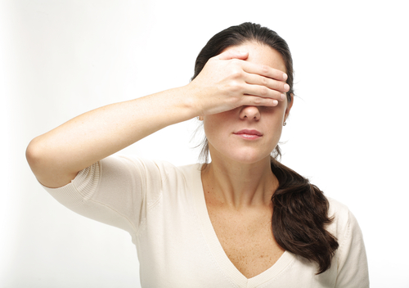
Questions
Who has affected you by showing you kindness or offering you help?
Copyright: Graphic design / www.shutterstock.com
When might teens stand by when they should stand up or step up?
What societal or global issues may worsen because we are not taking action?
Notes:
After students have answered the questions, poll them about the issues that came up in their writing or conversations.

Slide 4
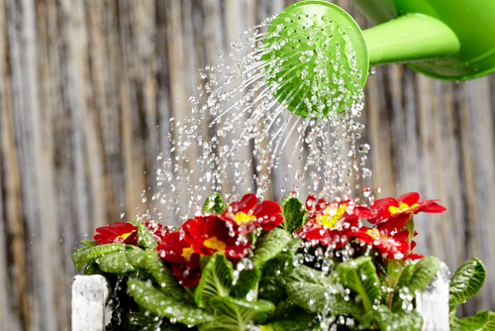
Social Justice
The moral principles God calls society to follow to ensure that essential human needs are met and that essential human rights are protected for all people.
Copyright: Zoom Team / www.shutterstock.com
Notes:
Review the biblical roots of social justice as outlined on pages 265–267 of the student handbook.

Slide 5
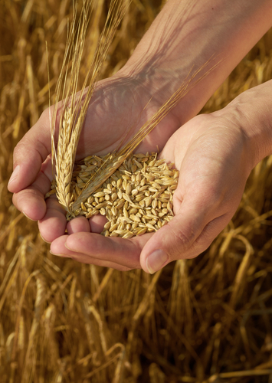
The Common Good
It is achieved when conditions in society allow all people to reach their human fulfillment.
It is not what is best for only our community or the country we live in.
Copyright: Anton Violin / www.shutterstock.com
Notes:
Ask the students to answer the following questions: When might teens give up something so their family could benefit? What societal change would you like to see that would benefit groups or individuals?

Slide 6
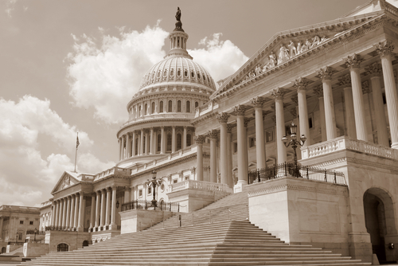
Responsibility of Political Authority
Political authority has an important role: to defend and promote the common good.
Policy makers must create laws that ensure people’s freedom to live moral lives.
Policy makers should ensure that everyone can access the resources needed for a truly human life.
Copyright: Konstantin L / www.shutterstock.com
Notes:
Ask the students to share their reflections on the following question: In our world, who needs better access to necessary resources?

Slide 7
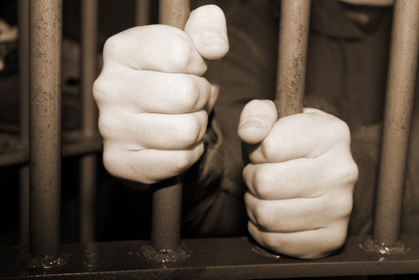
Human Dignity
Copyright: val lawless / www.shutterstock.com
God calls us to see that every single human being has value.
The equality of people flows from the human dignity we all share.
Sinful inequalities and a lack of human rights are grave matters we are responsible for solving.
Notes:
After showing the statement that everyone has value, explain that our prejudices and judgments can prevent us from seeing people’s value: we may judge a person by their dress or economic status, or we may fail to see their value because we know they have done something wrong. You may want to expand on this last point: that we are all sinners, and that people have value even when they have sinned in a serious way.

Slide 8
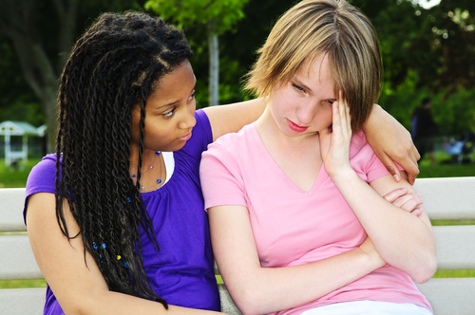
Human Solidarity
Copyright: Elena Elisseeva / www.shutterstock.com
Thinking in terms of friendship and charity toward our brothers and sisters in society.
When one suffers, all suffer.
The virtue of solidarity gives us motivation to act for justice.
Notes:
Ask the students to share their reflections on the following question: How could you show solidarity with a particular group somewhere in the world that is suffering?

Slide 9
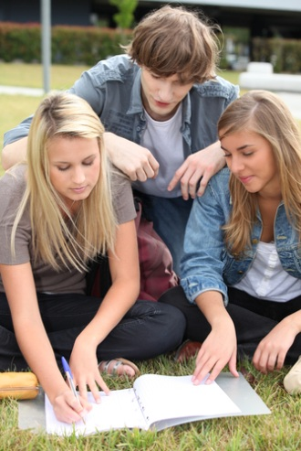

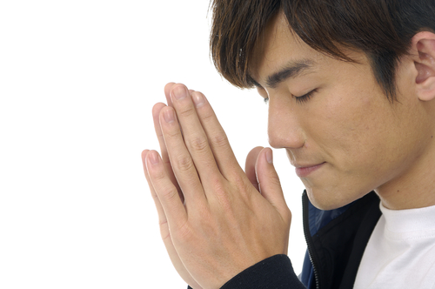
Working for Justice
Pray
Study
Join with others
Copyright: East / www.shutterstock.com
Copyright: auremar / www.shutterstock.com
Notes:
Call the students’ attention to the balance between service and justice depicted on page 272 of the student handbook. Remind them that both are needed as part of our response to social injustice.

