Slide 1
Bible Covenants
The Church Course
Document # TX001505

Slide 2
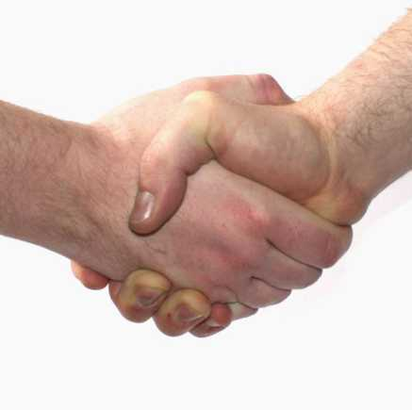
What Is a Covenant?
A solemn agreement between human beings or between God and a human being in which mutual commitments are made.
Image in public domain

Slide 3
A Covenant with God?
The concept of a covenant between God and his People is one of the most central themes of the Bible.
In the biblical sense, a covenant implies much more than a contract or a simple agreement between two parties.

Slide 4
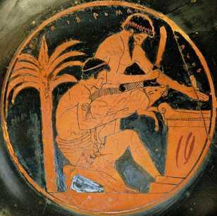
A Promise Is a Promise
The word for covenant in the Old Testament gives new meaning to this idea. It comes from a Hebrew root word that means “to cut.”
This explains the strange custom of two people passing through the cut bodies of slain animals after making an agreement. Such a ceremony always accompanied the making of a covenant in the Old Testament.
Image in public domain
Notes:
(Notes: Emphasize that sacrifice was part of daily life at the time. Sacrifice was a holy act.)

Slide 5
Blessings and . . .
A covenant often promises specific benefits, rewards, or blessings for people who keep the terms of the agreement.
But they also threaten sanctions, punishments, or curses for people who break the terms of the contract.

Slide 6
Conditional Covenant
With a conditional covenant, the terms of the covenant depend on the one receiving the covenant, not on the one granting it.
The receiver must meet certain obligations or conditions of the covenant before the giver of the covenant is obligated to fulfill what was promised.
Image in public domain
Notes:
(Notes: After this slide, open a brief discussion with the students, asking for examples of conditional covenants [e.g., escrow, work contracts, artist contracts].)

Slide 7
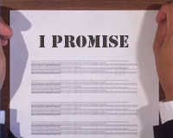
Unconditional Covenant
With an unconditional covenant, fulfillment for what is promised depends solely upon the authority and integrity of the one making the covenant.
It is a promise with no “if” attached to it.
Image in public domain
Notes:
(Notes: After this slide, open a brief discussion with the students, asking for examples of unconditional covenants [e.g., wills, inheritance, gifts].)

Slide 8
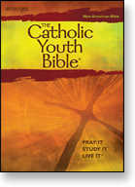
Covenants in the Bible
Five Major Covenants in the Old Testament
The first two apply to all human beings.
The next three apply specifically to the Jews, the “Children of Abraham.”

Slide 9
Old Testament Covenants
What Are the Five Covenants in the Old Testament?
Adam and Eve
Noah and his family
Abraham and his descendants
Moses and the Israelites
David and the Kingdom

Slide 10
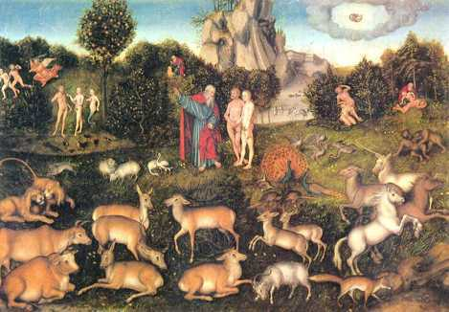
Adam and Eve
In the Garden of Eden, although the word covenant is not used, divine promises are made. These two covenants are unconditional.
Image in public domain

Slide 11
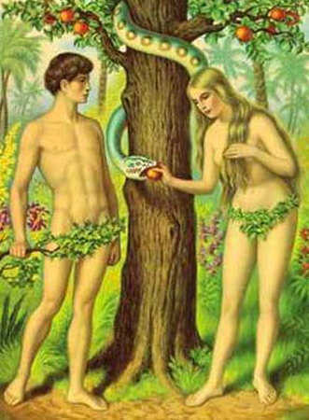
The Edenic Covenant (Innocence)
This outlined man’s responsibility toward creation and God’s directive regarding the tree of knowledge of good and evil.
islandcrisis.net

Slide 12
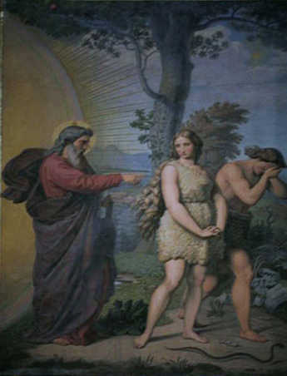
The Adamic Covenant (Grace)
This included the curses pronounced against mankind for the sin of Adam and Eve, as well as God’s provision for that sin.
Image in public domain
Notes:
(Notes: This Covenant is unconditional. God declared to Adam what man's lot in life will be now that sin is in the world. The conditions of this Covenant will exist until the Kingdom Age [see Romans 8:21].
There is no appeal, and there is no human responsibility involved. The outcome of the arrangement is entirely based on God and his sovereign control.
Elements of the Covenant are:
The serpent used by Satan is cursed [see Genesis 3:14; Romans 16:20; 2 Corinthians 11:3,14; Revelation 12:9].
A Redeemer is promised [see Genesis 3:15]. We see in this prophecy both advents of Christ.
The multiplied sorrow and pain of women in childbirth and motherhood is also mentioned.
Man would henceforth earn his living by sweat [see Genesis 2:15].
Man's life would now be filled with sorrow and ultimate death [see Genesis 3:19, Ephesians 2:5].
Perhaps the most significant curse was the spiritual death that Adam and Eve experienced "on the day they ate of the fruit." A flaming cherub was placed as a testimonial to the restriction of the covenant. [From www.gotquestions.org/bible-covenants.html and www.padfield.com/2004/covenants.html])

Slide 13
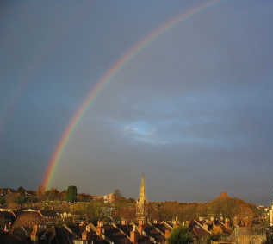
Noah and His Family
This was an unconditional Covenant between God and Noah (specifically) and humanity (generally).
God gave the rainbow as the sign of the Covenant, a promise that God would never again destroy all life on earth with a flood.
This is a reminder that God can and will judge sin.
Image in public domain

Slide 14
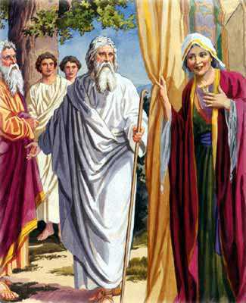
Abraham and His Descendants
God promised many things to Abraham:
He promised that he would make Abraham’s name great.
He promised that Abraham would have numerous descendants.
He promised that Abraham would be the father of a multitude of nations.
Image in public domain
Notes:
(Notes: Genesis 12:1–3,6–7; 13:14–17; chapter 15; 17:1–14; 22:15–18)

Slide 15
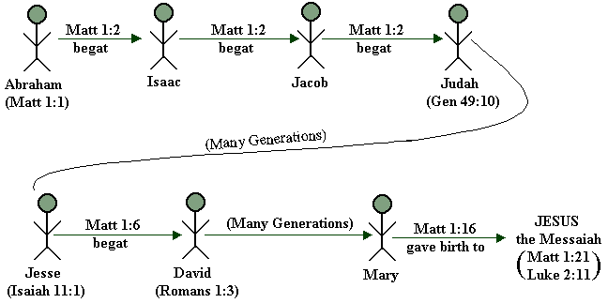
Abraham
God also made promises regarding a nation called Israel.
Another promise is that the families of the world will be blessed through the line of Abraham. (This is a reference to the Messiah, who would come from this line.)
Image in public domain
Notes:
(Notes: The geographical boundaries of the Abrahamic Covenant are laid out on more than one occasion in the Book of Genesis [see 12:7, 13:14–15, 15:18–21].)

Slide 16
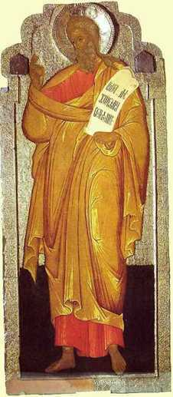
Abraham Is Foremost
God’s Covenant with Abraham is absolutely unconditional!
It is everlasting.
It is one of the most profound in the Scriptures.
Image in public domain

Slide 17
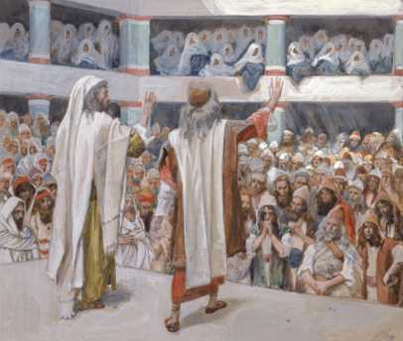
Moses and the Israelites
The Mosaic Covenant was a conditional covenant.
It brought either God’s direct blessing (if they followed his Laws) or God’s direct cursing (for disobedience).
Image in public domain
Notes:
(Notes: Review the concept of conditional and unconditional covenant.)

Slide 18
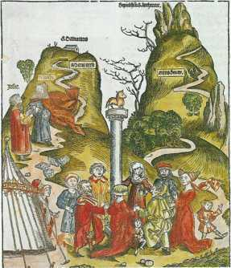
Mosaic Law
Part of the Covenant was the Ten Commandments, but there was also the rest of the Law, which contained more than six hundred commands—roughly three hundred positive and three hundred negative.
The history books of the Old Testament (Joshua–Esther) detail how Israel succeeded, or failed, at obeying the Law.
Image in public domain
Notes:
(Notes: Deuteronomy 11:26–28 details specifically the blessing / cursing motif.)

Slide 19
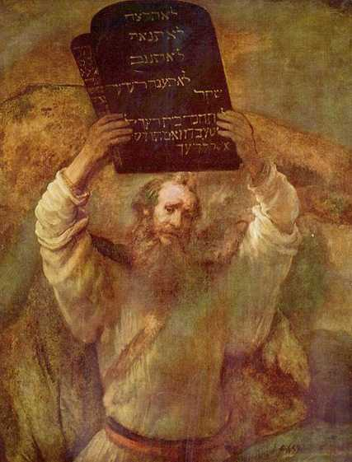
Mosaic Covenant
The Ten Commandments are a summation of the Mosaic Law.
Image in public domain

Slide 20
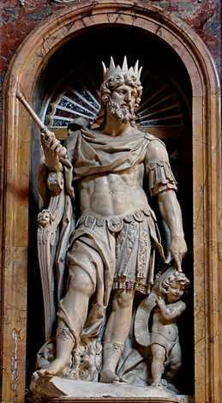
David and the Kingdom
The Davidic Covenant amplifies the “seed” aspect that was detailed in the Abrahamic Covenant.
God promises that David’s physical line of descent will last forever and that his kingdom will never pass away.
Image in public domain

Slide 21
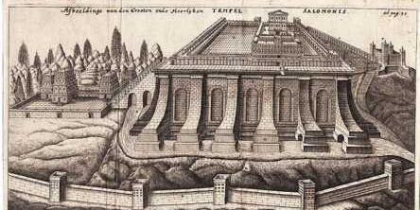
David’s “House”
God will establish forever David’s “house,” the royal dynasty through David’s descendants.
David’s son (Solomon) will build God’s “house,” the first Temple of Jerusalem.
The “sign” of this covenant will be the descendants of David and the Temple itself.
Image in public domain
Notes:
(Notes: 2 Samuel, chapter 7; 1 Kings 2:1–11, 6:1–13, 9:5–8)

Slide 22
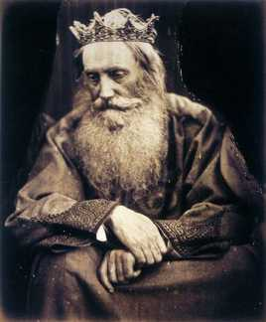
David’s Throne
David’s throne has not been in place at all times.
There would come a time, however, when someone from the line of David would again sit on the throne and rule as king.
Image in public domain

Slide 23
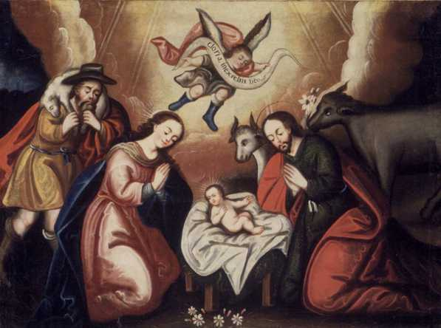
This Future King: Jesus
Image in public domain
Notes:
(Notes: Mary is a descendant from the line of David, as is Jesus’ earthly father, Joseph. From both sides, Jesus comes from the line of David.)

Slide 24
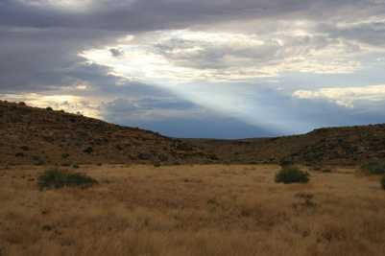
The New Covenant
The New Testament makes clear a distinction between the Covenants of the Old Testament and the Covenant of the New Testament.
Saint Paul speaks of these “two covenants,” one originating “from Mount Sinai” and the other from “the Jerusalem above” (Galatians 4:24–26).
Image in public domain
Notes:
(Notes: Be sure to indicate that God’s Covenants are everlasting, and that the New Covenant is a promise to all peoples, not just to the Israelites.)

Slide 25
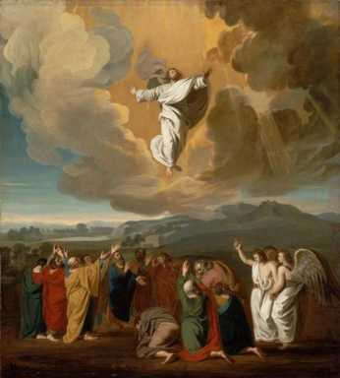
New Covenant
The death of Christ ushered in the New Covenant, under which we are justified by God’s grace and mercy. It is now possible to have the true forgiveness of sin.
Jesus himself is the Mediator of this better Covenant between God and man.
Jesus’ sacrificial death served as the oath, which God made to us to seal this New Covenant.
Image in public domain
Notes:
(Notes: Hebrews 9:15)

Slide 26
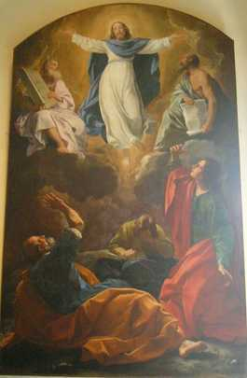
A New Agreement
The New Covenant is the new agreement God has made with mankind, based on the death and Resurrection of Jesus Christ.
The concept of the New Covenant originated with the promise of Jeremiah that God would accomplish for his People what the Old Covenants had failed to do (due to humankind’s sins and flaws).
Image in public domain

Slide 27
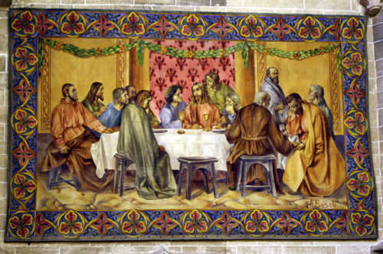
Christ as Covenant
At the Last Supper, Jesus spoke of the cup, saying, “This is my blood of the covenant, which will be shed on behalf of many for the forgiveness of sins” (Matthew 26:28).
Image in public domain

Slide 28
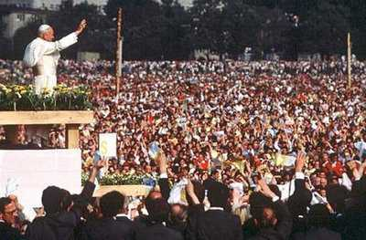
New Life through Covenant
Under this New Covenant, God would write his Law on human hearts.
©prayerfulorgodfull.blogspot.com

Slide 29
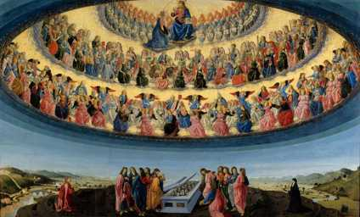
A Review
Five major Covenants of the Old Testament:
Adam and Eve
Noah
Abraham
Moses
David
The New Covenant
Secured by Christ
Removal of sin
Cleansing of the conscience
Image in public domain
Notes:
(Notes: Use this slide for a quick review of the ideas presented here.)

