Slide 1
Visible and Spiritual Church
The Church Course
Document # TX001508

Slide 2
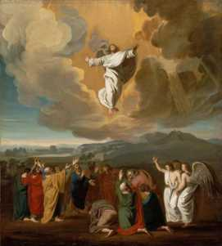
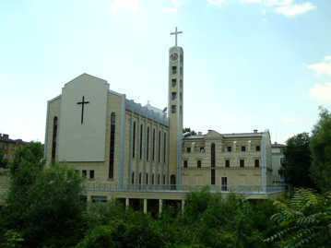
Visible and Spiritual
The Church is both visible and spiritual, a hierarchical society and the Mystical Body of Christ.
She is one, yet formed of two components, human and divine.
That is her mystery, which only faith can accept.
Images in public domain
Notes:
(Notes: Explain to the students that though they can see the physical dimension of Church, the spiritual or invisible dimension must be taken on faith.)

Slide 3
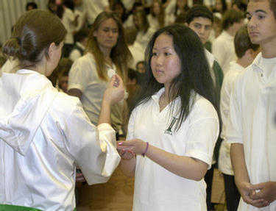
Visible
The visible Church consists of the People of God, the physical structures of the Church, the liturgies, and the Sacraments.
Can you name other visible elements of the Church?
Image in public domain
Notes:
(Notes: Examples: liturgy, service organizations, the People of God, the Church hierarchy, prayer books, hymnals, sacred art and music, the Church community, prayer groups)

Slide 4
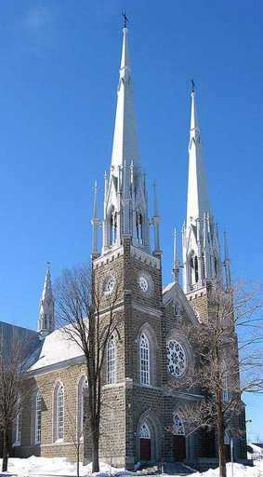
Visible Elements
The Church is a society with a hierarchical structure.
This hierarchy guides the People of God and protects the faith.
The physical churches are centers of prayer and worship for the People of God.
The human is directed toward, and subordinated to, the divine, the visible to the invisible.
Image in public domain

Slide 5
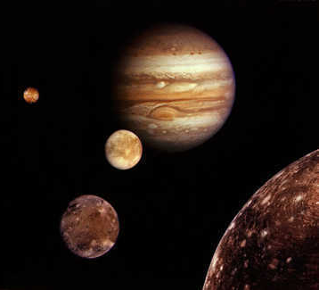
In History and Beyond
“The Church is in history, but at the same time she transcends it.” (Catechism of the Catholic Church [CCC], 770)
“It is only ‘with the eyes of faith’¹ that one can see her in her visible reality and at the same time in her spiritual reality as bearer of divine life.” (CCC,770)
Image in public domain
Notes:
1. Roman Catechism I, 10, 20.

Slide 6
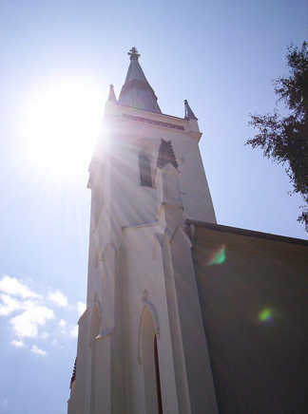
Truth and Grace
“The one mediator, Christ, established and ever sustains on earth his holy Church, the community of faith, hope, and charity, as a visible organization through which he communicates truth and grace to all men.”¹ (CCC, 771)
Image in public domain
Notes:
1. Lumen Gentium 8 § 1.

Slide 7
Endowed with Riches
The Church consists of the earthly Church (which we see) and the Church endowed with heavenly riches (which we don’t see).
The Church in this world is the sacrament of salvation, the sign and instrument of the communion of God and man.
Image in public domain

Slide 8
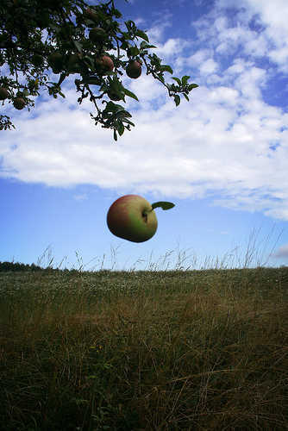
Invisible
If you can’t see it, it can’t be true. Do you agree or disagree?
What are some examples of things that are invisible yet real?
Image in public domain
Notes:
(Notes: Examples: wind, air, gravity, time, surface tension)

Slide 9
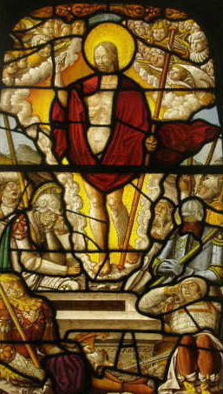
Invisible Church
What elements of the Church are invisible?
Image in public domain
Notes:
(Notes: Examples: faith, grace, holiness, forgiveness, the Holy Spirit, God the Father, Transubstantiation, the Communion of Saints, the intercession of saints, angels. Explain that the following slides are going to present elements of the Church that are invisible, yet very real.)

Slide 10
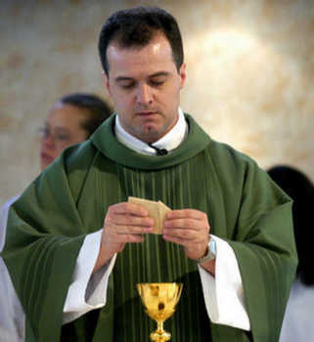
Transubstantiation
At the moment of consecration, the bread and wine become the Body and Blood of Jesus Christ.
We take this on faith, having been told by Christ, “This is my body, . . . this is my blood” (Matthew 26:26–28).

Slide 11
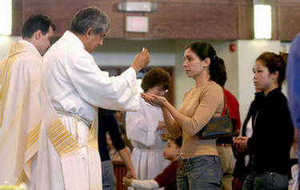
Grace
Grace is God’s unmerited favor.
Grace is divine assistance.
God continues to gift us with grace, freely given and never earned.
God causes grace in the soul when the Sacraments are received.

Slide 12
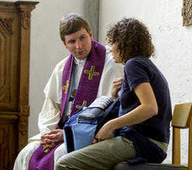
Forgiveness
Christ instructed his disciples to forgive sins. Those sins they forgive on earth are forgiven in Heaven; those sins that are not forgiven remain.
With his death, Christ opened the gates of Heaven, allowing for the redemption of mankind after the advent of Original Sin.
Forgiveness cannot be seen but must be accepted in faith.
Because sin is an offense against God, only God can forgive it.
Image in public domain

Slide 13
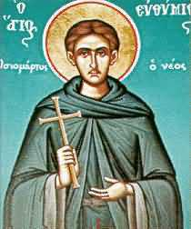
Holiness
God calls us to be holy.
To be holy is simply to live as someone who belongs to God, living by the vision of the Kingdom of God.
Without the presence of the Holy Spirit, we cannot know God.
The Holy Spirit’s presence leads us to God.
This is a tenet of faith. The presence of the Holy Spirit cannot be seen.
Image in public domain

Slide 14
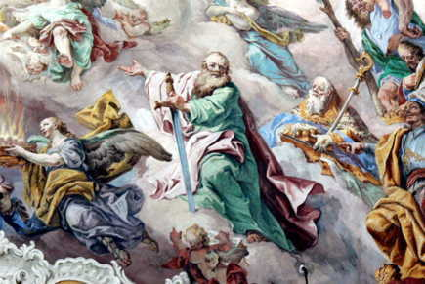
Intercession of the Saints
“Being more closely united to Christ, those who dwell in heaven fix the whole Church more firmly in holiness. . . . So by their fraternal concern is our weakness greatly helped.”¹ (CCC, 956)
Image in public domain
Notes:
1. Lumen Gentium 49; cf. 1 Timothy 2:5
(Notes: This would be a good time to discuss with the students the reality of the saints. Explain that we look to the saints as models of holy life and appeal to them for their help in attaining our own holiness, overcoming temptations and life’s struggles.)

Slide 15
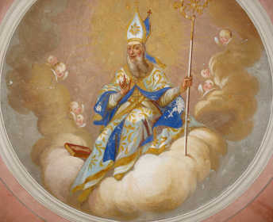
Communion with the Saints
“Exactly as Christian communion among our fellow pilgrims brings us closer to Christ, so our communion with the saints joins us to Christ, from whom as from its fountain and head issues all grace, and the life of the People of God itself.”¹ (CCC, 957)
Image in public domain
Notes:
1. Lumen Gentium 50; cf. Ephesians 4:1–6.

Slide 16
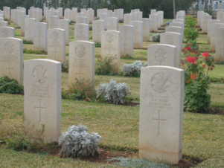
Memory of the Dead
“In full consciousness of this communion of the whole Mystical Body of Jesus Christ, the Church in its pilgrim members, from the very earliest days of the Christian religion, has honored with great respect the memory of the dead; and ‘because it is a holy and a wholesome thought to pray for the dead that they may be loosed from their sins’ she offers her suffrages for them.”¹ (CCC, 958)
Image in public domain
Notes:
1. Lumen Gentium 50; cf. 2 Maccabees 12:45.
(Notes: Share with the students that our prayer for the dead is capable not only of helping them, but also of making their intercession for us effective.
This is an excellent time to speak of the power of prayer as requests for intercession from those in Heaven and those who have gone before us. You may need to speak to the existence of Purgatory as well, another tenet taken on faith.)

Slide 17
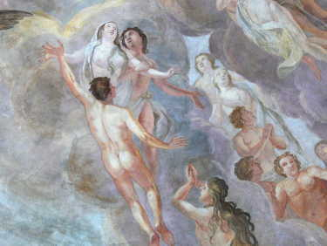
Salvation
“Salvation comes from God alone; but because we receive the life of faith through the Church, she is our mother: ‘We believe the Church as the mother of our new birth, and not in the Church as if she were the author of our salvation.’¹ Because she is our mother, she is also our teacher in the faith. (CCC, 169)
Image in public domain
Notes:
1. Faustus of Riez, De Spiritu Sancto, 1, 2: J. P. Migne, ed., Patrologia Latina (Paris: 1841–1855) 62, 11.

Slide 18
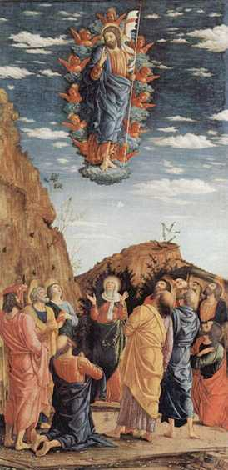
Salvation through Christ
“By His glorious Cross Christ has won salvation for all men. He redeemed them from the sin that held them in bondage. ‘For freedom Christ has set us free.’¹ In him we have communion with the ‘truth that makes us free.’² The Holy Spirit has been given to us and, as the Apostle teaches, ‘Where the Spirit of the Lord is, there is freedom.’³ Already we glory in the ‘liberty of the children of God.’”⁴ (CCC, 1741)
Image in public domain
Notes:
1. Galatians 5:1
2. Cf. John 8:32.
3. 2 Corinthians 17.
4. Romans 8:21.
(Notes: Explain that the entire concept of salvation must be taken on faith, based on the truth that Christ spoke to us. Salvation is the key to our faith. God so loves us that he wants us to dwell with him forever, and he gives us the means to do so.)

Slide 19
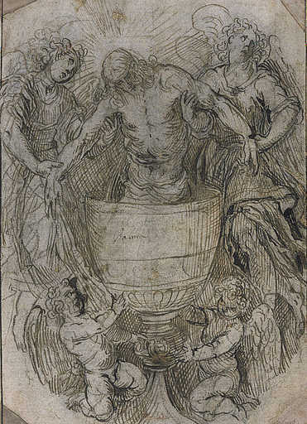
From Visible to Invisible
The visible elements of the Church are meant to guide us to an understanding of, and belief in, the invisible (spiritual) elements of the Church, from the sign to the thing signified, from the Sacraments to the mysteries.
Image in public domain

Slide 20
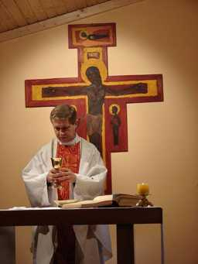
Visible and Invisible
“The Church is at the same time:
a “society structured with hierarchical organs and the mystical body of Christ;
the visible society and the spiritual community;
the earthly Church and the Church endowed with heavenly riches.”¹
These dimensions together constitute “one complex reality which comes together from a human and a divine element.”² (CCC, 771)
Image in public domain
Notes:
1. Lumen Gentium 8.
2. Lumen Gentium 8.

Slide 21
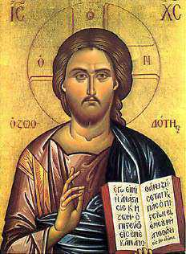
Visible Leads to Invisible
“To be sure, it is Christ who is seen, the visible image of the invisible God, but it is the Spirit who reveals him.” (CCC, 689)
Image in public domain
Notes:
(Resources used in this presentation include the Catechism of the Catholic Church for use in the United States of America, second edition, numbers 770, 771, 956, 957, 958, 169, 1741, 771, and 689, respectively. Copyright © 1994 by the United States Catholic Conference, Inc.—Libreria Editrice Vaticana. English translation of the Catechism of the Catholic Church: Modifications from the Editio Typica copyright © 1997 by the United States Catholic Conference, Inc.—Libreria Editrice Vaticana.)

