Slide 1
Respecting Life
The Catholic Faith Handbook for Youth, Respecting LifeEdition
The Catholic Faith Handbook for Youth, Third Edition
Chapter 28
Chapter 28
Document #: TX005292
Notes:
Use this presentation to introduce or review the key points in chapter 28 in the student handbook.

Slide 2

Human Life is Sacred
We are made in the image of God.
Even lives that we think are “imperfect” or “worthless” are precious to God.
Our God-given dignity is the foundation for loving God, other people, and ourselves.
© Monkey Business Images/www.shutterstock.com
Notes:
Both Sacred Scripture and Sacred Tradition speak to the dignity and value of every human life, no matter the person’s “worth” to society.
FOR DISCUSSION: The handbook claims that exposure to killing in movies, books, and news makes us less sensitive to the horror of harming or killing another person. Do the students think this is true? Can they see this happening in their own life or in others’?

Slide 3
Legitimate Defense
We have a right to stop someone from harming us or others.
If possible, we must avoid taking someone’s life, even in defense of self or others.
Notes:
The Church considers the principle of legitimate defense to be the only justification for killing a person. This principle only applies when there is absolutely no other way to defend yourself or other innocent people without killing the aggressor. Defending property/possessions is not justification for killing a person.

Slide 4
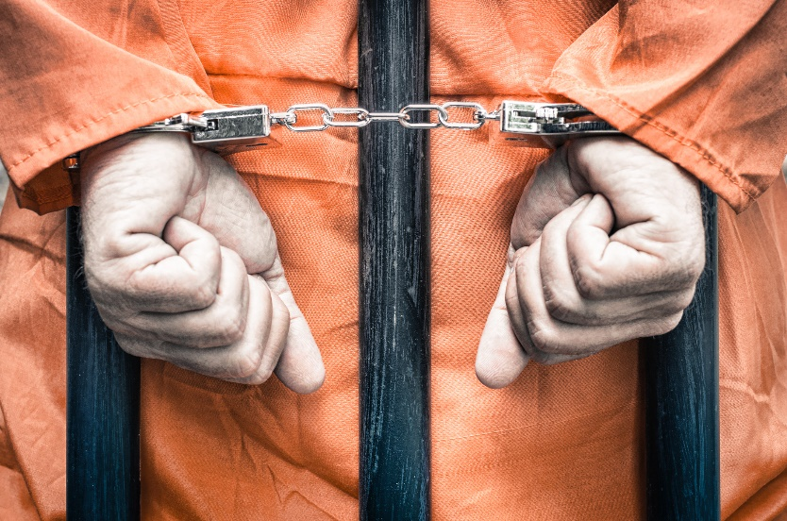
Life Issues and the Fifth Commandment:
Capital Punishment
The death penalty is only acceptable when there is no other way to protect society (human life) from the offender.
Even the worst sin does not take away a person’s God-given dignity.
© View Apart/www.shutterstock.com
Notes:
Although the Church acknowledges the necessity of the death penalty if it is the only way to protect society from a dangerous person, today our secure prisons make cases where capital punishment is necessary very rare or nonexistent.
QUESTION: Should the criminal justice/prison system be more about punishment, protecting society, rehabilitating the offender, or some combination?

Slide 5
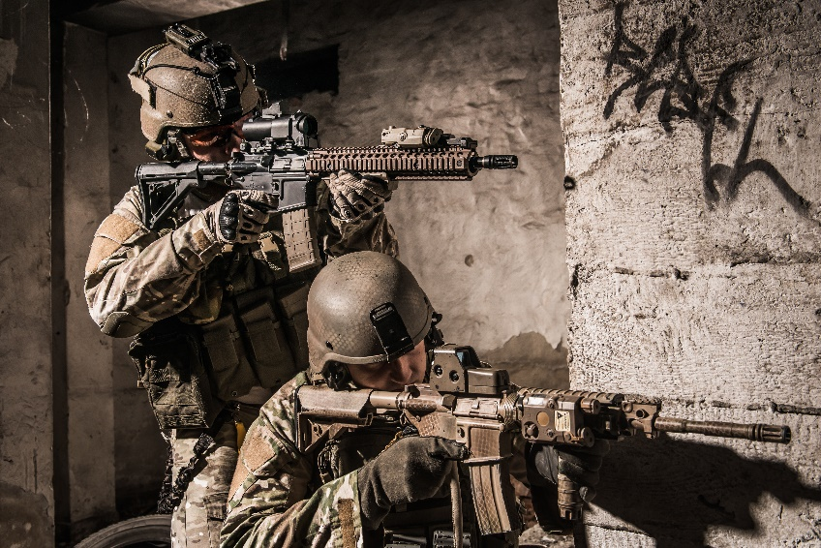
Life Issues and the Fifth Commandment:
War
Nations have the same right to self-defense as individuals.
Principles of just war must be met in order for a war to be moral.
Modern weapons lead people to question whether a just war is possible today.
© Przemek Tokar/www.shutterstock.com
Notes:
QUESTION: In your view, what kind of good would outweigh the suffering caused by war?
Encourage the students to give serious thought to this question. Remind them that as voters they will someday have input on issues of war and peace, and can voice their opinions even before they reach voting age.

Slide 6
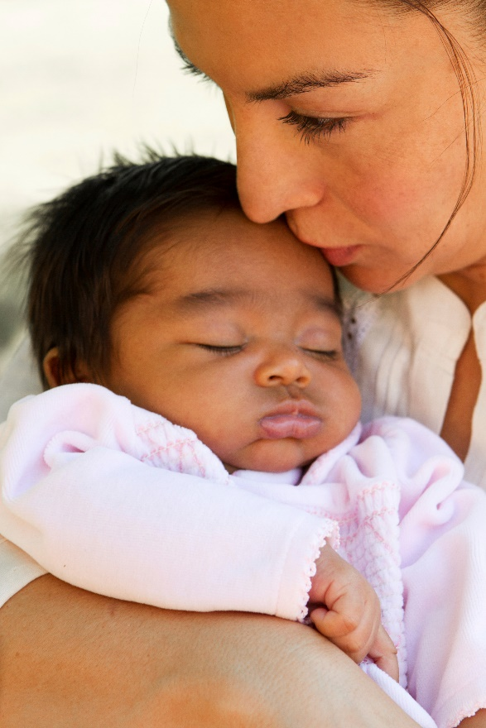
Life Issues and the Fifth Commandment:
Abortion
Abortion takes the life of a child and physically and psychologically harms a mother.
Everyone—women and men—has a responsibility to support pregnant women and protect unborn children.
digitalskillet/iStockphoto.com
Notes:
Note: Often opponents present the Church’s position as only caring about the baby, not the mother, and only until the baby is born. It may be helpful to share information about ministries such as crisis pregnancy centers that offer counseling, parenting classes, and financial support for baby clothes, formula, and medical expenses, as well as ministries that help women and men who regret or are struggling to cope with their involvement in an abortion.

Slide 7
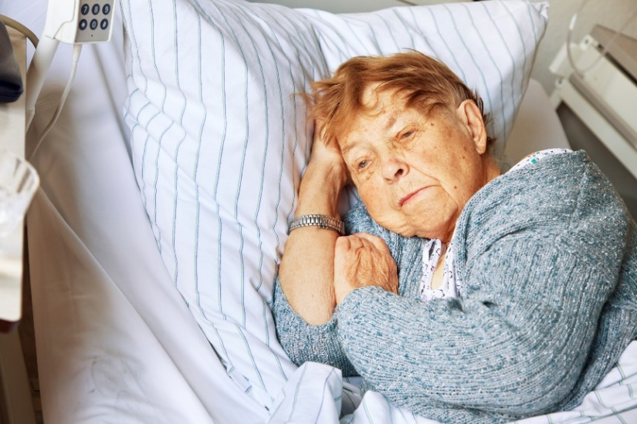
Life Issues and the Fifth Commandment:
Euthanasia
Euthanasia supporters claim to be offering a death with dignity, but the taking of a human life is still murder.
Dying with dignity is possible in other ways, including hospice programs and pain-relieving medicine.
SilviaJansen/iStockphoto.com
Notes:
Euthanasia is also known as assisted suicide or mercy killing.
A person’s dignity and personhood aren’t diminished because they require intensive care, or because they can no longer speak or respond as they normally do.
The Church’s teaching on this issue does not require that extraordinary means (such as breathing tubes) always be used to keep a person alive, no matter what.

Slide 8
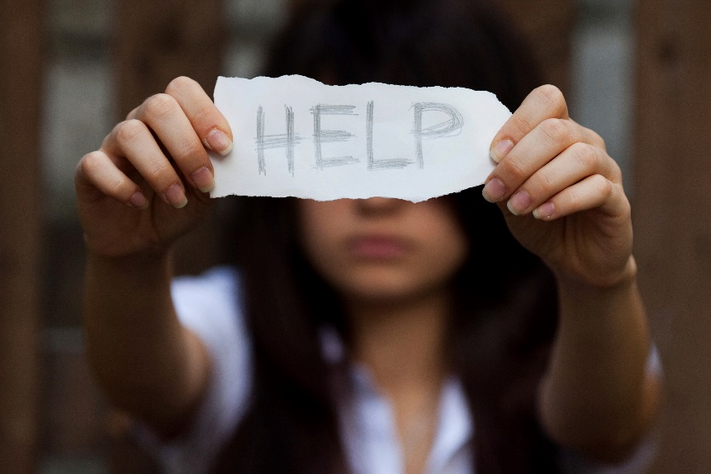
Life Issues and the Fifth Commandment:
Suicide
Suicide is the final rejection of the love of self, love of God, and love of neighbor.
We pray for those who have committed suicide and entrust them to God’s love and mercy.
filadendron/iStockphoto.com
Notes:
Serious mental illness can cause a person to make choices they would not freely make, such as self-harm or suicide. Encourage students to talk to a trusted adult—including you!—if they or someone they know is dealing with mental illness and/or suicidal thoughts, or if someone they know has committed suicide. There is always hope, and God’s mercy and compassion never end.

Slide 9
Life Issues and the Fifth Commandment:
Scandal
Scandal is an attitude or behavior that leads another person to sin, harming her or his spiritual life.
These attitudes or behaviors are especially wrong when committed by those who are supposed to educate or mentor others.
Notes:
Ask students for examples of scandalous behaviors/attitudes and how these behaviors/attitudes might lead observers into sin (e.g., skipping Mass could lead another Catholic to think Mass isn’t important, and to skip it themselves)

Slide 10

Life Issues and the Fifth Commandment:
Respect for Health
We should take care of our bodies and minds, which are wonderfully and carefully made.
A healthy diet, exercise, and getting enough sleep are just the start of respecting our own health and encouraging others to do the same.
monkeybusinessimages/iStockphoto.com
Notes:
Invite the students to brainstorm examples of how to respect their health and the health of their friends and family. Other examples from the handbook include avoiding excess of food, alcohol, and tobacco and driving safely.
QUESTION: What are some benefits of having a healthy mind and body? Are there any spiritual benefits?

