Slide 1
Respecting Truth
The Catholic Faith Handbook for Youth, Third Edition
Chapter 31
Document #: TX003162
Notes:
Have the students form pairs or groups of three or four to discuss the questions presented in this slideshow. Call on a few groups to share their ideas.

Slide 2
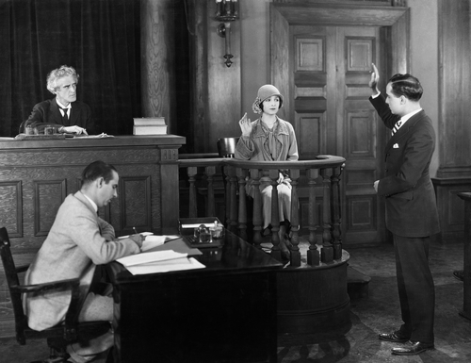
The Eighth Commandment:
You shall not bear false witness against your neighbor.
Copyright: Everett Collection / www.shutterstock.com
Notes:
Explain that this Commandment originally applied to giving testimony that could convict someone of a crime, but that it calls us to speak with honesty and to avoid lying.

Slide 3
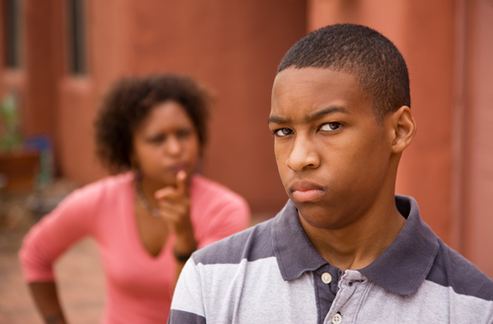
Your Thoughts?
What are some reasons teens may lie to or deceive others?
What might be the results of these deceptions?
Copyright: CREATISTA / www.shutterstock.com
Notes:
After the small groups have discussed the questions, allow for large-group sharing. (Reasons could include: to stay out of trouble, to avoid conflict, embarrassment, or hurting someone. Results include punishment and loss of trust if the lie is found out; guilt and a need to keep lying if it is not found out.)

Slide 4
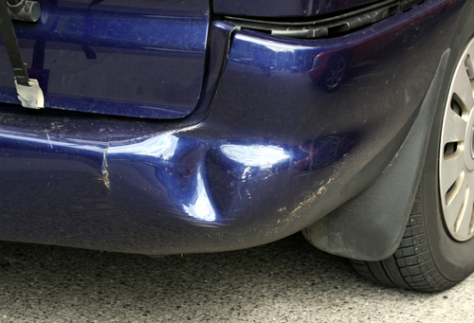
Your Thoughts?
Copyright: Pavelk / www.shutterstock.com
What are some situations where telling the truth may be difficult, but worth it?
What price might a person have to pay for telling the truth?
Notes:
After the groups have discussed these questions, follow up by asking, “Why do you think that telling the truth is worth it even when it might be difficult?”

Slide 5
Respecting Reputations
Detraction: a negative comment about someone’s character
Calumny: spreading false information about someone
Empathy: understanding another person’s feelings
Copyright: Monkey Business Images / www.shutterstock.com
Notes:
Ask the students to share examples for each term.

Slide 6
Your Thoughts?
Why does empathy break the cycle of rumors and gossip?
What can make us more empathetic?
Copyright: MANDY GODBEHEAR / www.shutterstock.com
Notes:
Call on a few groups to share their ideas. (Empathy enables us to see the harm we are causing; we become empathetic when we come to know others and listen to them.)

Slide 7
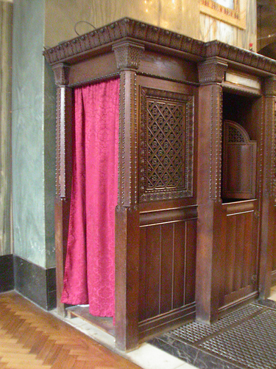
Confidentiality
You are not morally bound to tell the truth to someone who will use it to harm another person.
Professionals only reveal certain information in unusual cases.
The seal of confession in the Sacrament of Penance and Reconciliation
Copyright: Elena Ray / www.shutterstock.com

Slide 8
Your Thoughts?
In what circumstances might you reveal a secret for someone’s own good?
What are some of the risks you might be running?
What outcome would you hope for?
Copyright: Martin Novak / www.shutterstock.com
Notes:
Invite the students to respond to the questions. Consider providing specific information about resources in your school and community for situations that require intervention.

