Slide 1
The Formation of a Priest
Vocations, Unit 6

Slide 2
Family: The First Formation
Image in public domain
Notes:
Teacher notes: Where and how does the first formation of a priest begin? (Allow the students to volunteer answers.) The first formation of a priest usually begins in the family. Loving and healthy families teach us to trust in God’s goodness. They first bring us to church and introduce us to the Sacraments. The witness of parental self-sacrificial love and faith can help to lay a firm foundation for the faithful, committed service of a future priest.

Slide 3
Discernment
Discernment . . .
comes from a Latin word meaning “to separate or to distinguish between”
is the practice of listening for God’s call in our lives and, when making moral choices, distinguishing between good and bad choices
© Shutterstock/Leah-Anne Thompson
Notes:
Teacher notes: What do you think a person should do who feels called to be a priest? (Allow the students to answer.) An important step in following God’s call is to first discern God’s call. In discernment God’s call is discerned from among other good options. The sign of correct discernment is peace and a sense of conviction that God is with you, despite what may be your own anxiety or questions.

Slide 4
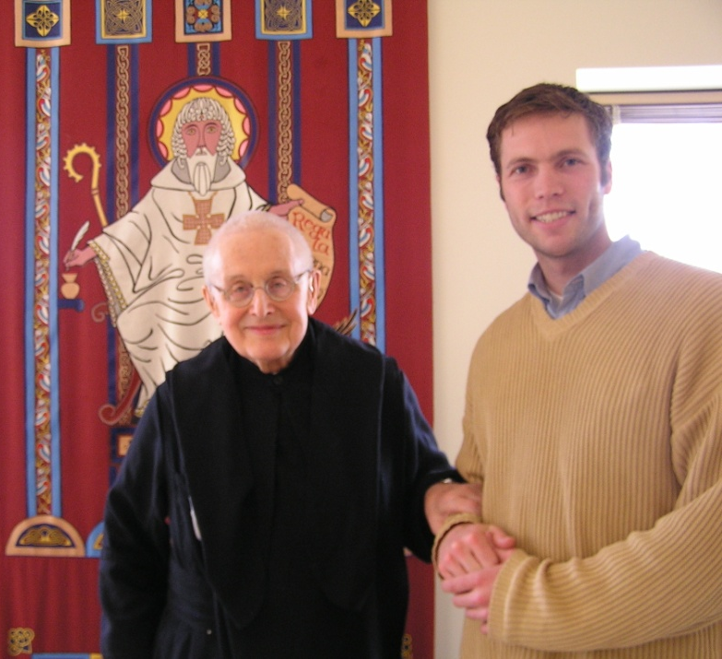
The Vocations Director
Vocations directors for the diocese and for religious orders help a young man to discern whether he is being called to the priesthood.
For a list of vocations directors for the priesthood, go to www.foryourvocation.org and click on the “Discerning Men” tab.
Clintrogersonline.com
Notes:
Teacher notes: What role does a vocations director play in helping someone discern a call to the priesthood? (Allow the students to answer.) A process of discernment usually entails praying and reflecting over an extended period of time. The next step is finding a vocations director. There are vocations directors for each diocese and for each religious order or congregation. Discernment is ongoing. Even in seminary studies, the process of discernment continues.

Slide 5
The First Stage of Seminary Training: Pre-Theology or “Minor Seminary”
the first two to four years of formal training
dedicated to the study of philosophy
dedicated to the studies of Latin (official language of the Latin Rite of the Catholic Church) and Greek (original language of the New Testament)
pastoral experiences are required during the summers
© Shutterstock/corepics
Notes:
Teacher notes: What is the primary course of studies during the “pre-theology or minor seminary” stage of priestly formation? (Allow the students to answer.) The word philosophy means “love of wisdom.” Philosophy deals with the big questions of life in a systematic way. These questions concern a wide range of topics. Some of them are: What is the purpose of human life? How did the world come to be? What is the meaning of death? What makes a decision morally right or wrong? What is the purpose of knowledge? The study of philosophy is important because this area of study helps the students to think more clearly, logically, and critically about the world around them. It is also extremely important because philosophy underpins all theological studies. Often these classes are taken in a college setting with other college students.

Slide 6
The Second Stage of Seminary: Theology Studies
Seminarians study four areas of theology:
dogmatic theology: the study of the objective truths and teachings of our faith
moral theology: the study of what is good versus what is sinful
spiritual theology: the study of prayer and spirituality
Sacred Scripture: the study of the Old and New Testaments
orbiscatholicussecundus.blogspot.com
Notes:
Teacher notes: What are the four areas of theology that seminarians must study? (Allow the students to answer.) The final stage of seminary training is the study of theology, a word which literally means “the study of God.” Theology is, in fact, a study of God’s Revelation and the Church’s Tradition. There are four broad areas of theological studies (see previous slide).

Slide 7
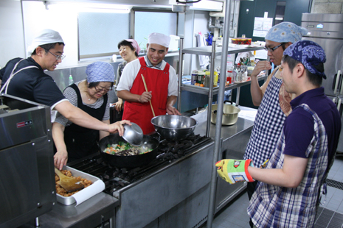
Theology Studies (continued)
Personal formation continues in a variety of ways:
meeting regularly with a spiritual director
supervised service assignments such as visiting nursing homes and hospitals, teaching religious education, or helping the poor in shelters or soup kitchens
working alongside a pastor or priest during the summers in local parishes
http://www.ucanews.com
Notes:
Teacher notes: Besides studying theology what other requirements must seminarians fulfill during this period of formation? (Allow the students to answer.) Because the period of theology studies is the last step before ordination, it is important that a seminarian be prepared for the many demands that will be made upon him as a priest. All of us can support our priests as they respond to the call to bring God and his love to us in the midst of our everyday lives.

