Slide 1
Western Monasticism
Church History, Unit 2

Slide 2
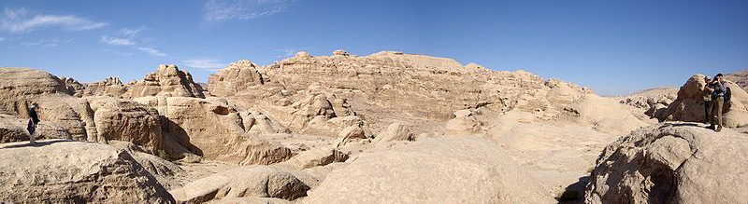
The founding of Christian monasticism is attributed to Saint Anthony of the Desert, who withdrew from society to live as a hermit. As his reputation spread, other men sought him out and took up their own lives of solitary prayer.
Image in public domain
Notes:
Image: Petra, desert near Jordania

Slide 3
These groupings of monks centered around a spiritual leader, like Anthony, and spread through the deserts of Asia Minor and Egypt.
Image in public domain

Slide 4
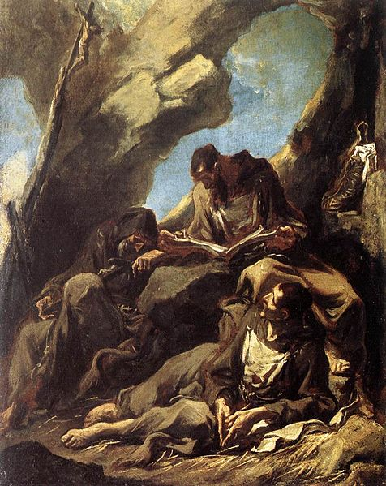
A contemporary of Anthony, Pachomius, recognized the need for uniformity. Around AD 320 he organized the first monasteries as walled communities, where men and women lived in communal houses.
In these early monastic communities, men and women pledged lives of prayer, celibacy, poverty, and obedience to a superior called an abbot or abbess.
Image in public domain
Notes:
Image: Three Capuchin Friars Meditating in Their Hermitage

Slide 5
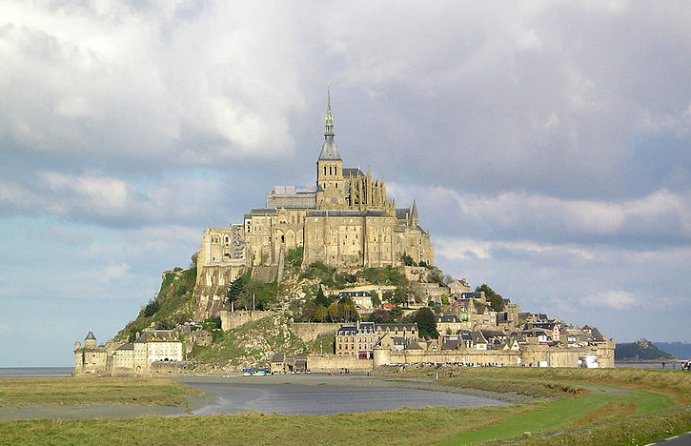
After Saint Athanasius wrote about the life of Saint Anthony of the Desert, monasticism spread into Western Europe.
Image in public domain
Notes:
Image: Mont Saint-Michel in France

Slide 6
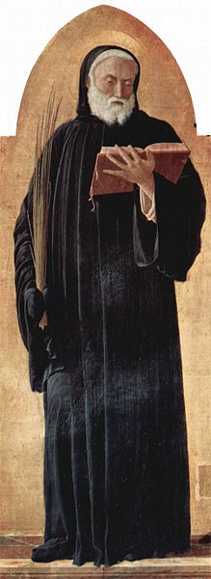
In the early sixth century, Saint Benedict of Nursia formed a group of men into the community that became the famous monastery at Monte Cassino, in present-day Italy.
Benedict’s monastery was a self-sustaining community, meaning that it supplied itself with food, clothing, and shelter.
Benedict’s sister, Scholastica, formed a nearby community for women.
Image in public domain
Notes:
Image: Saint Lucas altarpiece, detail: Saint Benedict of Nursia

Slide 7
At Monte Cassino, Benedict developed the Rule of Saint Benedict.
A rule is a constitution that clarifies the mission and directs the daily life of a religious community or institute according to the spirit of the Gospel.
Benedict’s Rule was based on moderation in all things. For example, rather than partake in extreme fasting, a common practice among the hermits, the monks ate two meals a day.
Benedict also called on his monks to take vows of chastity, poverty, and obedience.
The Rule of Saint Benedict is still used by many religious orders today.
Image in public domain

Slide 8
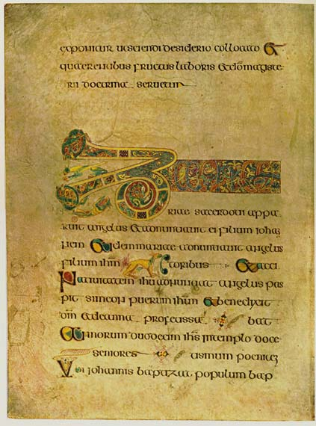
Meanwhile, in the sixth and seventh centuries, barbarian invaders destroyed many early Church writings on the European mainland. They also disrupted trade routes between major cities, which had the effect of reducing communication, learning, and literacy.
Image in public domain
Notes:
Image: Book of Kells

Slide 9
Irish monks were somewhat protected from these disruptions by the English Channel, separating Ireland from the mainland. They devoted their lives to illustrating and copying manuscripts.
Many of these illuminated manuscripts survive today—called “illuminated” because of their brilliantly colored decorations.
Image in public domain
Many historians credit the Irish monastic communities for helping to preserve Western culture and reintroduce vital Church texts to the European mainland.

Slide 10
The rise of Western monasticism had a
lasting effect on Western civilization:
Monasteries preserved Western knowledge by copying manuscripts and promoting learning through monastery schools.
Monks developed great music, art, and architecture.
Monks developed techniques in agriculture, wine production, and wool spinning and weaving.
Monasteries Christianized Europe.
Images in public domain
Notes:
All images in public domain.

