Slide 1
Chapter 15: Religion in the Modern World
World Religions: A Voyage of Discovery
DOC ID #: TX003952

Slide 2
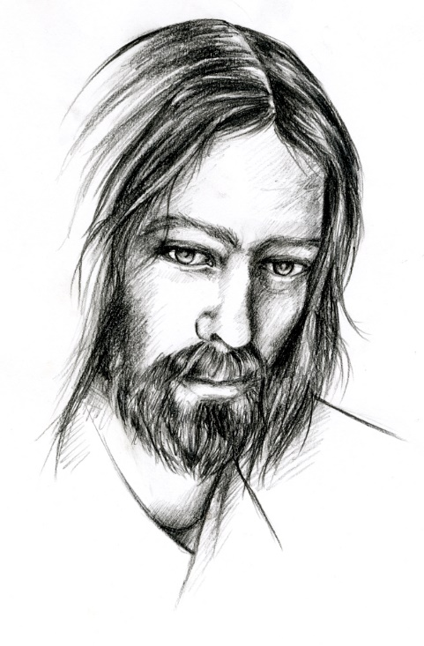
Traditional Religion in the Modern Age
Religious figures and other cultural heroes typically undergo some degree of metamorphosis as the centuries pass.
The variety of visual depictions of Jesus through the ages has been extreme, from a boyish appearance to something of a “rock star” look.
© carla castagno / www.shutterstock.com
Notes:
Notes: King Arthur is another example of a cultural hero who has undergone metamorphosis; for every period of English history, there has been a King Arthur who fits the times. Previous chapters have drawn attention to various depictions of religious figures, such as the Buddha and Jesus. This might be a good occasion to review some of that material, so as to gain better historical context for what might seem to be (and perhaps really are) rapid changes occurring today.

Slide 3

Technology and Traditional Religion
Advancements in technology, such as the invention of the printing press and even writing itself, have affected religion through the ages.
What other technologies exist that have an effect on religion today?
© Diego Cervo / www.shutterstock.com
Notes:
Notes: The invention of the printing press in the fifteenth century brought about revolutionary transformations within Christianity and other religions. The invention of writing in Mesopotamia about five thousand years ago brought about profound changes in religion and other forms of culture.

Slide 4

Internet Religion
The Internet provides many sites that offer religious materials, some facilitating active worship.
Visitors are able to make inquiries—and purchases—on the spot.
© Feng Yu / www.shutterstock.com
The Internet has brought about a new subcategory: “Internet religion.”
Notes:
Notes: The Online Puja website (www.spiritualpuja.com) is a good example of how the Internet can facilitate active worship. Others among the many websites offering Internet religion are “The Monastery of Christ in the Desert” (http://christdesert.org/) and an online engagement with Zoroastrianism (http://zarathushtra.com/).

Slide 5
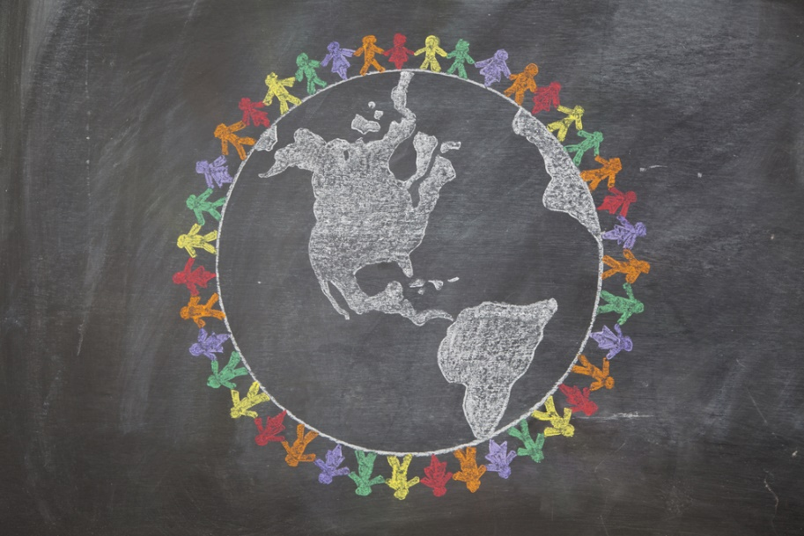
Multiculturalism
Multiculturalism is commonplace in today’s world.
For most of human history, societies have not been multicultural.
© Prixel Creative / www.shutterstock.com
Societies have historically tended to assume their way is the right way.
Notes:
Notes: The effects of multiculturalism on the religious landscape of modern times should become clearer in this light; far from assuming that their religion must be the right one, many today consider religious choice to be natural. Whereas traditionally a society’s religion helped very much to maintain that society, in today’s multicultural world, religions often struggle to maintain themselves, which is a profound shift. One compelling theoretical perspective on religion as a society-maintaining phenomenon is set forth in the first four chapters of sociologist Peter Berger’s The Sacred Canopy (New York: Anchor Books, 1967). As at least one critic has pointed out, Berger seems to assume in his analysis homogeneity at the societal level. An interesting approach to take with the students would be to compare modern society with an ancient society that experienced multiculturalism, for example, Greece and the vast regions conquered by Alexander the Great, or the Roman Empire.

Slide 6

The Integration of Religion in Society
As the world becomes more multicultural, familiarity with religions increases.
This can lead to greater levels of acceptance.
Some theorists are less optimistic about the capacity of modern society to embrace religious differences.
© dboystudio / www.shutterstock.com
Notes:
Notes: The third bullet point sets up issues for discussion. One important and engaging scholarly work that tends to be less optimistic in this regard is Bruce Lincoln’s Holy Terrors: Thinking about Religion after September 11, in which Lincoln endeavors to show that religion—far from always being a cause promoting peace—has great potential to inspire and nurture violent confrontation.

Slide 7

A New Religious Movement: Santeria
The cast iron “spell pot” is used by practitioners of Santeria.
Santeria originated through the identification of deities of Africa’s Yoruba culture with Catholic saints.
“New” religious movements often have roots that extend far back in time.
© mikeledray / www.shutterstock.com
Notes:
Notes: Having originated in Cuba during the time of the slave trade, practitioners of Santeria have gradually spread into various countries around the Caribbean; in the United States alone, they number in the hundreds of thousands. Other new religious movements that similarly combine elements of other preexisting religions, including religions of Africa, are Voodoo and Condomblé. This general phenomenon of new religions arising out of the intermixing of established traditions is not itself new. Zen Buddhism is an amalgamation of Indian Buddhist and Chinese Taoist elements. Gnosticism was a radically Platonized recasting of Judaism, and rapidly took on Christian elements as well (although at that time Christianity itself was a new religious movement). There are many other examples; perhaps the students can name some.

Slide 8
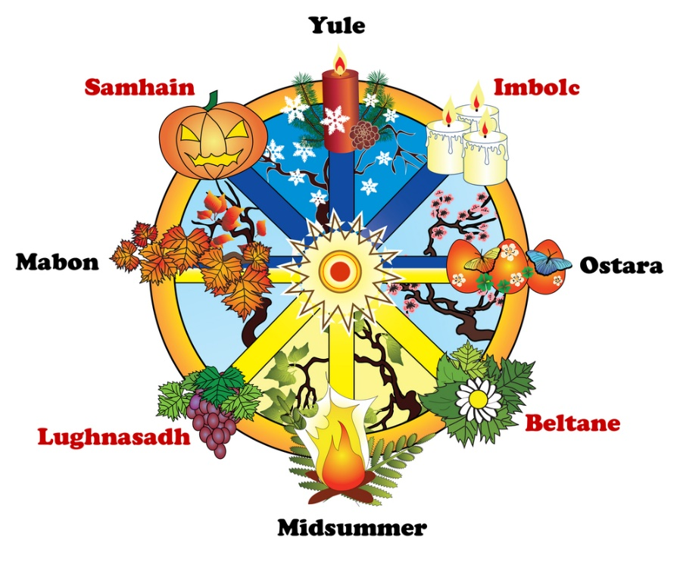
Wheel of the Year
This marks important festivals celebrated by many forms of Neopaganism, including Wicca.
The dates of the eight festivals are based on the solstices and equinoxes.
Samhain (Halloween) is the most important festival, or sabbat, for Wicca.
© Snowbelle / www.shutterstock.com
Notes:
Notes: Given Neopaganism’s emphasis on nature and on the cycle of seasons, it is apt that the wheel would provide the basis for its calendar. Samhain is celebrated in Wicca as a festival of darkness, balanced by its calendric opposite, Beltane, which is celebrated as a festival of light. Samhain marks the point of the year at which the partition separating the living from the dead is at its thinnest, and so communication with that realm is thought to be easiest.

Slide 9
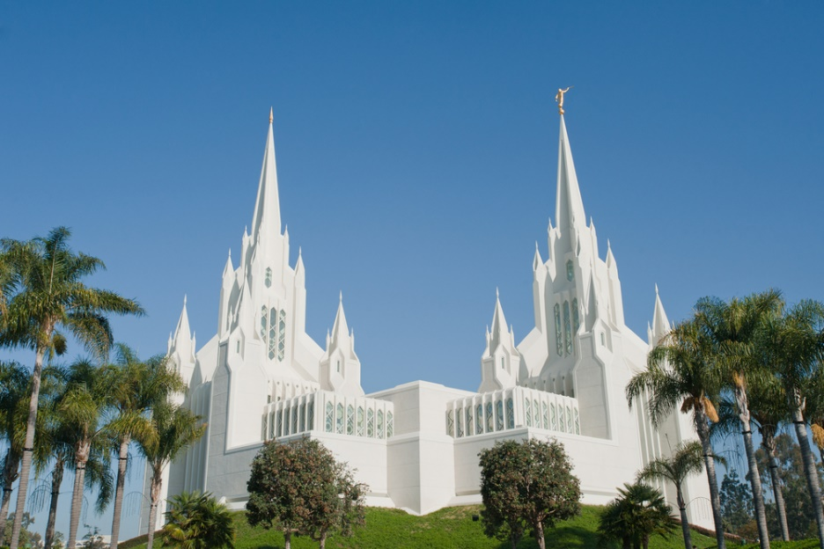
A New Religious Movement: Mormonism
Mormonism is growing quite rapidly.
The 2012 United States presidential campaign featured a Mormon candidate for the first time.
Gaining acceptance by “the mainstream,” Mormonism challenges the category “new religious movement.”
© Natalia Bratslavsky / www.shutterstock.com
Notes:
Notes: Mormonism, founded in the 1820s, is the largest manifestation of the Church of Jesus Christ of Latter-day Saints, but not the only. Mitt Romney and his campaign faced the threat that Americans would not elect a Mormon as their president; he did lose, but it would seem that his Mormon identity turned out to be not such a crucial factor. The challenge referenced in the final bullet point could be applied to almost every religion so categorized, and perhaps there is something to be said for being less insistent on the term. Still, in light of the proliferation of, dare we say, new religions—about fourteen thousand globally have come about in the twentieth century and first part of the twenty-first century—it seems useful at least as a tool for analysis to maintain some such category.

Slide 10


A Battle Over Fishes
Debates between Darwinists and the religious have occurred since the time of Darwin himself.
Since early times, Christians have used the fish as a symbol of the religion.
Supporters of Darwinian theory have struck back with their own symbols.
© PiXXart / www.shutterstock.com
© Stanil777 / www.shutterstock.com
Notes:
Notes: The vast variety of Jesus / Darwin symbols is astonishing, and engaging to behold, especially if accompanied by sober consideration of the implications for understanding the relationship between science and religion. The debates rage on, as on car bumpers and elsewhere we see Jesus fish gobbling up Darwin fish or vice versa, philosopher Friedrich Nietzsche being quoted (“God is dead”—Nietzsche) or refuted (“Nietzsche is dead”—God), and the like.

Slide 11

Big Bang Theory
Cosmologists believe they are narrowing in on understanding the origins of the universe.
Findings as of spring 2013 basically confirm the big bang theory.
Such a theory compels a sense of mystery that some might call religious.
© Igor Zh. / www.shutterstock.com
Notes:
Notes: The findings of spring 2013 came courtesy of the orbiting Planck Observatory and its measurements of cosmic microwave background radiation. They confirm that the universe came to be in a sudden, massive expansion from an almost infinitesimally small object, some 13.6 billion years ago (the spring 2013 data adjusted the time span slightly, from 13.7 billion years). Even more mystery-provoking than the big bang theory itself are questions involving what there was before, and possibilities regarding the existence of parallel universes. A discussion of the potential effects of new cosmological findings on religious perspectives may be engaging for the students. Certainly the more general question of the proper relationship between religion and science would be worth pondering as well.

