Slide 1
Grace
Christian Morality
Document # TX001913

Slide 2
Grace is God’s initiative in preparing us for salvation.
Image in public domain

Slide 3
We are given free will, the freedom to choose right and wrong. Grace helps us to use our freedom for our greater good.
Image in public domain

Slide 4
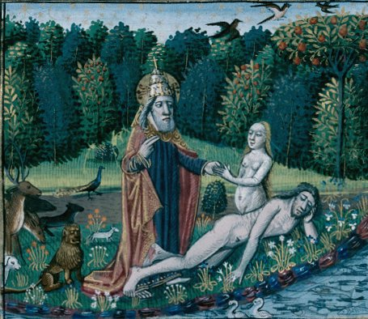
When we respond to grace, we respond to God’s invitation to friendship.
Image in public domain

Slide 5
There are many sources of grace in our lives.
sanctifying grace
actual grace
sacramental grace
charism

Slide 6
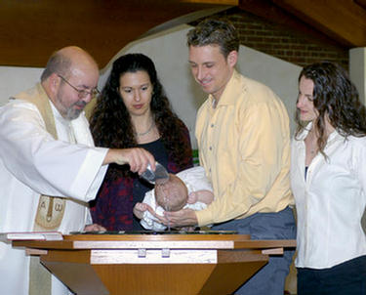
In the Sacrament of Baptism, the Holy Spirit infuses us with sanctifying grace through which we share in God’s divine life.
Wpwittman.com
Notes:
[

Slide 7
Have you ever faced a difficult moral decision, and just the right person shows up to help you out?
This is actual grace, the work of God in our lives.
Shutterstock/Dean Mitchell

Slide 8
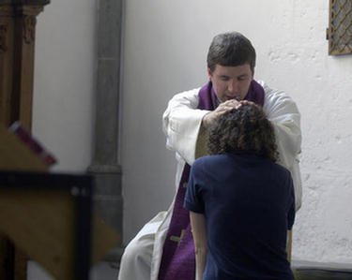
Have you experienced a tremendous sense of peace after participating in the Sacrament of Reconciliation?
This is sacramental grace.
Wpwittman.com

Slide 9
Do you know someone whose life is graced with a particular gift, such as compassion?
This is an example of a special grace called charism.
Shutterstock/Lucky Business

Slide 10
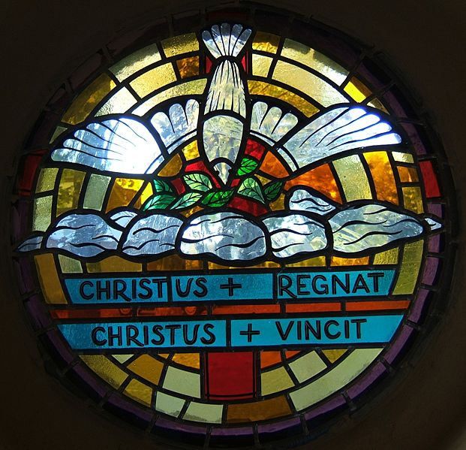
How do we experience the grace of God within us?
We experience grace through the Gifts of the Holy Spirit.
Image in public domain

Slide 11
Consider how each of these gifts could enable you to live a Christian moral life.
Wisdom
Understanding
right judgment
Courage
knowledge
Reverence
wonder and awe
Image in public domain

Slide 12
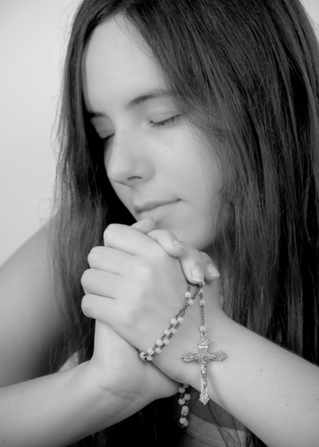
How do we know that the choices we make are leading us toward salvation?
We experience in our lives the traits of virtuous living.
Shutterstock/jcjgphotography

Slide 13
Charity
Joy
Peace
Patience
Kindness
Goodness
Generosity
Gentleness
Faithfulness
Modesty
Self-control
Chastity
Image in public domain

