Slide 1
The Incarnation
Jesus Christ: God’s Love Made Visible, Second Edition Unit 3, Chapter 6
Document#: TX004811

Slide 2
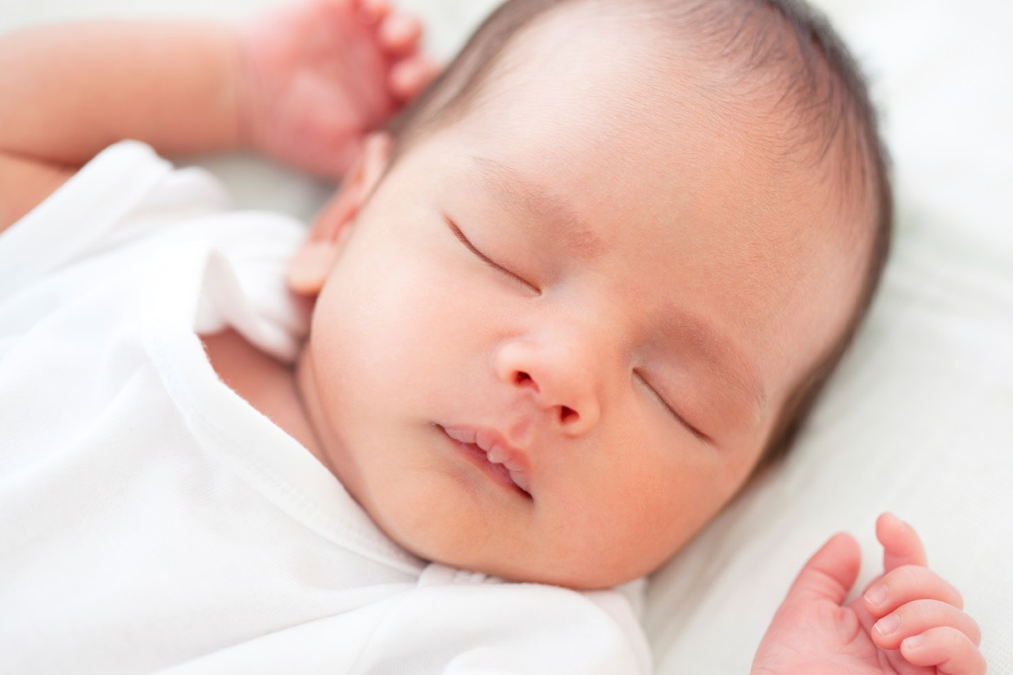
What Is the Incarnation?
Jesus Christ, the Son of God, became human to accomplish our salvation.
The Incarnation is an important mark of our Christian faith.
© Goldmund Lukic / iStockphoto.com
Notes:
Point out that Christianity, like Judaism and Islam, recognizes that God works within human history. Explain that the Incarnation means that God actually entered into human history at a particular time and in a particular place.
This slide corresponds to content in article 25, “What Is the Incarnation?” in the student book.

Slide 3
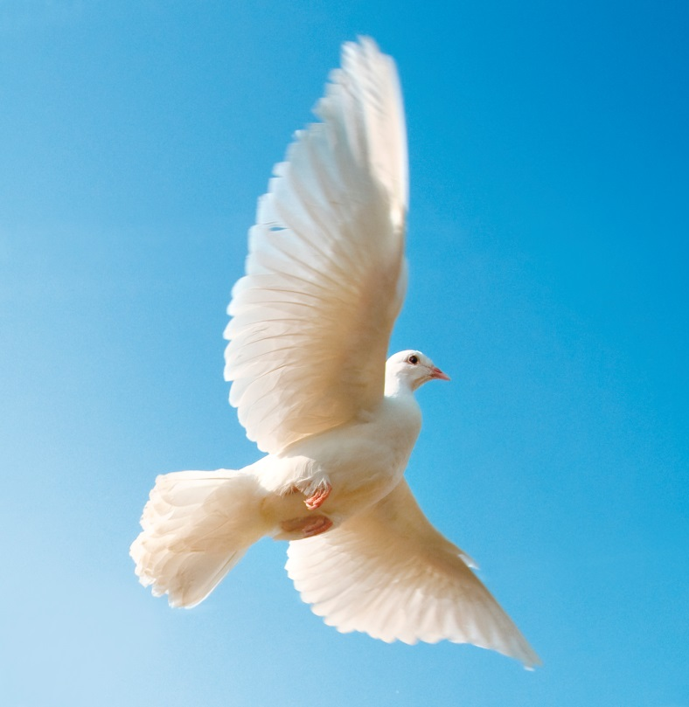
By the Power of the Holy Spirit
The angel Gabriel announced to Mary that she would give birth to a son.
The child would be called Jesus, which means “God saves.”
Jesus was conceived by the Holy Spirit in order to begin his saving work among us.
© davidsorensen / iStockphoto.com
Notes:
Discuss the names for the savior mentioned in the Gospels of Luke and Matthew: Jesus (God saves) and Emmanuel (God with us). Ask the students which name best describes for them the meaning of Jesus’ life and why.
This slide corresponds to content in article 25, “What Is the Incarnation?” of the student book.

Slide 4
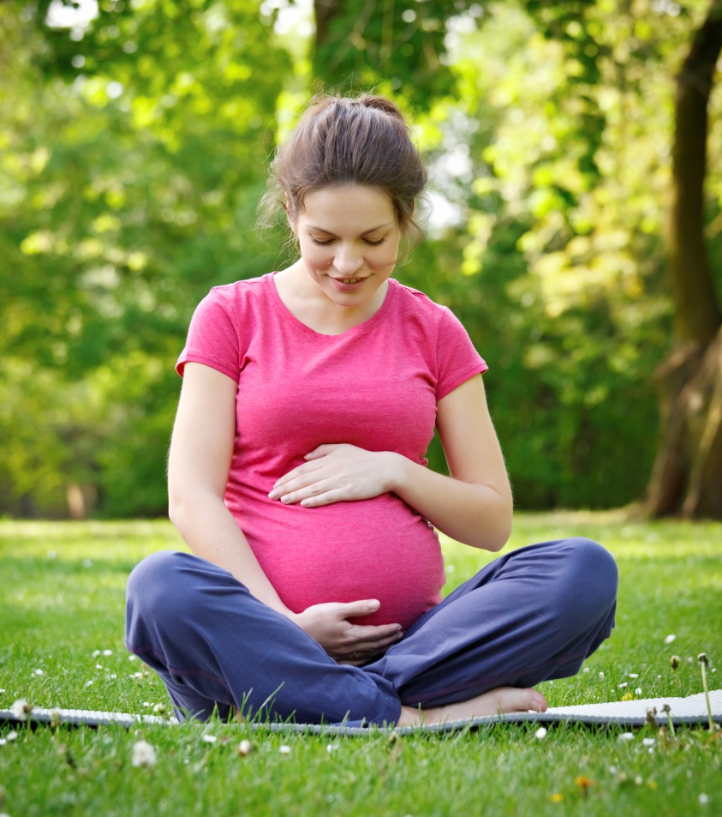
From All Eternity
Jesus’ conception in Mary’s womb began the earthly existence of the Son of God.
His heavenly existence is eternal—that is, without a beginning or an end.
© sborisov / iStockphoto.com
Notes:
Explain that when the Son of God became flesh, he did not stop being God, but now he was a man as well. Point out that the term “Eternal Son of God” means Jesus was divine before, during, and after his time on earth.
This slide corresponds to content in article 25, “What Is the Incarnation?” in the student book.

Slide 5
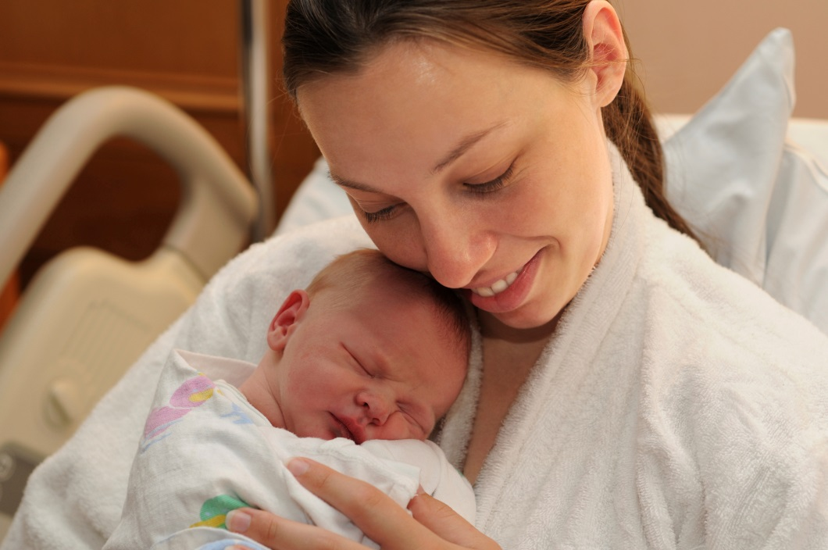
Mary’s Role in the Incarnation
For the Incarnation to occur, the Eternal Word of God needed a human mother.
Mary’s willingness to say yes to God’s gracious plan made our salvation possible.
She is truly the Mother of God.
© Yarinca / iStockphoto.com
Notes:
Draw a parallel between Mary’s obedience to God’s will and our own call to obedience. Explore with the students what saying “yes” to God can look like in our lives.
This slide corresponds to content in article 26, “Mary’s Role in the Incarnation,” in the student book.

Slide 6
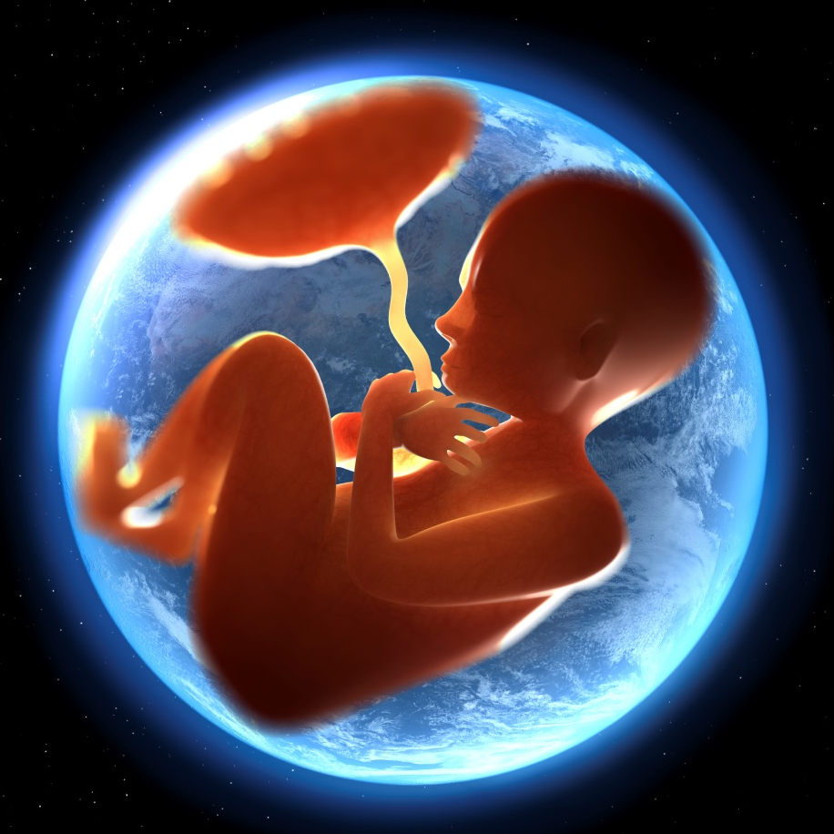
Mary’s Immaculate Conception
On December 8 we celebrate the day on which Mary was conceived.
She was redeemed from the first moment of her life, conceived without original sin.
She also remained free from all personal sin throughout her life.
© Henrik5000 / iStockphoto.com
Notes:
Explain that Mary had been prepared from all eternity for the unique role of bringing the Son of God into the world, but that does not mean that Mary had no choice. Reiterate that Mary’s “yes” made our salvation possible.
This slide corresponds to content in article 26, “Mary’s Role in the Incarnation,” in the student book.

Slide 7
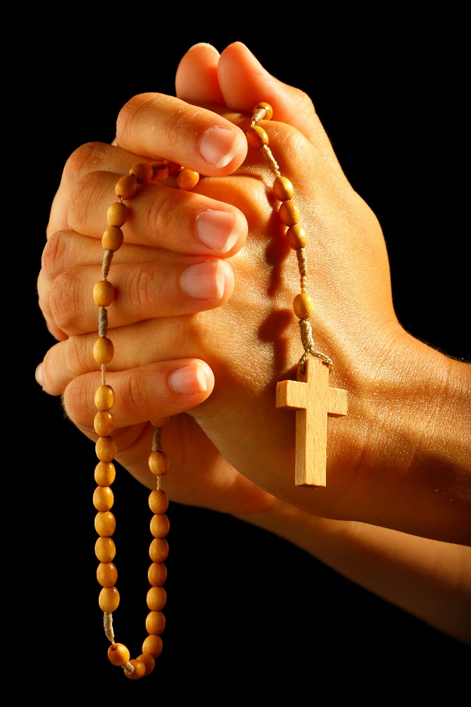
Mary’s Perpetual Virginity
Mary became pregnant with Jesus while remaining a virgin.
She remained a virgin throughout her life, a sign of her total dedication to God.
Mary is a spiritual mother to all of us.
© mffoto / shutterstock.com
Notes:
Direct the students’ attention to article 26 in the student book, specifically the section about Mary’s perpetual virginity. Review the two explanations offered for biblical passages referring to Jesus’ siblings.
This slide corresponds to content in article 26, “Mary’s Role in the Incarnation,” in the student book.

Slide 8
Mary’s Assumption
When Mary died God did not allow her body to decay.
God brought her whole being—body and soul—into Heaven.
We celebrate this event on August 15.
© Studio-Annika / iStockphoto.com
Notes:
Write these phrases from the Litany of Loreto on the board: Mother of Divine Grace, Spiritual Vessel, House of God, Ark of the Covenant. Discuss these titles for Mary in light of the material from article 26 in the student book.
This slide corresponds to content in article 26, “Mary’s Role in the Incarnation,” in the student book.

Slide 9
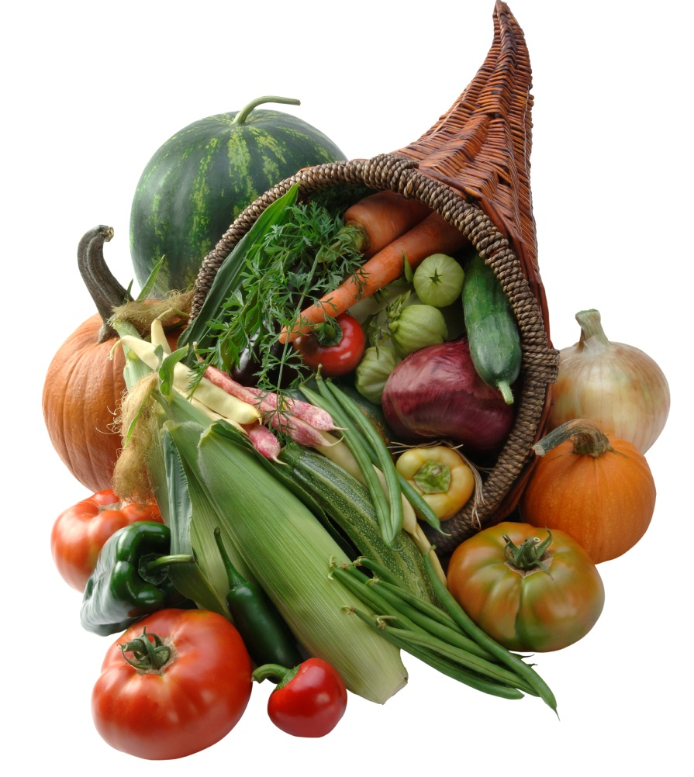
Mary, Seat of Wisdom
We call Mary the Seat of Wisdom.
God’s Word, made flesh in Mary’s womb, is full of wisdom for us.
In the Old Testament, Wisdom is personified as a woman.
© pixhook / iStockphoto.com
Notes:
Explain that the Old Testament figure of Wisdom invites people to share in her gifts. Brainstorm what a person would be like if he or she accepted the gifts that Wisdom has to offer.
This slide corresponds to content in article 26, “Mary’s Role in the Incarnation,” in the student book.

Slide 10
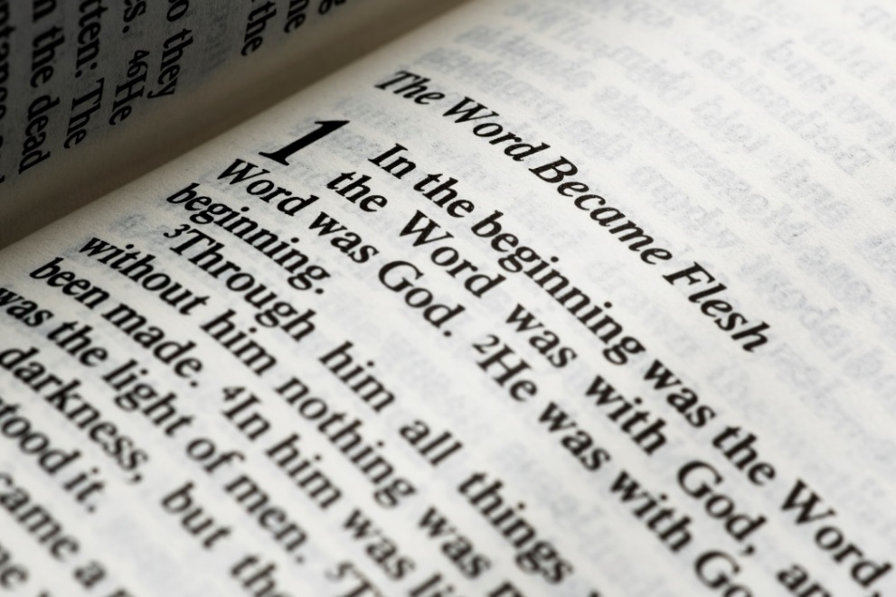
Jesus: The Word Made Flesh
The Gospel of John tells us the Word became flesh.
This “Word” is the Eternal Son of God.
The Word is with God the Father in Heaven for all eternity, along with the Holy Spirit.
© milosluz / iStockphoto.com
Notes:
Read John 1:1–5 and 1:14. Ask for some ways that Jesus overcame darkness through his Incarnation.
This slide corresponds to content in article 27, “Jesus: The Word Made Flesh,” in the student book.

Slide 11
God Prepared Humanity for the Incarnation
The Old Testament tells how God revealed himself to humanity.
God guided, corrected, challenged, and comforted us after sin had damaged our friendship with him.
© AVTG / iStockphoto.com
Notes:
If your students need a recap of salvation history, review the main points in article 27 in the student book. Explain that through this history, God prepared us for his ultimate self-revelation.
This slide corresponds to content in article 27, “Jesus: The Word Made Flesh,” in the student book.

Slide 12
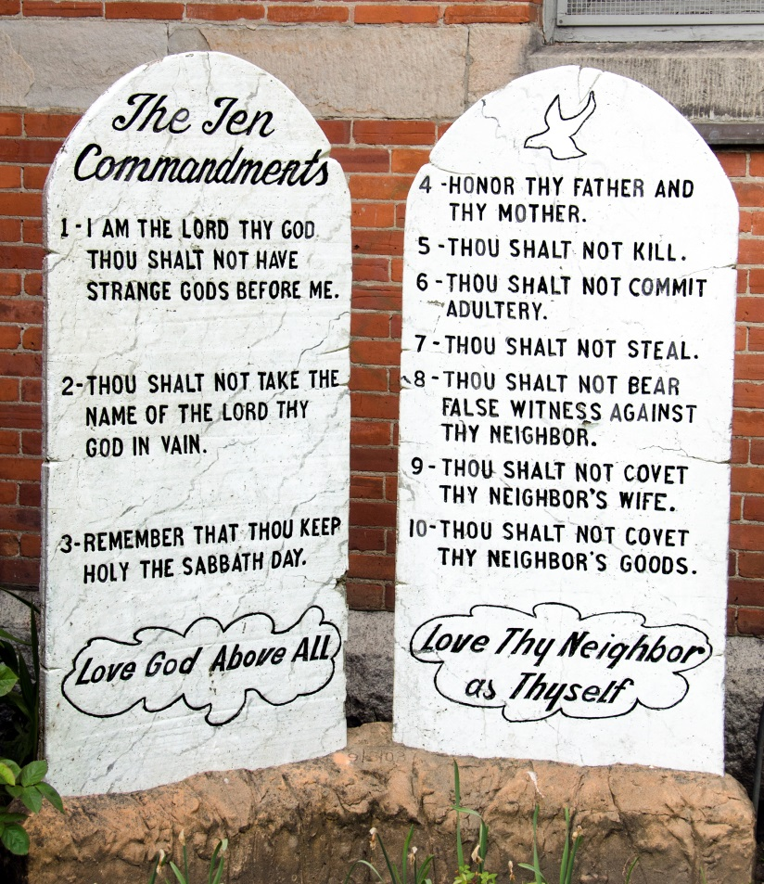
Jesus Perfects the Law
Jesus fulfilled, and did not replace, God’s Law, given to the ancient Israelites.
Jesus perfected the Law and revealed its ultimate meaning.
He redeemed any sins people had committed against the Law.
© wwing / iStockphoto.com
Notes:
Ask how Jesus revealed the meaning of the Law. Ask for specific examples of Jesus’ treatment of others and of his relationship with God, making connections to God’s Law.
This slide corresponds to content in article 27, “Jesus: The Word Made Flesh,” in the student book.

Slide 13
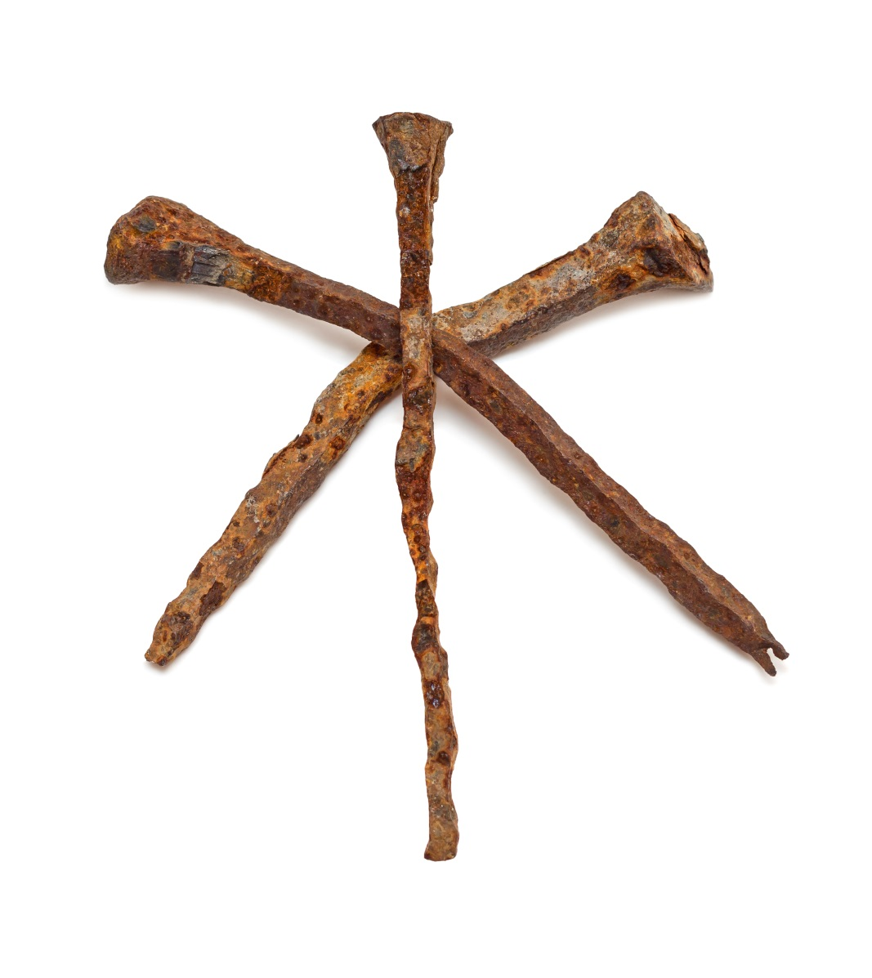
Jesus, the Revealer and Mediator
Jesus reveals God the Father to us.
Jesus is like a bridge that connects earth with Heaven.
He makes God accessible to us even though we had lost God’s friendship through sin.
© Martina_L / iStockphoto.com
Notes:
Discuss how Jesus accomplishes each action stated in the bullet points through his Incarnation.
This slide corresponds to content in article 28, “The Union of God with Humanity,” in the student book.

Slide 14
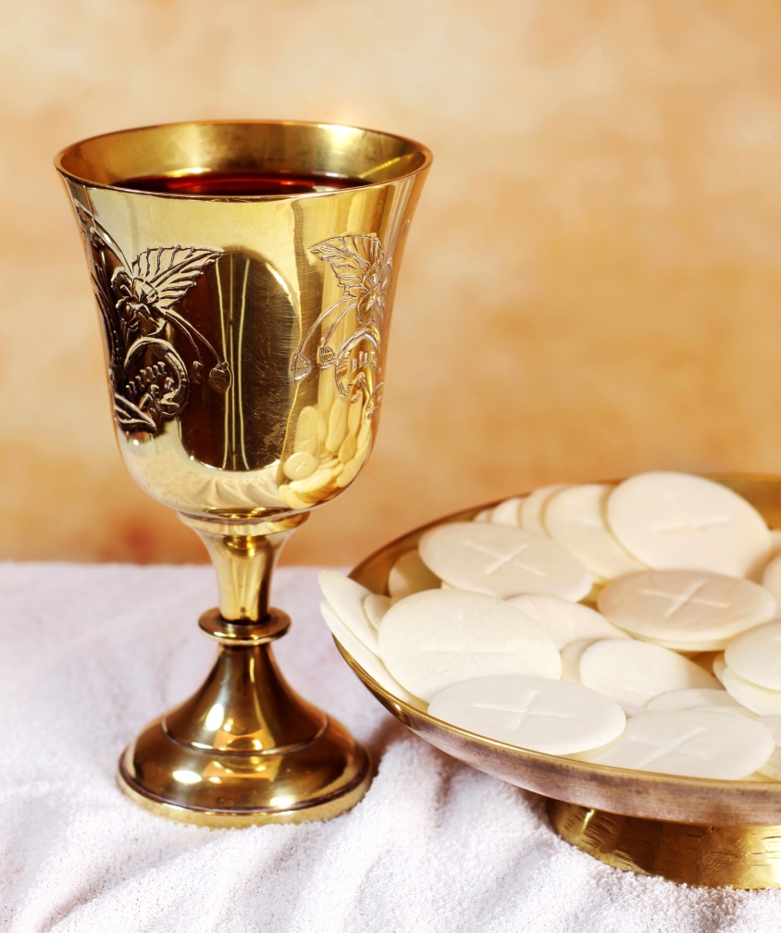
Sharing in the Divine Life
We are drawn into communion with the Trinity.
We are profoundly united with God through the Sacraments of the Church.
After death, we will enjoy God’s presence and glory forever.
© small_frog / iStockphoto.com
Notes:
Point out that sharing in the Divine Life is not automatic. Discuss the responses to Jesus’ invitation, which allow us to enjoy communion with the Trinity. Read and discuss the prayers from the Christmas liturgy found at the conclusion of article 28 in the student book.
This slide corresponds to content in article 28, “The Union of God with Humanity,” in the student book.

