Slide 1
Respecting Sexuality
The Catholic Faith Handbook for Youth, Third Edition
Chapter 29
Document #: TX003160
Notes:
Use this presentation to introduce or to review the material in chapter 29 about marriage and chastity.

Slide 2
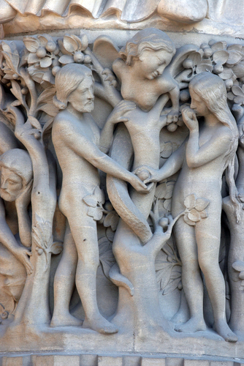
The Sixth and Ninth Commandments
Remind us not to misuse the gift of sexuality
We are intentionally made as male and female.
We must understand ourselves and our sexuality.
Copyright: Zvonimir Atletic / www.shutterstock.com
Notes:
Explain that God created us to be in relationship and to form families and communities.

Slide 3
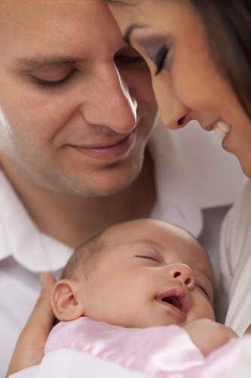
The Three Purposes of Sex
To create new life
To express loving union
To bring us joy and pleasure
Copyright: Andy Dean Photography / www.shutterstock.com
Notes:
These points are explained on pages 321–322 of the student handbook. Emphasize that all three purposes work as a unity only in marriage.

Slide 4
What are some ways that sex can be devalued for
commercial purposes?
Notes:
Invite the students to respond to the question, making sure they cover such points as the use of sex and sexuality in advertising, movies, gaming, and music in order to make money.

Slide 5

Marriage
A marriage must honor the purposes of love and life.
Artificial birth control
In vitro fertilization and artificial insemination
Divorce
Adultery
Cohabitation
Copyright: Monkey Business Images / www.shutterstock.com
Notes:
You may wish to invite volunteers to read about divorce and annulment in the Did You Know? sidebar on page 323 of the student handbook.

Slide 6

Chastity
Integration of sexuality with our bodies, minds, and spirits
Christ is the model for chastity.
Every person, single or married, is called to be chaste.
Copyright: Yuri Arcurs / www.shutterstock.com
Notes:
Invite a volunteer to read the Live It! sideabar “Ten Ways to Practice Chastity,” on page 324 of the student handbook.

Slide 7
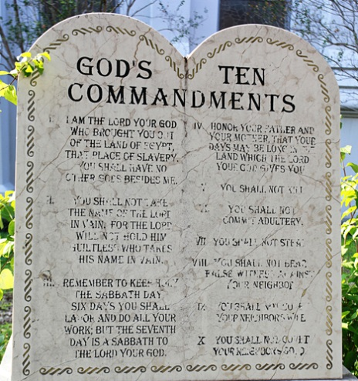
Sins against the Ninth Commandment
Lust
Fornication
Pornography
Copyright: VanHart / www.shutterstock.com

Slide 8

Homosexuality
Sexual attraction toward persons of the same sex
Copyright: William Perugini / www.shutterstock.com
Children of God
Immoral to discriminate against, act violently toward, make jokes about
The Church teaches that homosexual acts are against natural law.

