Slide 1
Mary, Our Mother
Document # TX004831

Slide 2
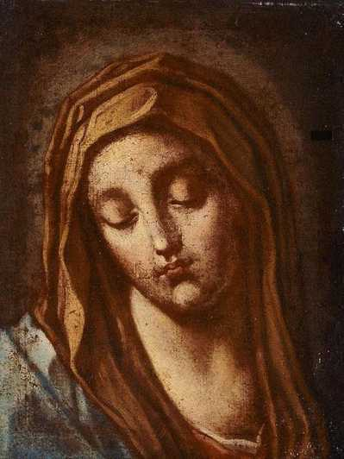
Mary, Our Mother
Think about when you first heard about Mary.
What were you told?
How has your understanding of Mary grown?
Public domain
Notes:
After the first bullet, allow a few quiet moments for reflection. After the second and third bullets, allow time for reflection and discussion as a class.

Slide 3
What Do We Know about Mary?
Her parents were Saints Anne and Joachim.
She was born in Jerusalem and lived in Nazareth in Galilee.
She was the cousin of Elizabeth, the mother of John the Baptist.
She was betrothed (engaged) to Joseph when the Angel Gabriel came to her.
The Angel announced that she was to be the mother of Jesus.

Slide 4
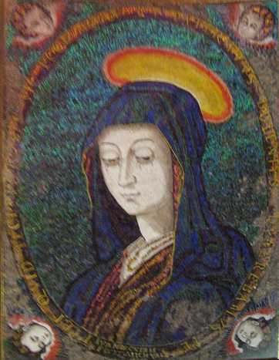
What Do We Know about Mary? (cont.)
Mary had a deep faith and trust in God.
She was young and unmarried.
She became pregnant by the Holy Spirit.
Public domain

Slide 5
Mary Became Pregnant by the Holy Spirit
Take a few moments to reflect on how difficult this must have been for Mary.
How would she tell Joseph?
How would he respond?
What would the neighbors say?
Remember, this was a culture that stoned unmarried, pregnant women.
Mary’s “yes” would mean that she would be in danger and so would the baby she would carry: Jesus.

Slide 6
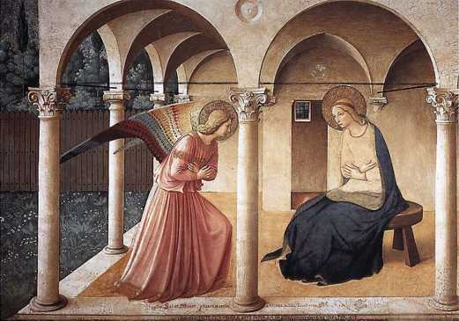
Mary Said Yes
“Behold, I am the handmaid of the Lord. May it be done
to me according to your word.” (Luke 1:38)
We celebrate Mary’s “yes” on the Annunciation, March 25.
Public domain

Slide 7
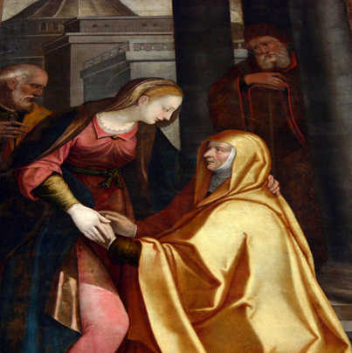
The Visitation
Mary learned that her cousin Elizabeth was also pregnant, and Mary went to visit her.
Elizabeth recognized Mary as a mother, the mother of her Lord.
Public domain

Slide 8
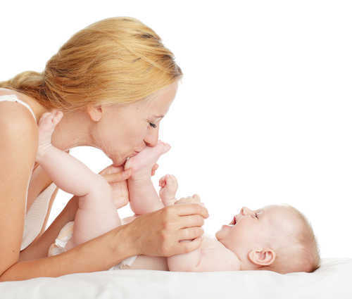
What Is a Mother?
What is a mother?
What can we learn about Mary from our response to this question?
© Gladskikh Tatiana / Shutterstock.com
Notes:
After the first bullet, allow a few moments for reflection, and then invite discussion. After the second bullet, have the class discuss.

Slide 9
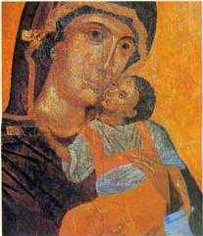
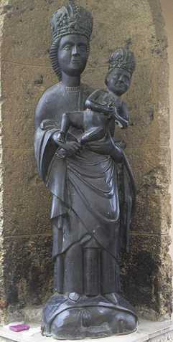
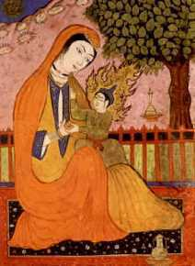
Mary, Mother of Jesus
Images in public domain

Slide 10
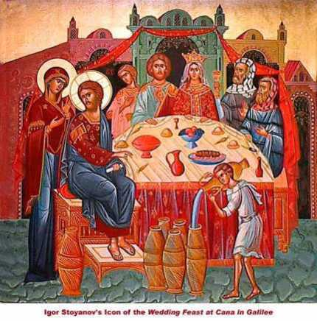
The Wedding Feast at Cana
Mary was a mother who knew her son.
She was concerned for others.
Mary saw that the couple had run out of wine at the wedding feast in Cana. She asked her son to do something.
It was his first public miracle.
He responded when she asked him to help.
Public domain

Slide 11
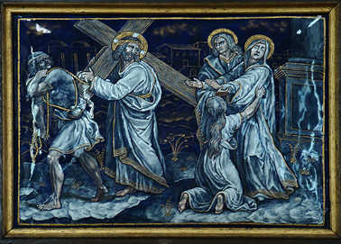
The Fourth Station of the Cross
Jesus meets his mother.
Public domain

Slide 12
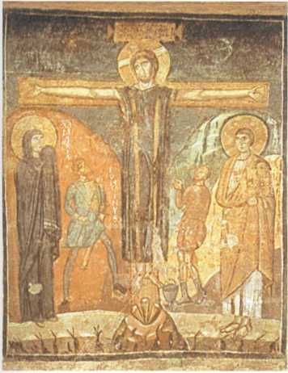
Mary at the Foot of the Cross
“Then he [Jesus] said to the disciple, ‘Behold, your mother.’ And from that hour the disciple took her into his home.” (John 19:27)
Public domain

Slide 13
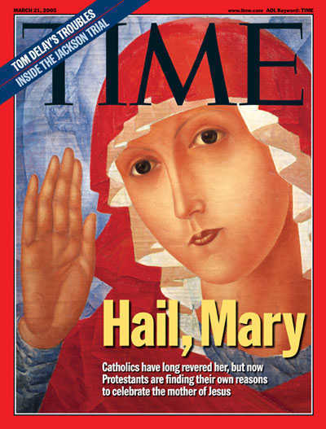
Mary, Our Mother
“Why should we not all together look to her as our common Mother who prays for the unity of God’s family and who ‘precedes’ us all at the head of the long line of witnesses of faith in the one Lord?” (Pope Saint John Paul II, Redemptoris Mater, 30)
Public domain
© www.time.com

Slide 14
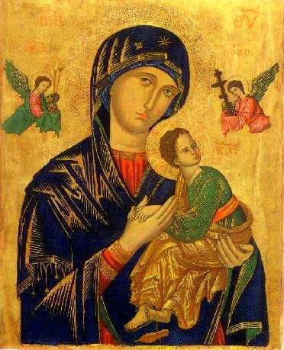
Mary, Our Mother
Public domain

Slide 15
Acknowledgments
The Scripture quotations in this PowerPoint are from the New American Bible, revised edition © 2010, 1991, 1986, 1970 Confraternity of Christian Doctrine, Inc., Washington, DC. All Rights Reserved. No part of this work may be reproduced or transmitted in any form or by any means, electronic or mechanical, including photocopying, recording, or by any information storage and retrieval system, without permission in writing from the copyright owner.
The quotation on Slide 13 is from On the Blessed Virgin (Redemptoris Mater), number 30, at www.vatican.va/holy_father/john_paul_ii/encyclicals/documents/hf_jp-ii_enc_25031987_redemptoris-mater_en.html. Copyright © Libreria Editrice Vaticana.

