Slide 1
Introducing the Trinity:
God Is Three-in-One
Jesus Christ Course
Document #: TX001186

Slide 2
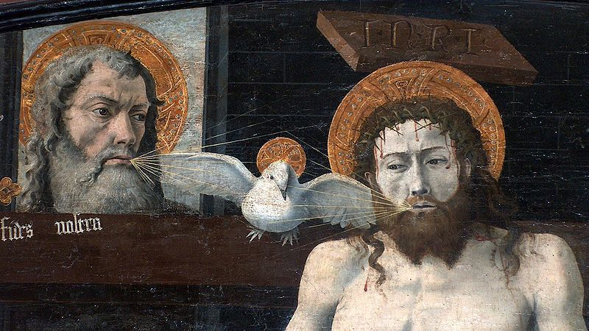
Image in public domain
Notes:
Notes: Ask the students to reflect on this image of the Trinity. Encourage discussion by asking some or all of the following questions:
• What do you see?
• What is going on in this picture?
• What is the symbolism in this picture?

Slide 3
Mystery of the Trinity: God Is Three-in-One
There are three Divine Persons in one God:
  The First Person of the Trinity is God the Father.
  The Second Person of the Trinity is God the Son.
  The Third Person of the Trinity is God the Holy Spirit.
Image in public domain

Slide 4
Mystery of the Trinity: God Is Three-in-One (cont.)
God: Three-in-One
  same substance or essence
  united as one . . . Divine Unity
  inseparable
  share the same attributes
  distinct from one another
  specific images of each Divine Person in the Scriptures
Image in public domain
Notes:
Notes: Ask students to recall specific images of each Divine Person in the Scriptures.

Slide 5
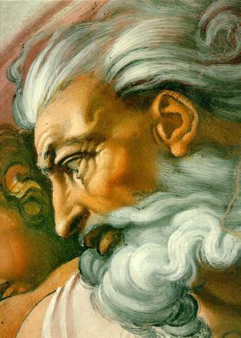
God the Father, First Person of the Trinity
Image in public domain
Notes:
Notes: Ask the students to reflect on the image. What does Michelangelo want the audience to know about God through this depiction? What does this image reflect?

Slide 6
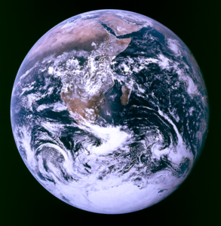
God the Father, First Person of the Trinity (cont.)
God the Father: the Source of the visible and the invisible
  Where can I hide from your Spirit?
  From your presence, where can I flee?
  If I ascend to the heavens, you are there;
  if I lie down in Sheol, you are there too.
  If I fly with the wings of dawn
  and alight beyond the sea,
  Even there your hand will guide me,
  your right hand hold me fast.
  (Psalm 139:7–10)
Image in public domain

Slide 7
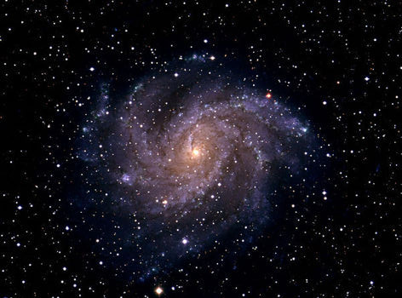
God the Father, First Person of the Trinity (cont.)
The Creator
“In the beginning, when God created the heavens and the earth . . .” (Genesis 1:1).
Image in public domain

Slide 8
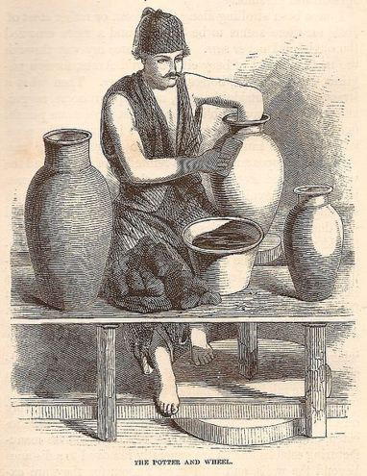
God the Father, First Person of the Trinity (cont.)
The Potter
Yet, O Lord, you are our father;
  we are the clay and you the potter:
  we are all the work of your hands.
  (Isaiah 64:7)
Image in public domain

Slide 9
God the Father, First Person of the Trinity (cont.)
Almighty One
  Who is this king of glory?
  The Lord, a mighty warrior,
  the Lord, mighty in battle.
  . . . . . . . . . . . . . . . . .
  The Lord of hosts is the king of glory.
  (Psalm 24:8,10)

Slide 10
God the Father, First Person of the Trinity (cont.)
  [Jesus] said, “Abba, Father, all things are possible to you”
  (Mark 14:36).
Abba
This word for father comes from Aramaic.
It is a term used by children to address their fathers.
Jesus used this term to express his relationship with God.
The term is affectionate and compassionate, like Papa or Daddy.
Jesus used this term so that followers could understand God in a new way.

Slide 11
God the Father, First Person of the Trinity (cont.)
Why is the term father, not mother, used in the description of the Trinity?
  Father identifies the relationship of the First Person of the Trinity to the Second Person of the Trinity: God the Father and God the Son.
  Jesus used the word abba, meaning “father.”
  Addressing God as Father helps to identify our relationship with God as one of parent-child connection.
  Father is a common title that many religions at the time of Christ used for God. This likely arises from the patriarchal culture in which these religions were practiced.

Slide 12
God the Father, First Person of the Trinity (cont.)
God transcends gender:
“God’s parental tenderness can also be expressed by the image of motherhood,¹ which emphasizes God’s immanence, the intimacy between Creator and creature. The language of faith thus draws on the human experience of parents” (Catechism of the Catholic Church, 239).
Can a mother forget her infant,
be without tenderness for the child of her womb?
Even should she forget,
I will never forget you.
See, upon the palms of my hands I have written your name.
(Isaiah 49:15–16)
Endnote Cited in a Quotation from the Catechism of the Catholic Church, Second Edition
1. Cf. Isaiah 66:13; Psalm 131:2.

Slide 13
God the Father, First Person of the Trinity (cont.)
As an eagle incites its nestlings forth
by hovering over its brood,
So he spread his wings to receive them
and bore them up on his pinions.
(Deuteronomy 32:11)
You spread out the heavens like a tent;
you raised your palace upon the waters.
You make the clouds your chariot;
you travel on the wings of the wind.
You make the winds your messengers;
flaming fire, your ministers.
(Psalm 104:2–4)
Notes:
Notes: Go through each of the passages and ask the students this question: What is God like from the perspective of this passage?

Slide 14
God the Father, First Person of the Trinity (cont.)
How many times I yearned to gather
your children together, as a hen gathers
her young under her wings.
(Matthew 23:37)
The lost I will seek out, the strayed I will bring back,
the injured I will bind up, the sick I will heal
[but the sleek and the strong I will destroy], shepherding them rightly.
(Ezekiel 34:16)
Notes:
Notes: Go through each of the passages and ask the students this question: What is God like from the perspective of this passage?

Slide 15
God the Father, First Person of the Trinity (cont.)
You set a table before me
as my enemies watch;
You anoint my head with oil;
my cup overflows.
(Psalm 23:5)
He said: I love you, Lord, my strength,
Lord, my rock, my fortress, my deliverer,
My God, my rock of refuge,
my shield, my saving horn, my stronghold!
(Psalm 18:2–3)
Notes:
Notes: Go through each of the passages and ask the students this question: What is God like from the perspective of this passage?

Slide 16
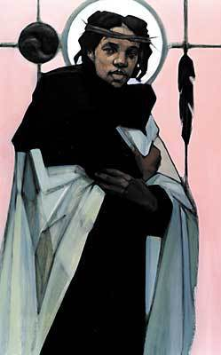
Jesus: God the Son, the
Second Person of the Trinity
Jesus was eternally begotten, incarnate.
The word consubstantial comes from the Latin words cum (“with”) and substantia (“substance”). The word describes the relationship with the Son as “one in being with” the Father.
“The Father and I are one” (John 10:30).
Jesus was born to a woman.
Jesus died a human death.
http://www.bridgebuilding.com
Notes:
[Design: This teacher’s note could also be made into an additional slide with a YawnBuster exercise asking the students to brainstorm which “I am” passages support Jesus’ divinity.]

Slide 17
Jesus: God the Son, the
Second Person of the Trinity
“I am the bread of life” (John 6:35).
“I am the light of the world” (8:12).
“I am the gate for the sheep” (10:7).
“I am the good shepherd” (10:11).
“I am the resurrection and the life” (11:25).
“I am the way and the truth and the life” (14:6).
“I am the vine, you are the branches” (15:5).
http://www.bridgebuilding.com

Slide 18

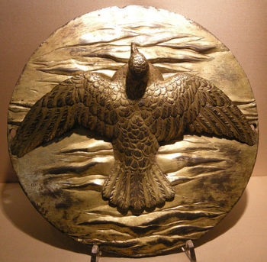
God the Holy Spirit, the Third Person of the Trinity
The Holy Spirit proceeds from the Father and the Son.
The Hebrew word ruah, meaning “wind,” may also be translated as “Spirit of God.”
“The earth was a formless wasteland, and darkness covered the abyss, while a mighty wind swept over the waters” (Genesis 1:2).
In the Old Testament, the Spirit was
the creative aspect of God.
“The Lord God formed man out of the
clay of the ground and blew into his
nostrils the breath of life, and so man
became a living being” (Genesis 2:7).
The Holy Spirit is the source of
inspiration and power.
“As he listened to this report, the spirit
of God rushed upon him and he became
very angry” (1 Samuel 11:6).

Slide 19
God the Holy Spirit, the Third Person of the Trinity (cont.)
“The Spirit of the Lord God is upon me, / because the Lord has anointed me” (Isaiah 61:1).
The Holy Spirit made God’s presence known in the community.
The Holy Spirit is the Advocate who empowers and inspires.
“And I will ask the Father, and he will give
you another Advocate to be with you
always, the Spirit of truth, which the
world cannot accept, because it
neither sees nor knows it. But you
know it, because it remains with you,
and will be in you” (John 14:16–17).

Slide 20
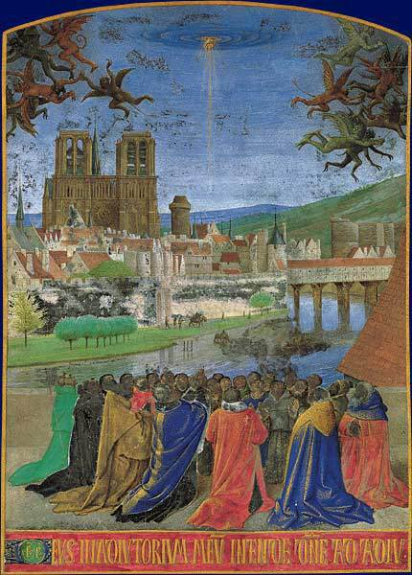
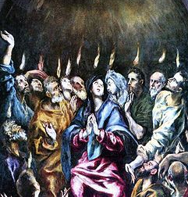
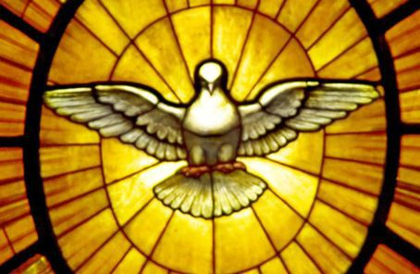
God the Holy Spirit, the Third Person of the Trinity (cont.)
Common images of the Holy Spirit:
Wind
Fire
Dove
Images in public domainV
Notes:
Notes: Ask the students to recall Scripture passages that depict each of these images. Consider Moses and the burning bush, Pentecost, Jesus’ breathing on the Apostles as a blessing, Jesus’ Baptism, and Noah and the Flood.

Slide 21
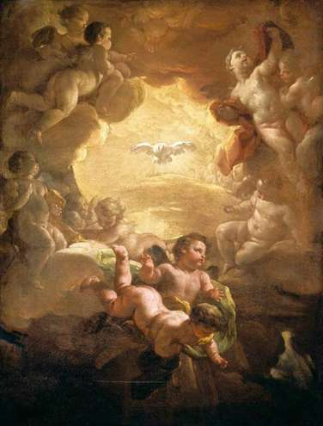
God the Holy Spirit, the Third Person of the Trinity (cont.)
Manifestation of the Holy Spirit can be seen through the
  Gifts of the Holy Spirit
  Fruits of the Holy Spirit
Image in public domain

Slide 22
God the Holy Spirit, the Third Person of the Trinity (cont’d.)
Seven Gifts of the Holy Spirit
Isaiah 11:2 describes the Gifts of the Holy Spirit:
  Understanding
  Knowledge
  Counsel
  Piety
  Fortitude
  Wisdom
  Fear (Awe) of the Lord
Notes:
Notes: Consider leading the students in a discussion on how and when they have been aware of the Holy Spirit in their lives or in the life of someone they know. If the students are preparing for the Sacrament of Confirmation, make the connection to the Gifts of the Holy Spirit and the Sacrament of Confirmation. Ask the students to make a T-chart by writing out this list and putting the name of someone they know next to the gift that is best expressed through this person. Encourage the students to share these faith stories.

Slide 23
God the Holy Spirit, the Third Person of the Trinity (cont.)
Nine Fruits of the Holy Spirit
God blesses us with positive virtues when we have opened our hearts and lives to God. These fruits are listed in Paul’s Letter to the Galatians.
  Love
  Joy
  Peace
  Patience
  Kindness
  Generosity
  Faithfulness
  Gentleness
  Self-control

Slide 24

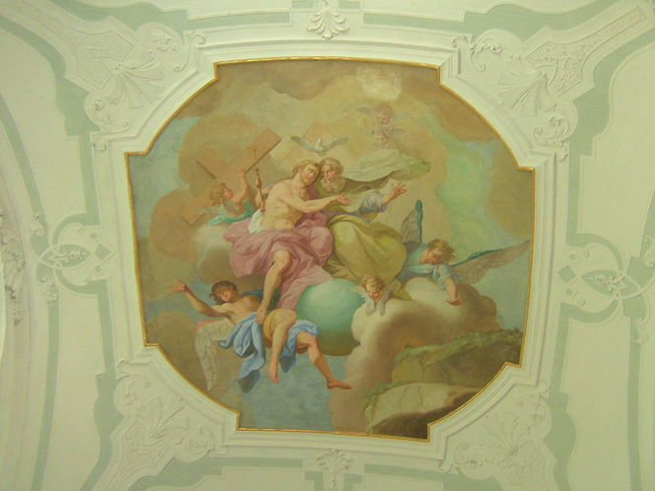
Mystery of the Trinity: God Is Three-in-One
Veni, Sancte Spiritus (“Come, Holy Spirit”)
V. Come, Holy Spirit, fill the hearts of your faithful
R. And kindle in them the fire of your love.
V. Send forth your Spirit and they shall be created.
R. And you shall renew the face of the earth.
Let us pray. O God, who by the light . . . . Amen. [Print entire prayer.]
Notes:
Notes: Invite the class to close by praying this prayer together.

