Slide 1
Finding God and Being Found by God
Document #: TX004696

Slide 2


God Invites Us to Live in Communion with Him
God constantly calls us to relationship with him.
We are invited into communion with God in order to experience the grace of his saving love.
© Leigh Prather/Shutterstock.com
Notes:
Notes: An introduction to what God desires from humans and why God chooses to reveal himself to us.

Slide 3
Finding God or Being Found by God?
“We don’t ‘find’ God, rather we find God finding us.”
– Fr. Larry Gillick, SJ
Quotation is from a free, downloadable audio retreat at onlineministries.creighton.edu/CollaborativeMinistry/AudioRetreat/AudioRetreats.html
What do you think this quotation means?
How might we find God finding us?
Notes:
Notes: Often people speak of searching for and then “finding” God. In reality, God, out of his desire for deep, loving communion with us, is relentlessly seeking every individual person, even if he or she is not aware of this seeking by God. Thus, whenever we “find” God, it is because God is already revealing himself to us in many ways throughout all of time. The answer to the second question is illustrated on the subsequent slides.

Slide 4
God Reveals Himself to Us
Search for Happiness & Meaning
The word revelation means “to unveil or disclose”
The Bible
Love
Creation
Thought & Reason
Notes:
Notes: This slide presents the five types of revelation that will be expanded on in subsequent slides. It might be interesting to have the students, individually or in groups, draw their own “image” for each. The slide is currently set to reveal “types” of revelation prior to showing the images to better facilitate this exercise.

Slide 5

God Reveals Himself To Us
How have you experienced God? Briefly describe.
Are any of these means of revelation unfamiliar to you?
Why do you think these are unfamiliar to you?
© Bragin Alexey/Shutterstock.com

Slide 6
Encountering God in the
Search for Happiness and Meaning
Songs, art, movies, literature, and poetry often speak to the human recognition that there is more to life than what is only experienced through the five senses.
We came from God and are going toward him.
Our ultimate desire is union with God.
Happiness is found only in a life fully committed to God.
How does the search for happiness help us to know God?
Notes:
Notes: A good song to illustrate this theme is “More Than This,” by Peter Gabriel. The refrain talks about the sense that there is more than what we find in the material world with our five senses. It does not name or explain the “more.”
The “How do you find God finding you” icon appears throughout. This can be a time to pause for the students to write or share orally on this reflective question as it relates to the specific form of revelation discussed on the slide.

Slide 7
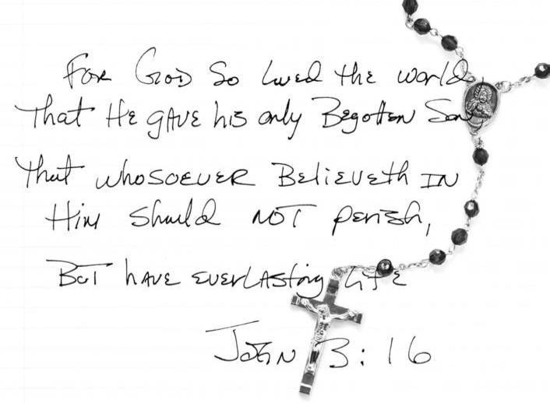
Encountering God in the Bible
The Holy Spirit inspired the Bible’s human authors in writing what God wanted to reveal for our salvation.
How does the Bible help us to know God?
© Margaret M. Stewart /Shutterstock.com
Notes:
Notes: Inspiration from the Holy Spirit means that the writers expressed the truth of God’s salvation message and the reader of the Bible can understand this truth. Thus the Bible, a written document from a specific time period, is a living document as the Holy Spirit continues to guide readers in understanding its truths.

Slide 8
Encountering God Through Love
Saint Augustine of Hippo (354–430) proposed four “objects” that we should love:
God deserves love above all created things.
Love of neighbor is inseparable from love of God.
Self-love knows God is imprinted on our hearts.
Our body is one of God’s masterpieces.
How does love help us to know God?
Notes:
Notes: An interesting exercise would be to use a concordance and find Bible passages using key words such as neighbor, self, self-love, body, and similar terms to see what the Scriptures say about these four “objects.”

Slide 9
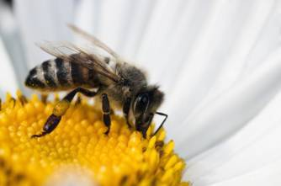
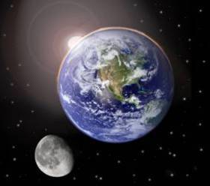
Encountering God in Creation
The Church Fathers saw God through “natural revelation” with humanity as the summit.
According to Saint Augustine, nothing created by God is insignificant, not even the tiniest insect.
© MilousSK/Shutterstock.com
© Beneda Miroslav/Shutterstock.com
How does creation help us to know God?

Slide 10
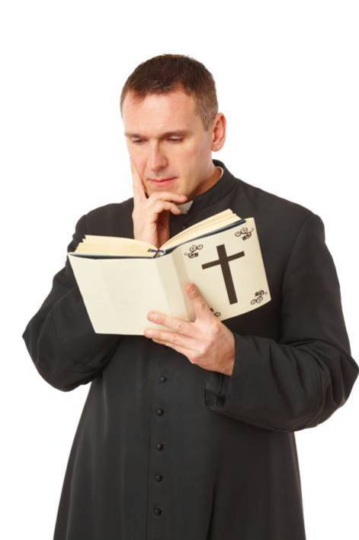
Encountering God Through
Thought and Reason
During the Middle Ages, new ways of proving the existence of God emerged.
Great thinkers held that humans could use their minds and logically develop arguments to attain truth and certainty about God and the human experience.
® Monika Wisniewska/Shutterstock.com
How does thought and reason help us to know God?
Notes:
Notes: This slide and the next three introduce students to apologetics. As this could be a difficult topic for some students, additional information can be found on Wikipedia.

Slide 11
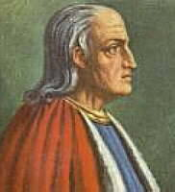
Saint Anselm of Canterbury’s Proof for the Existence of God
God is “that than which nothing greater can be thought.”
It is greater to exist in reality than to exist merely in the mind.
Therefore, God must exist in reality, not in mind and understanding only.
Public Domain
Saint Anselm of Canterbury (1033–1109)

Slide 12
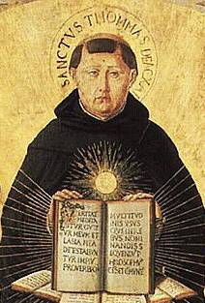
Saint Thomas Aquinas’s Five Proofs for Existence of God
First Mover – everything moves in the universe; something started the motion. The First Mover is God.
Causality – everything is caused by something else, but there must be an Ultimate or First Cause. This First Cause is God.
Public Domain
Saint Thomas Aquinas (1225–1274)
Notes:
Notes: Helping the students to understand and relate to these logical arguments for God is important. It is very likely many students have thoughts about these concepts already but not in these specific words.

Slide 13
Saint Thomas Aquinas’s Five Proofs for Existence of God
Contingency – humans cannot exist without a Necessary Being who creates all but is not created. This Necessary Being is God.
Perfection – we know perfection because there is one all-perfect being, God.
Intelligent Being – there is a remarkable order to all of creation. Because of this order, an intelligent designer must be behind the universe. This designer is God.

Slide 14

The Church Defends the Truth That God Can Be Known Through Natural Revelation
The bishops of Vatican I Council declared in Dei Filius (1870) that when people listen “to the message of creation and to the voice of conscience, [they] can arrive at certainty about the existence of God” (CCC, no. 46).
© James Peragine/Shutterstock.com

Slide 15
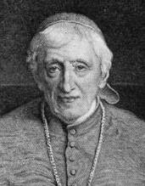
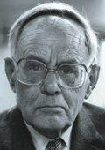
Two Great Thinkers on Natural Revelation
Courtesy of the University of Texas Libraries, The University of Texas at Austin
John Henry Cardinal Newman (1801–1890)
Karl Rahner, SJ (1904–1984)
Many “hints” point to the existence of God. When combined, they produce a powerful argument for God.
Public Domain
Anytime humans experience limitations in knowledge, freedom, or perfection, there is an awareness of God as Absolute Mystery.

Slide 16
Jesus Christ is God’s Perfect Revelation
Because God wants a deep relationship with us, he became flesh in the person of Jesus the Christ.
Jesus is the perfect image of the Father and the fullness of Divine Revelation.
The word incarnation means “to become flesh”
How can we know God through Jesus?
Notes:
Notes: This slide introduces the essential concept of the Incarnation. At this point it is important that the students understand that though the five previous methods of revelation are extremely important, the fullest Revelation of God is Jesus Christ. The students may have an incomplete answer to the question posed, but it can be used now to gauge prior knowledge and to begin to make the connection that to know Jesus is to know the Father. See John 14:8–14.

Slide 17
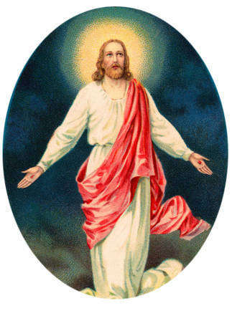
God Reveals Himself To Us
Search for Happiness & Meaning
The Bible
© Victorian Traditions/Shutterstock.com
Love
Creation
Thought & Reason
What have you learned about how God reveals himself to us?
Notes:
17

