Slide 1
The Church Is Holy
The Church
Unit 2, Chapter 5
Document #: TX005555
© 2016 Saint Mary’s Press
Living in Christ Series

Slide 2

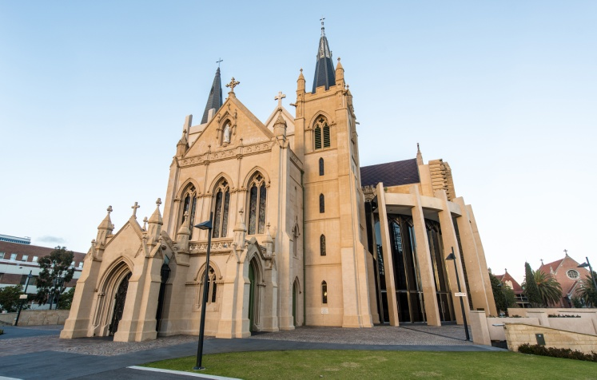
The Church’s Holiness
The Church is one but is made up of two elements, one human and one divine.
We see the human, visible reality of the Church in the people and buildings.
She also has an invisible dimension, always carrying out Christ’s mission.
© 2016 Saint Mary’s Press
Living in Christ Series
© Felix Lipov / Shutterstock.com
Notes:
Notes: Explain that the invisible dimension of the Church can be seen only with the eyes of faith. Remind the students that Jesus commissioned his Apostles to carry on his work; the Holy Spirit helps the Church to do this, despite the sins of the members.

Slide 3
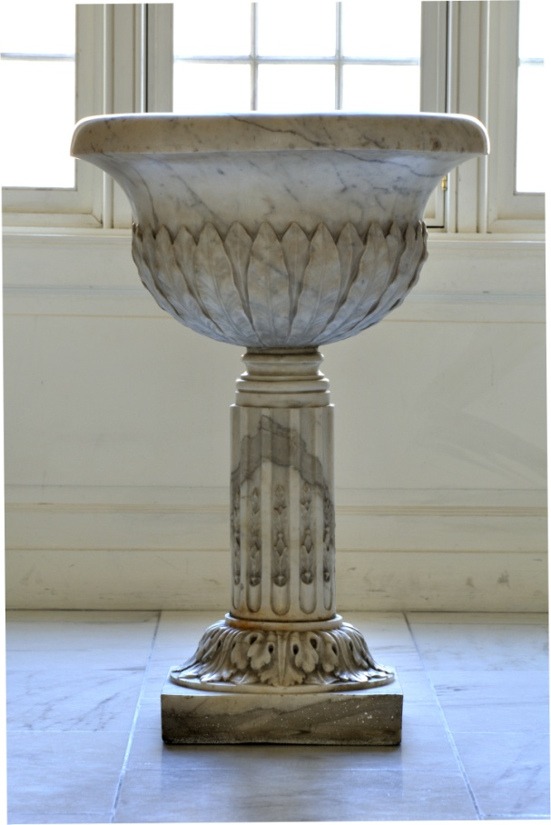
The Church: Holy Because . . .
God created her
she is united with Christ
God has given her everything that we require for salvation
© Chad Zuber / Shutterstock.com
© 2016 Saint Mary’s Press
Living in Christ Series
Notes:
Notes: Explain that the Church is God’s instrument of salvation. Ask how the Church carries out Christ’s saving work (through the Sacraments, preaching, call to community, and so on). Point out that the holiness of the Church on earth is real, but imperfect.

Slide 4

Our Call to Holiness
Christ calls all members of the Church to perfect holiness . . .
but this perfection always lies in the future.
Love is at the heart of holiness . . .
and is the principle vocation, or calling, of each person.
© wavebreakmedia / Shutterstock.com
© 2016 Saint Mary’s Press
Living in Christ Series
Notes:
Notes: Review the list of ways that we encounter the love of God, found in article 19 of the student book: in Sacred Scripture, in the Sacraments, in personal prayer, in relationships with loved ones, and in learning about the faith. Ask the students how each of these ways could lead us toward holiness.

Slide 5
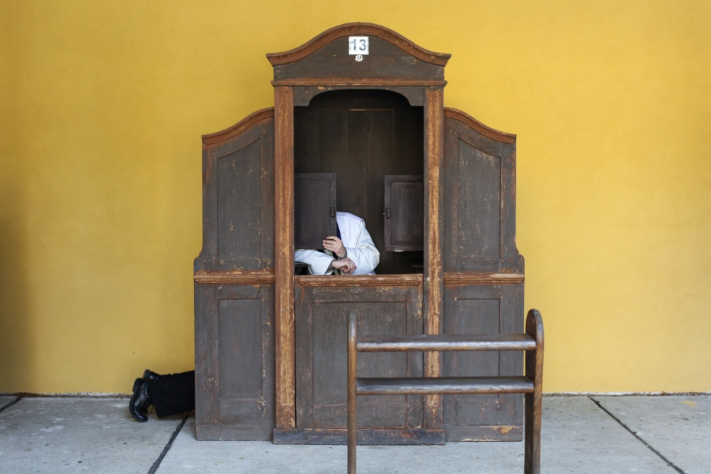
Holiness and Sinners
All of the members of the Church, including her leaders, are sinners.
With Christ and in Christ, the Church is fully focused on saving people from sin.
Repentance and conversion are important means for us to grow in holiness.
© 2016 Saint Mary’s Press
Living in Christ Series
© Martchan / Shutterstock.com
Notes:
Notes: Discuss the first and second conversions, as at the end of article 19 of the student book. Ask the students to read the second sidebar in article 19, “Pope Saint John Paul II and the Purification of Memories.” Note that admitting errors and wrongdoing, and asking for and receiving forgiveness, is a lifelong process for each individual as well as for the Church as a whole.

Slide 6
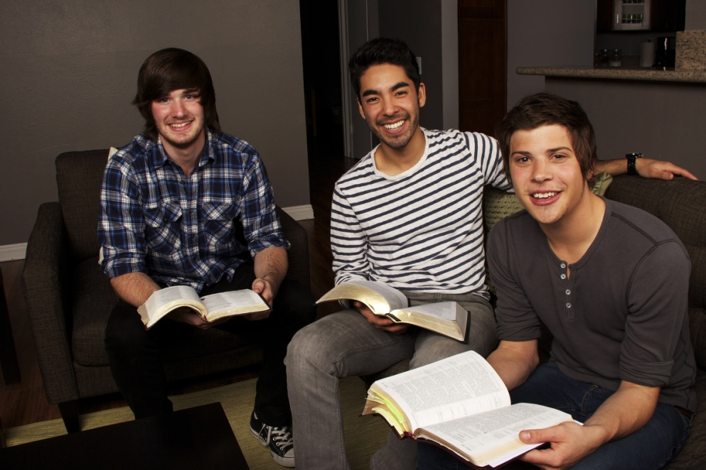
Holy through God’s Grace
Each member of the Church is called to be holy.
We make conscious choices to respond to the Holy Spirit . . .
but our holiness is the result of God’s grace, not of our human efforts.
© JHershPhoto / Shutterstock.com
© 2016 Saint Mary’s Press
Living in Christ Series
Notes:
Notes: Discuss the paradox seen in the last two bullet points. Ask why personal efforts and God’s free gift of grace work together in the lives of holy people. The next slide explores this point.

Slide 7

It’s All about Grace
God placed in our hearts the desire for God alone.
Grace enables us to avoid things that separate us from God.
How we respond to grace is up to us.
© Nikki Zalewski / Shutterstock.com
© 2016 Saint Mary’s Press
Living in Christ Series
Notes:
Notes: Point out that when we choose to cooperate with grace, we can actually contribute to the work of salvation. Ask how our own cooperation with grace can help to sanctify others and build up the Church.

Slide 8

Some Types of Grace
Sanctifying grace orients us to God and helps us to respond to his call.
It is a habitual grace, supernatural and always with us.
Actual grace is God’s intervention that comes throughout our lives.
© Lissandra Melo / Shutterstock.com
© 2016 Saint Mary’s Press
Living in Christ Series
Notes:
Notes: Share an example of actual grace, perhaps from the life of your school’s patron saint or a saint whose memorial is coming up. Or, share an example from your own life.

Slide 9
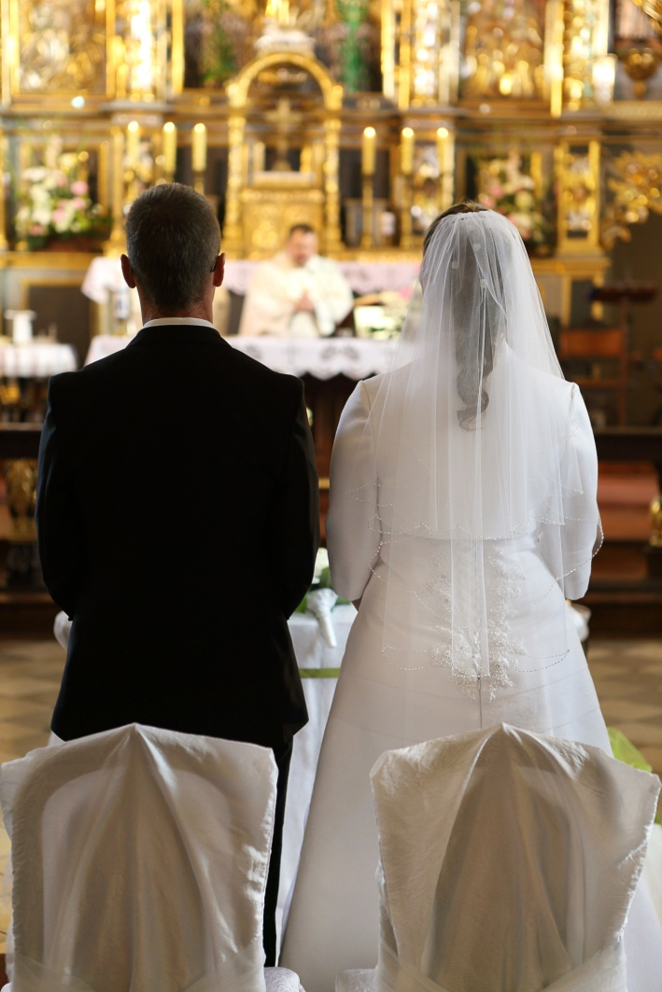
More Types of Grace
Sacramental graces are gifts that come from the particular Sacraments.
Charisms are special gifts to individuals or communities.
Graces of state help us to minister within the Church through specific vocations.
© wideonet / Shutterstock.com
© 2016 Saint Mary’s Press
Living in Christ Series
Notes:
Notes: Discuss examples of sacramental graces and graces of state, as in article 20 of the student book.

Slide 10
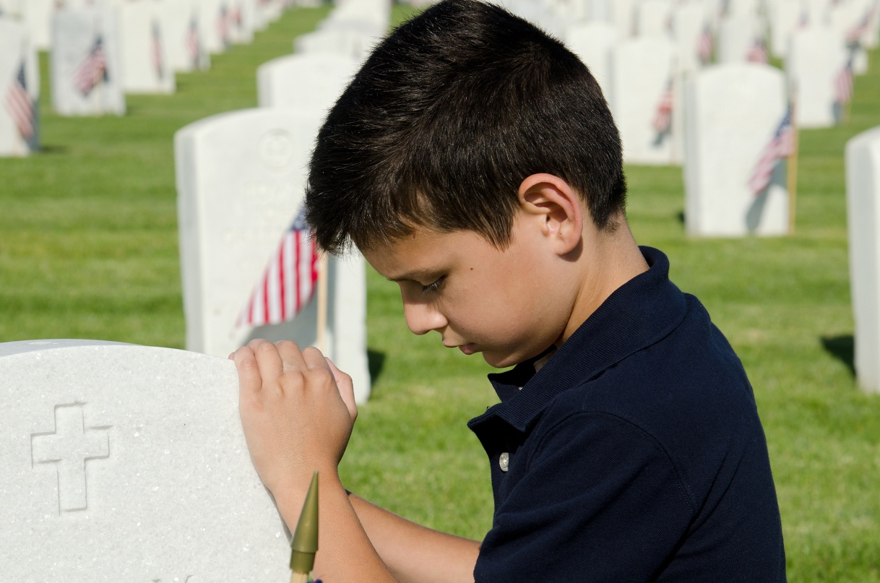
The Communion of Saints
This term refers to the Church, a communion of holy people, . . .
those living and those who are dead but alive with God.
Love, by its very nature, brings us into communion in the Body of Christ.
© John Roman Images / Shutterstock.com
© 2016 Saint Mary’s Press
Living in Christ Series
Notes:
Notes: Note the three stages of sanctification, as listed in article 21 of the student book. Ask the questions that conclude article 21, “How do those who have died benefit from your prayers? How do you benefit from theirs?” Consider sharing your answers.

Slide 11
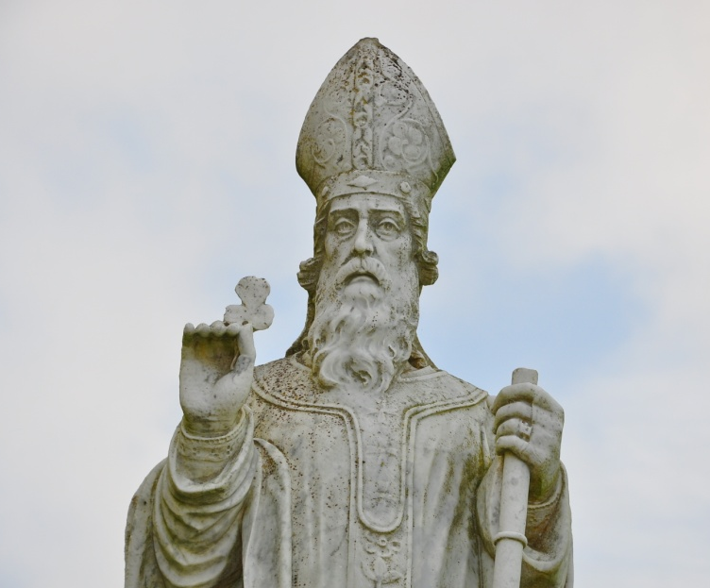
The Saints: Models and Intercessors
As models of holiness, saints encourage others.
They can pray to God on our behalf in a special way.
The Church honors saints on fixed days of the year.
© M Reel / Shutterstock.com
© 2016 Saint Mary’s Press
Living in Christ Series
Notes:
Notes: Point out the connection between the saints in Heaven and those on earth in the Eucharistic prayers, as in article 22 of the student book. Ask the questions that conclude article 22, “Have you chosen a Confirmation name based on the example of a saint? Who is the saint, and why is he or she meaningful to you?”

Slide 12
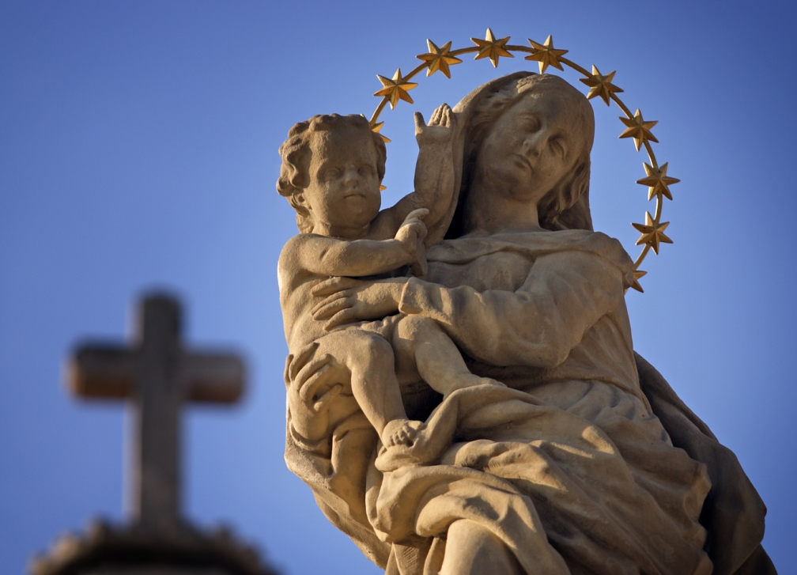
Mary’s Holiness
The Church honors Mary above all other saints.
She was born free of Original Sin and remained pure from personal sin.
Mary’s life is a model of holiness.
© OndroM / Shutterstock.com
© 2016 Saint Mary’s Press
Living in Christ Series
Notes:
Notes: Discuss some aspects of Mary’s life and character that come to mind when we say she is “full of grace.”

Slide 13
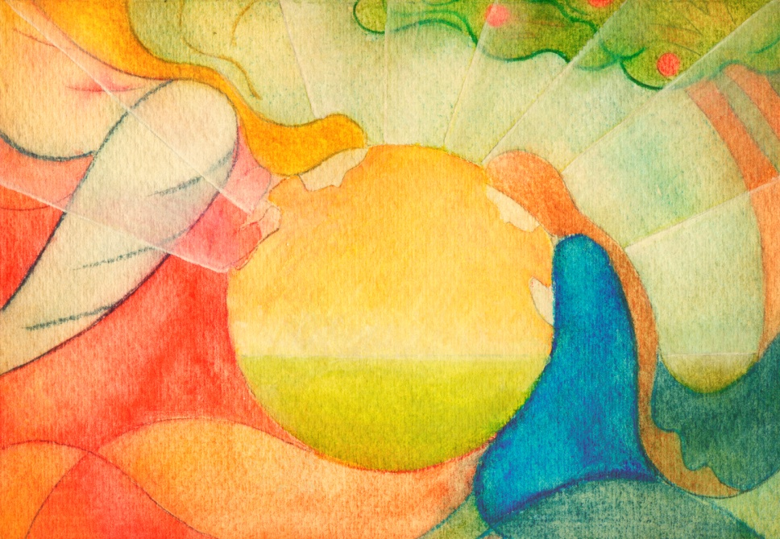
Mary’s Yes
Mary modeled the perfect response to God by saying yes to him.
The Church calls Mary the New Eve.
“The knot of Eve’s disobedience was untied by Mary’s obedience.”
© 2016 Saint Mary’s Press
Living in Christ Series
©Peter Zelei / iStock
Notes:
Notes: Explain that the knot mentioned in the last bullet point means that we were bound by sin, but have been released by Christ.

Slide 14
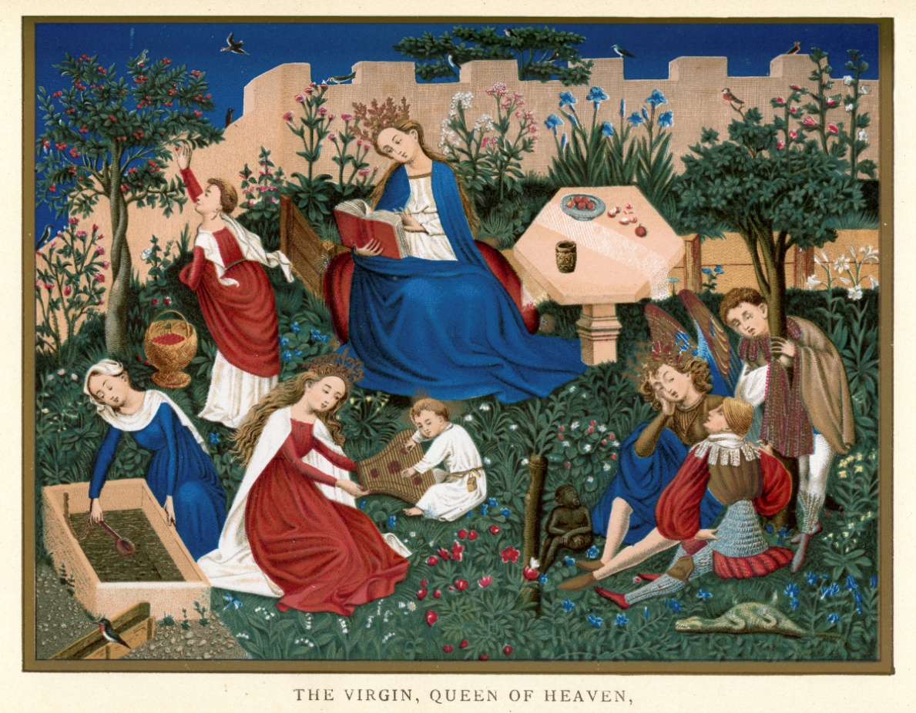
Mary Is Theotokos
Theotokos means “God-bearer.”
Mary was prepared in her own mother’s womb to be the holy Mother of God.
When Mary’s earthly life was over, she was taken up, body and soul, into Heaven.
© duncan1890 / iStock
© 2016 Saint Mary’s Press
Living in Christ Series
Notes:
Notes: Explain that Mary is the Mother of God because Jesus Christ is the Eternal Son of God who became man. Ask what the Marian feasts of the Immaculate Conception and the Assumption celebrate.

Slide 15
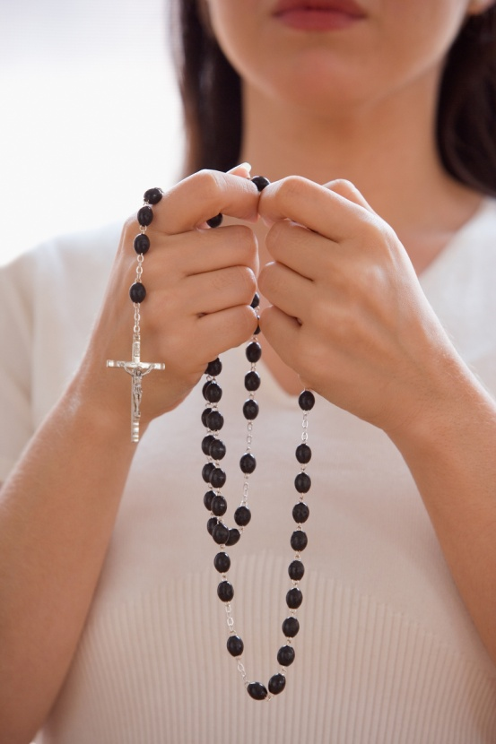
Mary, Our Mother
Mary is the Mother of the Church because of her role in God’s plan of salvation.
We know we can pray for Mary’s intercession.
Because of her assistance, we call her our Advocate, Helper, and Benefactress.
© Blend Images / Shutterstock.com
© 2016 Saint Mary’s Press
Living in Christ Series
Notes:
Notes: Sum up the chapter by reading and discussing the sidebar in article 19 of the student book, “The Desire to Be Holy.”

