Slide 1
Confirmation
The Catholic Faith Handbook for Youth, Third Edition
Chapter 19
Document #: TX003150
Notes:
Use this presentation to encourage personal sharing about the effects of Confirmation covered in chapter 19.

Slide 2
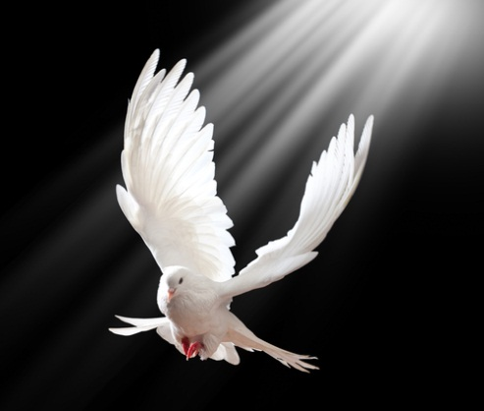
Confirmation
One of the Sacraments of Christian Initiation
Binds us more closely to the Church
Builds on the gifts already received in Baptism
Copyright: Tischenko Irina / www.shutterstock.com
Notes:
Ask the students about their own Confirmation. Have they been confirmed yet, or will they be confirmed soon? What was the experience like, or what do they look forward to?

Slide 3
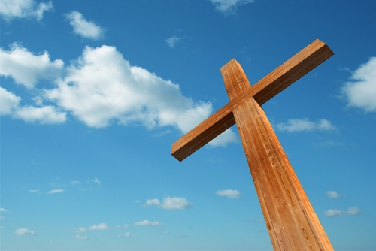
United More Firmly with Christ
We more closely identify with Jesus Christ.
We reach out to serve others in need.
Our words and actions reflect Christ acting in the world today
ACTION: Share a story about a confirmed teen that fits this description.
Copyright: design36 / www.shutterstock.com
Notes:
For this and the next five slides, line students up two-by-two, arranging the lines so that there are two circles around the classroom, with each student in the inner circle facing someone in the outer circle. Students may be widely spaced, with one group of three if there is an uneven number of students. Partners discuss the action item on the slide.

Slide 4
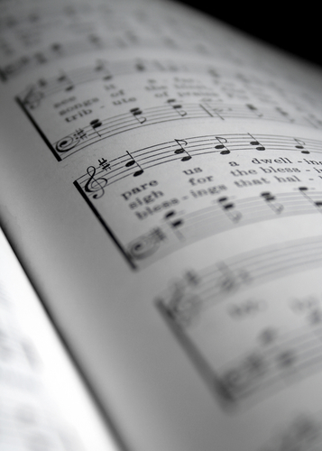
Deeper Participation in the Church
We have a desire to be active in ministry.
We are not afraid to be identified as a member of the Church.
ACTION: Discuss the reasons a teen might want to be involved in ministry.
Copyright: chris May / www.shutterstock.com
Notes:
Before showing the last statement, advance the outer circle by one or more students, so that new partners discuss the action item on this slide.

Slide 5
Strengthened to Spread and Defend the Faith
We want to share with others the joy and support we experience as members of the Church.
We are not afraid to let others know about our faith in Christ.
ACTION: Discuss ways you have seen others do this effectively.
Copyright: FuzzBones / www.shutterstock.com
Notes:
Continue advancing the outer circle by one or more students, varying the number each time.

Slide 6
Increased Gifts of the Holy Spirit
We experience a growth in the spiritual Gifts of the Holy Spirit.
The gifts help us to live holy, happy, and healthy lives.
The gifts prepare us for being of service to others.
ACTION: Discuss how the Gifts of the Holy Spirit can be helpful for teens.
Copyright: Ouverture / www.shutterstock.com
Notes:
Continue advancing the outer circle.

Slide 7
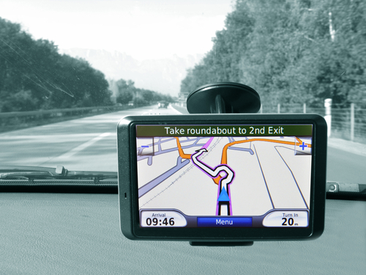
Discernment of God’s call
We believe God has a plan for us, and we ask for guidance from the Holy Spirit.
We know the Holy Spirit will guide us to the right decisions.
ACTION: Tell the story of someone you know, or someone famous, who has talked about God’s plan for her or his life.
Copyright: Pincasso / www.shutterstock.com
Notes:
Continue advancing the outer circle.

Slide 8
Stewardship
Copyright: vovan / www.shutterstock.com
We are good caretakers of the gifts of God.
We use our gifts in service of the Kingdom of God.
ACTION: Share an example of someone who has been a good steward of his or her time, treasure, or talent by sharing them with others.
Notes:
Continue advancing the circle. After the students have discussed the action item on this slide, ask them to return to their seats.

Slide 9
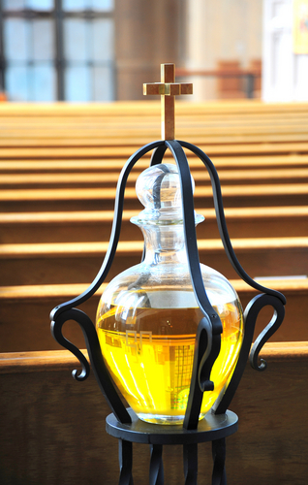
The Rite of Confirmation
Renewal of baptismal vows
Prayer for the Holy Spirit
Anointing with Sacred Chrism
Copyright: Oscar C. Williams / www.shutterstock.com
Notes:
Ask a volunteer to read the Did You Know? sidebar “Sacred Chrism,” on page 208 of the student handbook. Then ask the students to respond to the reflection question on page 211 (about Sacred Chrism).

