Slide 1

Praying the Triduum
The Paschal Mystery
Unit 5, Chapter 12
Document #: TX005443

Slide 2
The Paschal Mystery, Liturgy, and the Triduum
Our celebration of liturgies on holy days binds us together as the Body of Christ.
We celebrate God’s plan for our salvation, fulfilled through the Paschal Mystery.
Notes:
Notes: Define Liturgical Year, as found in the section “The Lord’s Day and the Liturgical Year” in article 47 of the student text. Review the major seasons as found in this section as well. Refer to the chart in the section “The Significance of the Triduum.” Remind the students that though some important days of the Liturgical Year (such as Christmas) have fixed dates, others (such as Easter) do not, so the location of the slices on the chart is an approximation.
This slide corresponds to student text content in article 47.

Slide 3
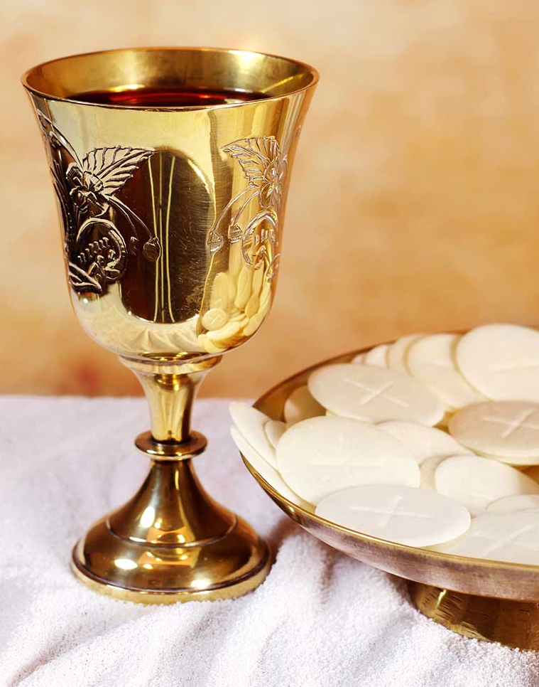
The Liturgy and the Paschal Mystery
Liturgy is the Church’s public, communal, and official worship.
The liturgy is not just a celebration of past events.
It makes the Paschal Mystery available to us now.
© Avalon_Studio / istock
Notes:
Notes: Explain the Trinitarian nature of the liturgy, as found in the section “The Liturgy and the Paschal Mystery” in article 47 of the student text.
This slide corresponds to student text content in article 47.

Slide 4

The Significance of the Triduum
Triduum literally means “three days.”
The liturgies of the Triduum form one continuous celebration.
We follow Jesus’ Paschal journey from the Last Supper to his Resurrection.
© wragg / istock
Notes:
Notes: Explain that when the days are counted beginning in the evening, as in the Jewish culture, Thursday evening to Sunday evening would be three days.
This slide corresponds to student text content in article 47.

Slide 5
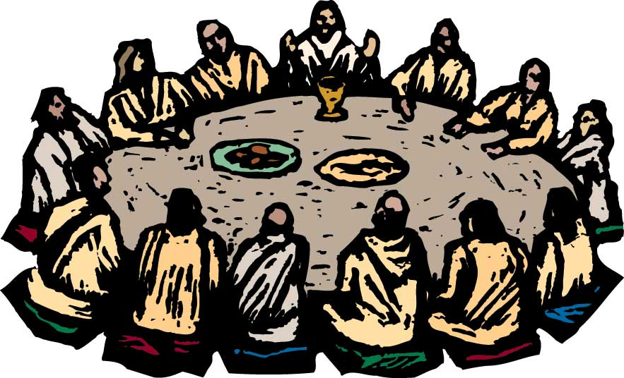
Holy Thursday
We keep watch with Jesus as we remember the final night of his earthly ministry.
We recall how Christ instituted the Eucharist at the Last Supper.
© Ron and Joe / Shutterstock
Notes:
Notes: Ask volunteers to explain the purpose of the Chrism Mass, and to identify the three oils and their uses. If you or any of the students have attended this Mass, discuss the experience.
This slide corresponds to student text content in article 48.

Slide 6
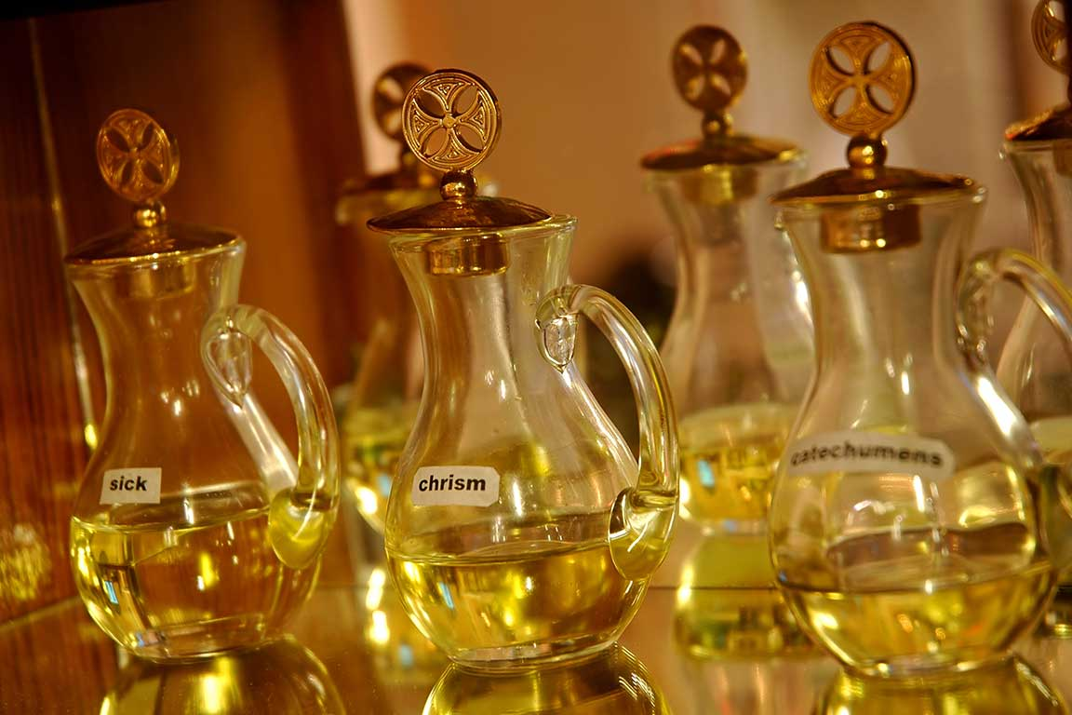
Liturgical Highlights
The presentation of the oils represents the parish’s connection with the diocese.
The washing of feet memorializes Jesus’ command to serve one another.
The dismissal of the elect inspires us to commit more deeply to Christ.
© Ezz Mika Elya / Shutterstock
Notes:
Notes: Explain that the Triduum is the last stage in the RCIA process, referred to in the last bullet point. Ask students about their experience with RCIA.
This slide corresponds to student text content in article 48.

Slide 7
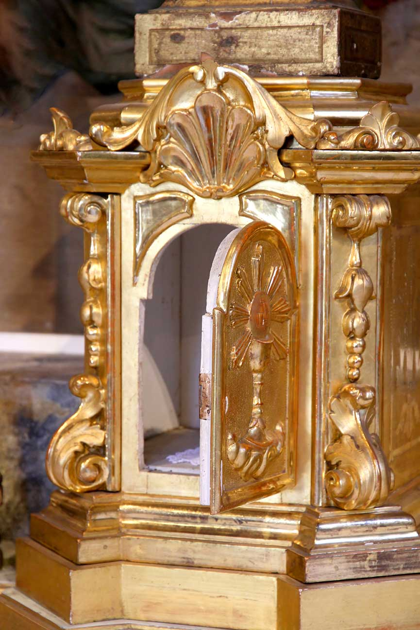
More Liturgical Highlights
The collection for the poor is a sign of sacrificial service.
The transfer of the Eucharist recalls the walk to the garden of Gethsemane.
The Paschal Fast is a sign that we turn our lives away from sin and toward God.
© ChiccoDodiFC / istock
Notes:
Notes: Explain why the Eucharist is transferred, and discuss the solemn ritual and the devotions that accompany this event, as in the section “The Transfer of the Eucharist” in article 48 of the student text.
This slide corresponds to student text content in article 48.

Slide 8
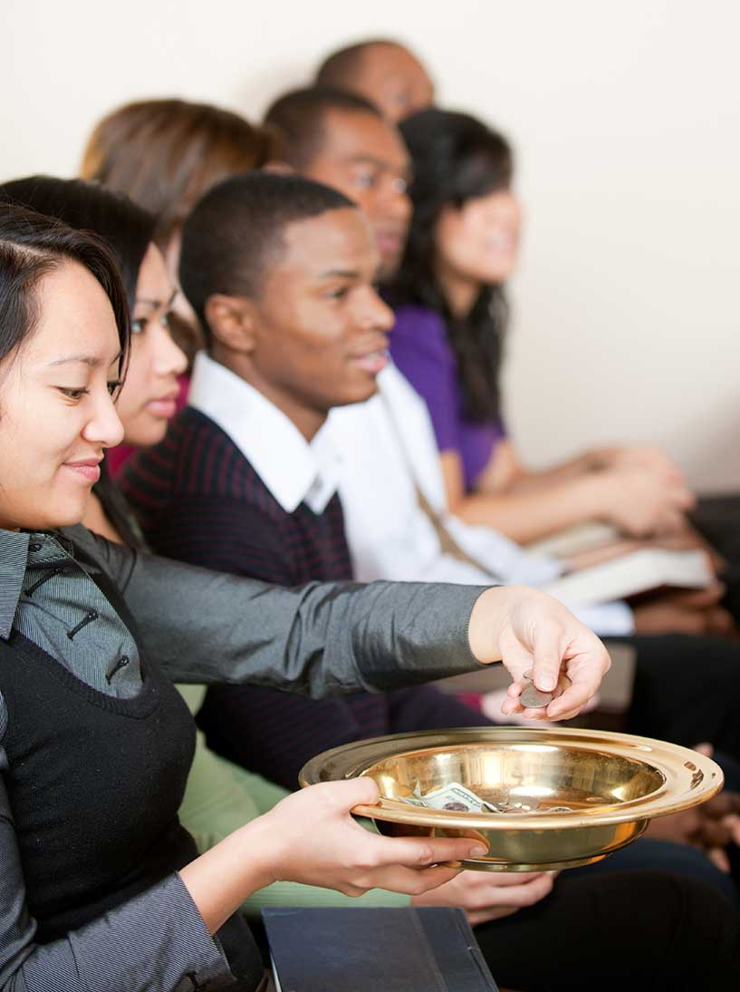
Entering into Sacred Time on Holy Thursday
Consider ways you can more fully enter into the celebration of the Paschal Mystery, beginning with Holy Thursday.
© Christopher Futcher / istock
Notes:
Notes: Direct the students to look over the suggestions in the section “Entering into Sacred Time on Holy Thursday” in article 48 of the student text. Ask, “Which of these suggestions would you like to try as a way to enter more deeply into Holy Thursday?” Consider sharing which suggestion has been most meaningful for you.
This slide corresponds to student text content in article 48.

Slide 9
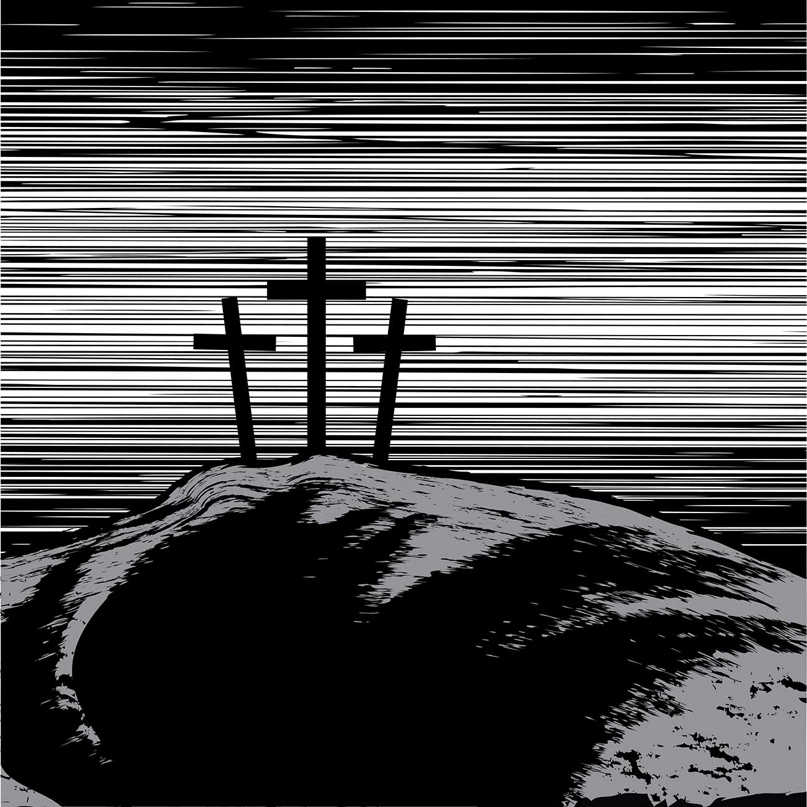
Good Friday
We remember Christ’s death, his love for us shown forth in his ultimate sacrifice.
It is both a day of sadness and a day of hope.
© CHEMADAN / Shutterstock
Notes:
Notes: Discuss the way the church looks when we enter it for the Good Friday liturgy (the altar is bare, statues are covered, the tabernacle is open and empty, and holy water fonts are empty). Ask how the appearance of the church might affect the assembly.
This slide corresponds to student text content in article 49.

Slide 10
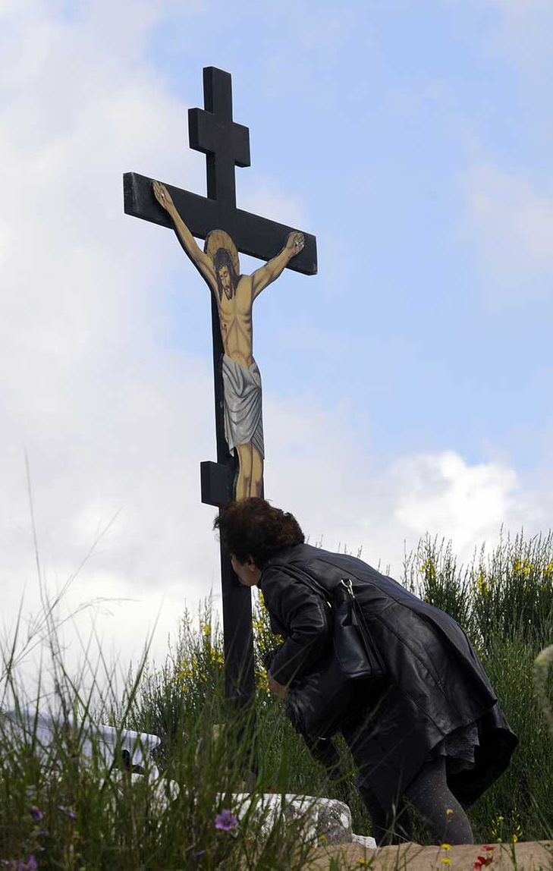
Liturgical Highlights
The Liturgy of the Word focuses on Christ’s Passion.
The intercessions ask God’s help for important needs.
The veneration of the cross shows our deep appreciation for Christ’s sacrifice.
© Kostas Koutsaftikis / Shutterstock
Notes:
Notes: Explain that the liturgy concludes with a simple Communion Rite where we receive the Body of Christ that was consecrated on Holy Thursday. Discuss the idea behind the caption for the photo in the section “The Veneration of the Cross” in article 49: to truly venerate the cross is to follow Christ’s example of loving sacrifice for others.
This slide corresponds to student text content in article 49.

Slide 11
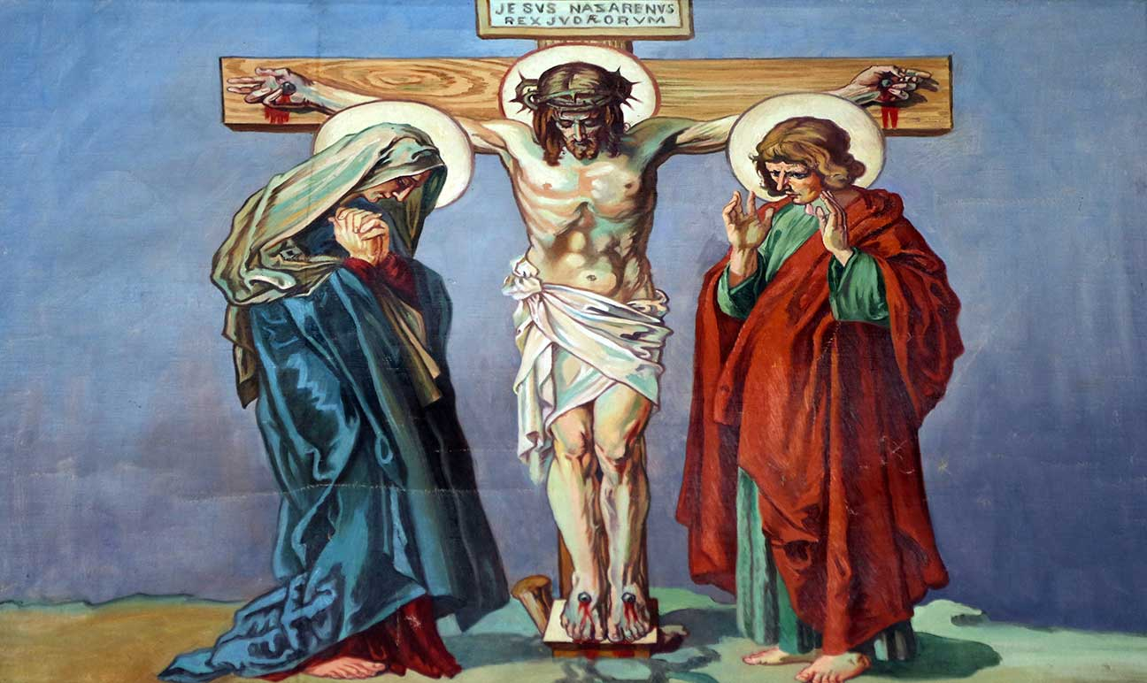
Entering into Sacred Time on Good Friday
Consider some ways you can more fully enter into the celebration of the Paschal Mystery, continuing into Good Friday.
© Zvonimir Atletic / Shutterstock
Notes:
Notes: Review the list of suggestions at the close of article 49 in the student text. Explain the practice of praying the Stations of the Cross. (See the definition in this section, and also the Did You Know? sidebar, “Walking in Jesus’ Footsteps,” in article 21.)
This slide corresponds to student text content in article 49.

Slide 12
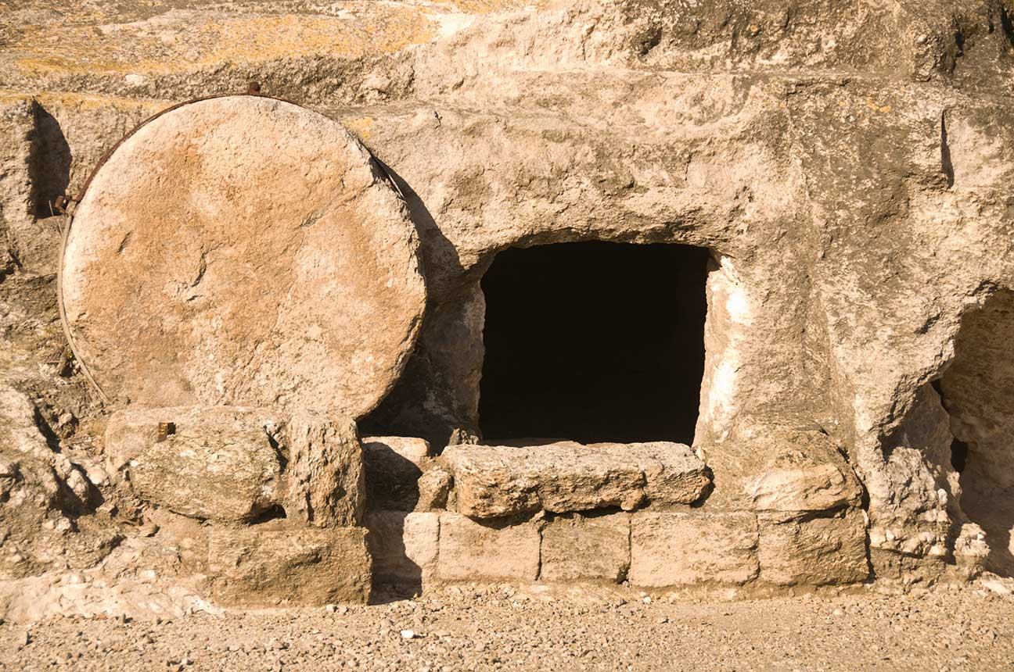
Easter Vigil
Holy Saturday is a day for reflection, meditation, and even rest.
The Easter Vigil begins our Easter celebration with many signs and symbols.
© Lokibaho / istock
Notes:
Notes: Ask volunteers to share their favorite part of the Easter Vigil. Ask how the church looks at the Easter Vigil (the church is dark before the Service of Light, but it is often filled with flowers and banners, with the liturgical color of white or gold).
This slide corresponds to student text content in article 50.

Slide 13
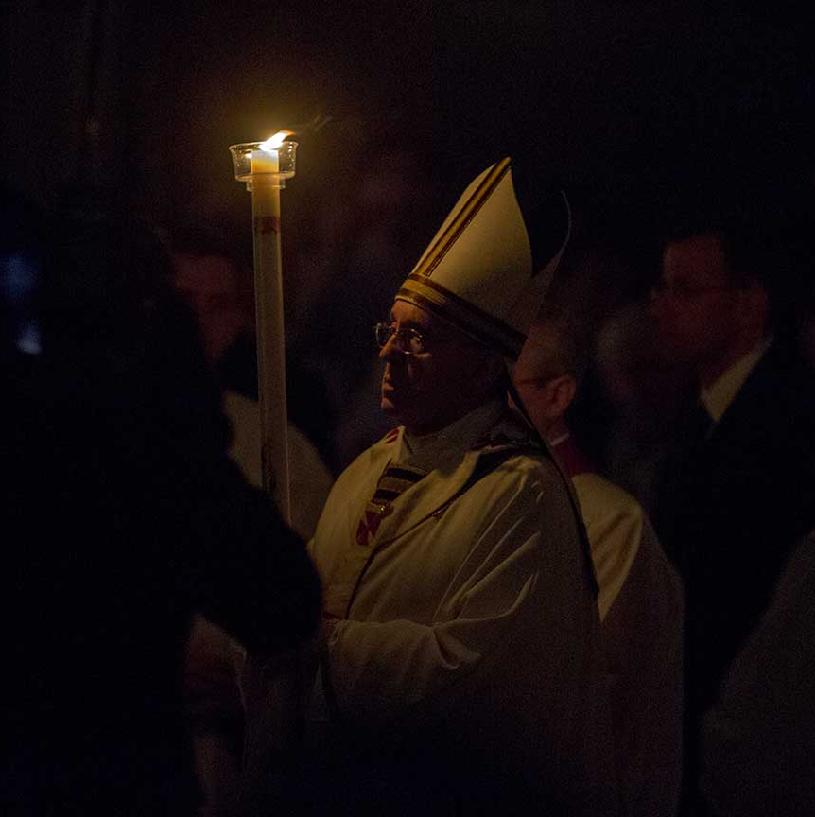
Liturgical Highlights
The Service of Light is a sign that the light of Christ has broken through the darkness of sin and death.
The Liturgy of the Word gives us an overview of salvation history.
© giulio napolitano / Shutterstock
Notes:
Notes: Consider reviewing the events of salvation history included in the readings. (See the calendar of Lectionary readings on the USCCB website.)
This slide corresponds to student text content in article 50.

Slide 14
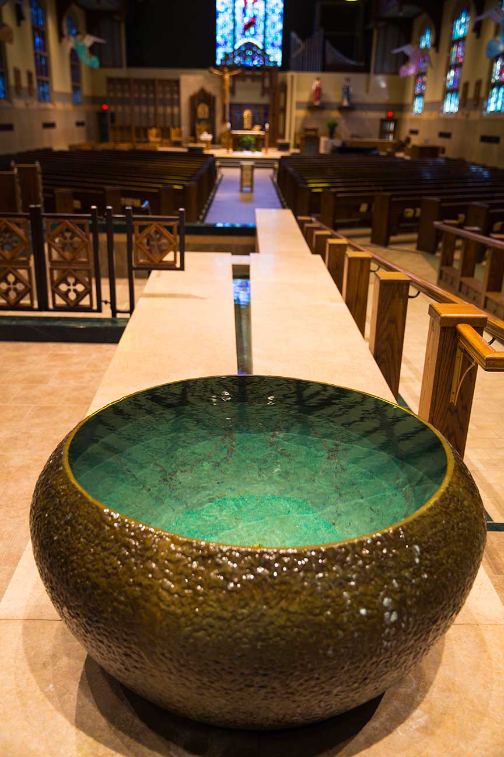
More Liturgical Highlights
The celebrations of Baptism and Confirmation renew our own faith.
The celebration of the Eucharist gives us a taste of the communion with God that awaits us in Heaven.
© Saint Mary's Press
Notes:
Notes: Point out that adults have been baptized and confirmed at the Easter Vigil since the earliest days of the Church. Help the students see the connection between Baptism (dying and rising with Christ) and Easter.
This slide corresponds to student text content in article 50.

Slide 15
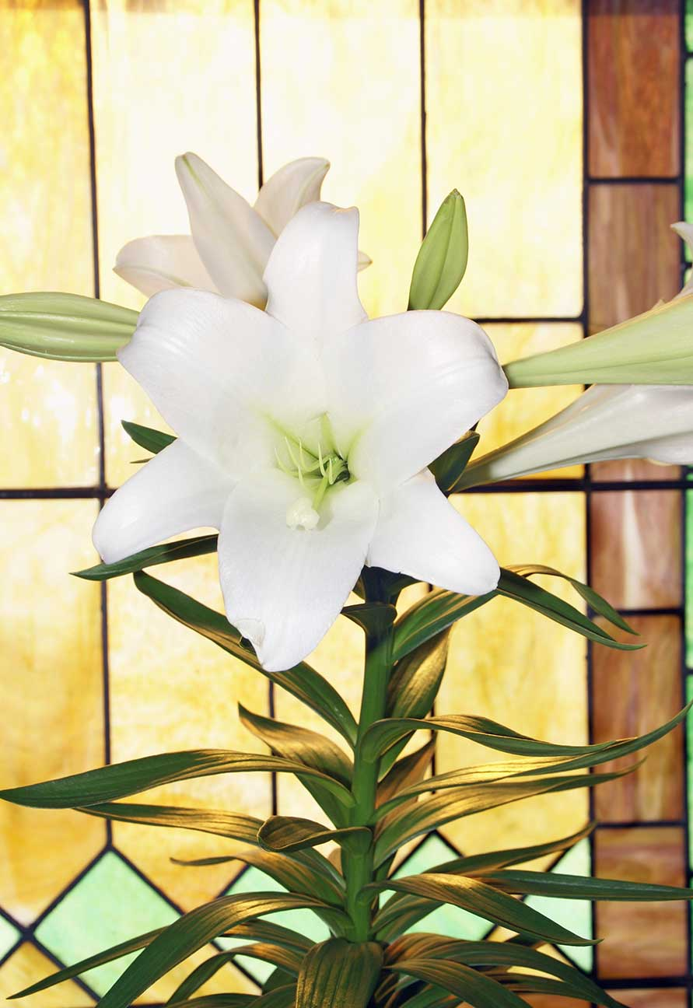
Entering into Sacred Time for the Easter Season
Consider some ways you can more fully enter into the celebration of the Paschal Mystery, culminating in the Easter Vigil and Easter Sunday.
© Cathleen Abers-Kimball / istock
Notes:
Notes: Review the list of suggestions in the section “Entering into Sacred Time for the Easter Season” in article 50 in the student text. Ask the question that concludes this section: Which of these suggestions would you like to try as a way to enter more deeply into the Easter Vigil and the Easter season? Consider sharing the suggestion that has been most meaningful for you.
This slide corresponds to student text content in article 50.

