Slide 1
The Historical Books
The Living Word: The Revelation of God’s Love, Second Edition
Unit 3, Chapter 9
Document#: TX004687

Slide 2
Sacred History
The main purpose of the historical books was not to record historical data.
These books are a sacred history that reveals God’s plan of salvation.
They begin by describing the settlement and unification of the new land.
© hidesy / iStockphoto.com
Notes:
Notes: Point out to the students that the historical books go on to describe the eventual division of the united kingdom into northern and southern kingdoms. They also portray the eventual destruction of the two kingdoms and the rebuilding of a nation after exile.
This slide corresponds to content in the chapter 9 introduction in the student book.

Slide 3
The Book of Joshua
After their Exodus from Egypt and their forty years in the desert, the Israelites finally reached Canaan, the Promised Land.
After the death of Moses, they needed a strong leader to guide them.
God commissioned the heroic and faithful Joshua.
© Richard Whitcombe / Shutterstock.com
Notes:
Notes: Point out to the students the similarities between the narratives about Joshua and Moses in article 43 in the student book. Brainstorm words or phrases to describe both men (faithful, respected, willing to take risks, etc.).
This slide corresponds to content in article 43, “The Book of Joshua: God Is on Our Side,” in the student book.

Slide 4
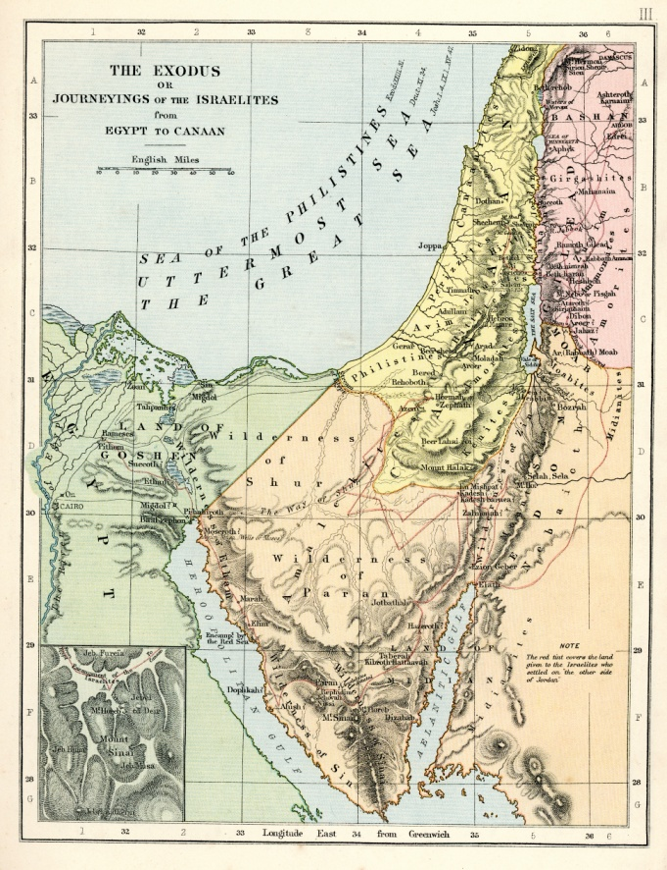
The Israelites Enter a Foreign Land
Under Joshua’s leadership, the Israelites entered Canaan.
The Israelites found Canaan to be hostile.
Joshua and the Israelite army swiftly conquered the land of Canaan.
© duncan1890 / iStockphoto.com
Notes:
Notes: Ask the students why the Canaanites were hostile to the Israelites (because of the Canaanites’ polytheistic beliefs and their refusal to hand over their land).
This slide corresponds to content in article 43, “The Book of Joshua: God Is on Our Side,” in the student book.

Slide 5
Rahab: Figure of Faith
Rahab, a prostitute, helped the Israelites in their conquest.
Rahab’s role in salvation history is mentioned several times in the New Testament.
She is an example of how God can work through anyone.
© Armin Staudt / Shutterstock.com
Notes:
Notes: Recount with the students the account of Rahab’s response to the Israelite spies when their lives were in danger (see Joshua, chapter 2).
This slide corresponds to content in article 43, “The Book of Joshua: God Is on Our Side,” in the student book.

Slide 6
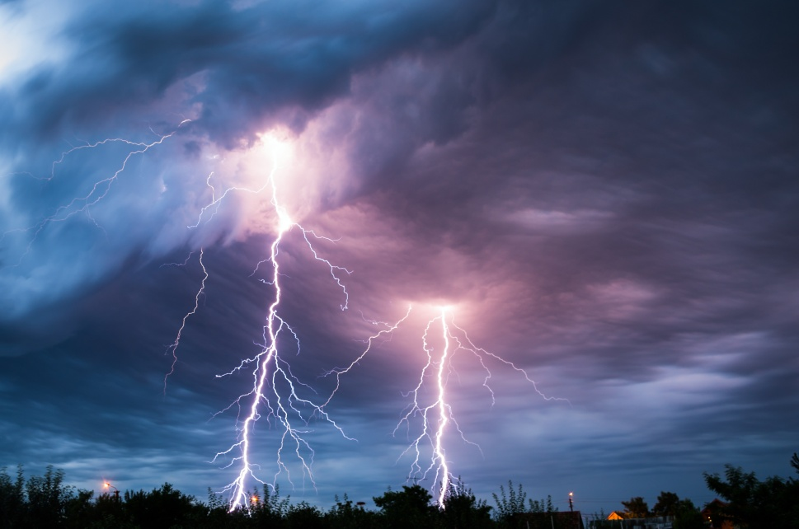
God as Warrior
The Book of Joshua presents God as a warrior waging a holy war.
Thinking of God as warrior provided the Israelites with a sense of security.
Their warrior God had freed them from Pharaoh and would now lead them into battle.
© Mihai Simonia / Shutterstock.com
Notes:
Notes: Ask the students to name situations where it might be helpful to think of God as a mighty warrior, helping to win a battle (in cases of addiction, illness, adversity, etc.).
This slide corresponds to content in article 43, “The Book of Joshua: God Is on Our Side,” in the student book.

Slide 7
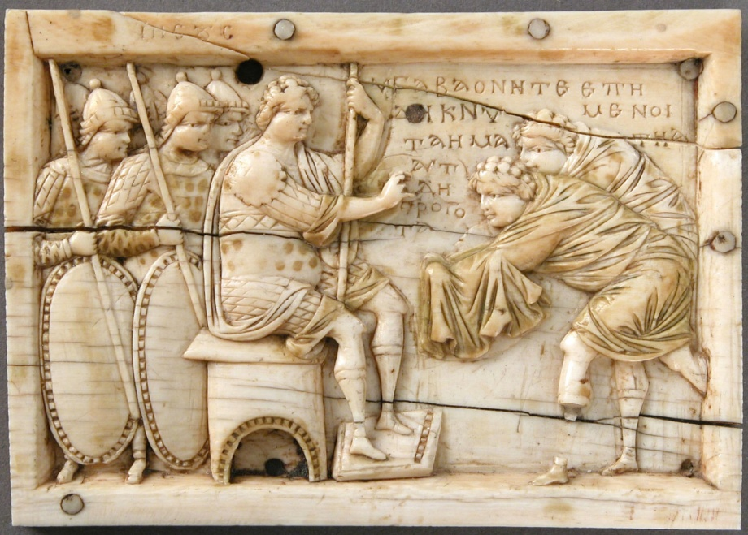
Joshua: Warrior and Faithful Leader
Joshua was a strong military leader.
He was devoted to God.
In the Book of Joshua, we learn that God stands firm against the wicked ways of the world.
The Metropolitan Museum of Art, Gift of J. Pierpont Morgan, 1917
Notes:
Notes: Point out to the students that Joshua’s name means “salvation of God.” Explain that in remaining faithful to God, Joshua demonstrated to the Israelites that when they remain true to the covenant, God will bless them abundantly.
This slide corresponds to content in article 43, “The Book of Joshua: God Is on Our Side,” in the student book.

Slide 8
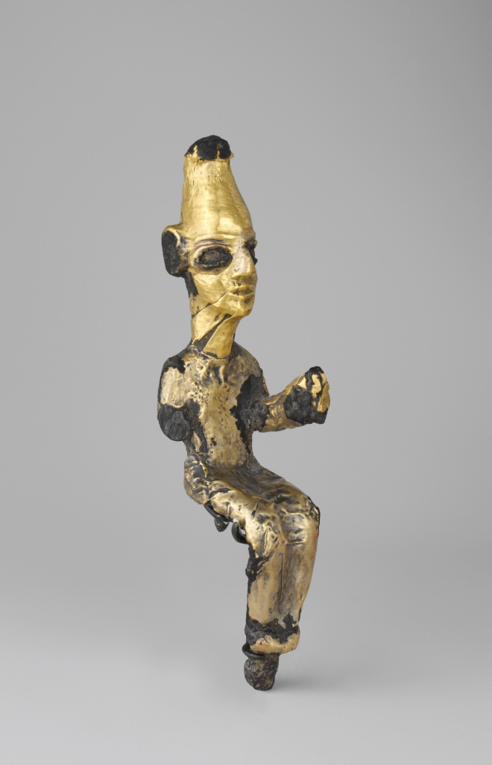
A Cycle of Sin
After the death of Joshua, the Israelites fell into a cycle of sin.
When Israel forgot the covenant, their neighbors dominated them.
Israel repented, and God introduced a hero to lead the people from destruction.
The Metropolitan Museum of Art, Gift of George D. Pratt, 1932
Notes:
Notes: Ask the students this question: From what you know of human nature, why might the Israelites have found it difficult to remain true to the covenant with God?
This slide corresponds to content in article 44, “Judges: The Book of Deliverers,” in the student book.

Slide 9
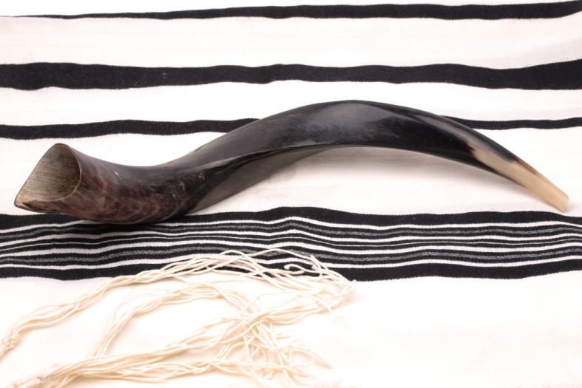
Judges: The Book of Deliverers
Judges led Israel up to the rise of the monarchy, from 1200 to 1000 BC.
The Book of Judges offers short accounts of these leaders.
Even though the fidelity of some judges wavered, God’s will was accomplished.
© Mordechai Meiri / Shutterstock.com
Notes:
Notes: Ask the students to explain the role of judges in the Old Testament (both judicial and military).
This slide corresponds to content in article 44, “Judges: The Book of Deliverers,” in the student book.

Slide 10
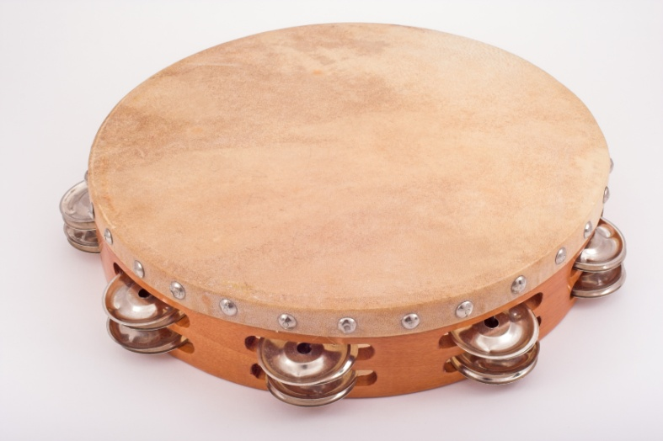
Three Judges
After she led the Israelite army to victory, Deborah broke into song.
Gideon stopped worshipping foreign gods and turned to the one true God of Israel.
Samson was a strong, passionate man who delivered Israel from its enemies.
© Arturo Limon / Shutterstock.com
Notes:
Notes: Point out to the students that the judges acted as a conscience for the Israelites, reminding them to be faithful to their covenant with God.
This slide corresponds to content in article 44, “Judges: The Book of Deliverers,” in the student book.

Slide 11
From Saul to Solomon: The Desire for Unity
The Israelites demanded a king.
Samuel, the last judge of Israel, feared that the Israelites wanted to replace God with a king.
He warned of the danger of a king.
© Natykach Nataliia / Shutterstock.com
Notes:
Notes: Share with the students some of the dangers outlined by Samuel in 1 Samuel 8:11–18. Ask if they agree with Samuel’s assessment of earthly leaders.
This slide corresponds to content in article 45, “From Saul to Solomon: The Desire for Unity,” in the student book.

Slide 12
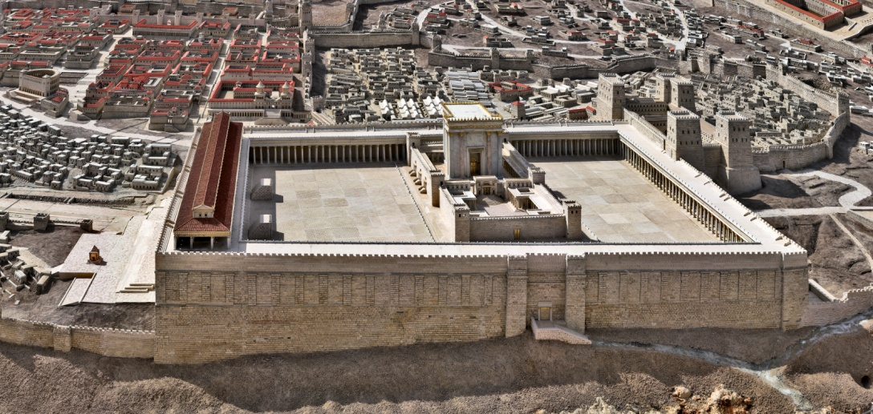
Samuel, David, and Solomon: The First Kings
Saul was Israel’s first king, but his rule ended tragically.
David was a visionary leader and a repentant sinner.
Solomon built the temple in Jerusalem but turned to foreign idols.
© karambol / iStockphoto.com
Notes:
Notes: Explain to the students that these kings were able to accomplish great things when they were faithful to God. Ask how the ego or self-interest of modern-day leaders can stand in the way of what is good and holy.
This slide corresponds to content in article 45, “From Saul to Solomon: The Desire for Unity,” in the student book.

Slide 13
David, the Man
King David united the northern and southern tribes.
He was a skilled musician and military leader.
David’s close friendship with Jonathan, son of King Saul, shows his tender side.
text
© piola666 / iStockphoto.com
Notes:
Notes: Ask the students to recall highlights of the David and Goliath narrative. Ask about details showing David’s complete trust in God.
This slide corresponds to content in article 46, “David: Recognizing a Servant,” in the student book.

Slide 14
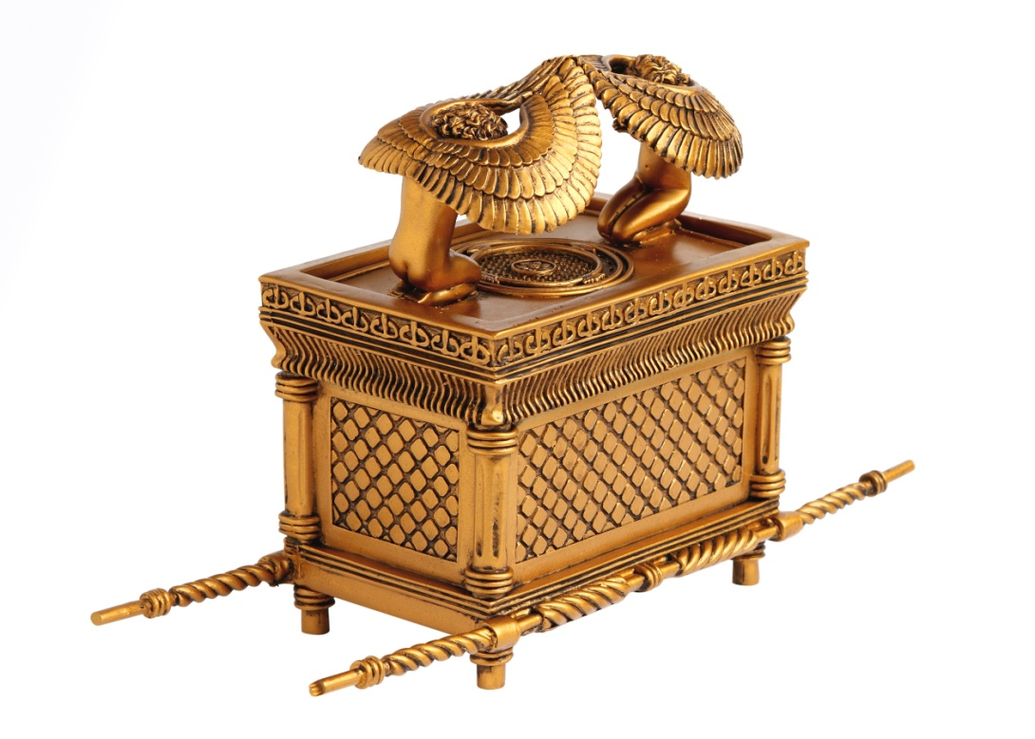
David’s Love of God
David fell prey to sin but returned to the Lord with a repentant heart.
He danced before the Ark of the Covenant, demonstrating his joy in God.
As a leader, he recognized his need for God’s strength.
© George Dukinas / dollarphotoclub.com
Notes:
Notes: Ask the students for a definition of servant leadership (found in article 46 in the student book). Ask volunteers to describe a modern-day servant leader whom they admire—either someone they know personally or someone they have read about.
This slide corresponds to content in article 46, “David: Recognizing a Servant,” in the student book.

Slide 15
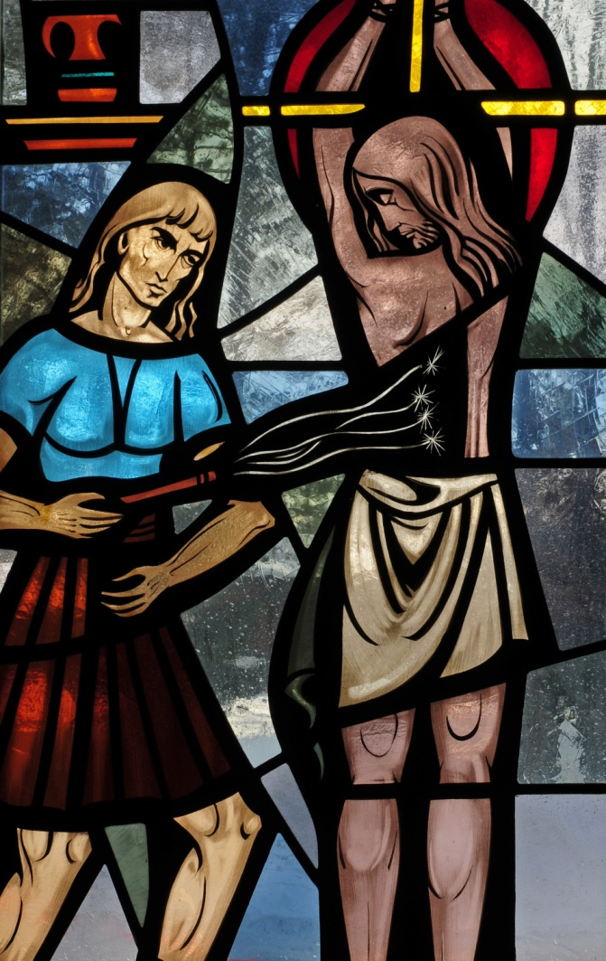
The Davidic Covenant
God promised to build a royal dynasty.
The house of David would endure forever.
We see this promise fulfilled with the birth of Jesus Christ.
© Nancy Bauer / Shutterstock.com
Notes:
Notes: Discuss with the students how Jesus demonstrated servant leadership.
This slide corresponds to content in article 46, “David: Recognizing a Servant,” in the student book.

Slide 16
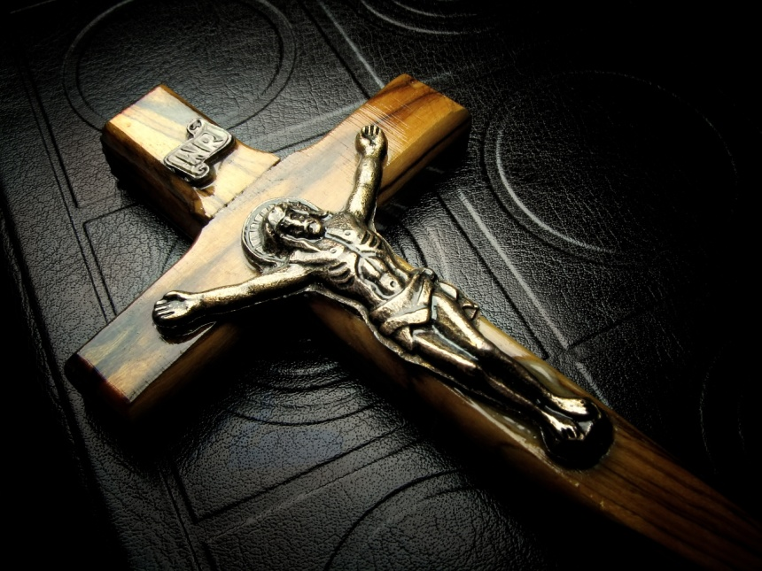
Another King, Yet Unborn
God’s promise to David led to the Jewish expectation of a Messiah.
The Gospels of Matthew and Luke trace Jesus’ ancestry through David.
Jesus’ royal leadership was of a different sort than the traditional image of a king.
© Andrii Ospishchev / Shutterstock.com
Notes:
Notes: Explain to the students that when Jesus was born, many Jewish people were waiting for a descendant of David to liberate them from the power of their Roman overlords.
This slide corresponds content in article 46, “David: Recognizing a Servant,” in the student book.

