Slide 1
God’s Call in the New Testament
Vocations, Unit 1

Slide 2
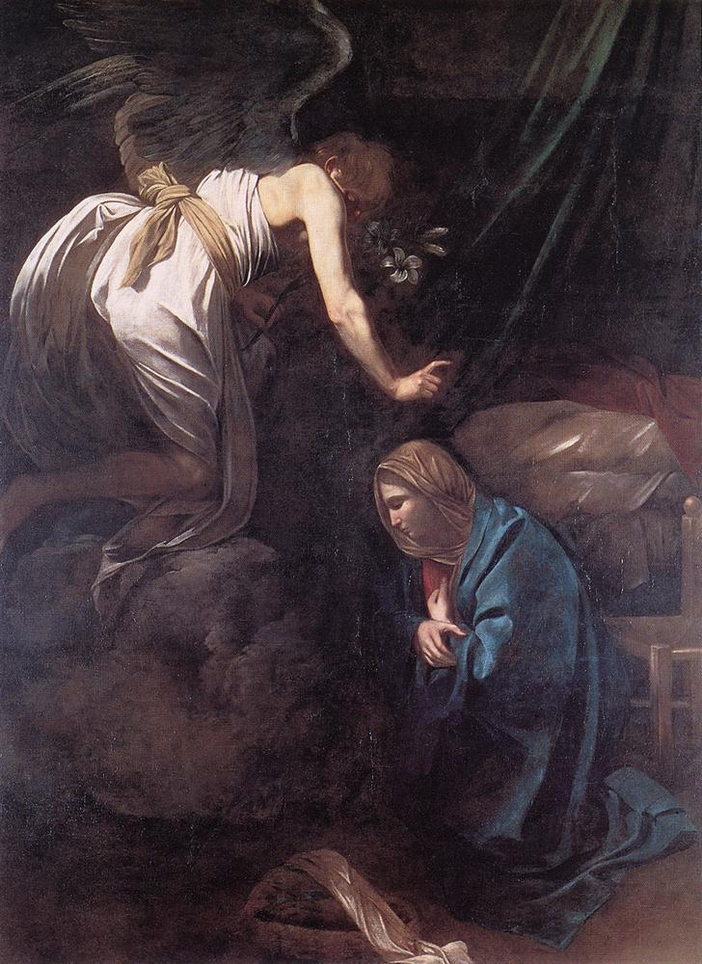
The Annunciation
Image in public domain
Notes:
Teacher Notes: Have a student read the story of the Annunciation (Luke 1:26–38) as you show slide 2, which is an artistic rendering of the Christian mystery of the Annunciation. After the reading, ask the students what they see in this image. Invite the students to answer; do not comment on their answers.
Image: Michelangelo Merisi da Caravaggio - The Annunciation - WGA04191.jpg, wikimedia commons

Slide 3
The Annunciation (continued)
Who conveys God’s invitation to its appointed destination?
What is Gabriel’s status in this Scripture account?
Why Mary?
Notes:
Answer 1: The angel Gabriel, one of the Archangels, mediated God’s invitation. One of the primary roles of angels in Scripture is to deliver God’s messages to humans.
Answer 2: Gabriel clearly has a high status as one of God’s most important emissaries.
Answer 3: Allow the students to speculate on answers such as Mary’s goodness and holiness, her willingness to do God’s will, perhaps her deep desire for the coming of the Messiah to her people.

Slide 4
The Annunciation (continued)
From whom does the invitation to Mary come?
What difference would it have made to the Jewish people at this time if they had known that the invitation comes from God?
Notes:
Answer 1: The invitation comes from the God of all creation: the God of Abraham, Moses, David, and the prophets.
Answer 2: There had been speculation among the Jewish people that the present age would be the time of the promised Messiah. Also, such an invitation to a young virgin such as Mary would have no credibility if it were not from God.

Slide 5
The Annunciation (continued)
To which country and people is this invitation sent?
What could be important about a little country that is about the size of Rhode Island?
Notes:
Answer 1: The message is clearly for Mary of Nazareth, who lives in a tiny town in northern Israel, but it is also a message of hope for Israel.
Answer 2: Though the country of Israel is small and seemingly insignificant, God chose its people as his own.

Slide 6
The Annunciation (continued)
What would a young Jewish girl’s social status have been in the first century?
How does Mary respond to the Angel Gabriel’s greeting and invitation?
Why is Mary afraid?
Notes:
Answer 1: Mary is a virgin and therefore an unmarried, childless woman. Women had no social status apart from their husbands. They were never considered to be valid public witnesses.
Answer 2: Most striking about Mary’s response to Gabriel’s invitation to her to bear God’s Son is her unconditional “yes.” It is important to note that she was also afraid.
Answer 3: Mary certainly must have experienced a great sense of awe and wonder at what was happening to her. She had no human “categories” to explain her experience, yet she responded in humility and, while visiting her cousin Elizabeth, identified herself with the poor and powerless in her prayer of praise—the Magnificat.

Slide 7
The Annunciation (continued)
What makes this story so strikingly unusual?
Which elements of a “call story” are present in this account?
Notes:
Answer 1: In the story of the Annunciation, God chooses a person who would seem to be among the least likely to become one of his most powerful witnesses; Mary truly becomes a first Apostle. Mary becomes the vehicle through which God makes his presence and salvation known to the world. No one else could surpass Mary as a witness to God’s love, and there could be no greater honor bestowed on any human being.
Answer 2: All of the elements are present: Mary is completely open to God; she experiences herself being called by name for a special purpose; she is scared and, no doubt, thrilled; she is “troubled” (Luke 1:29, NABRE) and questions Gabriel; and her call is fully validated through her Son, Jesus, and his life, death, and Resurrection.

Slide 8
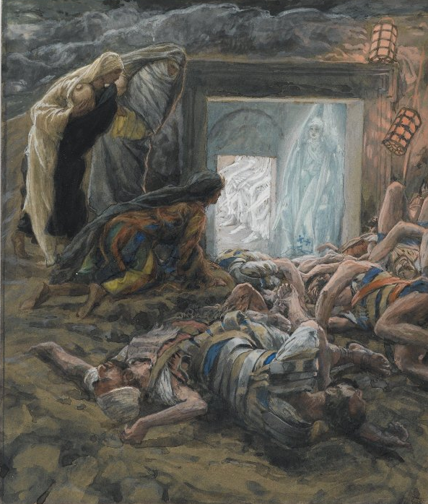
The Call of Mary Magdalene
Image in public domain
Notes:
Teacher Notes: Ask a student to read John 20:1–18, the call of Mary Magdalene, as the class views the image on the screen. Invite the students to comment on what they see in the image.
Image: File: Brooklyn Museum - Mary Magdalene and the Holy Women at the Tomb (Madeleine et les saintes femmes au tombeau) - James Tissot.jpg, wikimedia commons

Slide 9
The Call of Mary Magdalene (continued)
As this Scripture account begins, what is Mary Magdalene doing?
How does Mary Magdalene know who is offering her an invitation?
Notes:
Answer 1: Mary has accompanied Simon Peter and another disciple to the tomb of Jesus and discovered the empty tomb with only the burial cloths of Jesus. Mary remained behind, weeping, while the disciples returned home.
Answer 2: When Mary, thinking Jesus is the gardener, asks him where Jesus is, Jesus calls her by name.

Slide 10
The Call of Mary Magdalene (continued)
What does Jesus ask Mary Magdalene to do?
How does Mary Magdalene respond?
Notes:
Answer 1: Jesus asks Mary to return to the other disciples and tell them that Jesus has risen and is returning to his heavenly Father.
Answer 2: Mary did as Jesus asked and proclaimed the Good News to them; her message was validated as the resurrected Jesus appeared to other disciples as well.

Slide 11
The Call of Mary Magdalene (continued)
Do you find anything unusual about this story?
Which elements of a “call story” are present in this Scripture account?
Notes:
Answer 1: It is unusual that a first witness would be a woman in a time when women were not allowed to be official public witnesses. Yet Mary Magdalene witnessed the Good News of Jesus’ Resurrection and became known in the early Church as “apostle to the apostles.”
Answer 2: Although some of the elements are more subtle in this story, all are present: Mary Magdalene is completely open as she asks where Jesus has been moved, she experiences Jesus actually calling her by name, Mary’s emotions shift from extreme sadness to extreme exhilaration, and her witness to the Good News of Jesus’ Resurrection is validated.

Slide 12
The Call of Mary Magdalene (continued)
What is new in your understanding of God’s call?
Is God’s call always dramatic?
What do you think God’s call to you today would be like?
Notes:
Teacher Notes: Invite the students to answer these three questions. Answers will vary, but confirm that God’s call is not always dramatic. Most often we are led by small steps or “nudges” that we find hard to ignore.

