Slide 1
The Dominican Missionaries in the Spanish Colonial Period
Church History, Unit 5

Slide 2
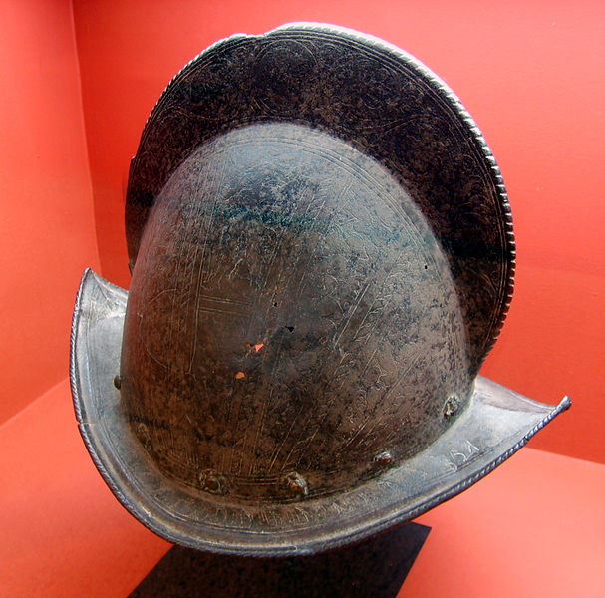
During Spain’s colonization of Latin America, the Spanish instituted the system of encomienda.
Spain granted colonists control over the Native American peoples living on a plot of land in Latin America.
The Spanish colonists—called encomenderos—were allowed to use the parcel of land and could require its native inhabitants to pay tribute.
Image in public domain

Slide 3
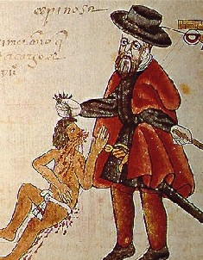
The tribute required from the
Indians usually took the form of
labor on plantations and in the
mines built by the Spanish,
although some native groups
were able to pay tribute in gold
or other goods.
In return the encomenderos
were supposed to care for the
Indians by protecting them from
external threats and converting them to Christianity.
In practice, however, the encomienda system became little more than a form of slavery.
Image in public domain
Notes:
Image: Part of the Codex Kingsborough, an indigenous Mexican complaint against an abusive encomendero.

Slide 4
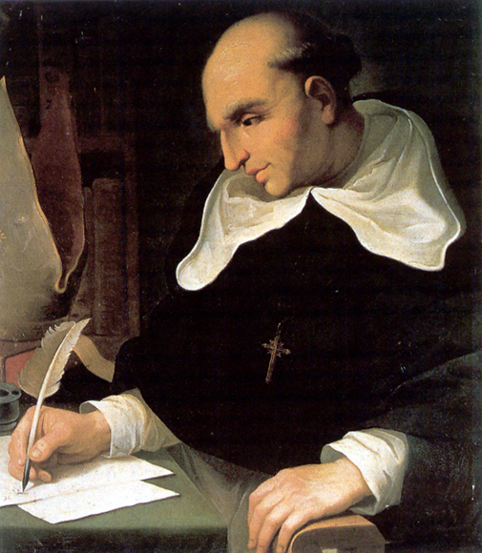
Dominican friars were among the most outspoken defenders of the Indians who were subject to the abusive encomienda system.
Bartolomé de las Casas (1484–1566) was one Dominican friar who devoted his life to defending the Indians.
Image in public domain

Slide 5
Las Casas was a former encomendero who became a Dominican priest after witnessing the harm caused to the native peoples for the sake of colonization.
He tried to end slavery and the
system of encomienda.
He argued that the native
peoples were fully human
and that it was sinful to
subjugate and abuse
them.
Image in public domain

Slide 6
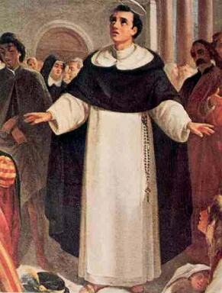
The Dominicans, led by Las Casas, spread the message that the missionaries would win many more converts to Christianity if they treated the Indians with respect and dignity.
Image in public domain

Slide 7
In 1542 Las Casas wrote his influential Brief Narrative of the Destruction of the Indians
detailing how the Spanish abused and decimated the native peoples of Latin
America through
violent conquest,
forced labor, and
unfair treatment.
Image in public domain

Slide 8
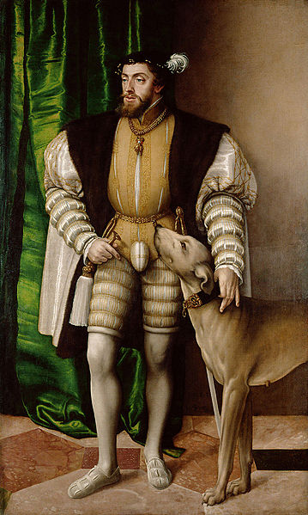
Because of the advocacy of Las Casas and others, in 1542 King Charles V of Spain established the “New Laws” governing the treatment and protection of the native peoples in Spanish colonies in Latin America.
Image in public domain
Notes:
Image: Portrait of King Charles V with his English Water Dog (1500–1558), date 1532

Slide 9
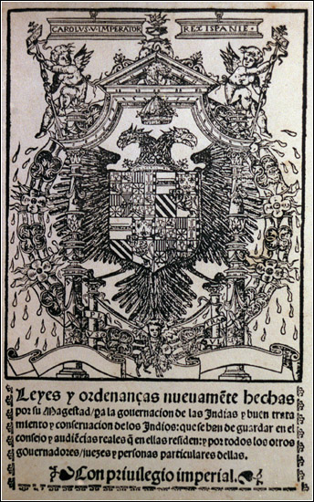
The New Laws defined the Indians
as free people who could not be
enslaved.
If the Indians worked on the land,
the colonists were required to pay
them wages, which the Indians
could then use to pay tribute.
In practice the New Laws were not
widely adopted in the colonies.
They were gradually weakened by later changes.
Although today they are considered unsuccessful, the New Laws did help protect and liberate many native workers in the New World.
Image in public domain

