Slide 1
We Respond through a Life of Discipleship
Jesus Christ: God’s Love Made Visible, Second Edition Unit 5, Chapter 15
Document#: TX004821

Slide 2
Being a Disciple
The word disciple comes from the Latin word meaning student.
Jesus’ disciples learned from all of his words and actions.
Jesus’ whole life was a model for living a holy life.
© MachineHeadz / iStockphoto.com
Notes:
Brainstorm a list of things we might do if we truly modeled our life on Jesus, writing the ideas on the board. Refer to this list throughout the presentation.
This slide corresponds to content in the chapter 15 introduction.

Slide 3
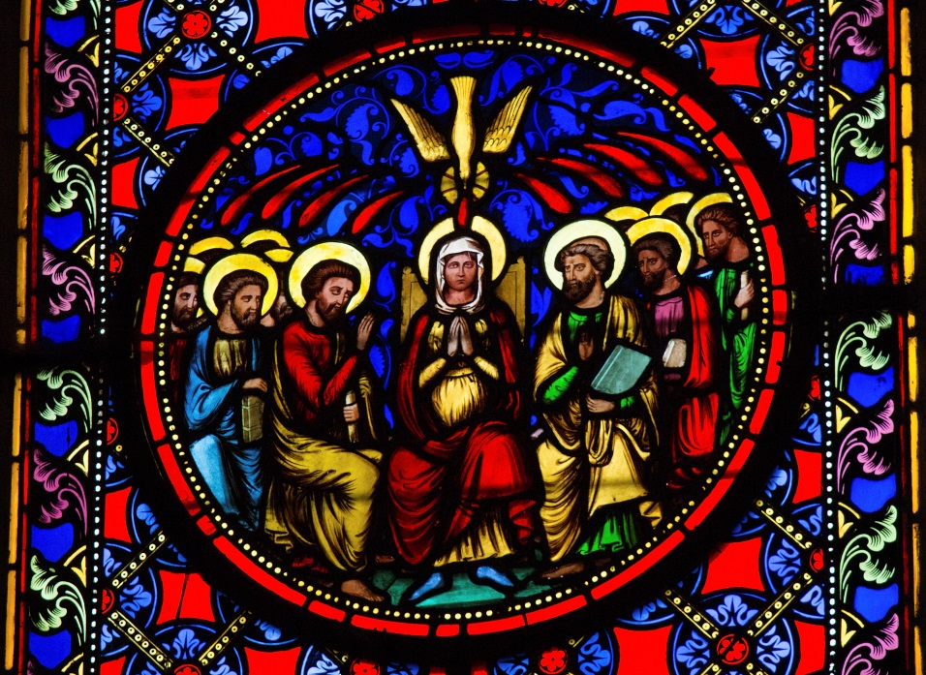
Mary: First Disciple
Mary was among the first people to believe in Jesus.
She followed him as a disciple.
Mary “aided the beginnings of the church by her prayers.”
Mary is the Mother of all disciples, the Mother of the Church.
© Jorisvo / iStockphoto.com
Notes:
Read John 2:1–11, the account of the wedding at Cana. Point out that in the Gospel of John, this is the very first of Jesus’ signs, or miracles.
This slide corresponds to content in article 69, “Mary: First Disciple of Jesus and Model of Faith,” in the student book.

Slide 4
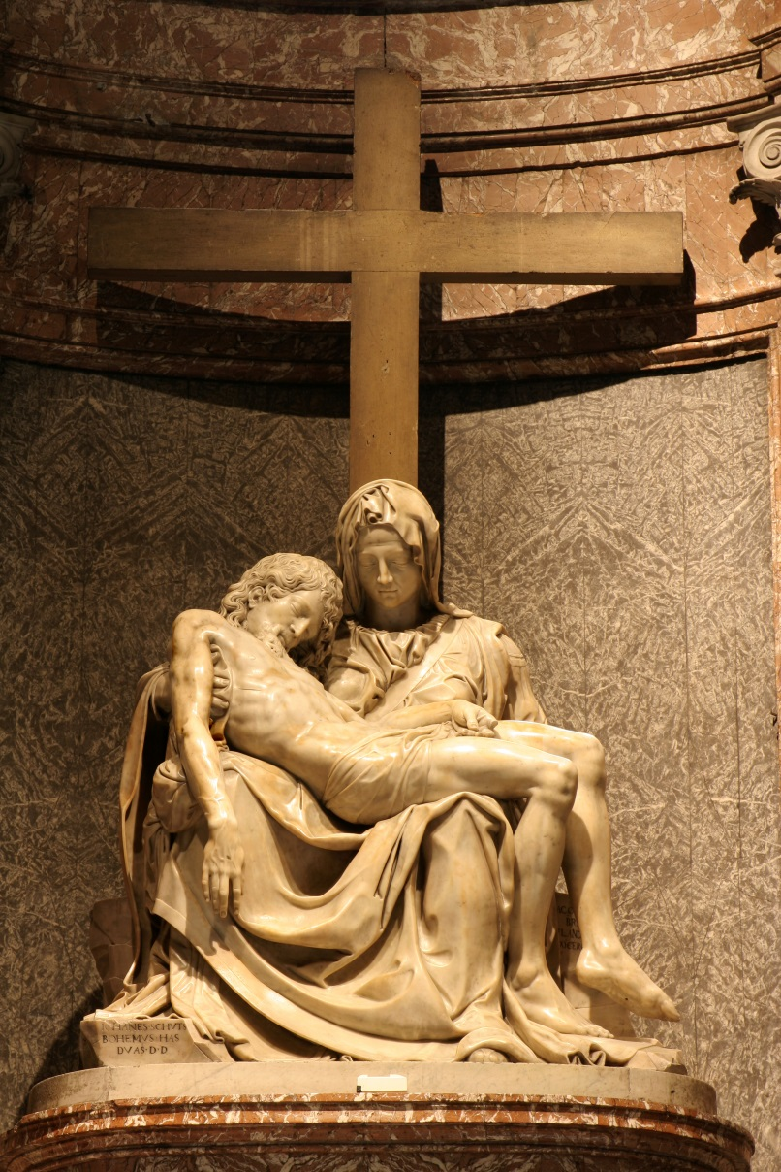
Mary: Model of Faith
Mary’s faith led her to freely choose to cooperate with God’s plan for our salvation.
© sedmak / iStockphoto.com
Notes:
Ask the question that concludes article 69 in the student book, “In what way is Mary uniquely suited for her role as a model of faith?”
This slide corresponds to content in article 69, “Mary: First Disciple of Jesus and Model of Faith,” in the student book.

Slide 5
Resisting Evil
Having free will means that we must freely decide for ourselves.
Our new life in Christ delivers us from the power of sin.
God’s grace makes it easier for us to choose the good and resist evil.
© diego_cervo / iStockphoto.com
Notes:
Ask students what aspects of a faith-filled life can help us to resist evil (learning, prayer, community support, sacramental grace, and so on).
This slide corresponds to content in article 70, “Discipleship: Resisting Evil, Seeking Forgiveness,” in the student book.

Slide 6
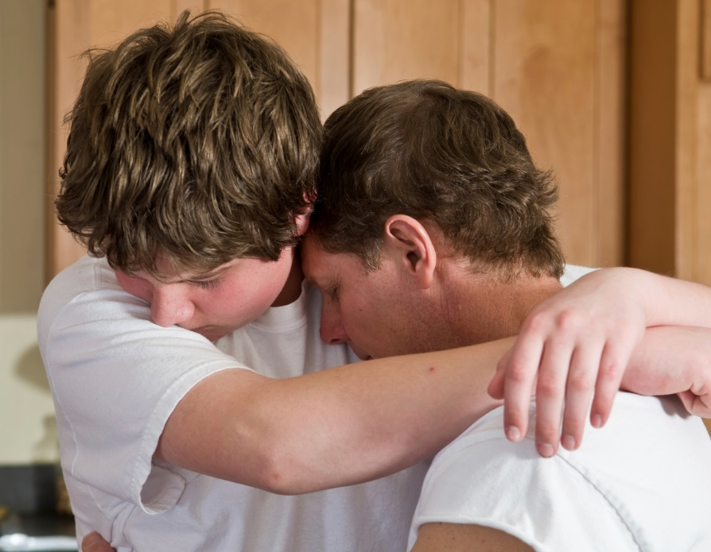
Seeking Forgiveness
When we give in to temptation, Jesus teaches us to repent.
When we freely admit our sin, God can then truly heal us.
The Sacrament of Penance and Reconciliation grants us the gift of God’s pardon.
© ejwhite / iStockphoto.com
Notes:
Discuss why we need to admit our sin and what happens when we do (avoid it in the future, recognize who was hurt and make amends, strengthen our sense of dependence on God, and so on).
This slide corresponds to content in article 70, “Discipleship: Resisting Evil, Seeking Forgiveness,” in the student book.

Slide 7
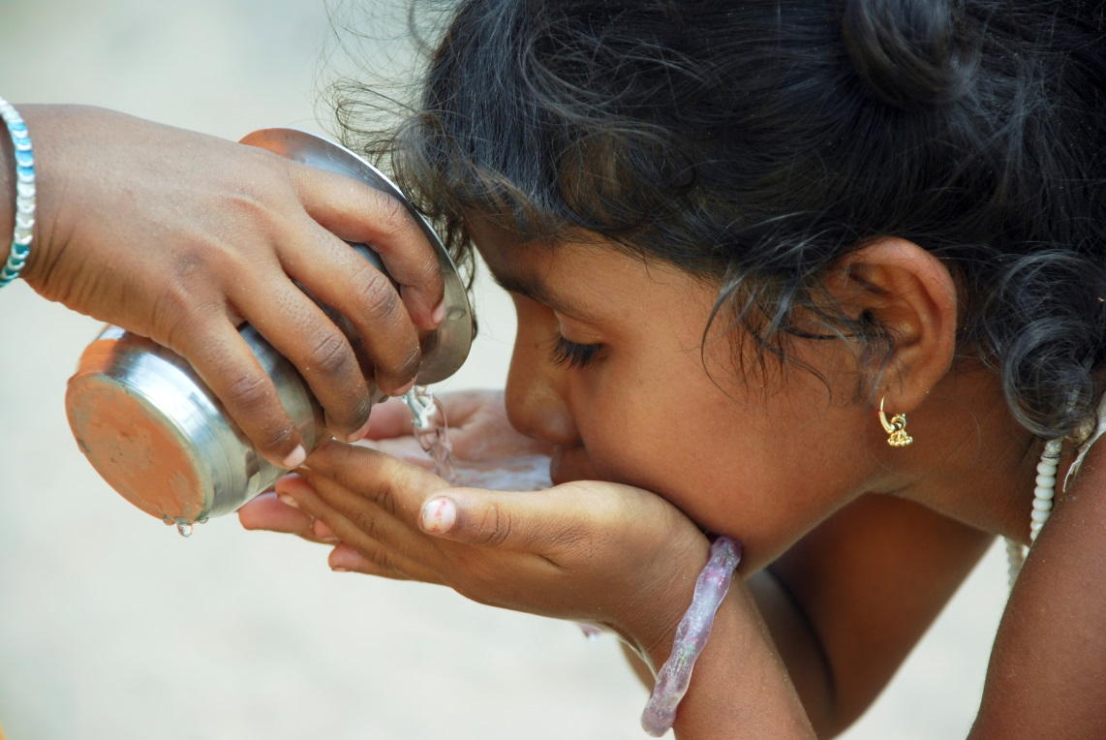
Concern for the Common Good
Our life of Christian discipleship is rooted in a close relationship with Jesus.
We recognize Jesus in the vulnerable, and are moved to serve them.
Active involvement in the world is a key element of our baptismal call.
© Sunitha Pilli / iStockphoto.com
Notes:
Remind students of Jesus’ parable The Judgment of the Nations (Matthew 25:31–46), with its call to offer care and comfort to those in need.
This slide corresponds to content in article 71, “Discipleship: Concern for the Common Good,” in the student book.

Slide 8
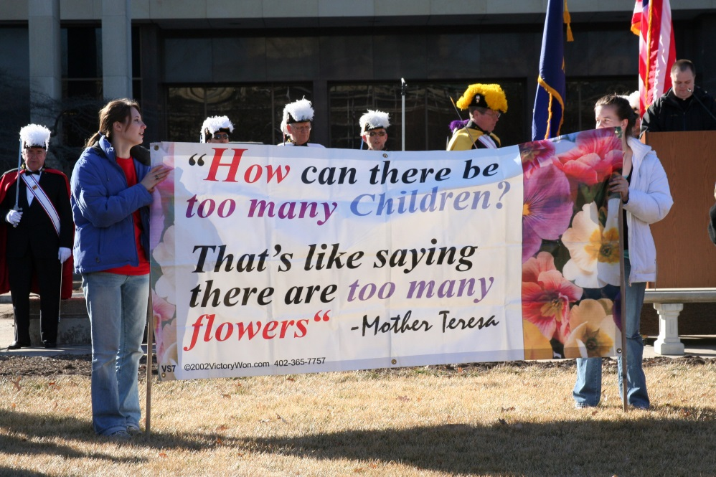
Catholic Social Teaching
These teachings guide our efforts to create a more just and peaceful world.
Seven key principles have emerged as elements of Catholic social teaching.
© Melissa Brandes / Shutterstock.com
Notes:
Point out that Pope Paul VI said, “If you want peace work for justice.“ Discuss the relationship between peace and justice. The next slides show the seven principles.
This slide corresponds to content in article 71, “Discipleship: Concern for the Common Good,” in the student book.

Slide 9
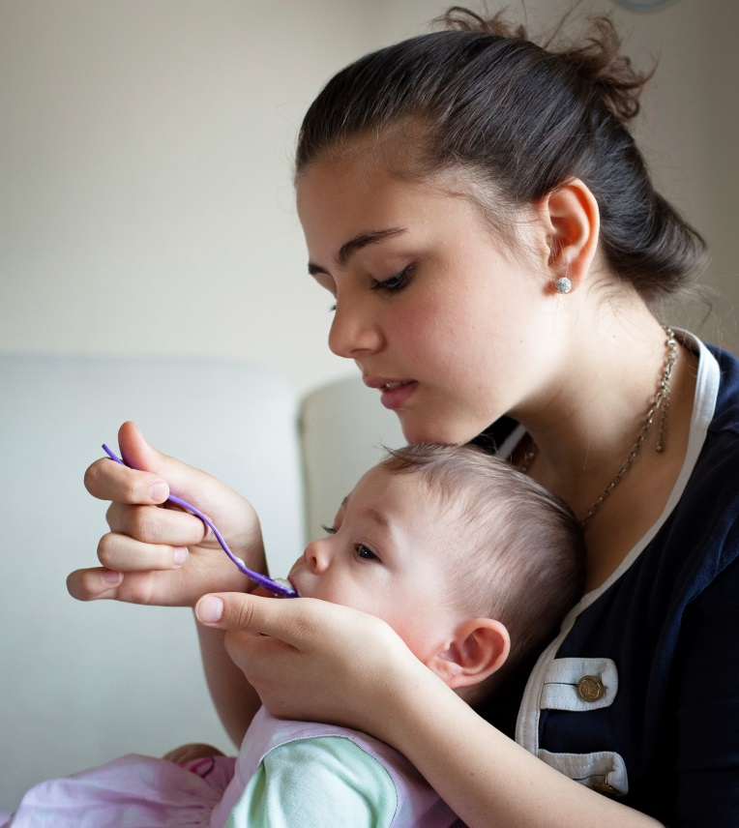
Some Key Principles
All human life is sacred.
We must be concerned about the common good of all.
All have a right to life’s basic needs, and we have a duty to protect those rights.
The needs of those who are poor must have first priority.
© annedde / iStockphoto.com
Notes:
Explain the last bullet point by suggesting some scenarios where the needs of a more vulnerable family member might receive priority (an infant, a grandparent, a child with a disability).
This slide corresponds to content in article 71, “Discipleship: Concern for the Common Good,” in the student book.

Slide 10
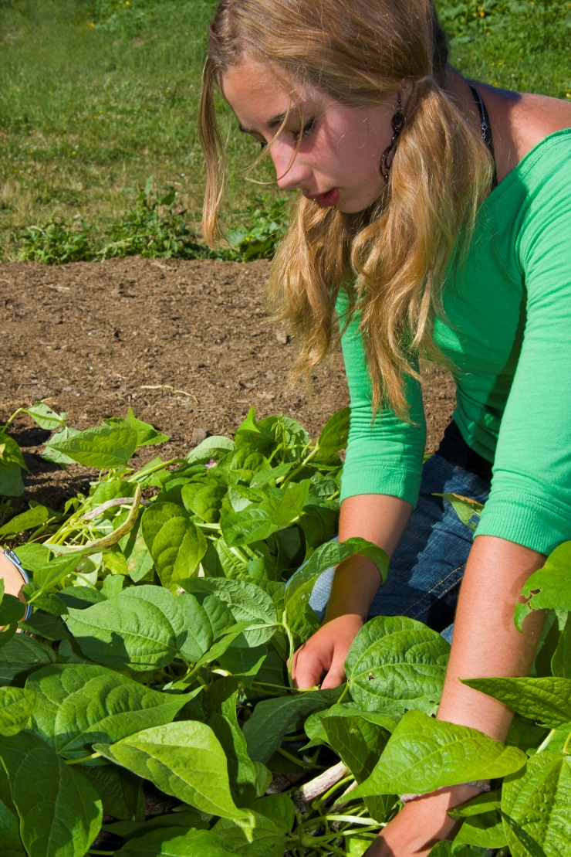
Three More Principles
Workers have a right to a fair wage and to decent working conditions.
We must care for one another as brothers and sisters in one global family.
We must protect the resources of our planet.
© Steve Froebe / iStockphoto.com
Notes:
Ask the students whether any of the seven principles surprise them. (See article 71 in the student book.) Ask the question that concludes article 71 in the student book, “Which of the seven principles of Catholic social teaching do you think most needs to be promoted in your world?”
This slide corresponds to content in article 71, “Discipleship: Concern for the Common Good,” in the student book.

Slide 11
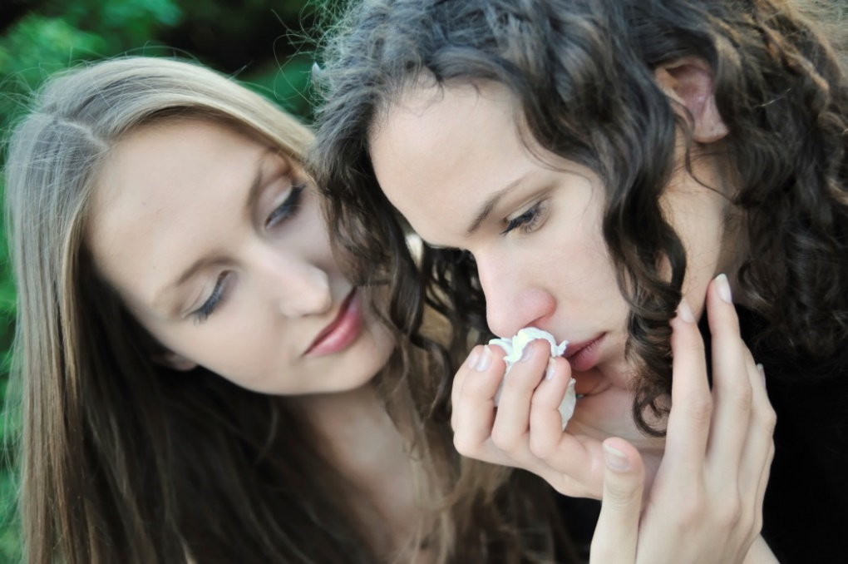
Evangelization
Jesus called his first disciples to evangelize.
Jesus has entrusted us with the same mission of evangelization.
Our own faithful lives bear witness to the Good News.
© Martinan / iStockphoto.com
Notes:
Discuss what evangelization might mean today, differentiating it from proselytizing by focusing on “witnessing,” not “converting.”(See article 72 from the student book.)
This slide corresponds to content in article 72, “Discipleship: The Call to Evangelization,” in the student book.

