Slide 1
Many Vocations to Holiness
The Church
Unit 3, Chapter 10
Document #: TX005560

Slide 2


The Evangelical Counsels
Poverty, chastity, and obedience are called the evangelical counsels.
Every Christian is called to make a commitment to these virtues.
© Dmitry Kaminsky / Shutterstock.com
© 2016 Saint Mary’s Press
Living in Christ Series
Notes:
Notes: Explain how priests and those in consecrated life live out the evangelical counsels, as in article 42 of the student book.

Slide 3

Poverty
We are each called to focus on spiritual riches, not material wealth.
We must not become attached to money and material things.
We are to use money
and possessions in a
moderate and healthy
way.
© GWImages / Shutterstock.com
© 2016 Saint Mary’s Press
Living in Christ Series
Notes:
Notes: Discuss what the last point might entail for Christians in different situations: for teens, parents, those who are highly paid, and so on. Include the meaning of the vow of poverty for those in consecrated communal life and in the priesthood, as in article 42 of the student book.

Slide 4

Chastity
Chastity is the healthy
integration of our
sexuality into our
whole person.
We are all called to
control our sexual
desires, not have them control us.
Priests and consecrated religious live chaste lives through a vow of celibacy.
© prudkov / Shutterstock.com
© 2016 Saint Mary’s Press
Living in Christ Series
Notes:
Notes: Explain the ways that people in different life situations live out chastity, as in article 42 of the student book.

Slide 5

Obedience
All Christians are called to obey Christ, to be disciples.
We also have a duty to obey the Church’s Magisterium.
© PeskyMonkey / iStock
© 2016 Saint Mary’s Press
Living in Christ Series
Notes:
Notes: Explain the meaning of obedience for those who are ordained and for those in consecrated life. Ask how laypeople obey Christ and the Church.

Slide 6
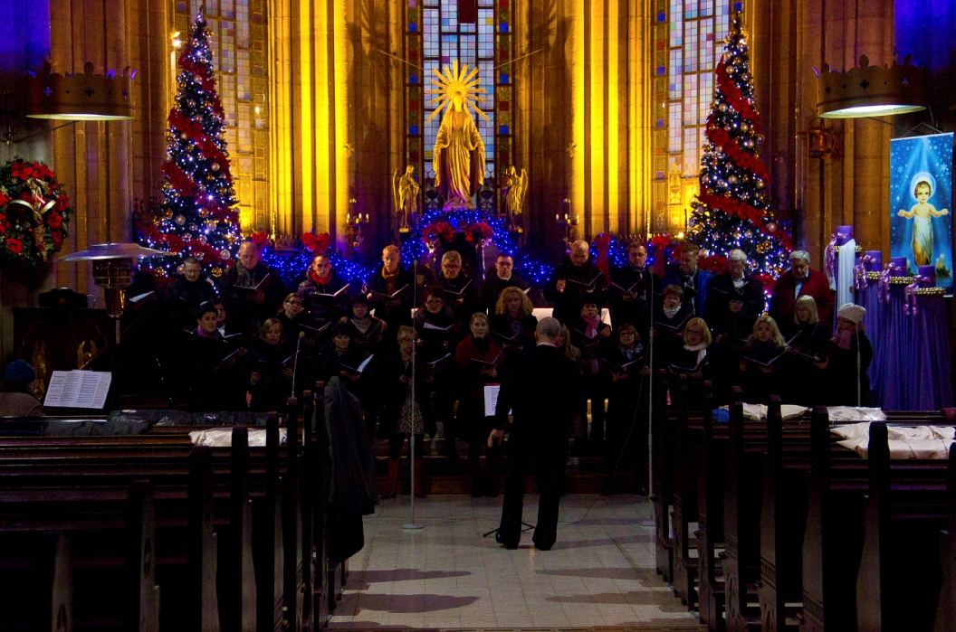
The Mission of the Laity
The laity includes the members of the Church who are not ordained.
The laity witness to God’s love throughout the whole world.
You have the duty
to help others
know the saving
message of Christ.
© Reddiplomat / iStock
© 2016 Saint Mary’s Press
Living in Christ Series
Notes:
Notes: Ask the students how laypersons have helped them to know the saving message of Christ. Ask for examples of some of the other ways laypersons help people to know Christ.

Slide 7
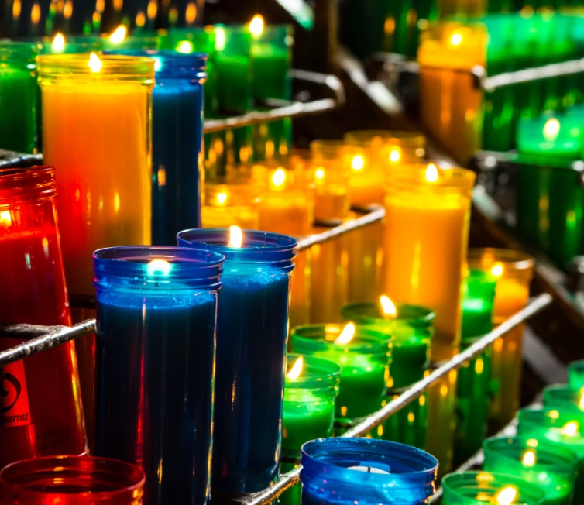
The Priestly Office of the Laity
In the common priesthood of the faithful, we are united with Christ . . .
in serving the world.
The ordination of priests confers on them a sacred power for the service of the faithful.
©Maxx-Studio / Shutterstock.com
© 2016 Saint Mary’s Press
Living in Christ Series
Notes:
Notes: Ask the students to identify the three ways that laypeople can exercise their priestly ministry, as in article 43 of the student book (offering their activities, praying, and assisting in ministry). Discuss the students’ experience with these ministries. Consider sharing your own experience.

Slide 8

The Prophetic Office of the Laity
To be a prophet means to share God’s Word with those who need to hear it.
Laypeople proclaim
Christ through words
and through the
witness of their lives.
They may also teach;
some make use of
the media to do so.
© michaeljung / Shutterstock.com
© 2016 Saint Mary’s Press
Living in Christ Series
Notes:
Notes: Share examples of the lay Catholic voice on television, radio, Internet sites, blogs, and so on. Discuss the last bullet point in the section “The Prophetic Office of the Laity,” in article 43 of the student book, about making our opinions known.

Slide 9

The Kingly Office of the Laity
For Christians, being a leader means consistently choosing what is good and right . . .
following God’s call for our entire lives . . .
and serving those most in need.
© Goodluz / Shutterstock.com
© 2016 Saint Mary’s Press
Living in Christ Series
Notes:
Notes: Point out that Christian leadership can mean leading by the example of our commitment to God’s will, and through service. Ask the question that concludes article 43 of the student book, “How have you exercised Christian leadership in your school, parish, and community?”

Slide 10

The Work of the Laity
Laypeople participate in Christ’s mission through their work.
Another important way is through the vocation of marriage.
Some laypeople have
chosen to follow Christ
as a celibate single
person.
© Spotmatik Ltd / Shutterstock.com
© 2016 Saint Mary’s Press
Living in Christ Series
Notes:
Notes: Discuss each of these ways of participating in Christ’s mission, exploring how each offers a context for service.

Slide 11

The Family
A Christian family is called a “domestic church.”
The Christian home is the place where children first hear the Word of God.
Parents can teach their children the virtues and set a good example.
© Skucina / Shutterstock.com
© 2016 Saint Mary’s Press
Living in Christ Series
Notes:
Notes: Discuss some of the ways that parents can teach the virtues and help their children hear the call of faith. Ask for examples of how other family members take part in this ministry as well (e.g., being role models, praying for each other, forgiving).

Slide 12

The Consecrated Life
Members of religious orders live communal lives . . .
publicly profess the evangelical
counsels . . .
share a liturgical
character . . .
and belong to
institutes recognized
by the Church.
© Riccardo Piccinini / Shutterstock.com
© 2016 Saint Mary’s Press
Living in Christ Series
Notes:
Notes: Ask the students if they know a member of a religious order. Discuss their familiarity with orders in your region. If your school was founded by an order, ask what the students know about it.

Slide 13
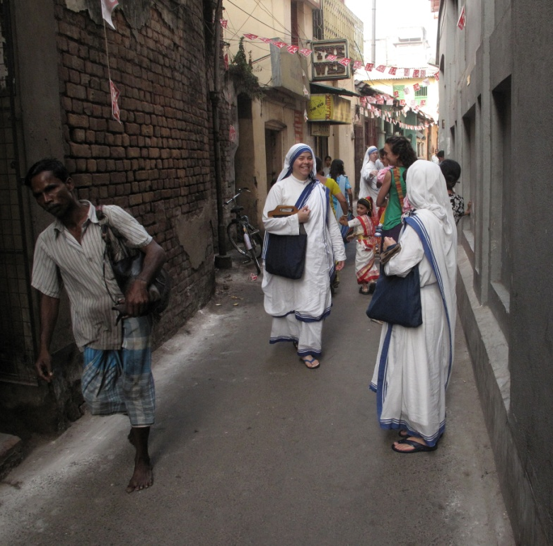
Variety of Religious Orders
New religious orders can emerge in response to changing conditions.
The founders of religious orders impart a certain charism to their community.
Religious orders in the Roman Catholic Church must be approved by the Pope.
© Zvonimis Atletic / Shutterstock.com
© 2016 Saint Mary’s Press
Living in Christ Series
Notes:
Notes: Discuss examples of the various ministries that religious orders may focus on, pointing out that many orders were founded to address particular situations. Include both active and contemplative orders.

Slide 14

Prayer as the Rhythm of the Religious Life
The daily life of all religious orders is characterized by regular prayer.
Most pray some form of the Liturgy of the Hours.
This liturgical prayer
is composed of Psalms,
hymns, Scripture
readings, prayers,
and responses.
© Marijus Auruskevicius / Shutterstock.com
© 2016 Saint Mary’s Press
Living in Christ Series
Notes:
Notes: Explain that priests also pray the Liturgy of the Hours, also known as the Divine Office. Point out that many deacons and members of the laity pray all or some of the seven Hours throughout the day.

Slide 15
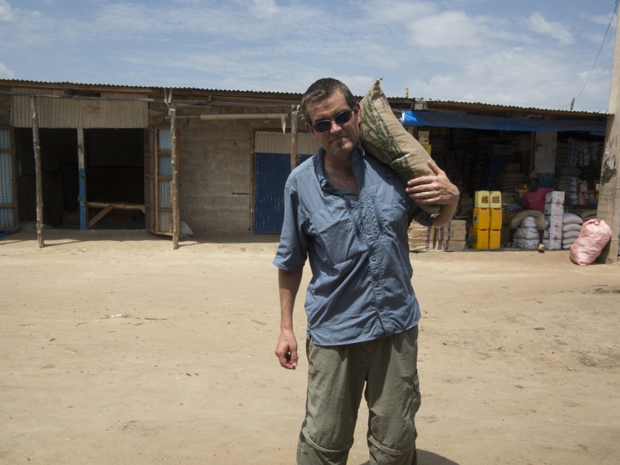
Third Orders and Lay Associates
Associations of laypeople may be connected to a particular religious order.
Members practice the order’s spirituality and assist with its ministries.
© 2016 Saint Mary’s Press
Living in Christ Series
© John Wollwerth / Shutterstock.com
Notes:
Notes: If you are familiar with a Third Order or lay association, provide examples of its activity. Point out that members can be associated with the order’s ministry, but also have a family and secular career.

Slide 16

Other Types of Consecrated Life
The Holy Spirit calls people to different ways of living out the evangelical counsels.
Some are hermits; others are consecrated virgins or widows.
Others are members
of secular institutes
or apostolic societies.
© BrankaVV / Shutterstock.com
© 2016 Saint Mary’s Press
Living in Christ Series
Notes:
Notes: Point out that those who live a consecrated life are a sign of a spiritual reality: hermits witness to the interior aspect of the Church; consecrated virgins and widows are a sign of the Church’s love for Christ; members of lay associations witness to Gospel values in society.

