Slide 1
Marriage: Contract or Covenant?
Vocations, Unit 3

Slide 2

What is a contract?
Crackhunters.ca
Notes:
Teacher Notes: Invite the students to respond. Do not define contract at this point.

Slide 3

What is a covenant?
©Shutterstock/iofoto
Notes:
Teacher Notes: Invite the students to respond. Do not define covenant at this point.

Slide 4
Can you name some characteristics of a contract?
A contract . . .
is binding for the time of the agreement and can be broken.
is a basic time-limited guarantee that can be extended longer for more money.
guarantees that you can return (or get a refund for) the product or service if it fails to deliver on expectations.
is limited: you can trade for a new, improved model when contract expires and usefulness ends.
is relative to your “investment”; the more you pay, the fancier or more powerful the “model” or the better the service.
Can you think of others?

Slide 5
In contrast to a contract, a covenant . . .
cannot be broken; has no “time limit” until death.
is a sacred life relationship between two people.
is open-ended; no guarantees!
continues under all conditions: money or poverty, health or sickness, etc.
is rooted in deep friendship and love, not in money or power.
Can you think of others?
Notes:
Teacher Notes: Suggest the following:
● is a relationship of equals
● is a relationship of mutual honor and respect
● is a lifelong commitment that flows into family and community
● is a gift of God that enables a husband and wife to give themselves faithfully to each other every day of their lives

Slide 6

What evidence exists today that reveals too many marriages today are treated as contracts rather than covenants?
How is the covenant of Christian Marriage different from a contract?
Notes:
Teacher Notes: After each question, invite the students to respond.

Slide 7
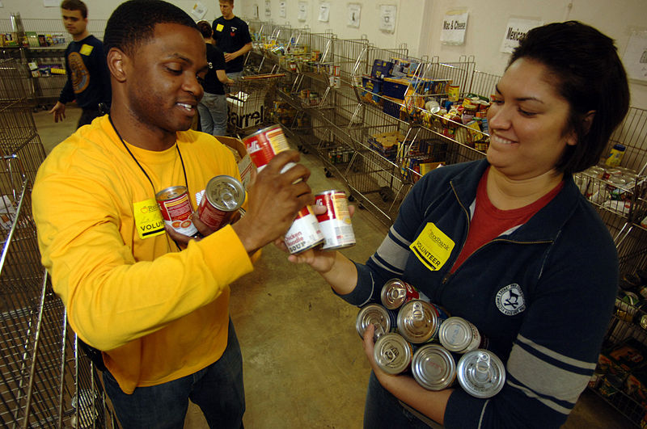


Why does the Catholic Church call the Marriage covenant a Sacrament at the Service of Communion?
Image in public domain
©Shutterstock/Monkey Business Images
©Shutterstock/Monkey Business Images
Notes:
Teacher Notes: Invite the students to respond. Conclude by allowing time for the students to make comments or ask questions.

