Slide 1
Praying Together
The Catholic Faith Handbook for Youth, Third Edition
Chapter 37
Document #: TX003168
Notes:
Use this presentation to answer questions the students may have about communal prayer and to highlight key points under each heading in chapter 37.

Slide 2
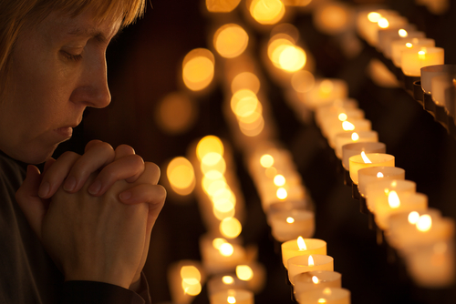
Praying Always
Copyright: Kuzmin Andrey / www.shutterstock.com
“Pray without ceasing, give thanks in all circumstances; for this is the will of God in Christ Jesus for you” (1 Thessalonians 5:17–18).
If we are committed to praying regularly, we will feel its constant effect in our lives.
Notes:
Point out that prayer is our response to God’s invitation to be in a loving relationship with him. The directive “pray without ceasing” can mean that we should always be saying “Yes” to God’s invitation.

Slide 3
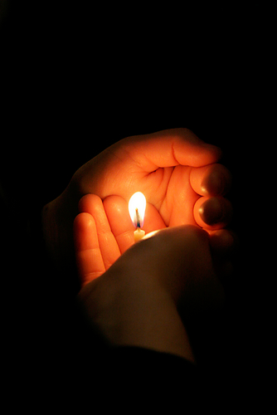
Why Do We Pray Together?
Prayer is more than our own personal response to God’s initiative.
When we pray, our voices are joined both to Christ’s and to the voice of Christ in every member of his Body.
Copyright: Rostislav Glinsky / www.shutterstock.com
Notes:
Remind the students that during the Easter Vigil, the entire congregation receives and spreads the light from the Easter candle, also called the Christ candle. Explain that whenever we pray, we pray in union with Christ and with the entire Church.

Slide 4
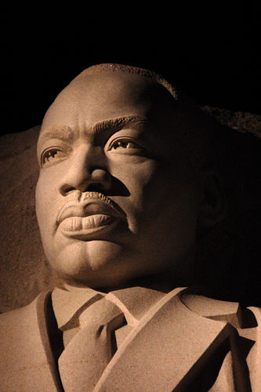
Why Do We Pray with Scripture?
Encountering the Word of God in Scripture changes us as individuals and as a community.
As we hear the Word of God proclaimed, we encounter Jesus Christ, the Living Word.
Copyright: Daniel M. Silva / www.shutterstock.com
Notes:
Point out that Dr. Martin Luther King Jr. inspired individuals, but also an entire nation, with his words. Ask, “In what ways can the Word of God change a community, and not just the individuals in the community?”

Slide 5
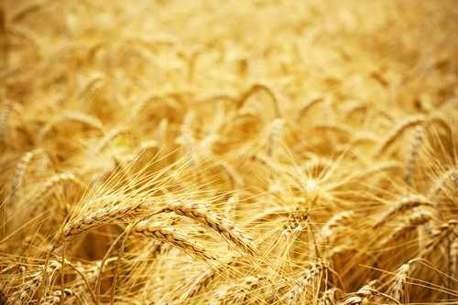
Why Is the Eucharist Important?
It is the fullest expression of communal prayer.
In the Eucharist, we gather as the People of God.
We are nourished by Christ’s Real Presence.
We are sent to be the Body of Christ in the world.
Copyright: Sukharevskyy Dmytro (nevodka) / www.shutterstock.com
Notes:
Ask the students how the Eucharist nourishes us for our mission as Church.

Slide 6
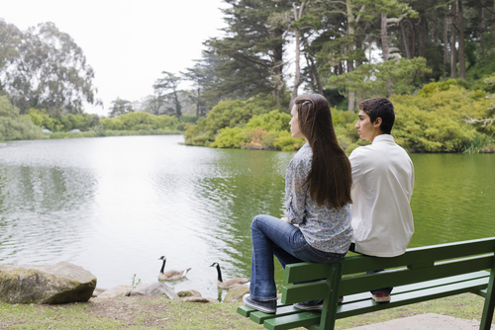
Eucharistic Adoration
The Body and Blood of Christ under the species of bread is reserved in the tabernacle.
Catholics contemplate with the Blessed Sacrament to spend time with Jesus.
Copyright: PT Images / www.shutterstock.com
Notes:
Ask the students what feature of friendship the image portrays. Explain that some churches hold Perpetual Adoration, inviting parishioners to commit to an hour or more with the Blessed Sacrament around the clock every day.

Slide 7
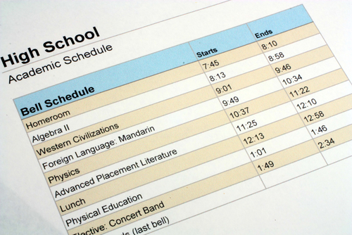
Do Priests Pray a Special Way?
The official nonsacramental prayer of the Church is called the Liturgy of the Hours.
Vowed religious and the ordained pray the Liturgy of the Hours every day, as do many laypeople.
Copyright: Ryan R Fox / www.shutterstock.com
Notes:
Note that the Liturgy of the Hours divides the day into periods of prayer, just as the students’ day is divided into class periods. Explain the basic structure of the Liturgy of the Hours, described on page 412 of the student handbook.

Slide 8
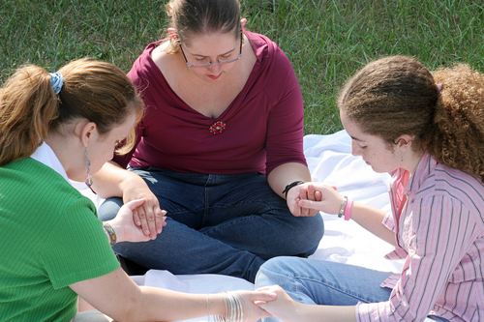
Praying with Groups
Make prayer a part of family celebrations and gatherings.
Organize a student prayer group.
Form a music group for praise and prayer.
Ask a friend from Bible study to be your prayer partner.
Copyright: Lisa F. Young / www.shutterstock.com
Notes:
Invite the students to think of other opportunities for communal prayer in their parish or school.

Slide 9
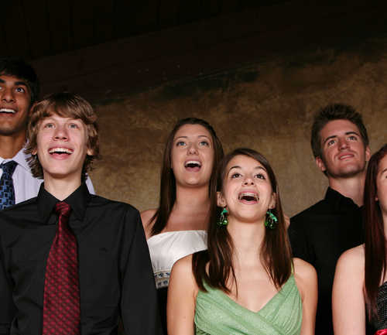
Questions
What do you think is the most important aspect of communal prayer?
What communal forms of prayer would you like to try?
Copyright: Tracy Whiteside / www.shutterstock.com
Notes:
Invite the students to reflect on these questions, and then ask them to share their thoughts and responses.
(The Scripture quotation contained herein is from the New Revised Standard Version of the Bible, Catholic Edition. Copyright © 1993 and 1989 by the Division of Christian Education of the National Council of the Churches of Christ in the United States of America. All rights reserved.)

