Slide 1



Slide 2
Christian Morality
and Social Justice
Chapter 45
Working for Justice

Slide 3

Chapter Summary
Working for Justice
In this chapter, you will consider the concept of social justice and how we can integrate this basic concept of human dignity with our lives of faith. This chapter reminds us that we are all part of the Body of Christ and that each person is valuable and worthy of human dignity. We must be aware of the basic needs of our brothers and sisters and also do our best to guar-antee the human dignity and freedom of all.
© PixelEmbargo/www.shutterstock.com

Slide 4
Key Scripture Passages
“I pray that they may all be one, Father!” (John 17:21; Handbook, page 491)
“Love your neighbor as you love yourself.” (Matthew 22:39; Handbook, page 493)

Slide 5

Introduction and
“That All May Be One” (Part 1)
(Handbook, pages 490–491)
As Jesus’ followers, we become a loving community, acting on principles of social justice.
© AfricaStudio/www.shutterstock.com

Slide 6
Introduction and
“That All May Be One” (Part 1)
(Handbook, pages 490–491)
When we learn to love as God loves, we see strangers as neighbors.
To love as God loves, it helps to understand what God is like: a communion of perfect love and peace.
Social justice is respect for creation and for human rights.
When we are concerned about social justice, we are loving as God loves.

Slide 7

Introduction and
“That All May Be One” (Part 1)
(Handbook, pages 490–491)
Activity: “What Is God Asking of Me Today?”
The teacher will arrange you into groups of two or three.
Each group will read Amos 2:6–8 together.
Discuss and write down your group’s responses to these questions:
What is Amos saying? Who is he trying to help with his words? How does this Scripture reading call us to live our faith in the practice of charity and the pursuit of justice?
4. Share your group’s responses with the class.
© AlixKreil/www.shutterstock.com

Slide 8

“That All May Be One” (Part 2)
(Handbook, pages 491–492)
As a loving community, we work in our parish and community to help one another.
© alphaspirit/www.shutterstock.com

Slide 9
“That All May Be One” (Part 2)
(Handbook, pages 491–492)
The Church works to transform our world into a loving community where people respect one another.
People need their basic needs met, but they also need respect, freedom, and life-giving relationships with others.
We can make a difference today and in the future by responding to others’ pain with compassion.

Slide 10

“That All May Be One” (Part 2)
(Handbook, pages 491–492)
Journal It!
© RuslanDashinsky/www.istockphoto.com
How do those in our parish or school community work together to help one another?
How can we work to help others even more?

Slide 11
“That All May Be One” (Part 3)
(Handbook, pages 492–493)
As a Christian community, we are called to be involved in meeting the needs of those who are poor in our own country.
© Artisticco/www.shutterstock.com

Slide 12
“That All May Be One” (Part 3)
(Handbook, pages 492–493)
We are called to do works of charity, which means meeting someone’s immediate physical needs.
We also work for justice, which means challenging society to eliminate the causes of injustice.
We are called to both charity and social justice. They are different, but both are necessary.

Slide 13

“That All May Be One” (Part 3)
(Handbook, pages 492–493)
Activity
Each of you will be given a Bible.
Work individually to find Bible passages where Jesus talks about serving those in need.
Write at least one word on the board that describes what you found Jesus saying about serving those in need. Note the book, chapter, and verse.
© EKS/www.shutterstock.com

Slide 14
“That All May Be One” (Part 4)
(Handbook, page 493)
We are a world community.
© DenisCristo/www.shutterstock.com

Slide 15
“That All May Be One” (Part 4)
(Handbook, page 493)
We are all part of the Body of Christ.
When one member of society suffers, all members suffer.
We should see ourselves in others and treat them as we want to be treated.

Slide 16
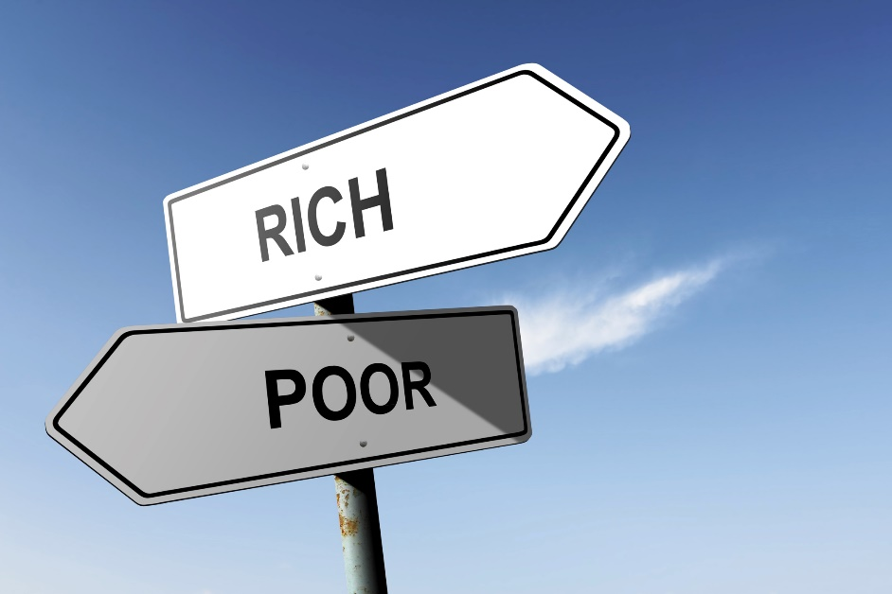
“That All May Be One” (Part 4)
(Handbook, page 493)
Activity: “The Gospels: Here, There, and Everywhere”
Your teacher will arrange the class into small groups, giving each group a message from the Gospels concerning those who are poor. Look up your assigned verse, read it, reflect on it, and then diagram how it can be applied in four ways:
(1) at school, (2) in your parish,
(3) in our country today, and
(4) on a global level.
© MarkRubens/www.shutterstock.com

Slide 17
Acknowledgments
The scriptural references and quotations in this presentation are from the Good News Translation® (Today’s English Version, Second Edition). Copyright © 1992 by the American Bible Society. All rights reserved. Bible text from the Good News Translation (GNT) is not to be reproduced in copies or otherwise by any means except as permitted in writing by the American Bible Society, 1865 Broadway, New York, NY 10023 (www.americanbible.org).
During this presentation’s preparation, all citations, facts, figures, names, addresses, telephone numbers, Internet URLs, and other pieces of information cited within were verified for accuracy. The authors and Saint Mary’s Press staff have made every attempt to reference current and valid sources, but we cannot guarantee the content of any source, and we are not responsible for any changes that may have occurred since our verification. If you find an error in, or have a question or concern about, any of the information or sources listed within, please contact Saint Mary’s Press.

