Slide 1
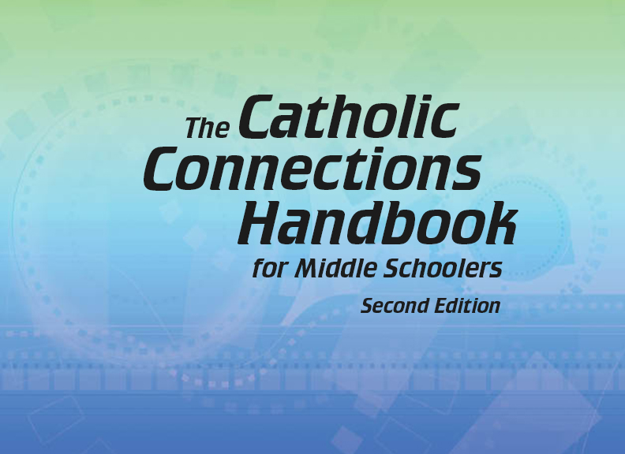


Slide 2
The New Testament
and the Church
Chapter 19
The Bible: The Gospels

Slide 3
Chapter Summary The Bible: The Gospels
The Church’s mission is to spread the Good News as discovered in the Gospels.
The Gospels share the Good News of Jesus Christ.
This chapter will cover how the Gospels came to be, the unique messages found within each, and how getting to know Jesus more closely enriches all who serve as disciples.

Slide 4
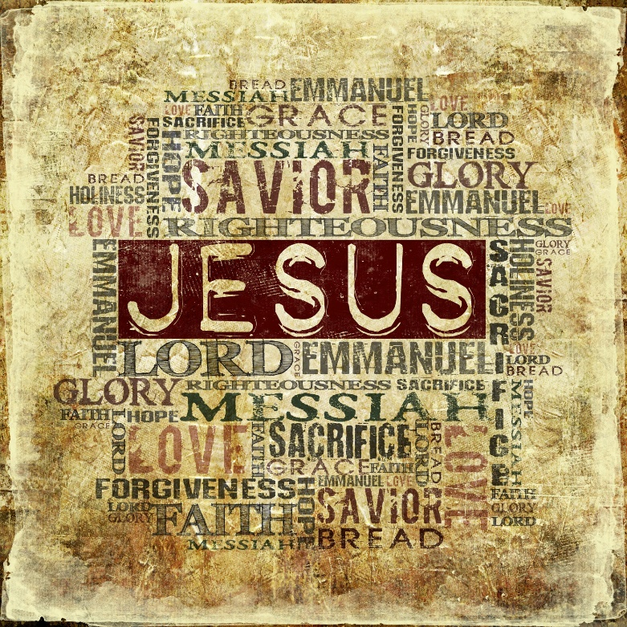
Introduction (Handbook, pages 202–203)
Through the Gospels Jesus calls us to know him, serve him, and share in God’s love.
The Gospels contain sacred stories through which we meet Jesus, our Lord and Savior.
©Genotar/www.shutterstock.com

Slide 5
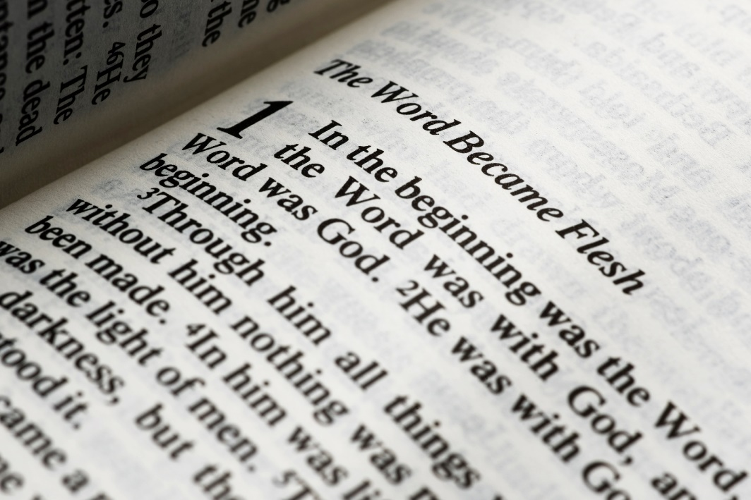
Introduction (Handbook, pages 202–203)
The Gospels are the inspired Word of God.
In the Gospels, Jesus shows us that our lives have meaning and purpose.
© milosluz/www.istockphoto.com

Slide 6
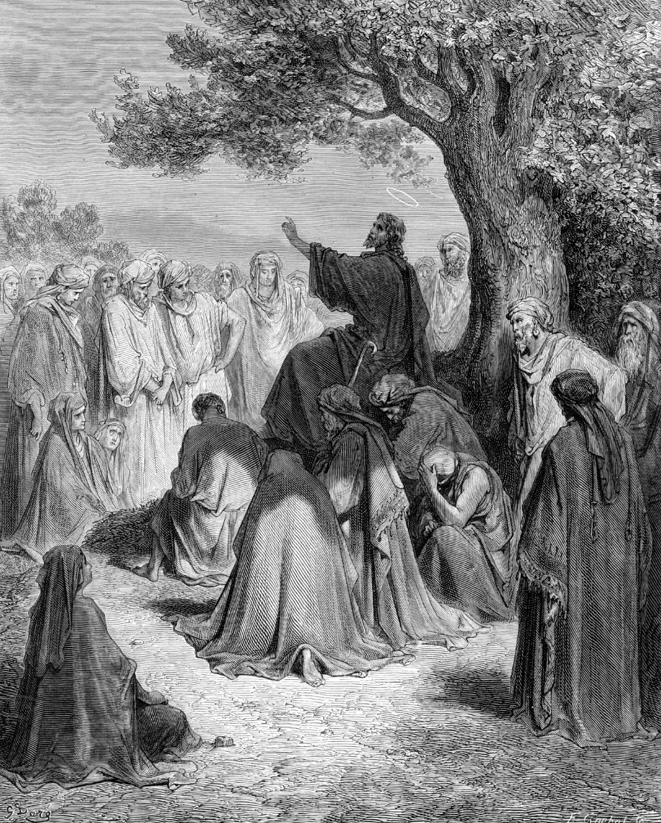
Introduction (Handbook, pages 202–203)
Discussion Question
Where would you be in this picture—close to Jesus, wanting to know and follow him, or standing outside the circle, afraid to change your life?
© HultonArchive/www.istockphoto.com

Slide 7
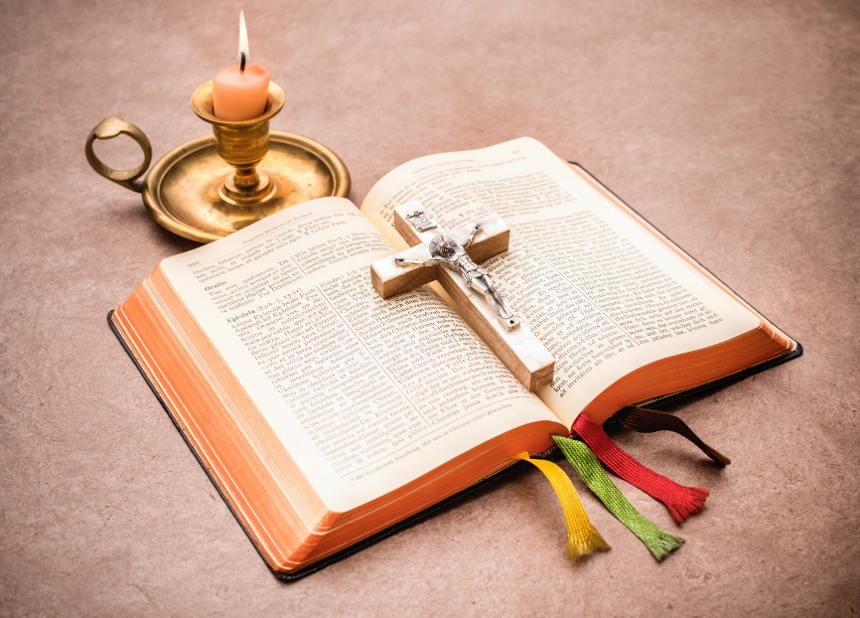
“Jesus and the New Testament” (Handbook, pages 203–204)
With the guidance of the Holy Spirit, Jesus’ followers teach us about him through their stories.
The Gospels are at the heart of the whole Bible, because Jesus is at their center.
Gospel means “good news.”
© AlexRaths/www.istockphoto.com

Slide 8

“Jesus and the New Testament” (Handbook, pages 203–204)
Matthew, Mark, Luke, and John, or their helpers, wrote the Gospels.
Theirs are the only reports of Jesus’ life that the Church accepts as inspired by the Holy Spirit.
Discussion Question
What are ways you can serve God and others as the Gospels teach us to?
©Serge Nivens/www.shutterstock.com

Slide 9
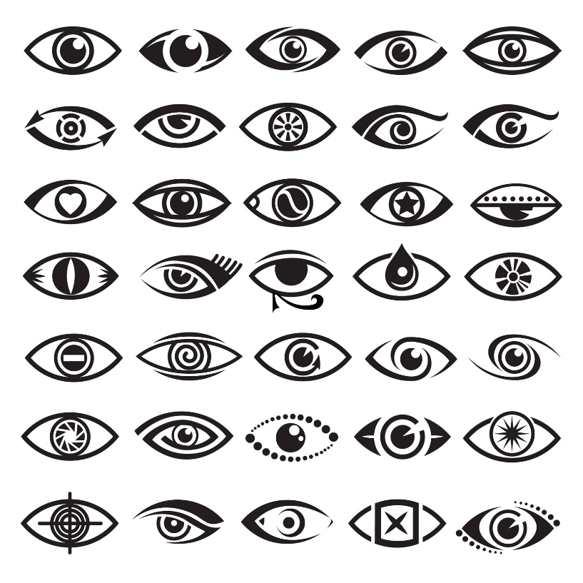
“Writing the Gospels” (Handbook, pages 205–208)
Each of the Gospel writers used unique source material and wrote for different audiences.
The Gospels of Matthew, Mark, and Luke record many of the same events in about the same order. They are called the synoptic Gospels; synoptic means “seen together.”
© alexkava/www.istockphoto.com

Slide 10
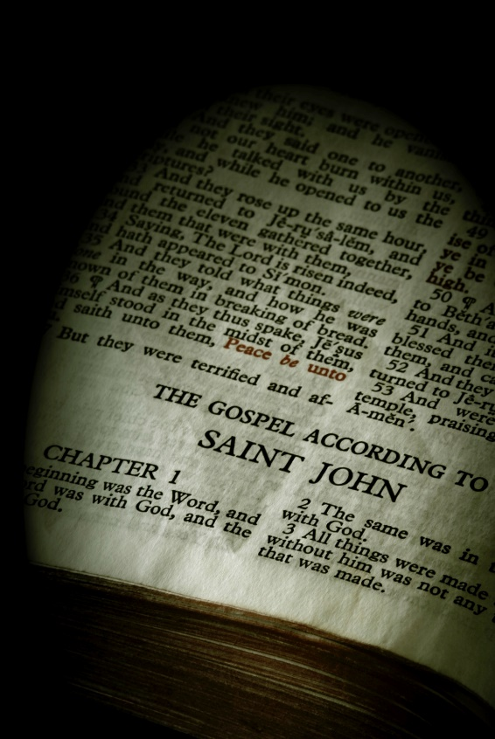
“Writing the Gospels” (Handbook, pages 205–208)
Each of these Gospels is slightly different because the sources and readers of each were different.
John’s Gospel was written after the others and has a different focus and structure.
© sorsillo/www.istockphoto.com

Slide 11

“Writing the Gospels” (Handbook, pages 205–208)
Activity
Read John 20:24–29.
How do the Gospels
portray different images
of Jesus?
What questions might you have for Jesus if he appeared in the classroom today?
©RobertChurchill/www.istockphoto.com

Slide 12

“Getting to Know Christ” (Handbook, pages 208–211)
Pursuit of a deeper understanding of Jesus through the Gospels will lead to happiness and discipleship.
The Gospel writers’ different audiences and purposes help explain what each author includes and emphasizes.
©monkeybusinessimages/www.istockphoto.com

Slide 13

“Getting to Know Christ” (Handbook, pages 208–211)
Careful, intentional reading of the Gospel stories, along with study helps found in many Bibles, helps clarify complexities often found in Scripture.
Reading the Gospels can change the lives of those who read them and want to be disciples.
© DawidKasza/www.istockphoto.com

Slide 14
“Getting to Know Christ” (Handbook, pages 208–211)
Activity
Write the following questions on bookmarks for your Bible, decorate the bookmarks, and think about these questions each time you read a Bible passage:
How can I see myself in this story?
What is God saying to me in its words?
How can I apply this message to my life?

