Slide 1
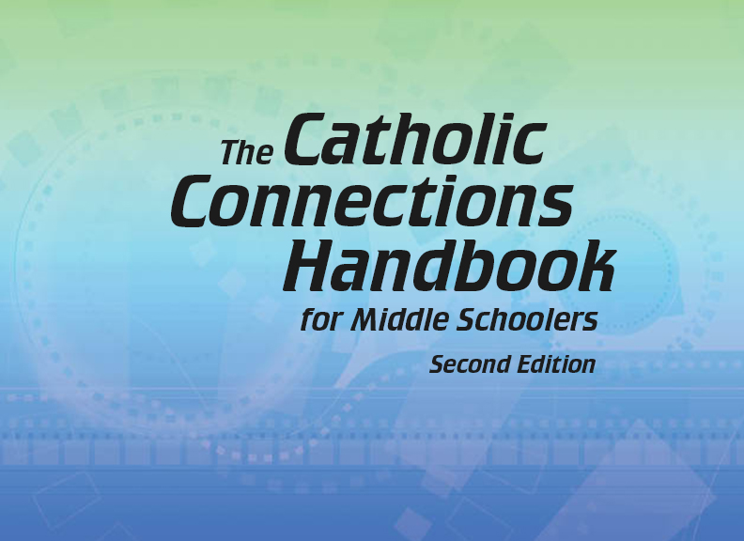

Document #: TX005839

Slide 2
Prayer and
Church History
Chapter F
The Age of the Fathers

Slide 3
Chapter Summary
In this era, the Church Fathers wrote and debated about the core teachings of Christianity.
They organized Ecumenical Councils.
Their leadership strengthened the Church to care for the people when the Roman Empire collapsed.

Slide 4
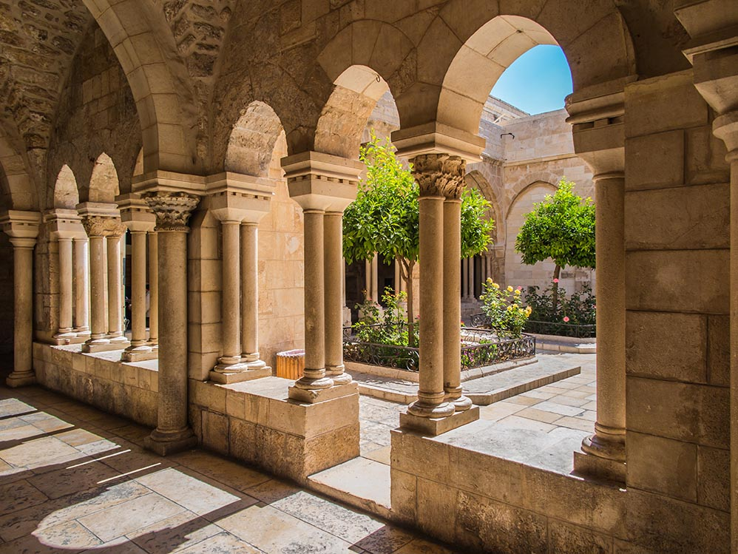
Introduction and “The
Dawn of the Fourth Century”
(Church History, pages 22–25)
As the Church grew, the
Church Fathers firmly
defined the Church’s
beliefs and made
secure the Church’s
power.
© DyziO/Shutterstock.com

Slide 5

Church Fathers and Heresies
Heresies are teachings
that reject Church doctrine.
The Church Fathers watched
over the teachings of the Church
and, by their writings and preaching,
corrected misunderstandings
and outright errors.
© Yuriy Vlasenko / Shutterstock.com

Slide 6
Correct the Heresy!
Each one of the statements below is heretical. With a partner, correct each statement and share the true belief with your group.
Jesus is fully human but not fully God. (Arianism)
Jesus only seemed to be human. (Docetism)
Pictures or statues of Jesus and the saints is a form of idolatry. (Iconoclasm)

Slide 7
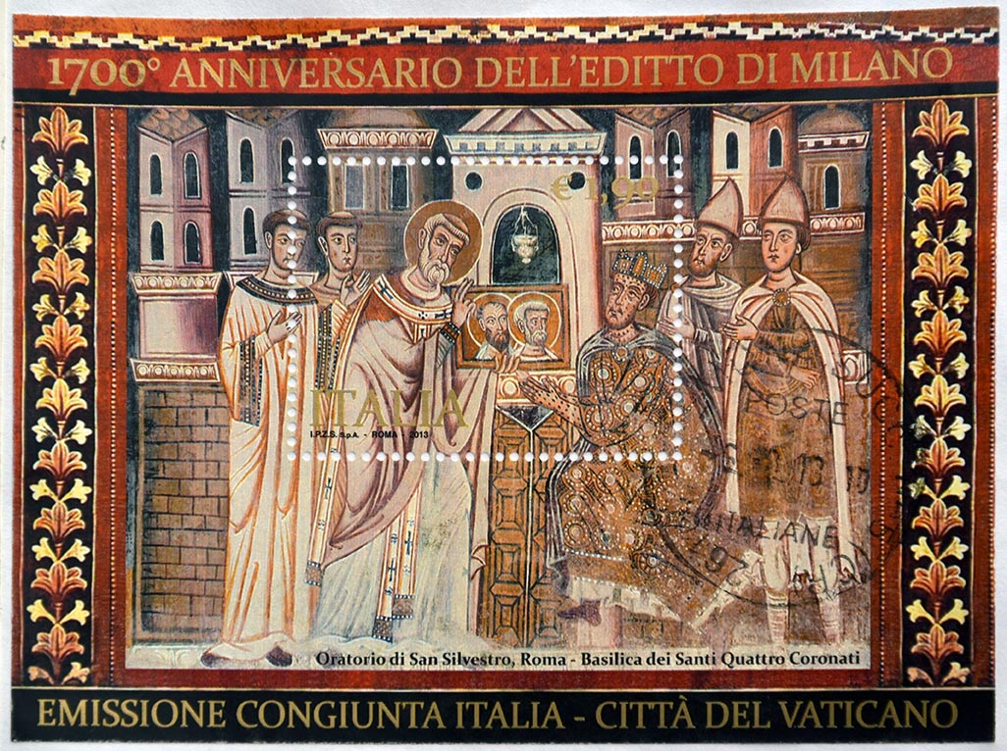
“Constantine Takes Charge”
(Church History, pages 25–27)
Emperor Constantine made
the practice of Christianity
legal with the Edict of Milan,
spurring massive growth
of the Church.
This Italian stamp (2013)
marks an anniversary
of the Edict of Milan.
© neftali/Shutterstock.com

Slide 8
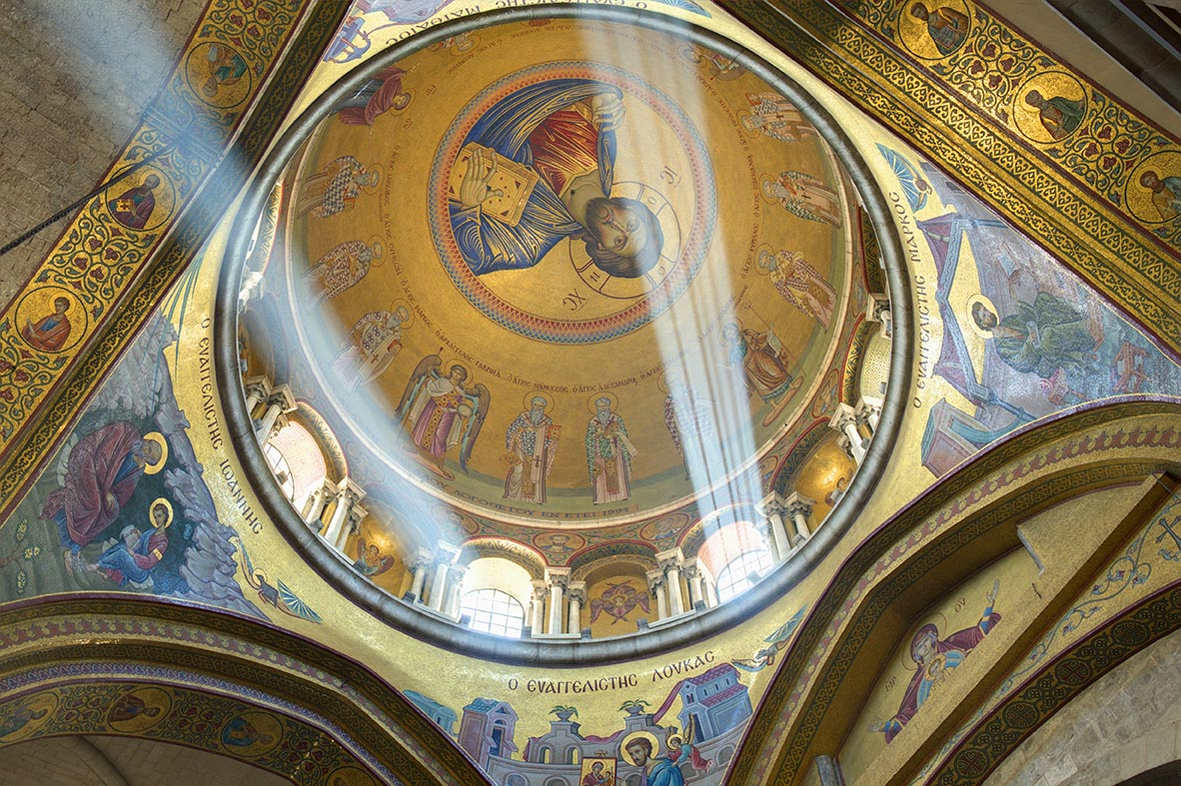
Christianity Is Legal!
Constantine made
Christianity legal in
the Roman Empire.
Christians could worship
freely in large groups
instead of in private homes.
Churches were built
to accommodate hundreds
of people.
(This is the dome of the Church of the Holy Sepulchre in Jerusalem.)
© Sean Pavone / Shutterstock.com

Slide 9
Search It!
Research the history of your parish church. Use these questions as a guide:
When was your church built?
What is its architectural style?
Who was the first pastor?
When was your school organized?
Who was the first principal?

Slide 10
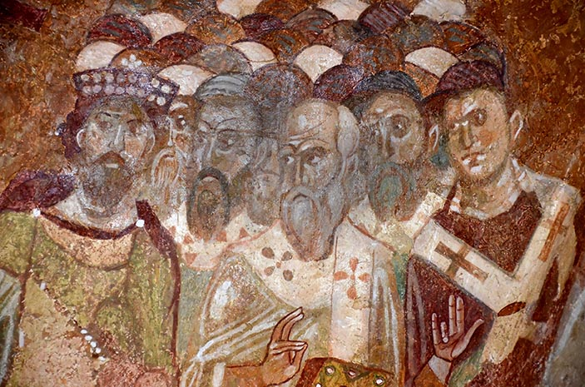
“Who Are the Fathers of the Church?” and “Church Decisions and Doctrine”
(Church History, pages 28–32)
The Fathers of the Church
clarified key Christian
beliefs in Ecumenical
Councils.
During this time
differences between
the Eastern and
Western Churches grew.
(This is a fresco of the Council of Nicea.)
© mountainpix/S hutterstock.com

Slide 11
Journal It!
Look at the list of Church Fathers on pages 29 and 30.
Choose one Church Father. Do an online search of this Church Father’s quotes. Write one or two of them on paper and share them with your group.
You might want to illustrate one as a meme.

Slide 12
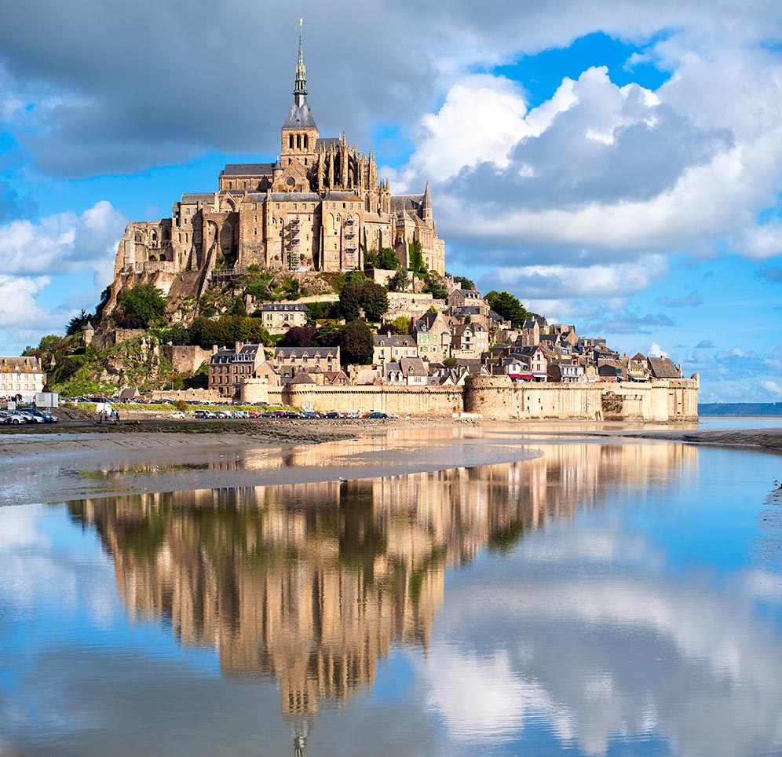
“The Roman Empire Falls” and
“Our Church Today”
(Church History, pages 33–39)
Despite the chaos
that occurred when
the Western Roman
Empire fell, the
Church remained
strong and provided
stability.
© Boris Stroujko / Shutterstock.com

Slide 13
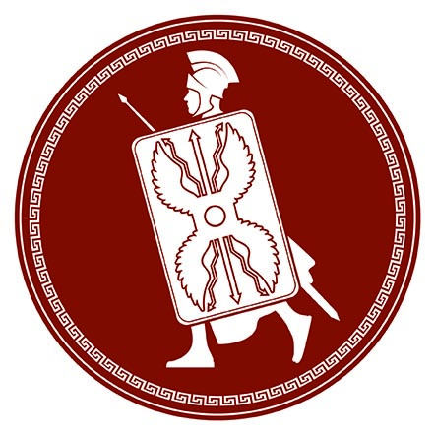
Rome and Constantinople
When Constantine moved the
capital to Constantinople,
the Eastern Roman Empire
grew in power and influence.
The Western Roman Empire
continued to decay and
finally fell in 476 A.D.
© LANTERIA/Shutterstock.com

Slide 14

The Widening Role of the Church
The role of the Church
became more important.
The Church organized
to provide for the poor, to
educate boys, to pay for
protecting armies, and even
to maintain city services.
Spiritually, the Church
offered stability and hope.
© Dxinerz-Pvt-Ltd/Shutterstock.com

Slide 15
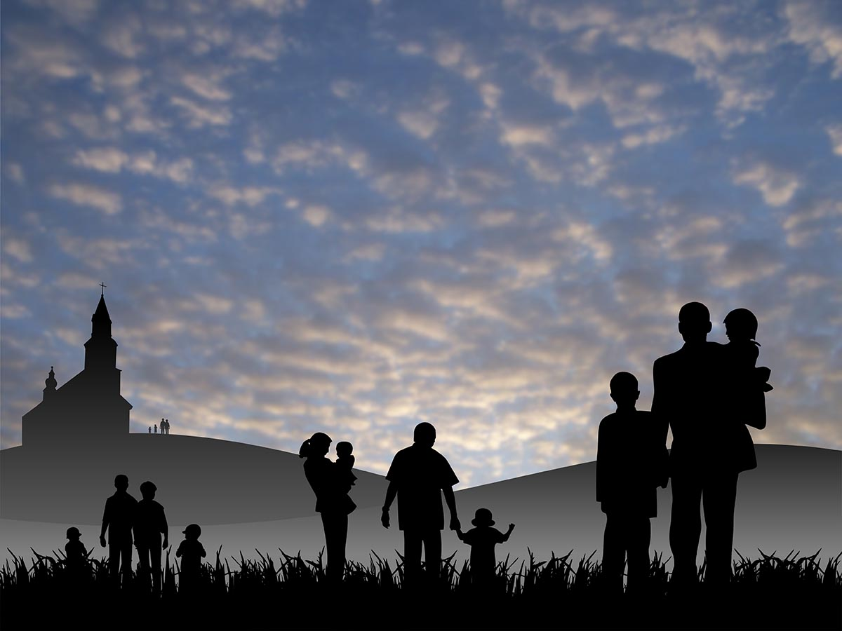
Share It!
Each parish is a microcosm of the world-wide Church.
Gather in pairs, discuss, and share: How does your parish help parishioners and society as a whole in the following areas?
Aid to the poor
Education of children
and adults
Spiritual aid through prayer
and the Sacraments
Concern and aid for the
world-wide Church
© alexwhite/Shutterstock.com

Slide 16
Pray It!
A litany is an ancient form of prayer that we use today. The Fathers of the Church would have prayed litanies.
Gather in groups of two or three. Write petitions for the Church today.
Pray them aloud with the whole group. After each petition, respond “Kyrie eleison” (Lord, have mercy). Like the Church Fathers, you will be praying in Greek!

