Slide 1
Overview of the Old and New Testaments
The Living Word: The Revelation of God’s Love, Second Edition
Unit 2, Chapter 6
Document#: TX004684

Slide 2
The “Old” Testament
Old does not mean “out of date.”
The Old Testament lays the framework for our Christian faith.
It is the account of a loving relationship between God and the Hebrew people.
© Christian Delbert / Shutterstock.com
Notes:
Notes: Explain to the students that the descendants of Sarah and Abraham may be called Hebrews, Israelites, or Jews, depending on the historical period.
This slide corresponds to content in article 28, “The Old Testament: Old Does Not Mean ‘Out of Date,’” in the student book.

Slide 3
Sacred for Christians
Jesus fulfills the prophecies of the Old Testament.
The books of the Old Testament bear witness to God’s plan of salvation.
© sumos / iStockphoto.com
Notes:
Notes: Point out to the students that the Old Testament contains Scripture that is sacred to the Jewish people. Ask the students to name a person or event in the Old Testament that they find especially meaningful or memorable and explain why.
This slide corresponds to content in article 28, “The Old Testament: Old Does Not Mean ‘Out of Date,’” in the student book.

Slide 4
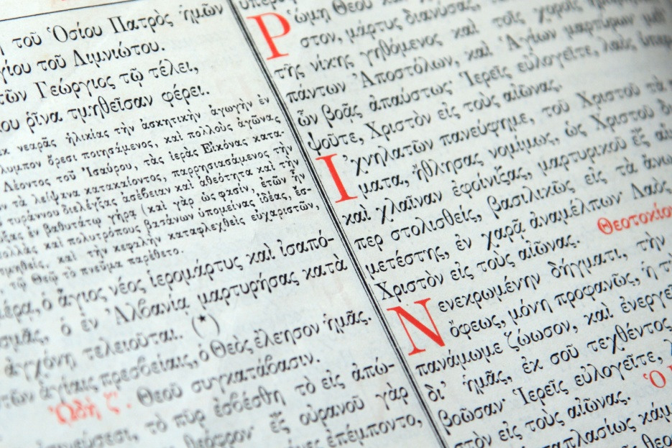
The Canon of the Old Testament
The Catholic Bible contains forty-six Old Testament books.
It includes seven Old Testament books not found in the Protestant Bible.
They are called the deuterocanonical books.
© Netfalls - Remy Musser / Shutterstock.com
Notes:
Notes: Explain to the students that the deuterocanonical books are included in the Catholic Bible because the Church recognizes the validity of the Greek translation of the Old Testament known as the Septuagint. Protestant reformers relied on Hebrew texts only.
This slide corresponds to content in article 29, “The Canon and Structure of the Old Testament,” in the student book.

Slide 5
Types of Books in the Old Testament
The books of law (Torah, Pentateuch, Law of Moses)
The historical books
The prophetic books
The wisdom books
© Matt Ragen / Shutterstock.com
Notes:
Notes: Review with the students the content of each category, as described in article 29 in the student book.
This slide corresponds to content in article 29, “The Canon and Structure of the Old Testament,” in the student book.

Slide 6
The “New” Testament
It is called “new” because God sent his only Son, Jesus Christ, to initiate a New Covenant.
Christ opened the doors to a new day, a new Revelation, a new freedom.
© glenda / Shutterstock.com
Notes:
Notes: Explain to the students that God revealed himself in Jesus in a way that God had never before done.
This slide corresponds to content in article 30, “The New Testament: Why Is It Called ‘New’?” in the student book.

Slide 7
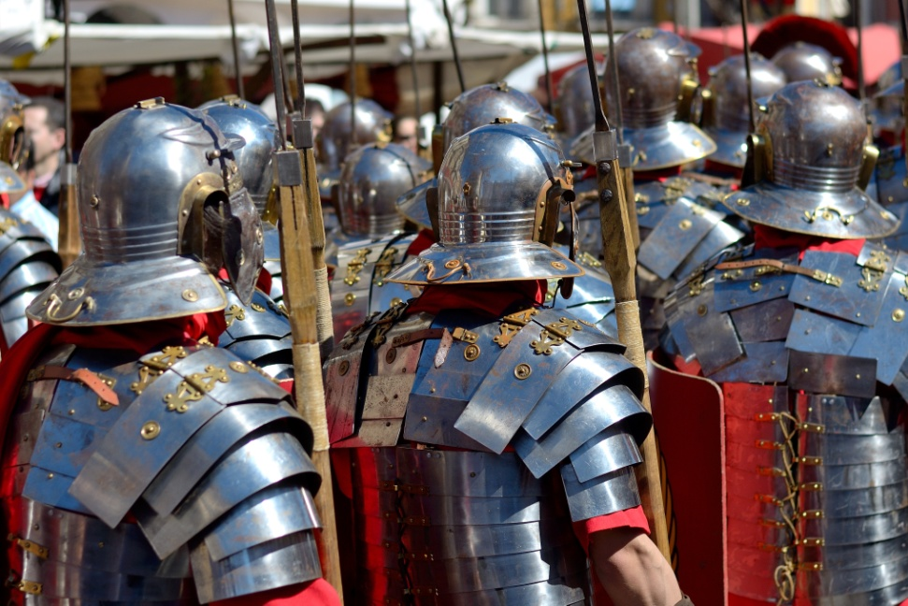
Politics
Jesus lived in Palestine, or the Holy Land, in a diverse society.
The major provinces were Judea, Samaria, and Galilee.
Palestine was governed by Roman rule and was also influenced by Greek culture.
© jcfmorata / Shutterstock.com
Notes:
Notes: Point out to the students that Palestine had been conquered by its enemy, Rome; it was occupied territory.
This slide corresponds to content in article 30, “The New Testament: Why Is It Called ‘New’?” in the student book.

Slide 8
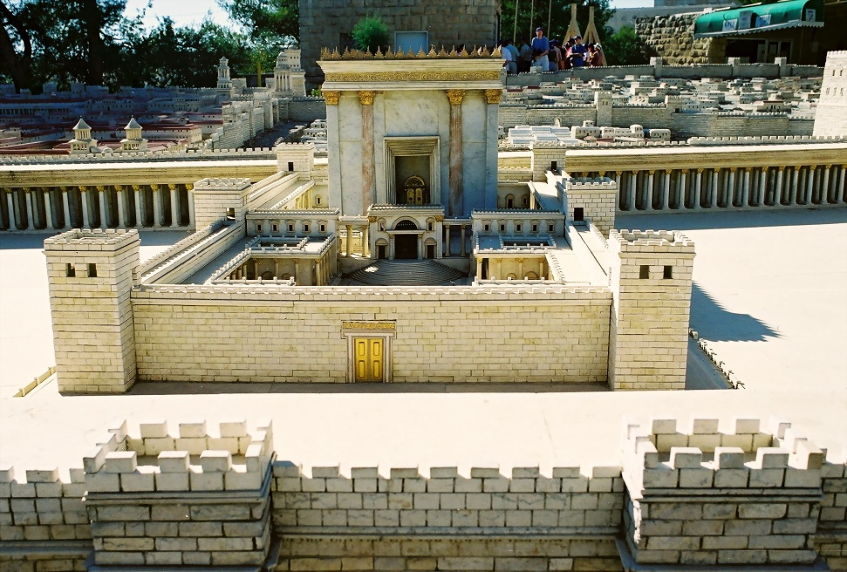
Religious Groups
Pharisees strictly observed the Law of Moses.
Sadducees were associated with the Temple in Jerusalem.
Esssenes were pious and conservative.
Zealots supported violent resistance to Roman occupation.
© IndianSummer / Shutterstock.com
Notes:
Notes: Explain to the students that 90 percent of the Jewish people did not belong to any sect. Jesus focused most of his efforts on this majority.
This slide corresponds to content in the Did You Know? sidebar in article 30 in the student book.

Slide 9
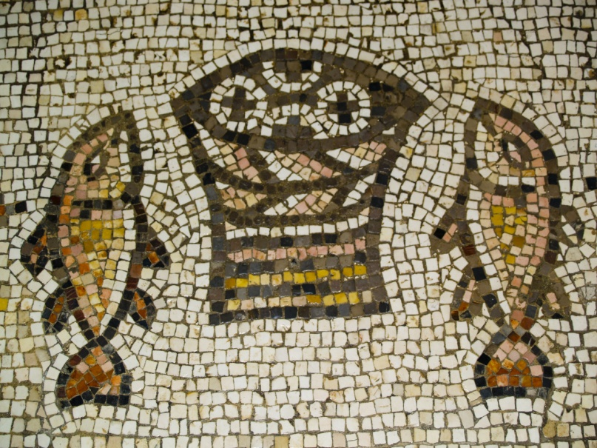
The Focus of the New Testament
It centers on Jesus Christ and all that he accomplished for the sake of our salvation.
It describes how the early Christian communities applied his teachings.
It covers events from 4 BC to AD 100.
© Doin Oakenhelm / Shutterstock.com
Notes:
Notes: Point out to the students that the Gospels are called the heart of the Christian message and the heart of all Scripture. Ask the students to identify events in the Gospels that they would like to learn more about.
This slide corresponds to content in article 30, “The New Testament: Why Is It Called ‘New’?” in the student book.

Slide 10
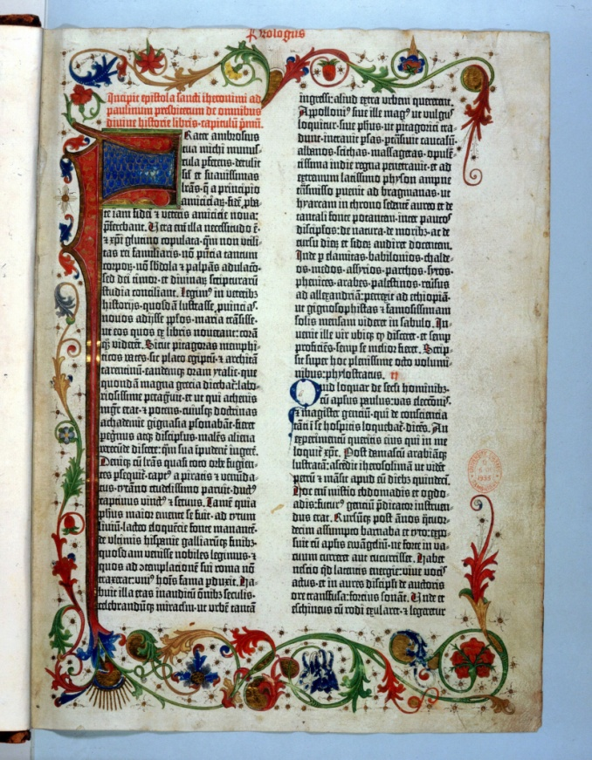
The Canon of the New Testament
The Gospels
• The Acts of the Apostles
• The Pauline letters
• The non-Pauline letters
• The Book of Revelation
© Photos.com / Thinkstock
Notes:
Notes: Challenge the students to recall events or teachings from each of these five categories. Remind them that readings from each category are included in the Lectionary and proclaimed at Mass during the liturgical year.
This slide corresponds to content in article 31, “The Canon and Structure of the New Testament,” in the student book.

Slide 11
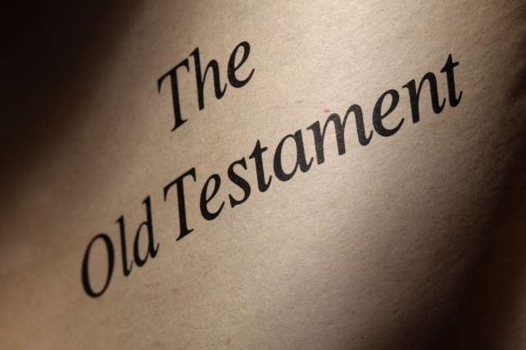
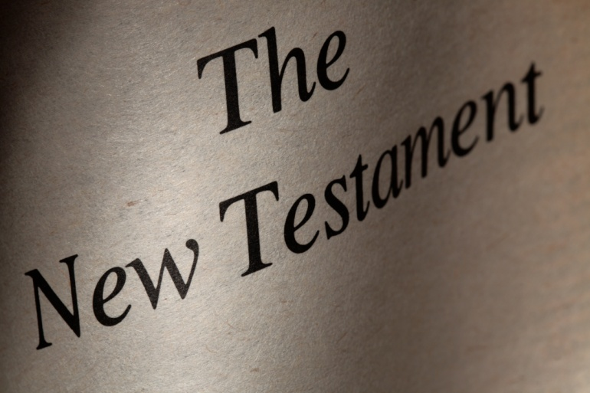
The Unity of the Old and New
Salvation history recorded in the Old Testament enables us to understand the life and mission of Jesus Christ.
The New Covenant is founded upon the Old, and the Old Covenant illuminates the way to the New.
© ptnphoto / Shutterstock.com
© ptnphoto / Shutterstock.com
Notes:
Notes: Ask the students the question at the end of article 32 in the student book: Why do we say that Sacred Scripture is a gift to all humanity?
This slide corresponds to content in article 32, “The Unity of the Old and New,” in the student book.

