Slide 1
The Popes of the Renaissance
Church History, Unit 4

Slide 2
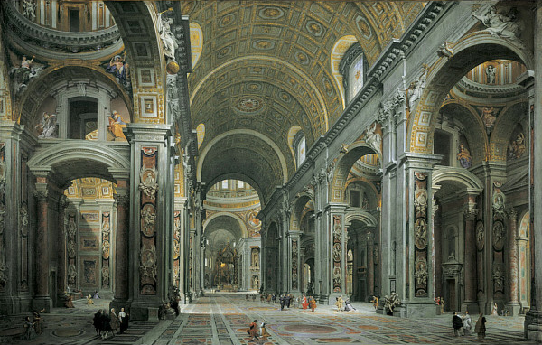
Ten popes headed the Church during the Renaissance:
Nicholas V
Callistus III
Pius II
Paul II
Sixtus IV
Innocent VIII
Alexander VI
Pius III
Julius II
Leo X
These popes reigned from 1447 to 1521.
Image in public domain

Slide 3
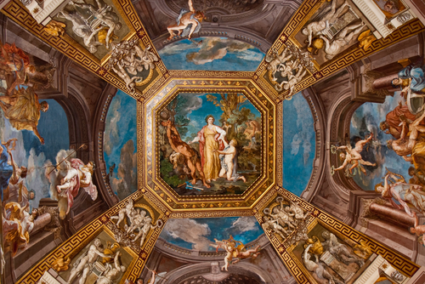
These ten Renaissance popes advanced the humanist movement by serving as patrons of the arts and initiating grand building projects.
Many of the works commissioned by the Renaissance popes still enrich the Church and the world today.
© Shutterstock/piotrwzk
Notes:
Image: Giotto di Bondone (1267–1337), Cappella Scrovegni a Padova, Life of Christ, Lamentation (The Mourning of Christ) Category:Giotto Category:Jesus Christ

Slide 4
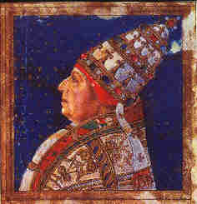
The efforts made by these popes during their respective reigns were sometimes less than positive.
At times their motivation was personal gain, not the glorification of God.
Some used their power to enrich themselves and promote their families, such as by appointing relatives to the college of cardinals.
For example, Pope Alexander VI appointed at least eight wealthy and powerful family members.
Image in public domain

Slide 5
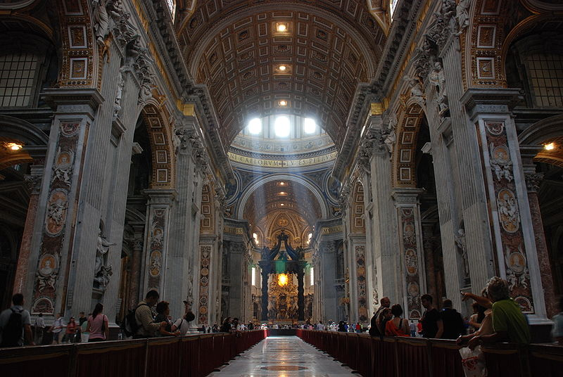
Renaissance-era art projects and new buildings cost a great deal, so various popes sought new sources of revenue to fund them.
It was in this period that the sale of indulgences began.
The sale of indulgences is the practice that led to the revolution in the Church that we now know as the Protestant Reformation.
Image in public domain

