Slide 1
Introduction to the Gospels
Document # TX004711

Slide 2
The Gospels
The Gospels are the heart of the Scriptures.
The four Gospels are Matthew, Mark, Luke, and John.
The Gospels bring the Good News of the Incarnation of Jesus Christ.
They also herald that Jesus came to fulfill the promises God made to our ancestors and to overcome the slavery of sin and death.
© Saint Mary’s Press
Notes:
Notes: Take time with the bullet on the Incarnation. Question the students to see if they know what the word Incarnation means. They should be clear that it indicates that Jesus, the Word of God, became flesh. Also be sure the students know that the Gospels build on Old Testament themes and point to Jesus as the New Covenant. Finally, the students should know that the word gospel comes from the Greek word for “Good News.”

Slide 3
Characteristics of the Gospels
The Gospels are the main source of information about the life and teachings of Jesus.
The Gospels are God’s Revelation.
When we encounter Jesus in the Gospels, we encounter God’s most definitive and perfect Revelation.
Each Gospel presents a unique perspective on Jesus.
© Ahturner / Shutterstock.com
Notes:
Notes: To expand on the content of this slide, ask the students what they understand about the idea that Jesus is God’s most definitive and perfect Revelation. You could ask a question such as, “Why would Jesus be able to reveal God to us in a perfect manner?” This will also help you to determine if any students are failing to grasp the material.

Slide 4
The Synoptic Gospels
Matthew, Mark, and Luke are called synoptic Gospels.
These Gospels are similar in style and share much of the same content.
Public domain
Notes:
Notes: Explain that synoptic comes from a Greek word meaning “seeing the whole together.” Many scholars believe that both Luke and Matthew used Mark as a source when writing their Gospels. Some scholars also propose that Luke and Matthew may have used a second source known as the Quelle, or Q Source.

Slide 5
The Gospel of Matthew
Who Was Matthew?
Jewish Christian well versed in the Hebrew Scriptures
Approximate Date of Authorship:
AD 85
Intended Audience:
Mixed community of Jewish Christians and Gentiles
Issues Addressed:
A possible rejection and even some persecution of Jewish Christians for their belief in Jesus
Public domain

Slide 6
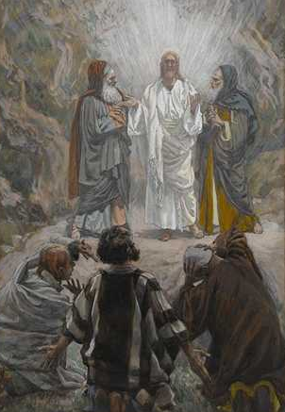
Matthew’s Image of Jesus
Matthew wanted his Jewish Christian readers to know that believing in Jesus was a continuation of their tradition.
Matthew highlights Jesus as the fulfillment of many Old Testament hopes and prophecies.
Jesus is presented with clear ties to Jewish ancestry. The genealogy at the beginning of the Gospel is one example.
Public domain
Notes:
Notes: Ensure that the students understand what a genealogy is. If time permits, have the students go through the genealogy of Jesus in the Gospel of Matthew. Ask them if they notice anything in particular. Point out that within Jesus’ genealogy are men and women, people who are wealthy and people who are poor, indicating that Jesus came to save all.

Slide 7
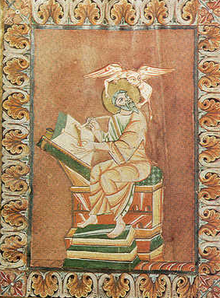
The Gospel of Mark
Who Was Mark?
Gentile Christian who may have been a disciple of Peter
Approximate Date of Authorship:
AD 65–70
Intended Audience:
Non-Jewish Christians
Issues Addressed:
Members of the community being persecuted (even to death) for their beliefs
Public domain

Slide 8
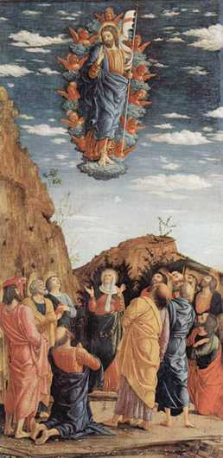
Mark’s Image of Jesus
Mark includes an aura of secrecy in this Gospel known as the messianic secret.
Mark emphasizes the humanity of Jesus.
Central to Mark’s Christology is the image of Jesus as the Suffering Servant.
True discipleship must imitate Jesus in both his ministry and his suffering.
Public domain
Notes:
Notes: Another thing the students may find interesting about the Gospel of Mark is that at the beginning the disciples are depicted as models of faith, due to their leaving everything behind and following Jesus. However, as the Gospel unfolds, they are sometimes portrayed unfavorably and as lacking faith. This will add to a fuller picture of the Gospel.

Slide 9
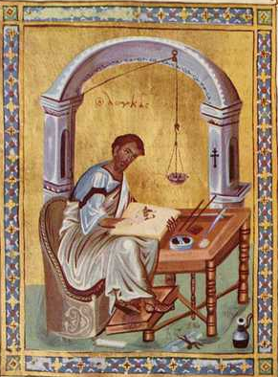
The Gospel of Luke
Who Was Luke?
Gentile convert to Christianity, and the author who wrote not only the Gospel of Luke but also the Acts of the Apostles
Approximate Date of Authorship:
AD 80–90
Intended Audience:
The audience of both the Gospel of Luke and the Acts of the Apostles is identified as Theophilus, meaning “lover of God.”
Public domain

Slide 10
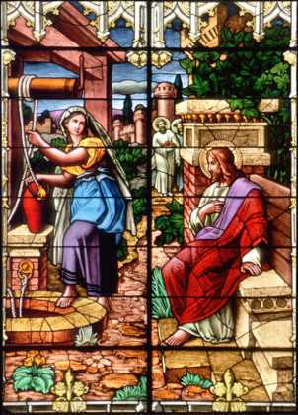
Luke’s Image of Jesus
Jesus is the compassionate Savior who welcomes all.
Much of Jesus’ ministry and preaching is directed toward the plight of the anawim.
Luke emphasizes the presence of women in the ministry of Jesus.
The final groups given special attention in the Gospel of Luke are those who are sick and sinners.
© The Crosiers/Gene Plaisted, OSC
Notes:
Notes: Add to the information on this slide that anawim is the Hebrew word for “the poor and marginalized.” Also apparent in Luke’s Gospel is that Jesus’ message of salvation was not confined to a particular religious or social group but rather to anyone who was open to hear and heed the Good News.

Slide 11
The Gospel of John
Who Was John?
The actual author is unknown.
Many believe the author was a member of a Christian community founded by the Beloved Disciple.
Approximate Date of Authorship:
AD 90–100
Public domain
Notes:
Notes: Remind the students that the Gospel of John is not one of the synoptic Gospels. Its tradition and teachings represent those of the whole Johannine community rather than just one individual.

Slide 12
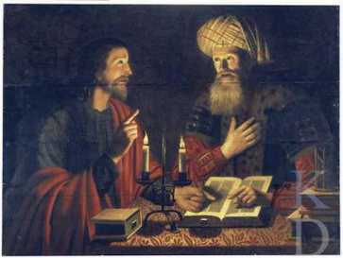
Characteristics of John’s Gospel
Twofold purpose:
To evangelize both Gentiles and Jews
To strengthen the faith of the local community as well as Christians everywhere
Two books in one Gospel:
In the first half of the Gospel, Jesus teaches mainly through signs that reveal his identity.
The second half of the Gospel focuses on the Passion, death, Resurrection, and Ascension— the events that glorify Jesus.
Image in public domain
Public domain
Notes:
Notes: John 1:19–12:50 is commonly known as the Book of Signs. John 13:1–20:31 is known as the Book of Glory.

Slide 13
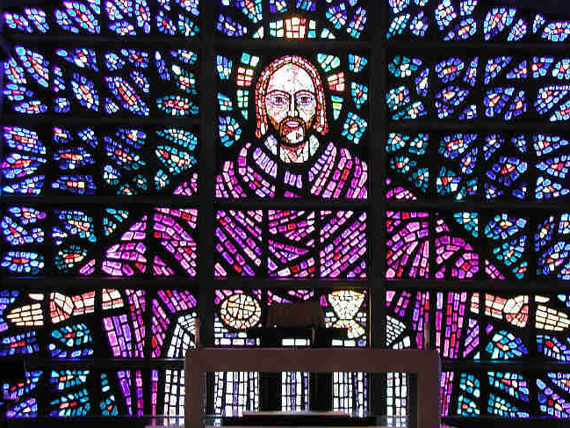
John’s Image of Jesus
The synoptic Gospels emphasize the humanity of Jesus.
The Gospel of John emphasizes the divinity of Jesus.
John uses high Christology—a term used to describe how John proclaims from the very beginning that Jesus is God, the Eternal Word of the Father.
Public domain
Notes:
Notes: The students should be informed that Christology means “the study of Christ.” For further discussion you could ask the students what some advantages and disadvantages are of using high Christology when learning about Christ and his mission.

