Slide 1
Chapter 8: Taoism
World Religions: A Voyage of Discovery
DOC ID #: TX003945

Slide 2
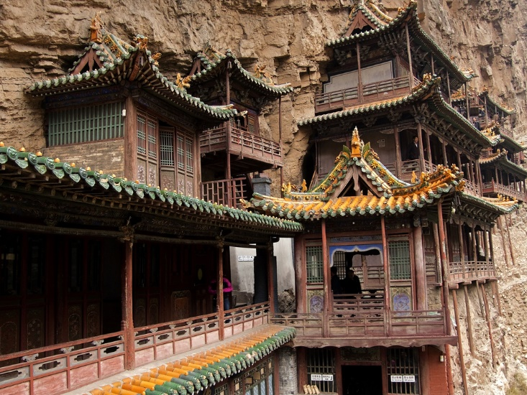
Hanging Temple
The Hanging Temple was built some fifteen hundred years ago.
It combines elements of Confucianism, Taoism, and Buddhism.
Chinese religion is a tapestry that includes the threads of all three traditions.
© Ryszard Stelmachowicz / www.shutterstock.com
Notes:
Notes: The Hanging Temple, or Hanging Monastery, is located near Datong, China. This slide also appears in the set on Confucianism. It is relevant here for the same reasons, that Chinese religion is best understood as a tapestry of three main traditions woven together. This would be a good occasion to explore with the students the depiction of Confucius in the Chuang Tzu, where he sometimes comes across as a Taoist sage, but more frequently falls far short of sageness because of his overly yang-oriented approach to life, insisting on social propriety and ethical conduct. In Burton Watson’s translation, titled Chuang Tzu: Basic Writings, see especially pages 34, 41, 42, 50–55, 68, 82–83, and 86–87. Watson also offers helpful points of explanation in his introduction.

Slide 3
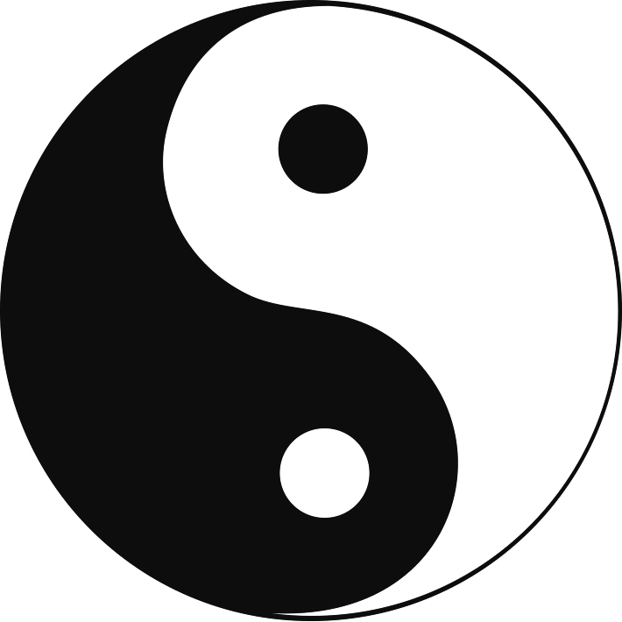
Symbol of Yin and Yang
This symbol signifies Chinese belief in complementary energies that form a balanced, harmonious whole
Yang represents the male, light, and hot.
Yin represents the female, darkness, and cold.
© Svitlana Amelina / www.shutterstock.com
Notes:
Notes: Literally, yang means “the south side of a mountain,” and yin means “the north side of a mountain.” The constant interpenetration of yin and yang is portrayed by the spots of each contained within the larger space of the other. Taoist philosophy tends to perceive human nature as too prone to emphasize the yang aspects, causing an overly assertive approach to life. Many passages in the Tao Te-ching and the Chuang Tzu address the need to settle back into a more yin-oriented existence.

Slide 4
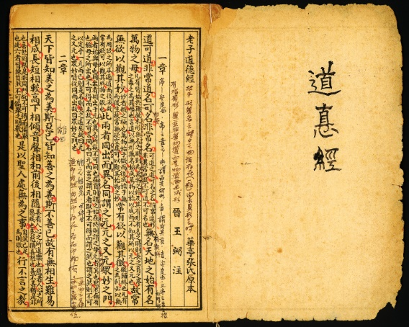
Tao Te Ching
The Tao Te Ching is among the most commonly translated books in the world.
Even scholars who are fluent in Chinese find the text difficult to interpret.
It was likely intended to be ambiguous in meaning.
© ixsblue / www.istockphoto.com
Notes:
Notes: The rather widely divergent translations of key terms and phrases reflect the underlying difficulty of determining the precise meaning of the Tao Te Ching. The student book includes a section called “The Arts of Translation” that offers a quick study of variations. Scholars tend to regard Lao Tzu (or Laozi) as a composite rather than single historical figure. Chuang Tzu (or Zhuangzi) is generally considered to have been an actual individual of the fourth century BC, although details about his life are scant.

Slide 5
The River
Taoist texts draw on the symbolism of water to convey essential teachings.
The river demonstrates wu-wei, “nonaction.”
The natural tendency of the water is to settle into rather than to fight against the natural course of the river.
© aspen rock / www.shutterstock.com
Notes:
Notes: Some examples in the Tao Te Ching include chapters 6, 15, 28, 32, 39, and 41, all of which draw on the idea of the valley; chapter 8, in which the best man is said to be like water; chapter 9, which advises against overfilling a cup; chapters 61 and 66, which refer directly to the ideal of being like a river; and chapter 43, with its teaching that the softest things can overcome the hardest, invites consideration of the effects over time of rivers as they carve away rock and form deeper valleys and canyons.

Slide 6
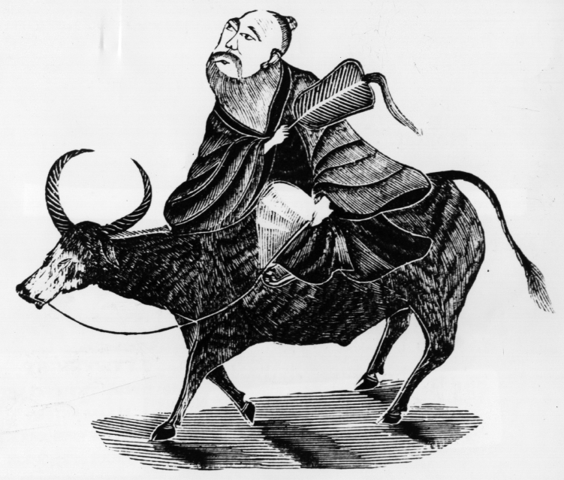
Lao Tzu
Lao Tzu is said to have written the eighty-one chapters of the Tao Te Ching.
He then retired from the realm of mortals.
He is venerated by Taoists as the founder of their tradition.
© HultonArchive / www.istockphoto.com
Notes:
Notes: As noted on slide 4, scholars tend to regard Lao Tzu (or Laozi) as a composite rather than single historical figure. The next slide addresses the deification of Lao Tzu, which proved crucial to the development of Taoism as a religion.

Slide 7
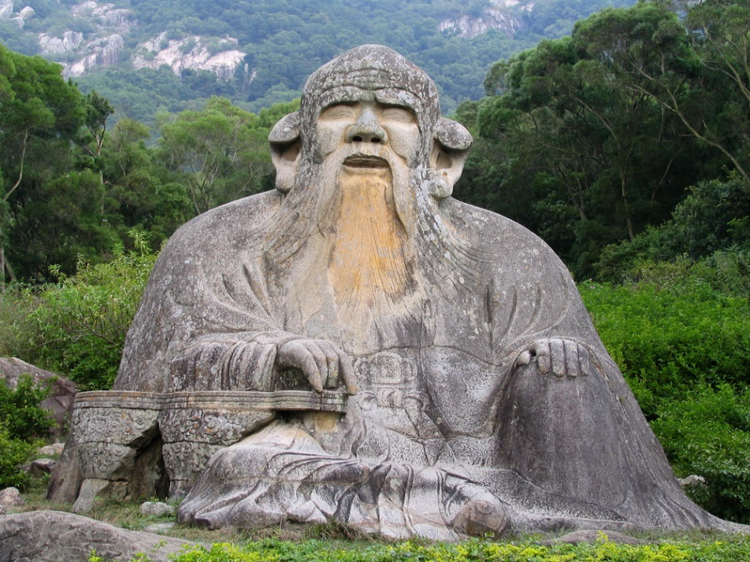
Lao Tzu Deified
By the second century AD, Lao Tzu had come to be regarded as divine.
He is revered as the human incarnation of Tao.
He had appeared at various times in the past to deliver to the world teachings essential for salvation.
© Luisa Fernanda Gonzalez / www.shutterstock.com
Notes:
Notes: Taoist religion eventually developed a pantheon of deities, with Lao Tzu being the chief one. The student book chapter intentionally avoids any detailed consideration of Taoist religion, apart from its textual foundations, but the ideas suggested by this slide might provide a good platform for delving into some of the details. The Taoist pantheon could be considered, or the interesting teachings on the pursuit of physical immortality. In 2000 the Art Institute of Chicago developed an informative website with fine works of art, available at http://www.artic.edu/taoism/renaissance/introg.php.

Slide 8
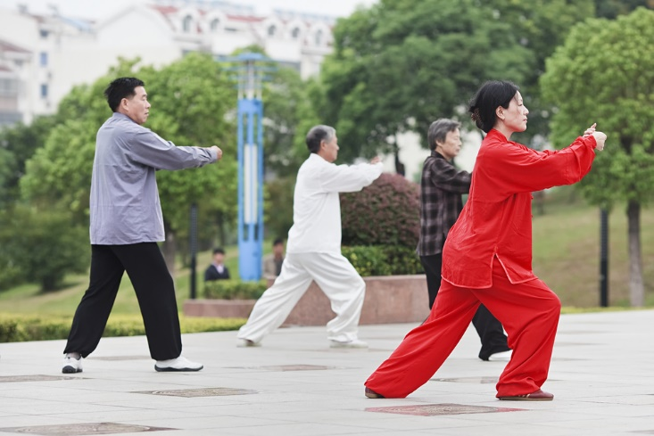
T’ai Chi
T’ai chi is rooted in Taoist philosophy.
It involves the harnessing of ch’i, vital energy for bodily and spiritual health.
The growing popularity of t’ai chi in Western societies suggests the enduring value of the ancient Taoist teachings.
© TonyV3112 / www.shutterstock.com
Notes:
Notes: This same slide is included in the chapter 1 set, as an example of the sometimes thin line between the religious and the secular. This slide depicts t’ai chi being practiced in Yangzhou, China.

Slide 9
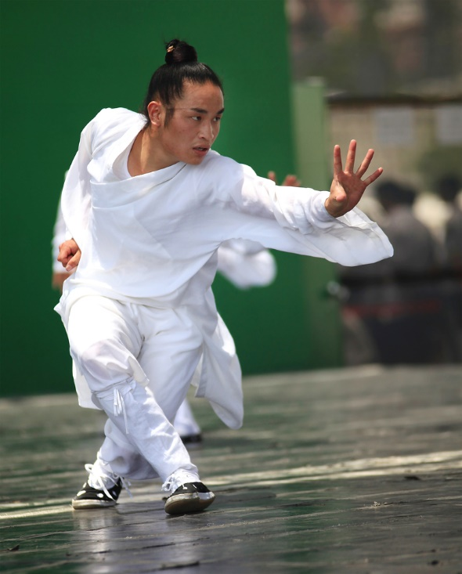
Taoism and Martial Arts
Martial arts like judo depend on the Taoist teaching of wu-wei.
The Tao Te Ching states that the softest things can overcome the hardest.
The martial arts embody this ideal by letting the opponent’s strength lead to defeat.
© testing / www.shutterstock.com
Notes:
Notes: One aspect of wu-wei is yielding in the yin-like manner of a river as it flows naturally. Chapter 43 of the Tao Te Ching specifically states that the softest things overcome the hardest; the same idea is expressed in several other chapters. The Internet abounds with websites emphasizing the interrelationship of Taoism and the martial arts. For example, the website of the Chinese organization Wudang Taoist Traditional Kung Fu Academy, available at http://www.wudanggongfu.com/.

Slide 10
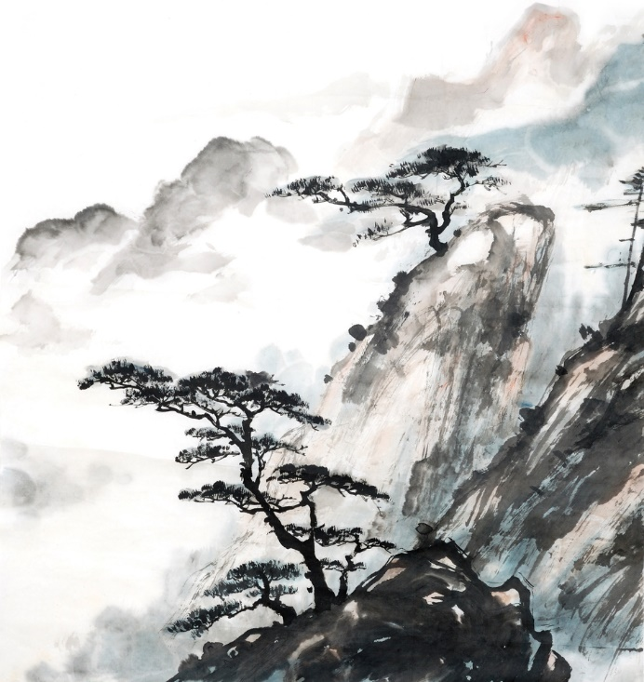
Taoism and Chinese Landscape Painting
Chinese landscape paintings illustrate Taoist influence in their depiction of balance and tranquility in nature.
Like calligraphy, the painting is done with brush and ink.
It is most commonly done on paper or silk.
© iBird / www.shutterstock.com
Notes:
Notes: The Metropolitan Museum of Art provides a fine web page devoted to Chinese landscape painting: http://www.metmuseum.org/toah/hd/clpg/hd_clpg.htm.

Slide 11
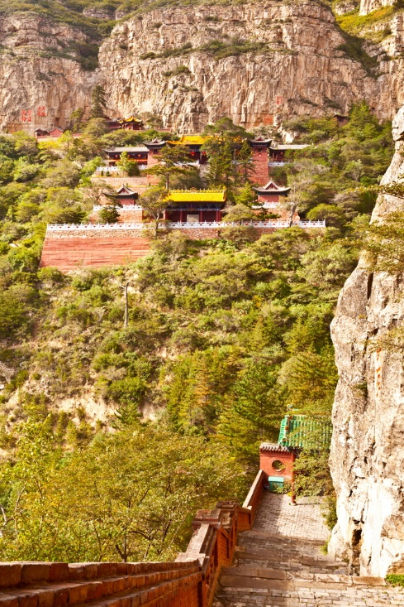
Taoist Temple
Taoism teaches the supremacy of nature.
Mountain settings are natural sites for Taoist temples.
Mount Heng (Heng Shan) is one of the Five Sacred Mountains of China.
© Meiqianbao / www.shutterstock.com
Notes:
Notes: In the last few decades, a resurgence in the interest of Taoism has led to the refurbishment and better maintaining of temples. The Chinese Taoist Association, which provides an English version of its website, is the main organization in the People’s Republic of China that orchestrates such restoration efforts: http://www.taoist.org.cn/webfront/English.jsp.

