Slide 1
The Lord’s Prayer: Human Need
The Catholic Faith Handbook for Youth, Third Edition
Chapter 39
Document #: TX003170
Notes:
Use this presentation, along with the one for chapter 38, as a quiet reflection on the Lord’s Prayer. Consider playing instrumental music and allowing time after each slide for journaling. If you are showing this presentation immediately after the previous one, begin the presentation at slide 3.

Slide 2

Let us remember that we are in the holy presence of God.
Copyright: Julia Ivantsova / www.shutterstock.com

Slide 3
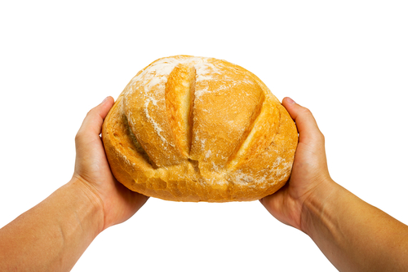
Give Us This Day
“Ask, and it will be given you; search, and you will find; knock, and the door will be opened for you” (Matthew 7:7).
How can I acknowledge my need for God every day?
Copyright: Nomad_Soul / www.shutterstock.com

Slide 4

Our Daily Bread
Copyright: photostudio 7 / www.shutterstock.com
“One does not live by bread alone,
but by every word that comes from the mouth of God.”
(Matthew 4:4)
How can I more fully trust in God’s care for me and others?
How can I better reflect God’s care for all people?

Slide 5
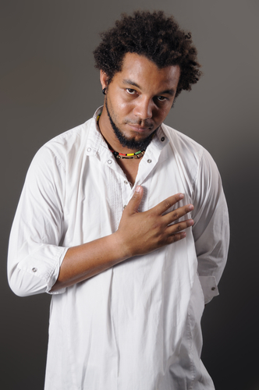
And Forgive Us Our Trespasses
In Christ “we have redemption, the forgiveness of sins” (Colossians 1:14).
How can I become more aware of my sins and my need for forgiveness?
Copyright: Roxana Gonzalez / www.shutterstock.com

Slide 6
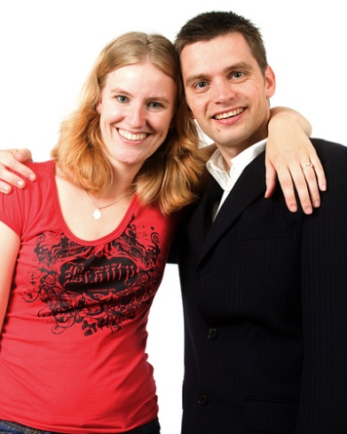
As We Forgive Those Who
Trespass against Us
Copyright: Valesca Hogeboom / www.shutterstock.com
“. . . those who do not love a brother or sister whom they have seen, cannot love God whom they have not seen” (1 John 4:20).
How can I become more committed to forgiving those who have hurt me?

Slide 7

Lead Us Not into Temptation
“But one is tempted by one’s own desire, being lured and enticed by it” (James 1:14).
What can I do to avoid situations of temptation?
Copyright: Piotr Marcinski / www.shutterstock.com

Slide 8

But Deliver Us from Evil
“I am not asking you to take them out of the world, but I ask you to protect them from the evil one” (John 17:15).
How can I more fully trust that God is freeing the world from sin and evil?
Copyright: Skyline / www.shutterstock.com
Notes:
(The Scripture quotations contained herein are from the New Revised Standard Version of the Bible, Catholic Edition. Copyright © 1993 and 1989 by the Division of Christian Education of the National Council of the Churches of Christ in the United States of America. All rights reserved.)

