Slide 1
Living Justly
Catholic Social Teaching, Unit 8
Document #: TX002047
Notes:
[Music: Introduction music such as “Peace Is Flowing like a River”]

Slide 2
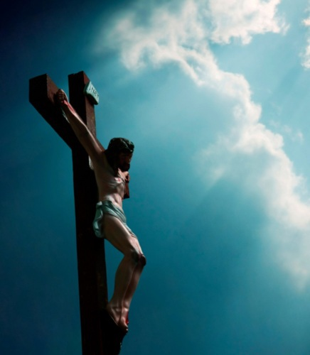
The Beatitudes Guide Our Actions
The Beatitudes are the fulfillment of God’s Covenant promises to Abraham.
The Beatitudes teach us the actions and attitudes essential for a Christian life.
The Beatitudes provide us with hope and courage to meet the challenges of this world.
Image in shutterstock

Slide 3
Becoming Poor in Spirit
“Blessed are the poor in spirit, / for theirs is the kingdom of heaven.”
(Matthew 5:3)
The first Beatitude calls us to place our complete trust in God.
We are called to choose a lifestyle based on contributing to the common good.

Slide 4
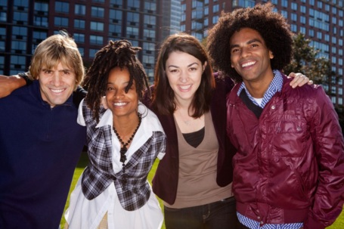
Example of Living in Solidarity: Catholic Worker Movement
The Catholic Worker movement was founded in 1933 by Dorothy Day and Peter Maurin.
Image in shutterstock
In 2010 the Catholic Worker Web site reported more than 185 Catholic Worker communities around the world, with 168 of them in the United States.
The movement practices a commitment to radical nonviolence, living the works of mercy, and living with the poor people they serve.

Slide 5
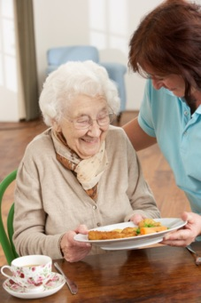
Becoming Compassionate
“Blessed are they who mourn, / for they will be comforted.”
(Matthew 5:4)
The second beatitude calls us to offer compassion to those who are suffering.
God calls us to be moved by the suffering and needs
of others and by the effects of sin and evil in the world.
Discussion
We are called to take action through prayer, works of charity, and works of justice. In what particular ways
are you called to action? In what ways are teens in general called?
Image in shutterstock

Slide 6
Example of Compassionate Service: Project Rachel
Project Rachel provides ministry to women and men whose lives have been touched by the loss of abortion.
Every human being deserves to know God’s compassion, forgiveness, and healing.
Project Rachel shows the world that justice and mercy must walk
hand-in-hand.

Slide 7
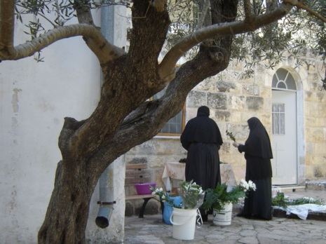
Example of Service: Vow of Poverty
Those who are called to the consecrated life offer a powerful witness of solidarity.
The vow of poverty is a public expression of the commitment to live the evangelical counsel of poverty.
Members of a religious community share their finances, and the community provides for basic needs: food, housing, clothing, transportation, and so on.

Slide 8
Becoming Meek and Thirsting
for Righteousness
“Blessed are the meek, / for they will inherit the land. / Blessed are they who hunger and thirst for righteousness, / for they will be satisfied.”
(Matthew 5:5–6)
The third and fourth beatitudes ask us to be willing . . .
to sacrifice our own comfort for the good of others
to endure injury with patience and without resentment
to respond to personal attacks with gentleness and forgiveness

Slide 9

Becoming Merciful
“Blessed are the merciful, / for they will be shown mercy.” (Matthew 5:7)
The fifth beatitude teaches us to live with mercy and forgiveness in the Christian life.
Christ calls us to be quick to ask for forgiveness and quick to extend forgiveness to others.
Reflection
How do you ask for or extend forgiveness?
Image in shutterstock

Slide 10
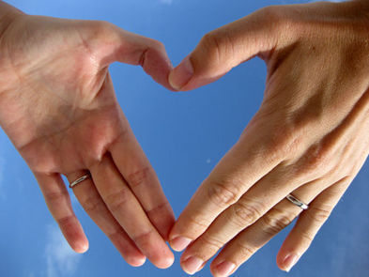
Becoming Clean of Heart
The sixth beatitude calls us to desire to be holy people—charitable and chaste.
Image in shutterstock
The sixth beatitude is connected to the Ninth Commandment: “You shall not covet your neighbor’s wife.”
Blessed are the clean of heart, / for they will see God.” (Matthew 5:8)
The struggle to keep our hearts pure can be a spiritual battle.
The virtue of modesty means avoiding sexually explicit talk, sexually explicit images, and sexually explicit dress.
Keeping a pure heart requires patience, decency, and good judgment.
Discussion
What can you do to call other teens to become more supportive of modesty?

Slide 11
Becoming Peacemakers and Suffering for Righteousness
“Blessed are the peacemakers, / for they will be called children of God.”
(Matthew 5:9)
In the seventh beatitude, Jesus gives high spiritual praise to those who make peace as “children of God.”
Image in shutterstock
A true peacemaker confronts injustice and violence with courage and love.
Reflection
In what ways do you live as a peacemaker?

Slide 12
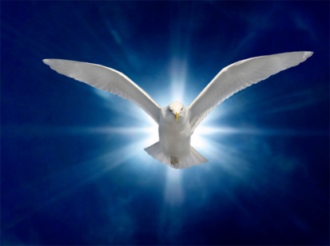
Eschatological Hope
Eschatological hope means . . .
relying on God’s grace to persevere
focusing on eternal reward
knowing that this earthly existence is passing away and that God has something better in store
Image in shutterstock

Slide 13
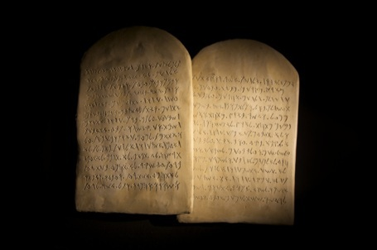
Christ Reminds Us
True power and strength come from . . .
living a life of virtue
following his Commandments
Image in shutterstock

Slide 14
Keep Holy the Sabbath
The Third Commandment is a reminder about the importance of . . .
balancing action and prayer
making God and his law our top priority
renewing ourselves to live our Christian vocation
Reflection
How do you do this on a daily basis?
Image in shutterstock

Slide 15
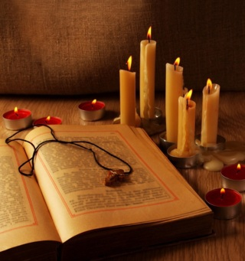
Keep Holy the Sabbath (continued)
God blessed the seventh day and made it holy.
The purposes of Sabbath are rest, renewal, and healing.
Human beings need to rest from labor.
We all need to take time to deepen our relationship with God.
We can take time on the Sabbath to do good works for others.
Discussion
Image in shutterstock
How can we relieve the burdens of those who are poor or suffering?

Slide 16
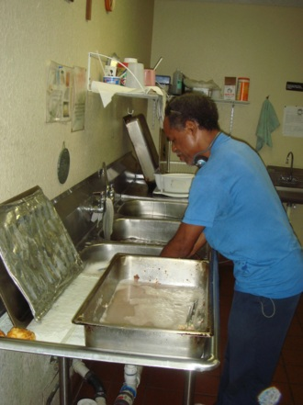
Keep Holy the Sabbath (continued)
Do you attend Mass?
Do you take time to renew body and soul?
Do you spend time in relationship with God?
Do you engage in works to help others?

Slide 17
Keep Holy the Sabbath (continued)
We keep the Lord’s day holy by . . .
attending Mass (Missing Mass on Sunday and other holy days of obligation is a grave sin unless you have a serious reason for doing so.)
answering the call to reach out to help others in need
Reflection
How do you keep holy the Lord’s day?

Slide 18
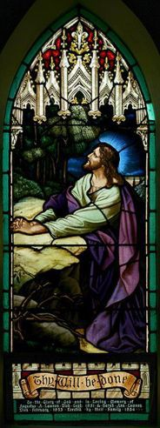
Jesus, Our Model for Prayer
Jesus is our model for prayer. Think of how often we see him pray in Scripture:
at the beginning of his ministry
after being baptized
during his forty days in the desert
before or during important events in his ministry
before teaching his disciples to pray
during the Last Supper
WikiMediaCommons

Slide 19
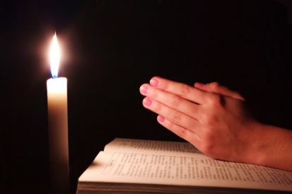
Jesus, Our Model for Prayer (continued)
What can we learn from Jesus about the balance between prayer and action?
Prayer must precede any work we do.
We must take the time to pray in silence and solitude.
We must pray in difficult and challenging times.
Image in shutterstock
Reflection
How do you pray? When do you pray?

Slide 20
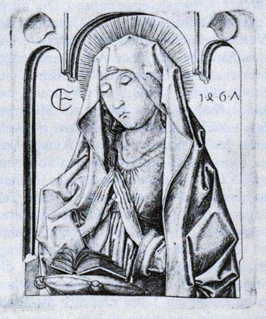
Mary’s Prayer
In complete trust Mary says yes to God’s will for
her life.
Mary has a role as our intercessor. We ask her to intercede with God on our behalf.
The Church has a great devotion to Mary.
Reflection
What role does Mary play in your prayer life? How can you include Mary in your prayer life more?

Slide 21
Mary’s Prayer (continued)
What does Mary teach us?
to trust in God for all things
to say yes to God’s call
to bring our needs and the needs of others to
God in prayer

Slide 22
The Lord’s Prayer
Why pray the Lord’s Prayer? It reminds us of some important truths:
Heaven is the fulfillment of the Kingdom of God.
The earth’s goods are for all people, living
in solidarity.
Forgiveness is important because it helps us to break the spiral of injustice and violence.
Image in shutterstock

Slide 23
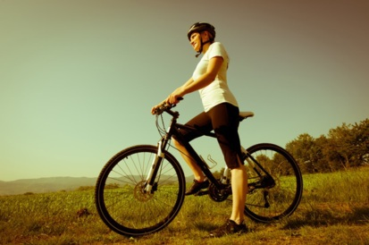
Learning from Human Role Models
What do you know about these individuals? What makes them role models for us?
Dorothy Day and Peter Maurin
Helen Prejean
Rosa Parks
Saint Benedict
Maximilian Kolbe
Martin Luther King Jr.
Image in shutterstock
Thomas Merton
Notes:
[Teacher note: Be prepared to flesh out details about these individuals, if the students have trouble explaining why they’re role models.]

Slide 24
Living the Life of a Disciple
What does it mean to “live the life of a disciple”?
How do you do it?
How will you live it?
Image in shutterstock
Notes:
(The scriptural quotation in this presentation is from the New American Bible with Revised New Testament and Revised Psalms. Copyright © 1991, 1986, and 1970 by the Confraternity of Christian Doctrine, Washington, D.C. Used by the permission of the copyright owner. All Rights Reserved. No part of the New American Bible may be reproduced in any form without permission in writing from the copyright owner.)

