Slide 1
Being Catholic: The “CliffsNotes” View
The Catholic Faith Handbook for Youth, Third Edition
Chapter 1
Document #: TX003132
Notes:
Use this presentation to introduce or review the key points in chapter 1 of the student handbook.

Slide 2
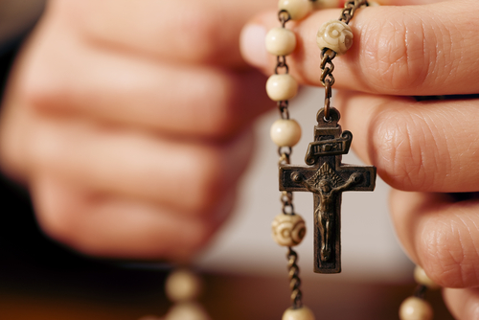
What Does It Mean to Be Catholic?
For some, being Catholic means a culture or way of being in the world.
People associate Advent wreaths, crucifixes, and the rosary with Catholic life.
It is a way of experiencing God
and following Jesus Christ.
Copyright: Kzenon / www.shutterstock.com
Notes:
Ask the students to name other activities that may be a part of Catholic life. Encourage them to think beyond participation in the Sacraments.

Slide 3
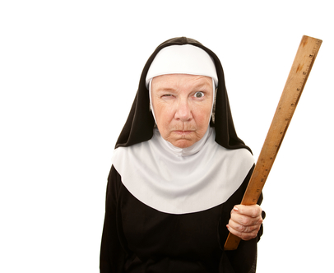
Catholic Images in the Popular Media
Reports that feature the negative actions of individual Catholics
News coverage that often shows the Church as out of touch
Other stereotypes and
misinformation
Copyright: CREATISTA / www.shutterstock.com
Notes:
Ask the students to recall media portrayals of Catholicism. Ask what impression each example might have made on someone unfamiliar with Catholicism.

Slide 4
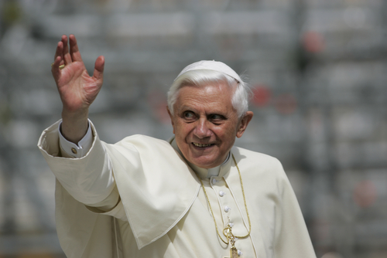
Did You Know?
There are over one billion Catholics in the world, about 16 percent of the world’s population.
There are more Catholics than there are people in any other Christian denomination.
Copyright: Gasper Furman / www.shutterstock.com
Catholics and Catholic churches can be found almost anywhere in the world.
There is great diversity within the Catholic Church, but all Catholics share some “common threads.”
Notes:
Tell the students that chapter 1 offers some basic facts about what it means to be Catholic by way of introduction to a more thorough explanation in later chapters.

Slide 5
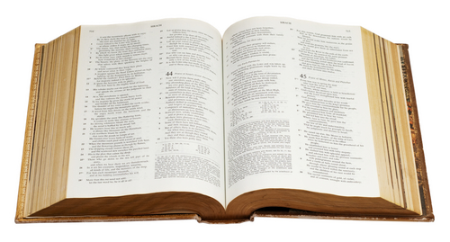
Some Core Catholic Beliefs
God has worked to restore our perfect union with him, lost through
Original Sin.
God sent his only begotten Son, Jesus Christ, as savior.
God revealed himself to be Trinity.
Christ established the Catholic Church on the foundation of the Apostles.
Copyright: Zakharoff / www.shutterstock.com
Notes:
Explain that Catholics recognize two sources of God’s revealed truth: Sacred Tradition, which is entrusted to the Pope and the bishops, and Sacred Scripture.

Slide 6
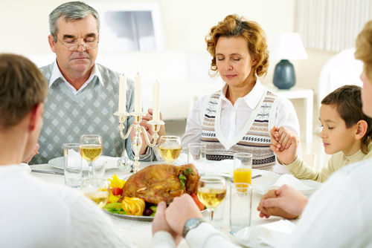
Some Core Catholic Practices
The Seven Sacraments
The Sacrament of the Eucharist is the heart of the Church’s life
Celebrating Sunday as the Lord’s Day and the events of the Liturgical Year
Following the Ten Commandments and defending human life
Copyright: Dmitriy Shironosov / www.shutterstock.com
Notes:
Ask students to comment on each practice. For example, ask them to name the Seven Sacraments.

Slide 7

Some Catholic Attitudes
Recognition that all creation is sacred
Faith in the essential goodness of the human person
Reliance on both faith and reason, both science and religion
Copyright: Joop Snijder jr. / www.shutterstock.com
Emphasis on community life and communal worship
Notes:
For each point, help the students uncover the basis for the attitude. For example, creation is sacred because God created the world.

Slide 8

Catholicism means . . .
Copyright: Philip Meyer / www.shutterstock.com
Notes:
Direct the students to read the Live It! sidebar “Young People’s Testimony,” on page 16 of the student handbook, and to write a similar personal view of Catholicism in their notebooks. You may want to reassure the students that even those who are not Catholic will have some impressions to note.

