Slide 1
Moses and the Exodus
The Bible Course, Unit 4
Document #: TX001076

Slide 2
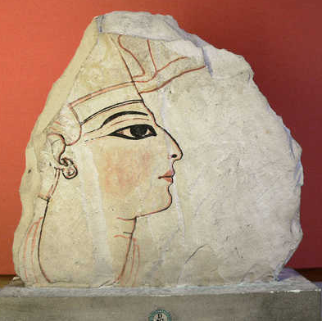
The Book of Exodus Begins . . .
Exodus begins by listing Joseph’s descendants and those of his brothers, who came to Egypt to live with him. Together they were the sons of Israel.
Pharaoh Ramses II (1290–1224 BC) came to power and “knew nothing of Joseph” (Exodus 1:8).
Ramses II felt threatened by the many Israelites, so he enslaved them.
Image in public domain
Notes:
Notes: You may wish to review the story of Joseph and how he and his brothers ended up in Egypt (Genesis 37:1—47:11).

Slide 3
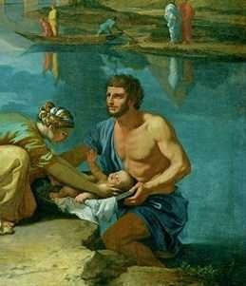
Miriam
Miriam the prophetess was the sister of Moses and Aaron.
She saved Moses from Pharaoh’s plan to kill all Israelite boys at birth by floating Moses on the Nile in a basket, where Pharaoh's daughter found him.
Miriam also provided her mother the opportunity to remain in Moses’ life by suggesting her to Pharaoh’s daughter as a nurse for the infant Moses.
Image in public domain
Notes:
Notes: Even in the midst of slavery and a brutal massacre, God’s providence is at work. Working through Miriam’s courageous action, God saves Moses, allows Moses to be raised by the Egyptian royalty, and even brings Moses’ mother to raise him.
Miriam fades into the background of Exodus until after the Israelites pass through the Red Sea. The “Song at the Sea” (see Exodus 15:1–21) is likely one of the oldest writings in the Bible. It is notable also because it clearly describes a woman leading prayer.

Slide 4
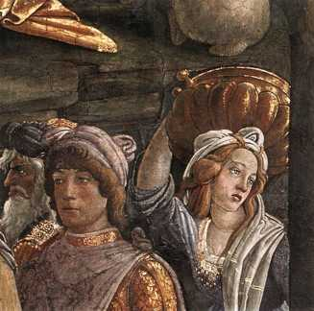
Moses’ Early Years
Moses was brought up as Egyptian royalty, but his contact with his family gave him exposure to and sympathy for the Israelites.
After Moses reaches adulthood, he sees an Egyptian striking an Israelite slave. In defense of the slave, Moses kills the Egyptian and hides the body in the sand.
When it becomes known what Moses has done, he fears for his life and flees to the land of Midian.
In Midian he encounters the daughters of Reuel, a priest of Midian. Moses stays with Reuel and marries his daughter Zipporah.
Image in public domain
Notes:
Notes: During this part of his journey, Moses likely felt a wide range of emotions. An interesting exercise would involve having the students write a first-person journal entry in which they describe Moses’ feelings in this chapter of his life. A briefer exercise would be a large-group discussion to list the emotions Moses may have felt and why he would have felt them.

Slide 5
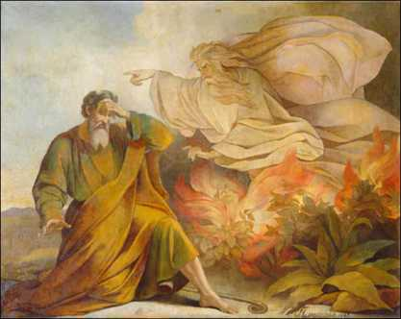
God Calls Moses
Years later God reveals himself to Moses and calls him to a key role in the salvation of God’s People.
Moses experiences a theophany through a burning bush.
God identifies himself as “I am who am” and calls Moses to be his voice of truth and arm of justice.
Image in public domain
Notes:
Notes: The communication by God through the burning bush is significant for a number of reasons. Chronologically it is the most direct communication by God to his People since the visit of the three men to Abraham (see Genesis, chapter 18) and Jacob’s all-night struggle (see Genesis 32:23–32). God says that he has “observed the misery of my people who are in Egypt” and that he will act through Moses to liberate his People. When asked by Moses, God introduces Himself as “I AM WHO (I) AM.” This holy name implies that God is eternally present and a wholly unique being in all of creation.
These reasons relate directly to what this theophany reveals to the Israelite community about God. From it they learn that God is still speaking directly and clearly to his Chosen People; God not only hears the concerns of his People but also responds to them; God’s name is given, and along with it the revelation that God is eternally present and wholly unique.

Slide 6
Moses Returns to Egypt
Upon returning to Egypt, Moses said to Pharaoh, “Thus says the Lord, the God of Israel: Let my people go . . .” (Exodus 5:1).
Pharaoh refused to release the Israelites, so God unleashed ten plagues on Pharaoh and Egypt.

Slide 7
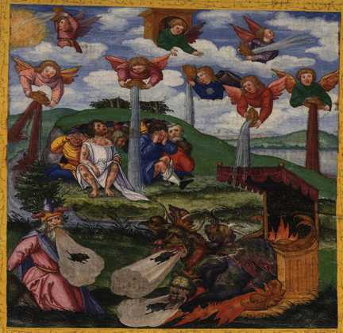
The Ten Plagues
First Plague: Water turned into Blood
Second Plague: Frogs
Third Plague: Gnats
Fourth Plague: Flies
Fifth Plague: Pestilence
Sixth Plague: Boils
Seventh Plague: Hail
Eighth Plague: Locusts
Ninth Plague: Darkness
Image in public domain
Notes:
Notes: The first pre-plague sign that God gives is having Aaron’s staff turn to a snake in the presence of the Pharaoh (see Exodus 4:1–5). Pharaoh’s “sorcerers” were able to do the same with their staffs. Although Aaron’s snake consumes those of the “sorcerers,” Pharaoh is unmoved and “his heart was hardened.”
The nine plagues that follow are extreme versions of natural events that occur in the Nile region of Egypt. The ninth plague of three days of darkness foreshadows the final plague that takes place in the dark of night.

Slide 8
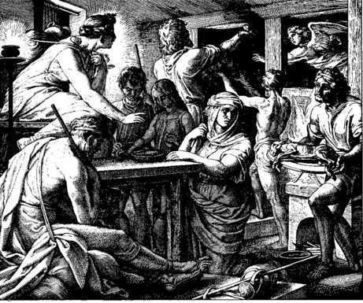
The Tenth Plague and Passover
Tenth Plague: Death of the Firstborn
God spared the Israelites from this plague by passing over the houses marked with the blood of the sacrificial lamb. This event is known as the Passover.
Image in public domain
What did the event of the Passover show the Israelites about God?
Notes:
Notes: The final plague involves a twist on the massacre of Israelite boys, which begins Moses’ story. God is more merciful than Pharaoh, for God will strike down only firstborn sons rather than every boy.
This event shows the connection between God’s power and protection and how these relate to obedience in following God’s commands. The Israelites are obedient to God’s specific commandments about the actions to take on the night that would come to be known as the Passover. The Egyptians, led by Pharaoh, do not obey God’s commandment to free the Israelites and then do not follow the commands for the night. As God promised, the Israelites are saved through their faithful obedience, and the Egyptians experience the loss of their sons and male animals. This confirms God’s promise that he has heard the cries of his People and will thus free them.

Slide 9
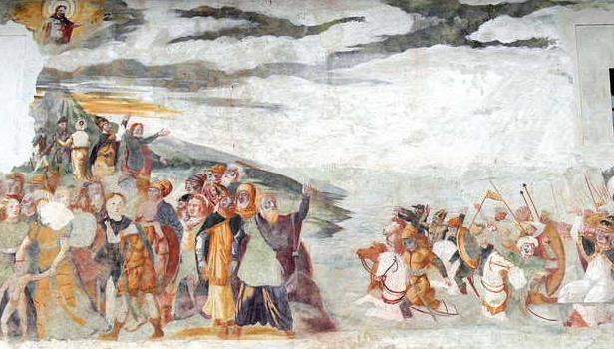
Freedom from Egypt
After the tenth plague, Pharaoh lets the Israelites go.
Pharaoh soon changes his mind and the Egyptian armies pursue the Israelites. On the shores of the Red Sea, God defeats the Egyptians.
What did this event show the Israelites about God?
Image in public domain
Notes:
Notes: This event gives the Israelites further insight into the power of God. When the Israelites are backed against the Red Sea by the advancing Egyptian chariots, they fear for their lives, crying out to Moses, “Were there no burial places in Egypt that you had to bring us out here to die in the desert?” (Exodus 14:11). God, who had previously led them by a pillar of cloud by day and fire by night, tells them to trust in his power and commands Moses to raise his hand over the sea. God sends a strong wind and forces the waters back to expose dry land. No situation is insurmountable by the power of God and his will.

Slide 10
The Sinai Covenant
Mount Sinai is the sacred ground where God forms a Covenant with his Chosen People.
Contained within this Covenant are the laws and obligations known as the Ten Commandments.
Within the framework of the Sinai Covenant, God declares himself to be their God, a God of fidelity, love, and justice.
Notes:
Notes: Ask a student to read aloud Exodus, chapter 20.
The laws that God will give Moses on Mount Sinai form the foundation of the Sinai Covenant. The covenants God made with Noah and then the Patriarchs were mostly one-sided—God will be with the people and the people will follow a general, broad ethical code. On Sinai, God spells out the laws that his people are to follow. These laws, governing nearly every aspect of religious, moral, and civic life, will guide the Israelites going forward through time.

Slide 11
The Ten Commandments
I am the Lord your God: you shall not have strange Gods before me.
You shall not take the name of the Lord your God in vain.
Remember to keep holy the Lord’s Day.
Honor your father and your mother.
You shall not kill.
You shall not commit adultery.
You shall not steal.
You shall not bear false witness against your neighbor.
You shall not covet your neighbor’s wife.
You shall not covet your neighbor’s goods.
(CCC, pp. 496–497)
Notes:
Notes: Much can be said about the importance of the Ten Commandments across the millennia. A simple but important thing to remember is how the first three describe how we are to love God; the remaining seven discuss the ways to love our neighbor and ourselves. These three related loves are the focus for Jesus when he affirms the Great Commandment: “You shall love the Lord your God . . . you shall love your neighbor as yourself” (Matthew 22:37–39).
“I am the Lord your God: you shall not have strange Gods before me.” This Commandment, in Christian versions of the Bible, is seen as one Commandment. In the Jewish tradition, this Commandment is divided into two different Commandments—the one above and “You shall not carve idols for yourselves. . . .” To maintain the balance of the number ten, the Jewish tradition combines Commandments nine and ten into one rule about not coveting. The Christian tradition maintains there are two commandments about coveting.

