Slide 1
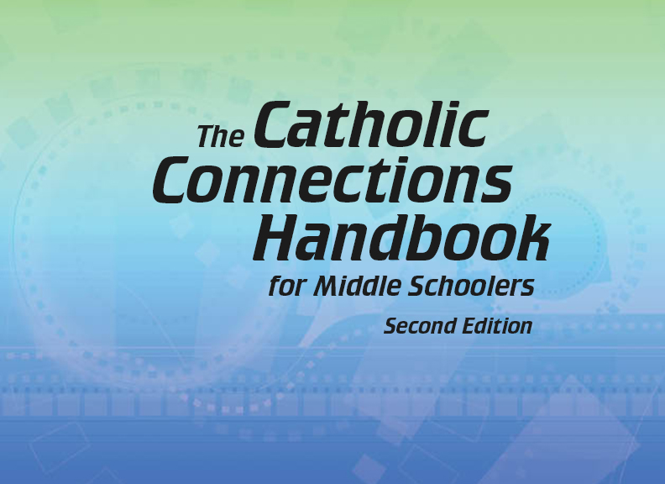

Document #: TX005813

Slide 2
Liturgy
and Sacraments
Chapter 26
The Bible: Worshipping God

Slide 3
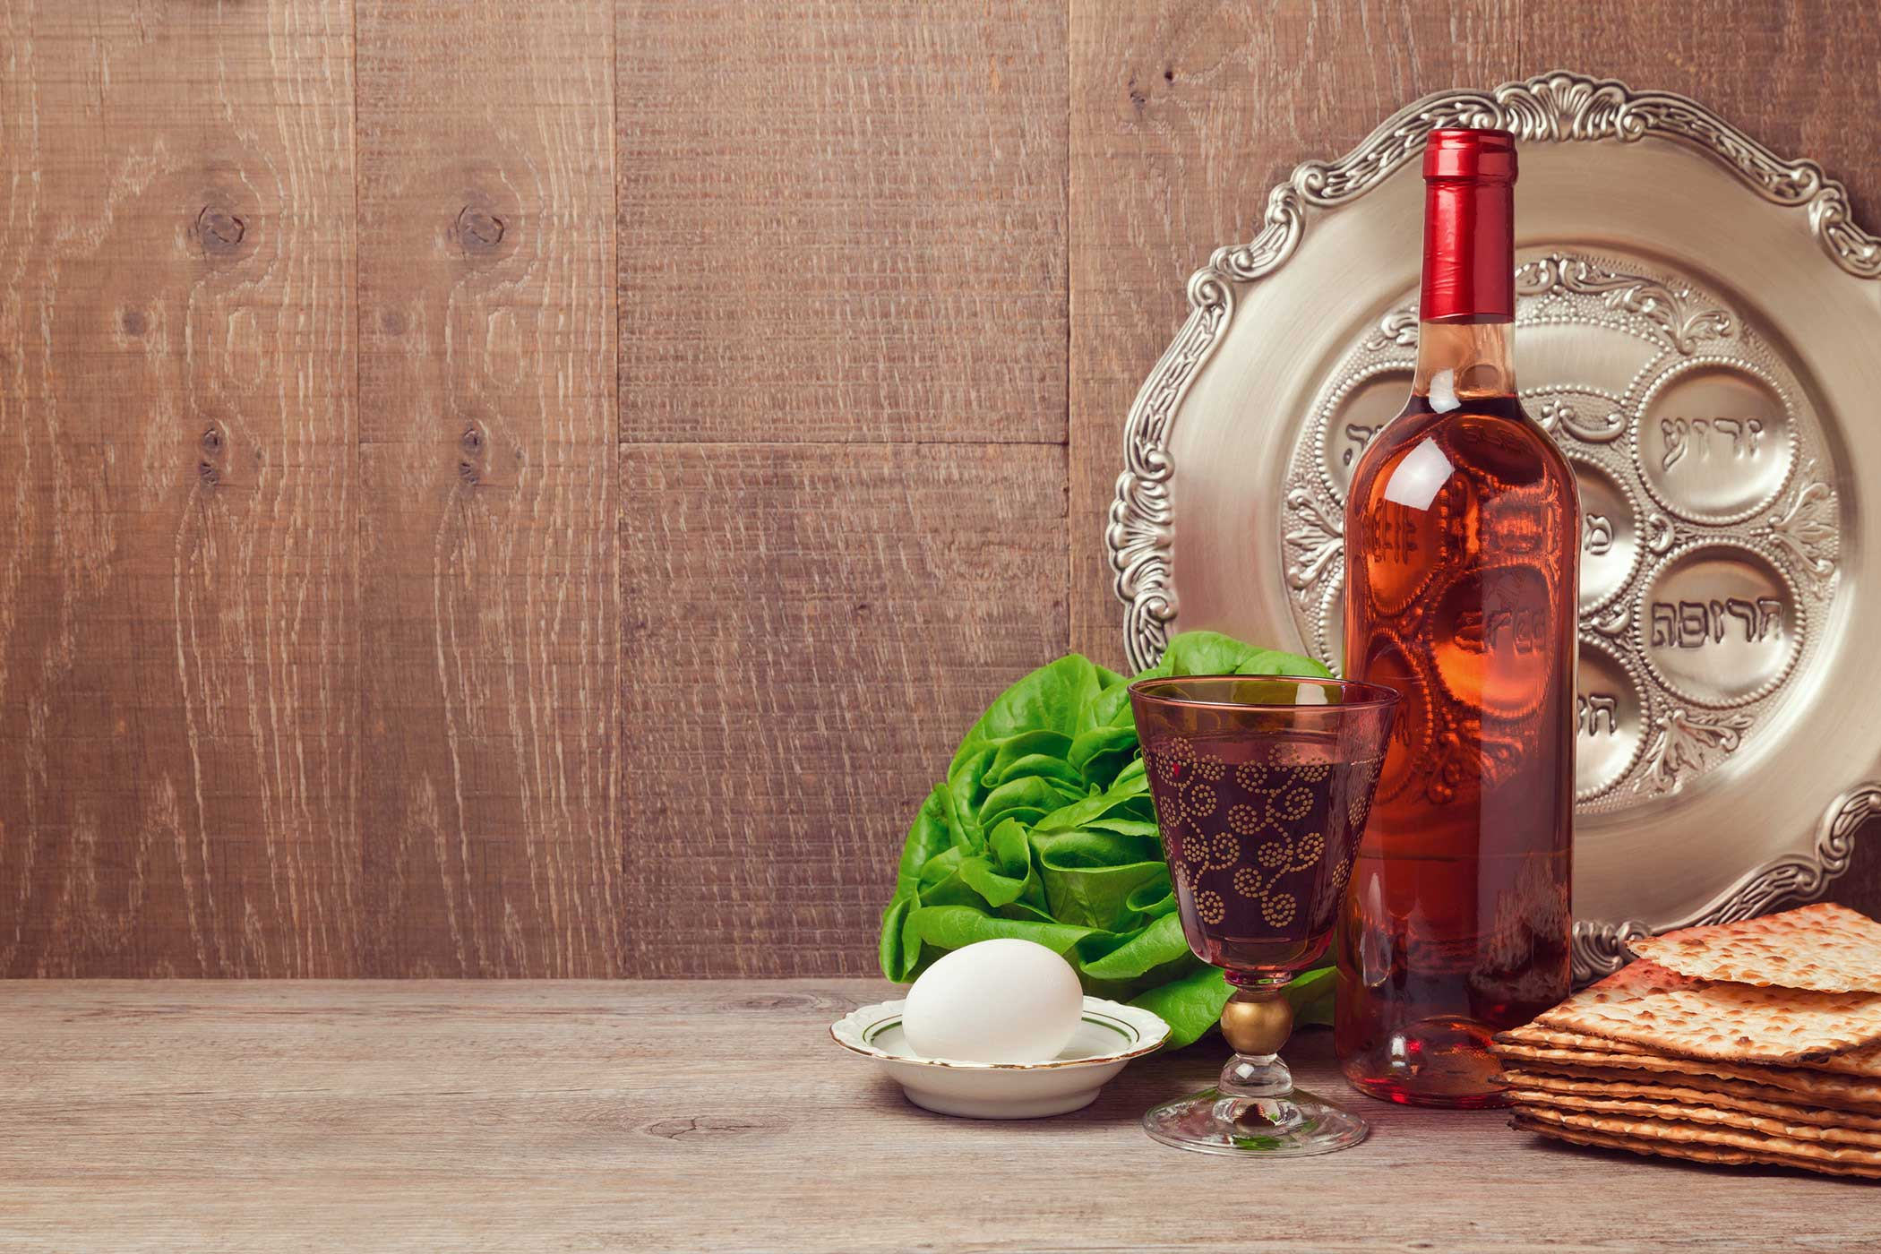
Chapter Summary
In this chapter, we will
explore the biblical
origins for the way
we worship as
Catholics today.
We will look at the
sacrificial rituals of the Old Testament, including the Passover and the connection to the Eucharist.
© Maglara/Shutterstock.com

Slide 4
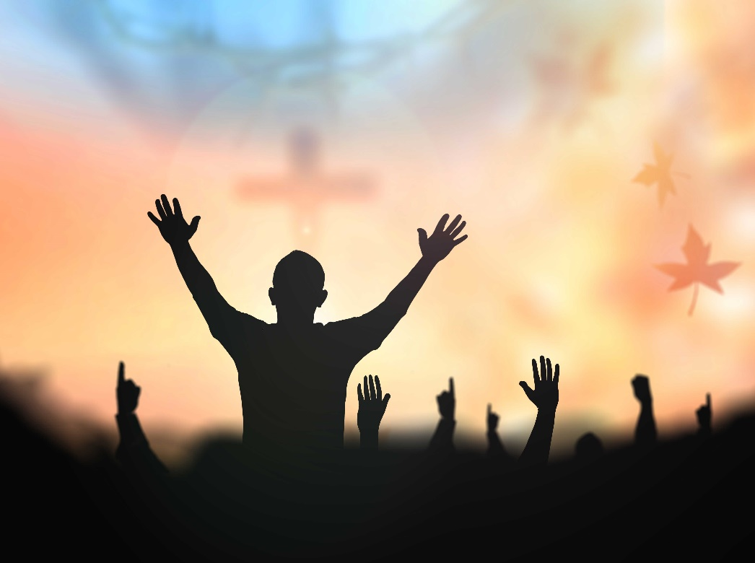
Introduction (Handbook, pages 276–277)
Exploring the development of the ways we worship God helps us better understand the meaning of the Mass.
© CHOATphotographer/Shutterstock.com

Slide 5
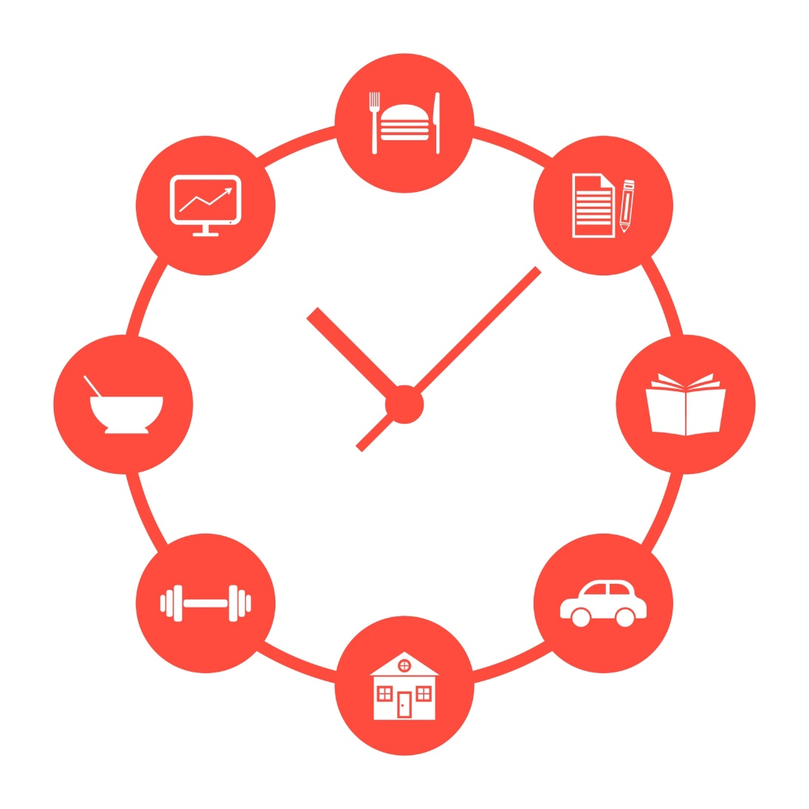
Discuss with the person next to you:
What are some of the daily rituals we perform at school?
What is the purpose behind these rituals?
© Pranch/Shutterstock.com

Slide 6

“Sacrifices in the Old Testament”
(Handbook, pages 277–280)
Like the feasts and rituals of our Old Testament ancestors in faith, the Mass is a sacrifice.
© P.Chinnapong/Shutterstock.com

Slide 7

Journal
It!
© ThomasZsebok/Shutterstock.com
The Old Testament shares many stories of God’s people sacrificing the best animals from their herds and the first and best fruit and grain from their harvests. Write about the most expensive thing you own.
What would it take for you to give this up?
What would you sacrifice this item for?

Slide 8
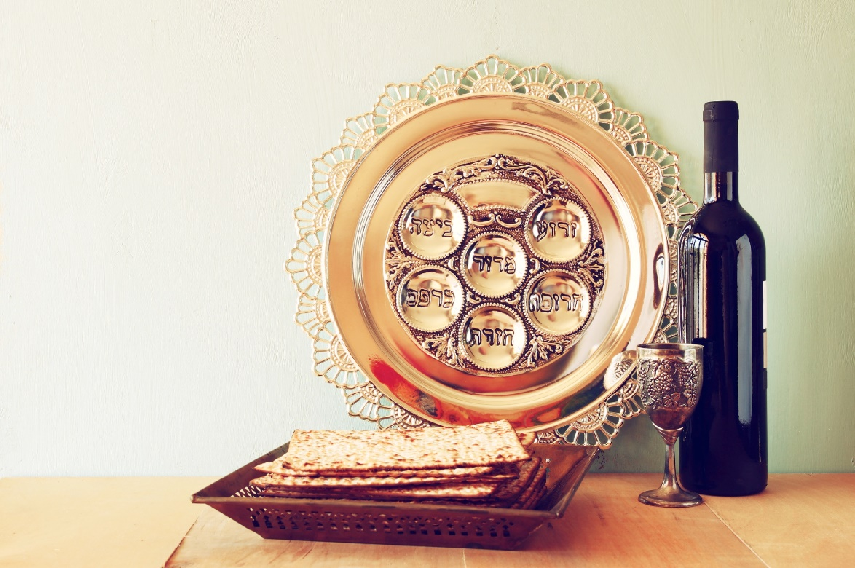
“Passover and the Temple”
(Handbook, pages 280–283)
The Mass has deep roots in the Feast of Passover, which recalls the event that freed the Israelites from slavery.
© Tomertu/Shutterstock.com

Slide 9

Search It!
Find a partner.
Together with your partner, look up the word plague in the dictionary.
Copy the definition into your notebook.
Rewrite the definition in your own words.
Share you new definition with another pair of students.
© Masson/Shutterstock.com

Slide 10
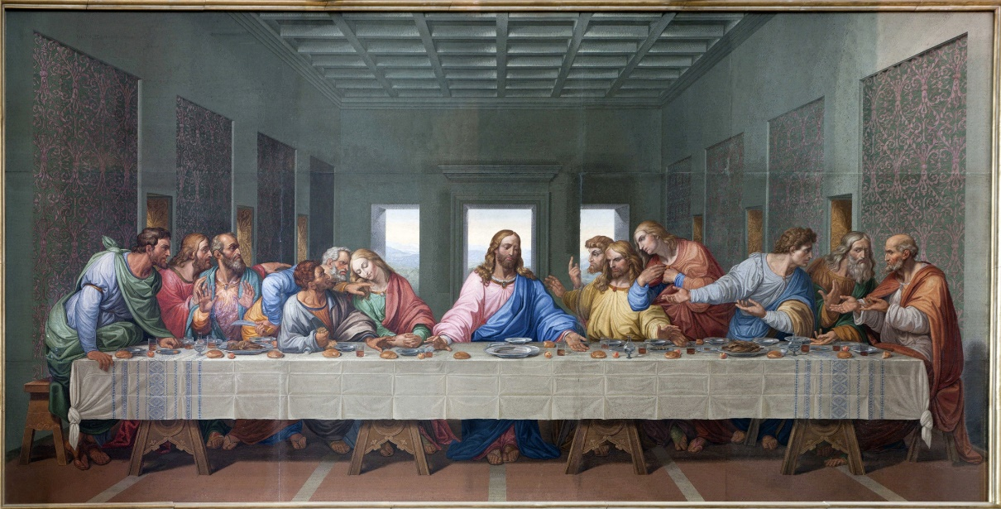
“The Last Supper”
(Handbook, pages 283–285)
In celebrating Passover at the Last Supper, Jesus establishes a new and ultimate sacrifice. He offers himself for the forgiveness of sins and calls us to continue the sacrifice in his memory.
© RenataSedmakova/Shutterstock.com

Slide 11

Share
It!
© AlexLMX/Shutterstock.com
Think about a time when you had to find strength to accept the inevitable.
Find a partner and share how you felt during this time.
How did you find the strength to accept?

