Slide 1
Life, a Precious Gift
Christian Morality
Document # TX001881

Slide 2
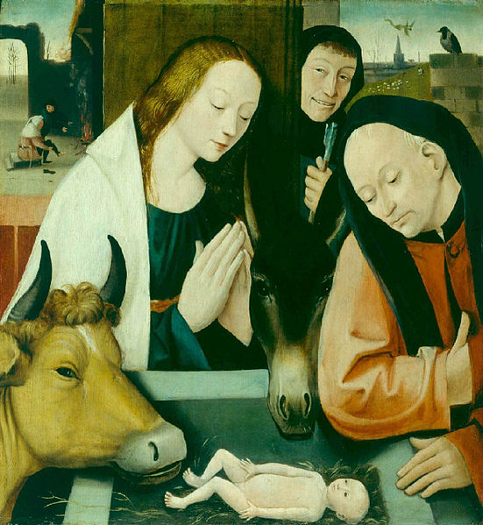
“At the dawn of salvation, it is the Birth of a Child which is proclaimed as joyful news: ‘I bring you good news of a great joy which will come to all the people, for to you is born this day in the city of David, as Savior, who is Christ the Lord.’ (Luke 2:10–11)” (John Paul II, The Gospel of Life, 1).
Image in public domain

Slide 3
“The source of this ‘great joy’ . . . also reveals the full meaning of every human birth and the joy which accompanies the Birth of the Messiah is thus seen to be the foundation and fulfillment of joy at every child born into the world” John Paul II, The Gospel of Life, 1).
Image in public domain

Slide 4
“When he presents the heart of his redemptive mission, Jesus says: ‘I came that they may have life, and have it abundantly’ (John 10:10)” John Paul II, The Gospel of Life, 1).
Image in public domain

Slide 5
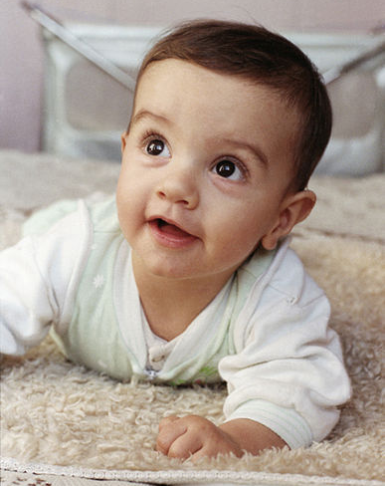
What stories do you recall about your birth?
Who do you think were the first people to hear the “good news” from your parents?
Image in public domain
Notes:
[Note: Pause to allow the students time to reflect on this question.]

Slide 6
What occasions have been celebrations of life in your family?
Shutterstock/Yuri Arcurs
Notes:
[Note: Pause to allow the students time to reflect on this question.]

Slide 7
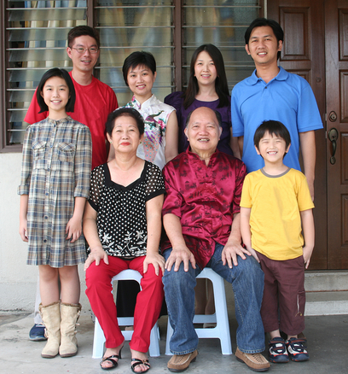
Which of your family members make you feel cherished?
Parents?
Grandparents?
Aunts or uncles?
Siblings?
Cousins?
Who do you think of with great respect?
Shutterstock/Jane September
Notes:
[Note: Pause to allow the students time to reflect on this question.]

Slide 8
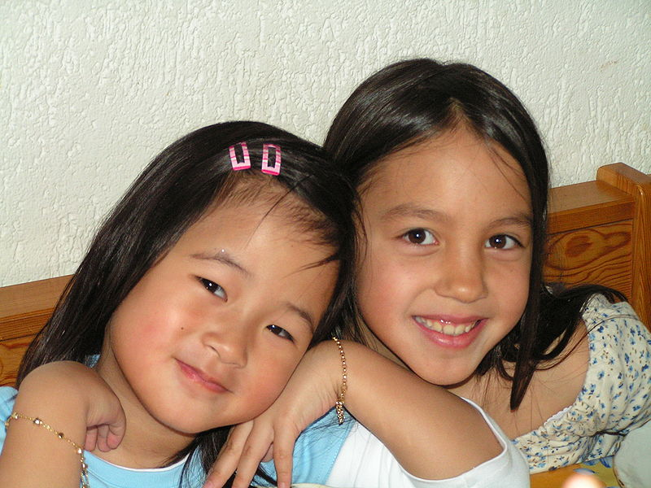
What childhood memories stand out as times of joy?
New friends?
New teachers?
Newly discovered talents?
Image in public domain
Notes:
[Note: Pause to allow the students time to reflect on this question.]

Slide 9
When have you experienced challenge or crisis in your life, such as the death of someone you love?
How do these times remind you of the gift of life?
Shutterstock/hartphotography
Notes:
[Note: Pause to allow the students time to reflect on this question.]

Slide 10
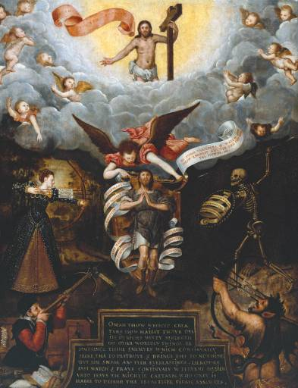
“How precious must man be in the eyes of the Creator, if he ‘gained so great a Redeemer’ and if God ‘gave his only Son’ in order that man ‘should not perish but have eternal life’ (John 3:16)” (John Paul II, The Gospel of Life, 25)
Image in public domain

Slide 11
Question for Written Reflection
Describe an event in your life that has caused you to appreciate that life is a precious gift.
?
Notes:
The quotations in the presentation are from The Gospel of Life (Evangelium Vitae), numbers 1 and 25, at www.vatican.va/holy_father/john_paul_ii/encyclicals/documents/hf_jp-ii_enc_25031995_evangelium-vitae_en.html. Copyright © Libreria Editrice Vaticana (LEV). Used with permission of LEV. [permission applied for]

