Slide 1
The Structure of John’s Gospel
The New Testament
Document #: TX002271

Slide 2

John’s Gospel has a unique structure:
the Prologue: 1:1–18
the Book of Signs: 1:19—12:50
the Book of Glory: 13:1—20:31
© posscriptum/shutterstock.com
Notes:
Notes: The student book mentions that John, chapter 21, a later addition to the text, is considered to be an epilogue. You may want to clarify that this presentation will focus on the primary three parts of the Gospel of John.

Slide 3

The Prologue: 1:1–18
The prologue is a poem, likely used by early Christians as a liturgical hymn.
As a hymn, the prologue probably first circulated independently of John’s Gospel. Sometime before the Gospel reached its final form, the prologue was added to it as a kind of “overture.”
It is full of richly symbolic language and introduces many of the central theological and Christological themes of the Gospel.
© Konstantin Sutyagin/shutterstock.com

Slide 4
The Prologue (continued)
In introducing John’s Christology, the prologue introduces Jesus as the following:
the Divine Son of God
the Light who comes into a world of darkness
the preexistent Word—present with God, in Heaven, from the beginning of time—who “became flesh” (1:14) at a particular point in human history
the One who reveals God’s glory and brings grace and truth to all who believe
Notes:
Notes: Remind the students that today they will delve into the prologue, after this brief overview of the Gospel concludes.

Slide 5
The Book of Signs: 1:19—12:50
The signs of John’s Gospel provide important points of contrast with the synoptics.
Miracles and Signs in the Gospels
 | The Synoptic Gospels | John’s Gospel
Greek word | Dynameis (translated as “miracle”) | Semeion (translated as “sign”)
Number | Jesus performs numerous miracles. | Jesus performs seven signs.
Purpose | The miracles demonstrate Jesus’ unique abilities to heal illness, restore life, and exercise authority and power over the forces of nature. | For those who witness the signs with open minds and hearts, the signs prompt greater faith in Jesus and a deeper understanding of his true identity.

Slide 6
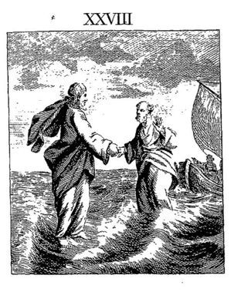
The Book of Signs (continued)
The Book of Signs recounts all seven signs that Jesus performs in John’s Gospel:
turning water into wine at the wedding at Cana (2:1–12)
healing of the royal official’s son (4:46–54)
healing a sick man at the pool of Bethesda (5:1–18)
multiplication of the loaves (6:1–15)
walking on water (6:16–21)
healing of the man born blind (9:1–41)
raising of Lazarus (11:1–45)

Slide 7
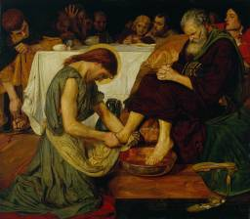
The Book of Glory: 13:1—20:31
The Book of Glory recounts Jesus’ final days, death, and Resurrection, beginning with the Last Supper and concluding with the post-Resurrection appearances.
Jesus’ glory (his divinity and the heavenly home from which he came and to which he will return) is fully revealed when he does the work for which he was sent, that is, when he is “lifted up” on the cross.
Jesus’ glory continues to shine even through his suffering and death.

Slide 8
The Book of Glory (continued)
The Book of Glory contains many unique elements not present in the synoptic accounts. These include the following:
Jesus’ washing of the disciples’ feet at the Last Supper
a mysterious figure known only as the Beloved Disciple, or “the one whom Jesus loved”
the piercing of Jesus’ side, with blood and water flowing out
a post-Resurrection appearance to Mary Magdalene at the empty tomb
a post-Resurrection appearance in which Jesus invites “doubting Thomas” to faith

Slide 9
The Epilogue
The last chapter of John’s Gospel—chapter 21—is considered to be an epilogue for the following reasons:
The Gospel clearly ends with chapter 20, verse 31: “These are written that you may [come to] believe that Jesus is the Messiah, the Son of God, and that through this belief you may have life in his name.” Therefore, chapter 21 reads like a second ending added after the Gospel had already been completed.
The style of the Greek in which the epilogue is written is different from that of the rest of the Gospel.
Some scholars believe that the epilogue was added as a way to “rehabilitate” the character of Peter. In the epilogue Peter declares his love for Jesus three times, symbolically reversing his three denials of Jesus earlier in the Gospel.

