Slide 1
The Lord’s Prayer: God’s Glory
The Catholic Faith Handbook for Youth, Third Edition
Chapter 38
Document #: TX003169
Notes:
Use this presentation, along with the one for chapter 39, as a quiet reflection on the Lord’s Prayer. Consider playing instrumental music and allowing time after each slide for journaling.

Slide 2
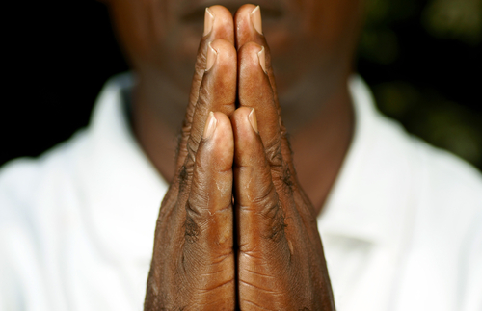
Let us remember that we are in the holy presence of God.
Copyright: Salim October / www.shutterstock.com

Slide 3

Our
“I will take you as my people, and I will be your God” (Exodus 6:7).
How can I more completely join with God’s People in worship?
Can I do more to join others in carrying on Jesus’ healing and saving work?
Copyright: Yuri Arcurs / www.shutterstock.com

Slide 4
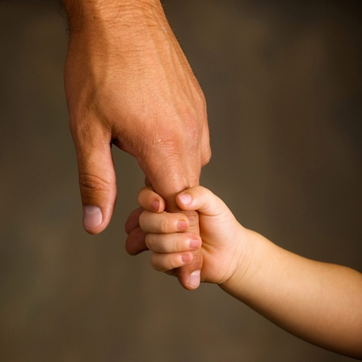
Father
Copyright: Kristina Postnikova / www.shutterstock.com
“and I will be your father,
and you shall be my sons and daughters,
says the Lord Almighty.”
(2 Corinthians 6:18)
How can I live every day as a son or daughter of God?

Slide 5

Who Art in Heaven
“. . . no eye has seen, nor ear heard,
nor the human heart conceived,
what God has prepared for those who love him.”
(1 Corinthians 2:9)
How can I more fully experience the deep happiness that comes from loving God?
Copyright: vita khorzhevska / www.shutterstock.com

Slide 6
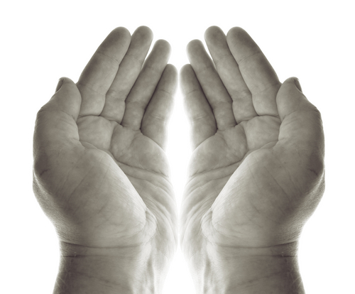
Hallowed Be Thy Name
“You shall be holy, for I the LORD your God am holy” (Leviticus 19:2).
How can I honor God’s name and holiness in everything I do?
Copyright: tlorna / www.shutterstock.com

Slide 7

Thy Kingdom Come
Copyright: Petar Paunchev / www.shuterstock.com
“From that time Jesus began to proclaim, ‘Repent, for the kingdom of heaven has come near’” (Matthew 4:17).
Can I do more to bring the love, peace, and justice of God’s Kingdom into the world?

Slide 8

Thy Will Be Done on Earth as It Is in Heaven
“Just as I have loved you, you also should love one another” (John 13:34).
How can I better live out Jesus’ command to love others?
Copyright: photostudio 7 / www.shutterstock.com
Notes:
The Lord’s Prayer is continued with a similar set of slides in the next presentation, “The Lord’s Prayer: Human Need,” for chapter 39 of the student handbook.
(The Scripture quotations contained herein are from the New Revised Standard Version of the Bible, Catholic Edition. Copyright © 1993 and 1989 by the Division of Christian Education of the National Council of the Churches of Christ in the United States of America. All rights reserved.)

