Slide 1
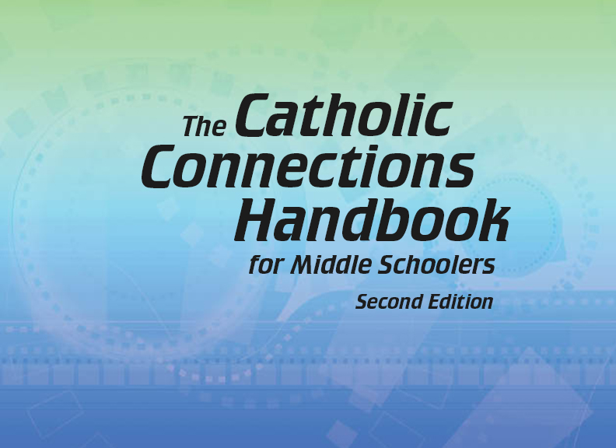

Document #: TX005814

Slide 2
Liturgy
and Sacraments
Chapter 27
Introduction to Liturgy

Slide 3
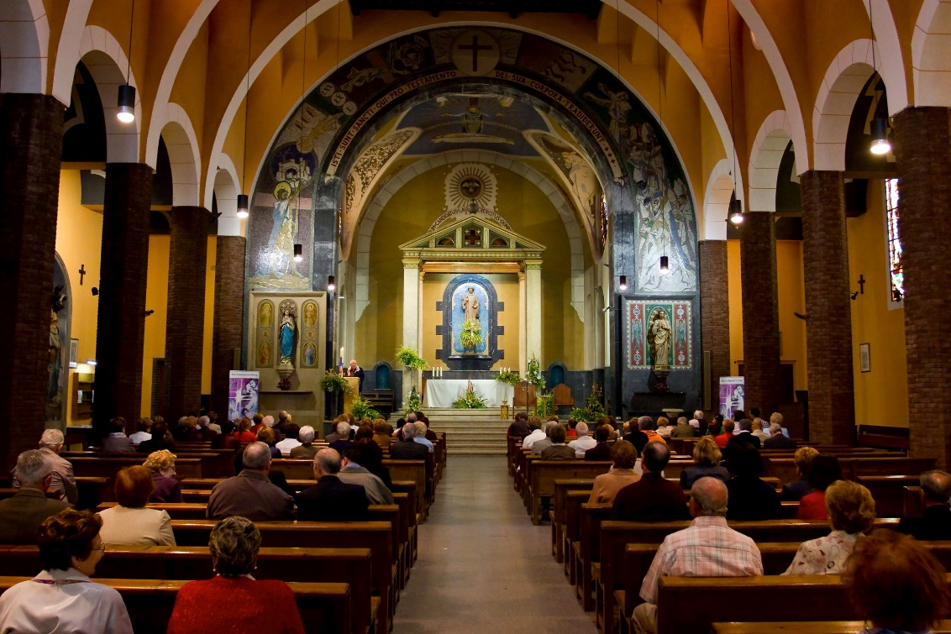
Chapter Summary
This chapter provides an overview of the practice and characteristics of liturgy.
We will learn about the communal, public, and official nature of worship and Sacraments, the role of symbols, and the rhythm of the Liturgical Year. We will also explore the importance of our own participation in liturgy.
© Natursports/Shutterstock.com

Slide 4
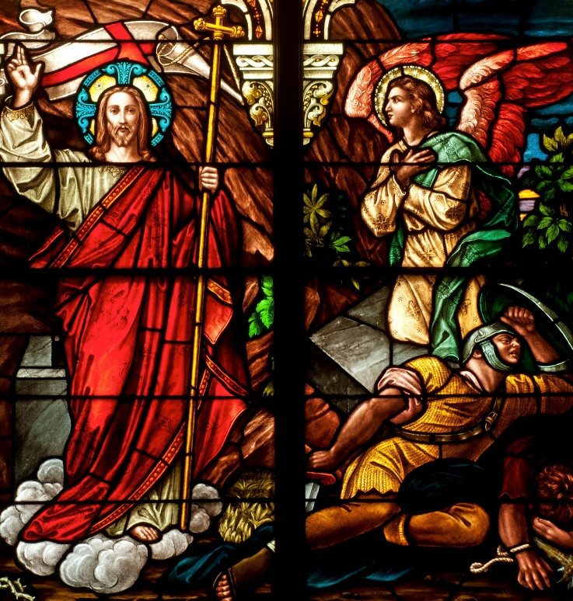
Introduction and “Reading the Map of the Liturgy” (Handbook, pages 286–289)
Liturgy is the communal, official, and public prayer through which we participate in the life of the Trinity and celebrate the Paschal Mystery.
© NancyBauer/Shutterstock.com

Slide 5
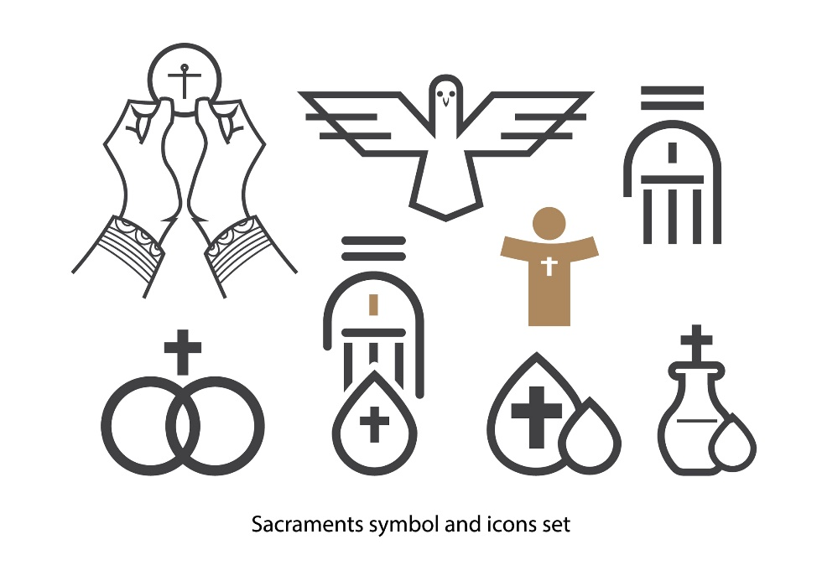
“The Key to Unlocking Symbols” and “Sacrament and Symbol”
(Handbook, pages 290–293)
Symbols and sacramentals are central to liturgy, for they help us see Christ. When we gather as the Church, we are united in Heaven and participating in the work of the Holy Spirit to make Christ visible.
© DigitalPen/Shutterstock.com

Slide 6

Journal It!
What are some special objects or treasures you keep?
Why do you keep them?
© Sweetok/Shutterstock.com

Slide 7
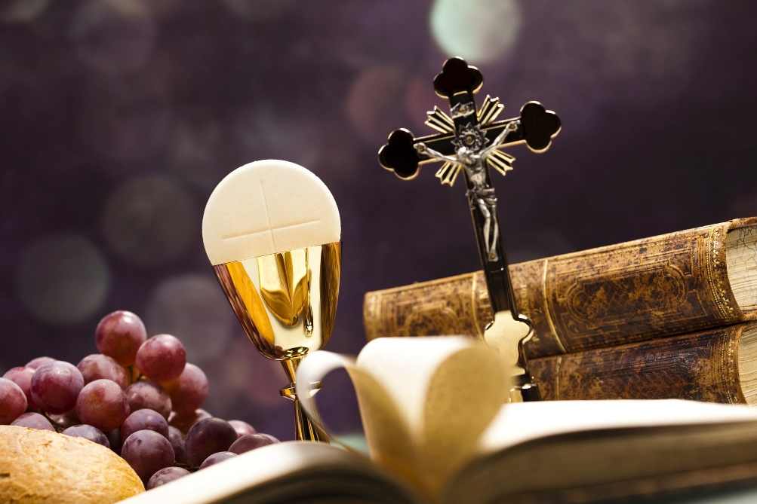
“Unity in Diversity”
(Handbook, page 294)
Necessary and beautiful variations happen within liturgical practice, but we are nonetheless united through the consistent symbols, words, and actions of our communal prayer.
© SebastianDuda/Shutterstock.com

Slide 8

Post It!
Take a sticky note.
Write down a way that you feel we can be better united as a class.
Post the sticky note to the board.
© AntonovRoman/Shutterstock.com

Slide 9
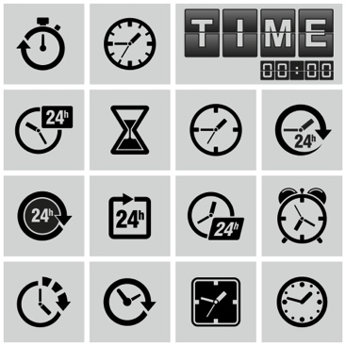
“Time Is a Symbol Too”
(Handbook, pages 294–297)
Liturgical life has a cycle of time with special days and seasons, all of which are important to the Church.
© VoodooDot/Shutterstock.com

Slide 10
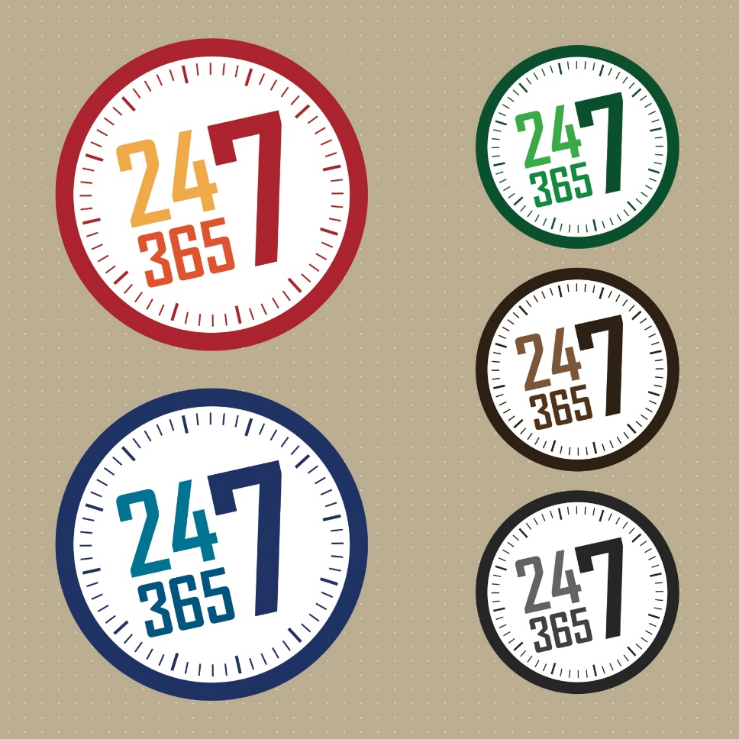
Share It!
What is your favorite day of the year? How do you celebrate? Why do you like this day?
Share your thoughts on your favorite day with your neighbor.
© Sopit.N/Shutterstock.com

