Slide 2
The Old Testament
and the Trinity
Chapter E
The Bible: Women of the
Old Testament

Slide 3
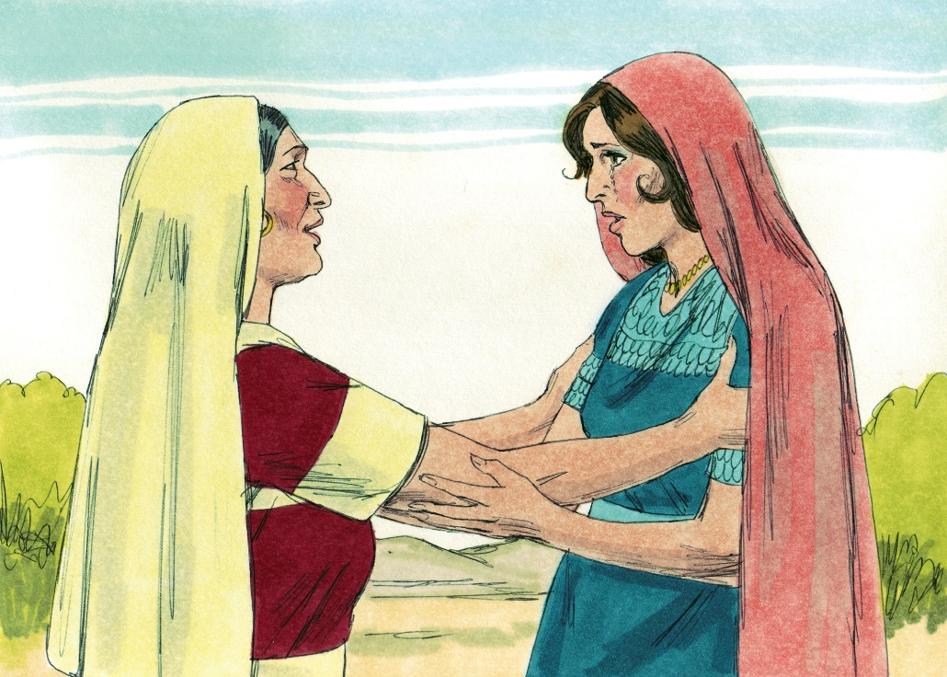
Chapter Summary Women of the Old Testament
In the Old Testament, God called strong, courageous women to save his people, Israel. Women played, and continue to play, an important role in God’s unfolding plan of salvation. God has given women particular gifts to be used in service of God and humanity.
© BibleArtLibrary/www.istockphoto.com

Slide 4
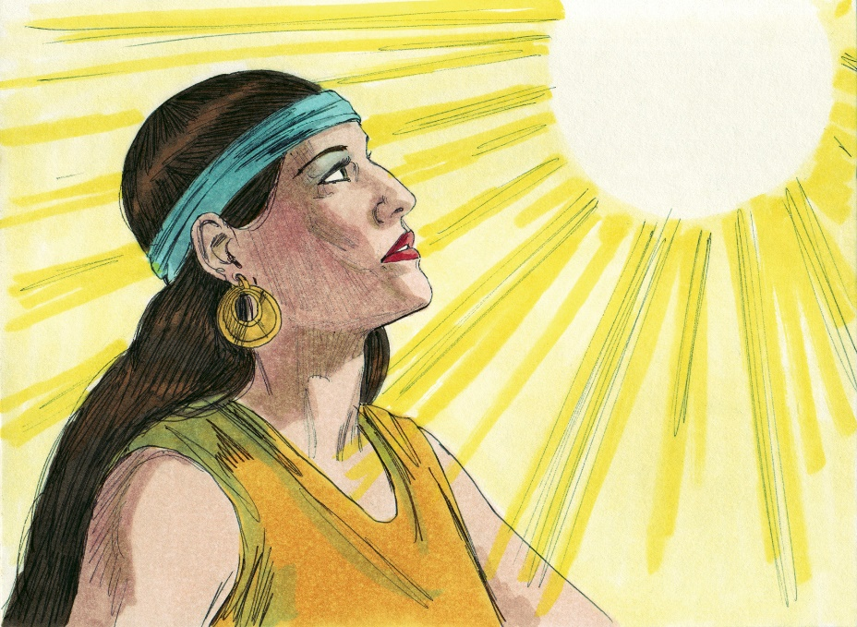
“Rebecca, the Planner” (Genesis, Chapter 27)
Through Rebecca’s courage and confidence, she orchestrated Isaac’s blessing of Jacob and Jacob’s escape from his brother, Esau.
© BibleArtLibrary/www.istockphoto.com

Slide 5
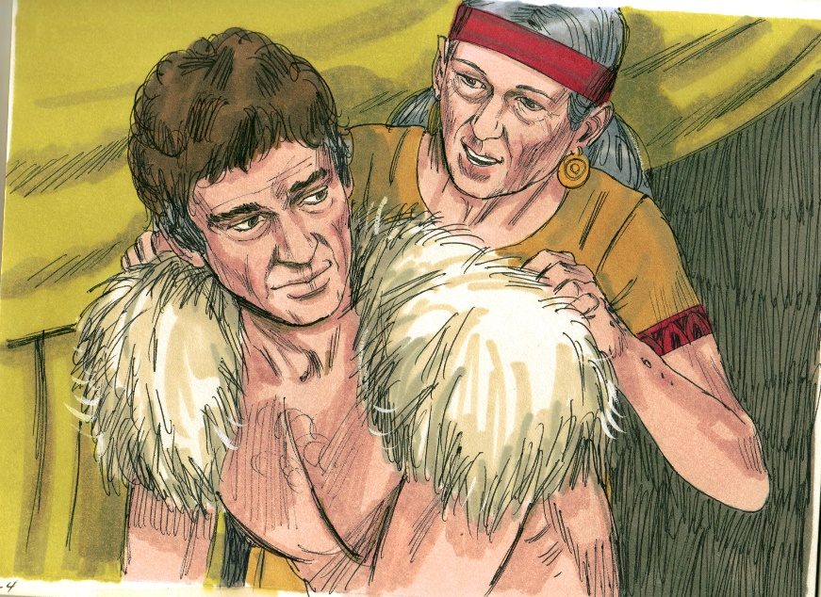
“Rebecca, the Planner” (Genesis, Chapter 27)
Rebecca favored her younger son, Jacob, and wanted him to receive the inheritance that would make him leader of the tribe.
Rebecca helped Jacob trick his father into giving away Esau’s inheritance to Jacob instead.
Rebecca encouraged Jacob to leave his home to find a wife and to allow Esau’s anger to cool down in his absence.
© BibleArtLibrary/www.istockphoto.com

Slide 6
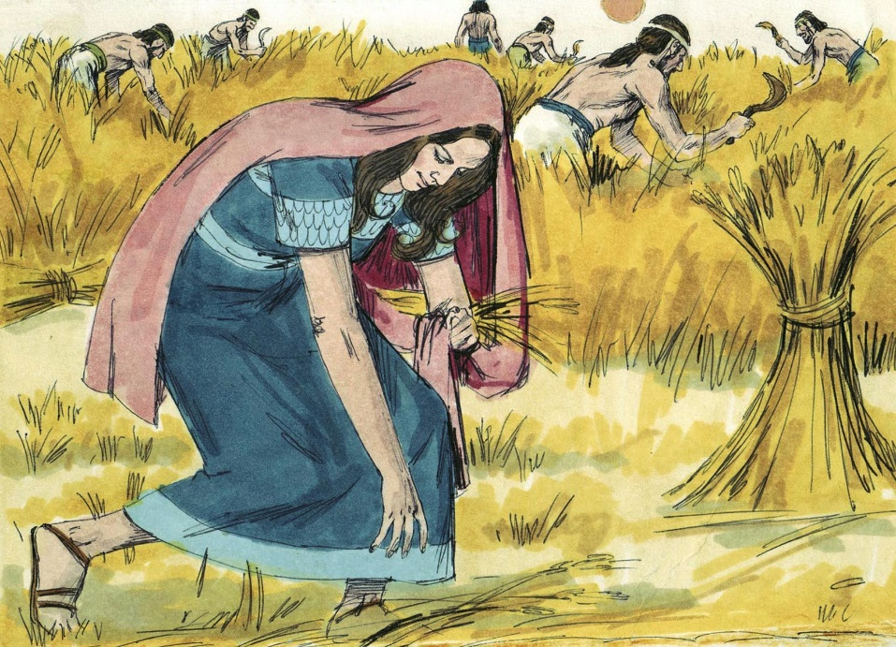
“Ruth, the Faithful” (Ruth)
Ruth, faithful to her God and mother-in-law, found happiness with Boaz and became the mother of Obed and the grandmother of King David.
© BibleArtLibrary/www.istockphoto.com

Slide 7
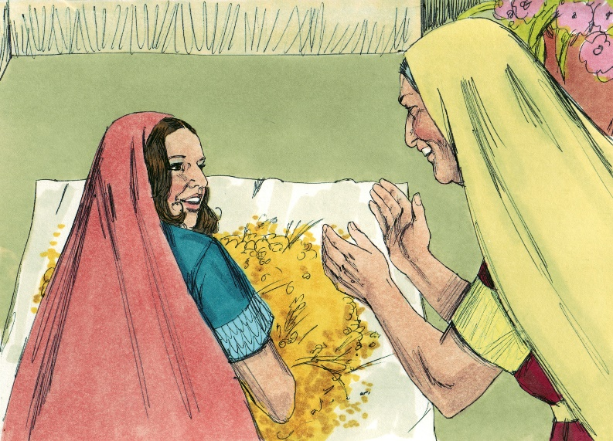
“Ruth, the Faithful” (Ruth)
Ruth stayed with her mother-in-law, Naomi, to be her help after Naomi’s sons and husband died.
Naomi and Ruth moved back to live with Naomi’s family in Bethlehem.
Naomi instructed Ruth how to gather food from the grain left in the field after harvesting.
Ruth married Boaz, and one of Ruth’s great-grandchildren is David, the great king of Israel.
© BibleArtLibrary/www.istockphoto.com

Slide 8
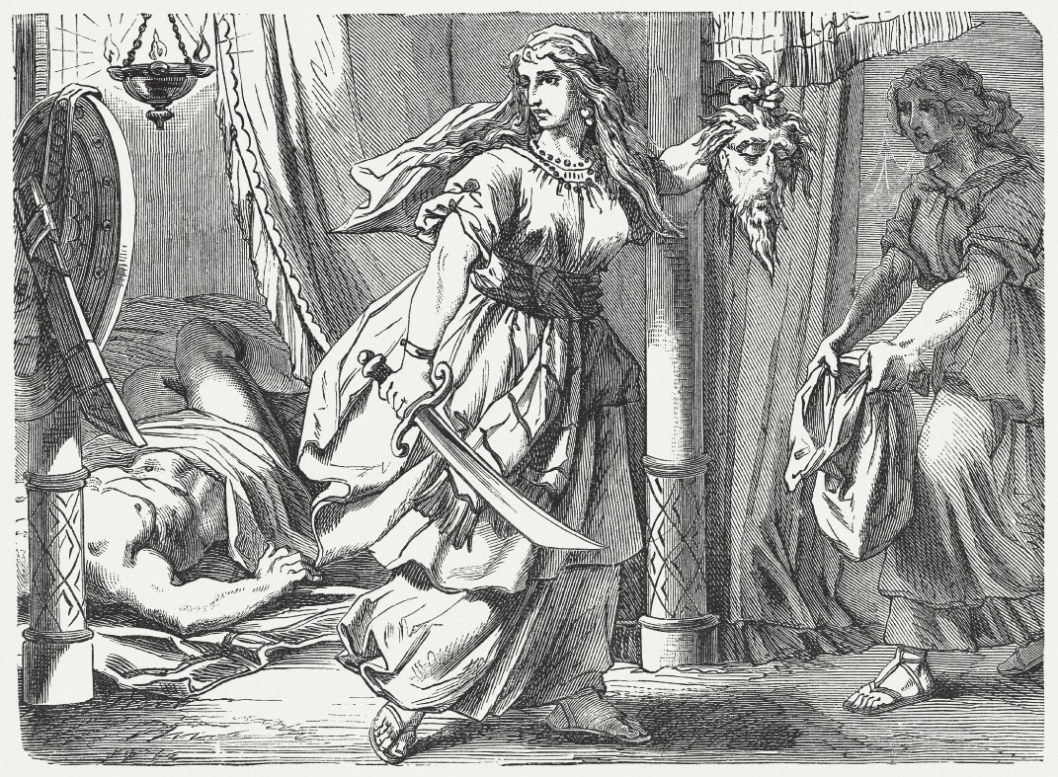
“Judith, the Brave” (Judith, Chapters 10, 12–13)
Judith courageously used her gifts of courage, cleverness, and beauty to infiltrate the Assyrian stronghold and kill their general, Holofernes, thereby saving her people, Israel.
© ZU_09 /www.istockphoto.com

Slide 9
“Judith, the Brave” (Judith, Chapters 10, 12–13)
The Assyrians were attacking the city that Judith lived in, and the men of the city were too afraid to do anything.
Judith made herself so beautiful that she was sure to attract the attention of any man who saw her—especially, Holofernes, the Assyrian general.
© WEKWEK/www.istockphoto.com

Slide 10
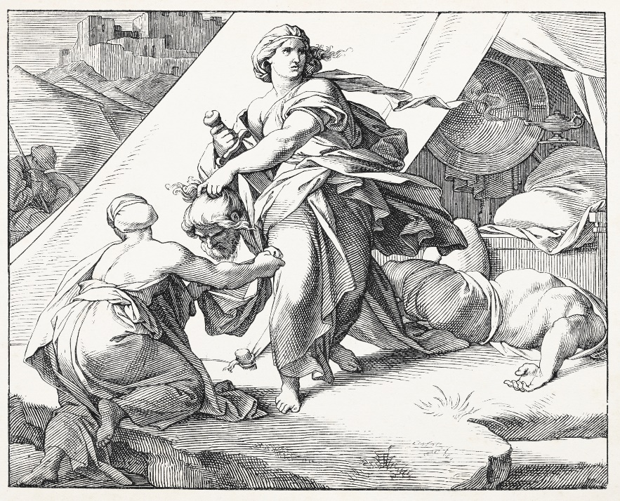
“Judith, the Brave” (Judith, Chapters 10, 12–13)
Judith went with her maid to the Assyrian camp and offered to help the Assyrians capture the territory.
When Holofernes invited her to his room to sleep with him, she prayed for strength, raised his sword, and killed him, throwing his army into a panic.
© Grafissimo/www.istockphoto.com

Slide 11
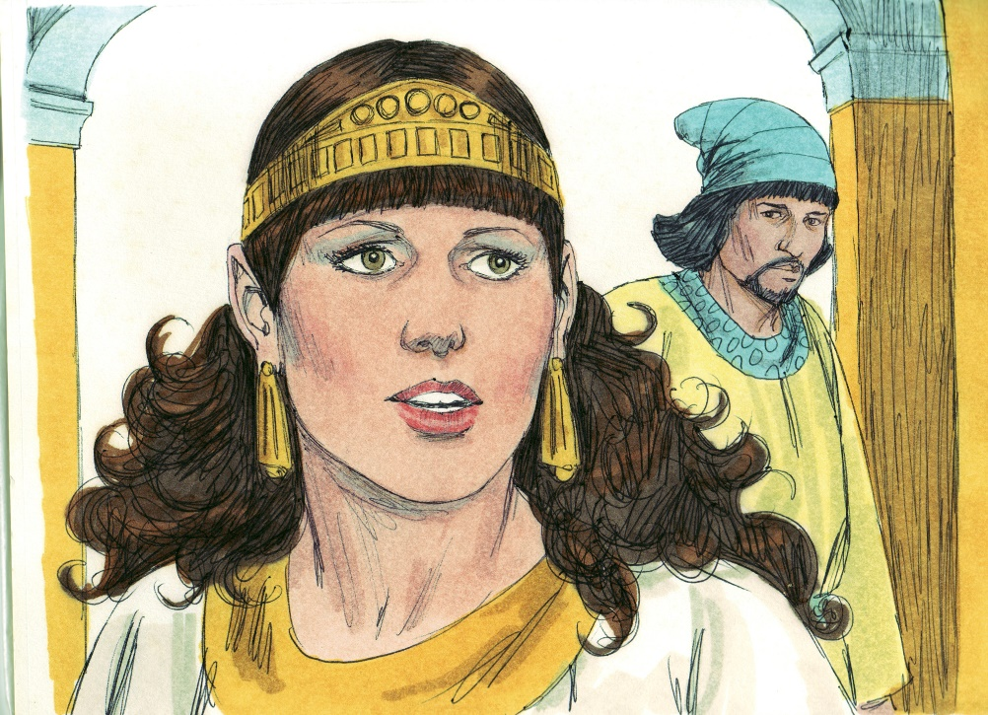
“Esther, Savior of Her People” (Esther, Chapters 5–7)
Esther’s fidelity and love for her king allowed her to uncover and thwart Haman’s plot to kill her cousin Mordecai and exterminate her people.
© BibleArtLibrary/www.istockphoto.com

Slide 12
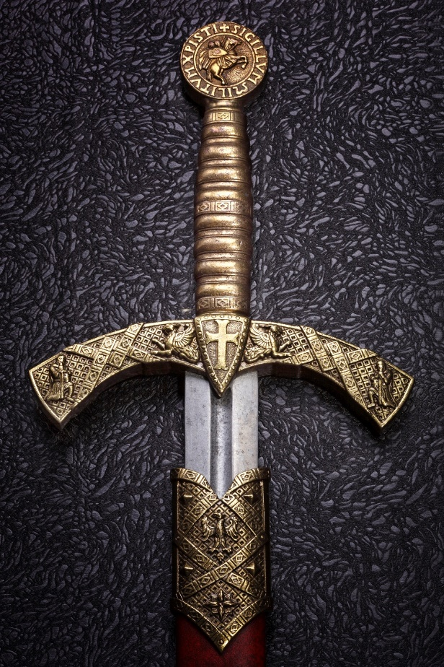
“Esther, Savior of Her People” (Esther, Chapters 5–7)
Haman, King Xerxes’s prime minister, plotted to kill Queen Esther’s cousin Mordecai and every Jew in the Persian Empire.
God set up a situation in which King Xerxes decided to honor Mordecai for uncovering a plot to kill the king, humiliating Haman in the process.
Esther used her position as queen to expose Haman’s plan to kill Mordecai and all the Jews to the king.
© Sergey856/www.shutterstock.com

Slide 13
Activity
Reflect: Which of the women in this presentation is your favorite? Why?
Choose one of the following ways to retell the story of your favorite woman from the Old Testament, and then share it with the class:
Make a poster highlighting the key points of your character’s story. Be sure to include pictures!
Write a song or rap about your character.
Find others who picked the same character as you and perform a skit to reenact her story.
Create an artistic representation of your character and explain it to the class.

