Slide 1
Social Teaching in the New Testament
Catholic Social Teaching
Document #: TX001946
Notes:
Intended Use: The instructor will present the PowerPoint and students will take notes using the mind mapping technique.

Slide 2
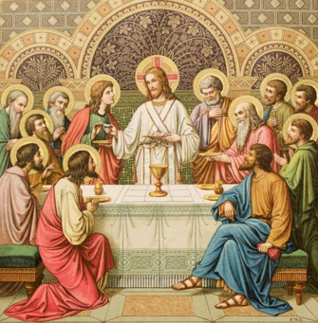
The New Law reveals the Old Law’s true meaning because Jesus fulfilled the Old Law perfectly. He took upon himself all the sins against the Old Law and redeemed them, making salvation possible for all people.
Image in shutterstock

Slide 3

The new life we receive from Christ calls us to put love into practice by performing acts of charity and building just social structures.
Image in shutterstock

Slide 4
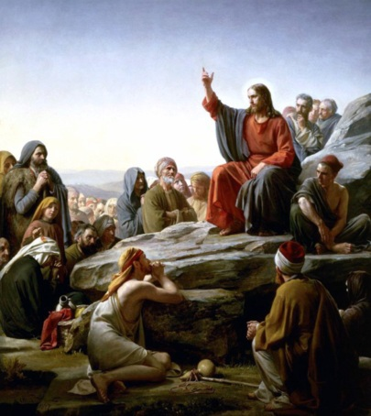

One of the most foundational social justice principles is that we must see the image of God in every person, as did Jesus, our role model.
Jesus welcomed the societal outcasts, and he calls us to do the same.
WikiMediaComons
Image in shutterstock

Slide 5

Jesus taught that mercy and forgiveness are an essential part of God’s justice.
In the Sermon on the Mount, Jesus instructs us to forgive others and not to respond to transgressions by means of violence.
By Louise Docker from sydney, Australia [CC-BY-2.0 (www.creativecommons.org/licenses/by/2.0)], via Wikimedia Commons

Slide 6

Jesus taught that detachment from wealth is necessary for entering the Kingdom of God. Jesus also asked some of his wealthy followers to share their wealth with those who are poor.
Image in shutterstock

Slide 7

Jesus taught that people who care for those who are poor and vulnerable (the corporal works of mercy) are placed at God’s right hand and receive the gift of eternal life.
WikiMediaCommons

