Slide 1
Models of Church
The Church
Unit 4
Document #: TX005572

Slide 2
Five Models of the Church
What are the five models of the Church?
Institution
Mystical Body / Communion
Herald
Servant
Sacrament
Notes:
Notes: Before you begin, you might explain that Cardinal Avery Dulles wrote about the Church and developed five (later six) models to explain the role of the Church in the world today.

Slide 3

The Church:
A Great Mystery and a Divine Gift
We can only begin to understand the Church as mystery through analogy—through models.
No matter what model—or combination of models—we choose, our models will fall short.
© Rafa Irusta/Shutterstock.com

Slide 4
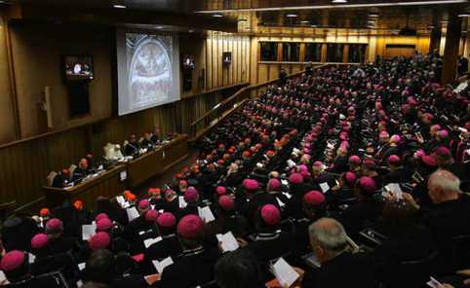
Institution
The Church is defined primarily in terms of its visible structures, especially the rights and powers of its hierarchy.
The authority of the Church leadership is understood as God-given, and should be accepted by the faithful wholeheartedly.
© MAX ROSSI/Reuters/Corbis
Notes:
Notes: Emphasize that this hierarchy is based on Christ’s commissioning of the Apostles.

Slide 5
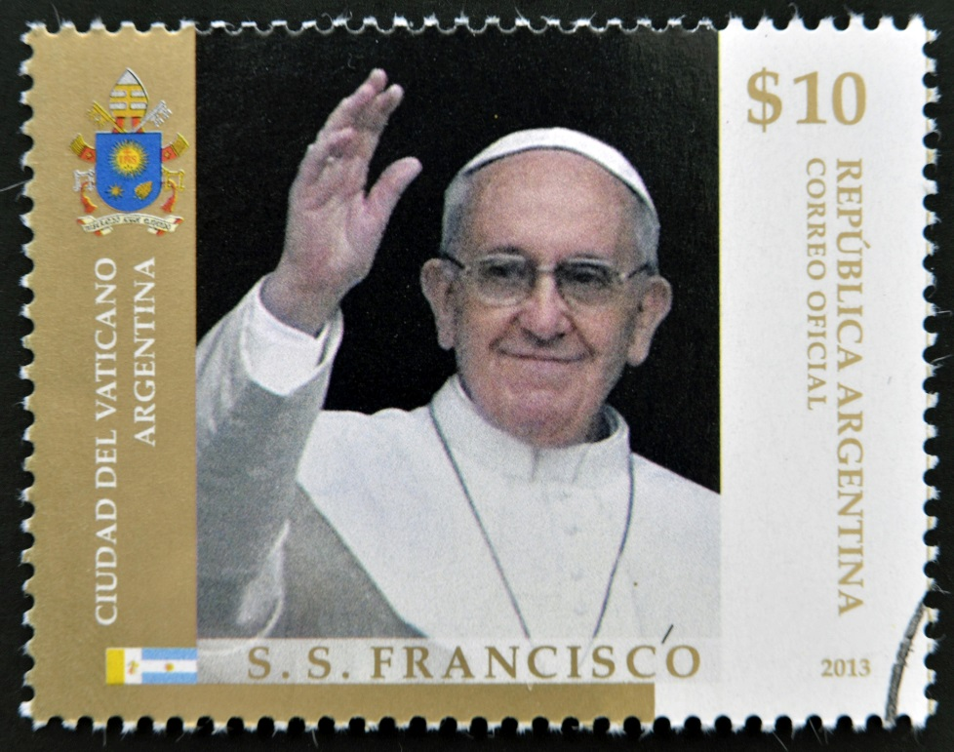
Structure
This model reflects a need for order, unity, and consistency of teaching.
Members are considered all those who formally recognize themselves
in relationship to an
official Church community and Church teachings.
© Neftali / Shutterstock.com

Slide 6

Strength of This Model
The strength of this model lies in its visible manifestation of unity.
Unlike any of the following models, all tests of membership are clearly visible.
This is the only model that must not be paramount. The institution must serve other ends besides its own preservation.
©mejnak / Shutterstock.com

Slide 7

Mystical Body / Communion
The Church consists of people of faith who are united by their common participation in God’s Spirit through Christ.
It is a communion of
people, expressed by
external bonds of
creed, worship, and
ecclesiastical fellowship.
©Kev Draws / Shutterstock.com
Notes:
Notes: Explain that we, as the People of God, are the Mystical Body of Christ, in communion with Christ and one another.

Slide 8

Strength of This Model
The strength of this model lies in its emphasis on the shared life of mutual fellowship in loving community.
This model emphasizes sharing.
©Rawpixel.com / Shutterstock.com
Notes:
Notes: Community life is vital for growth in the faith.

Slide 9

Herald
The herald model emphasizes faith and proclamation over interpersonal relations and mystical communion.
The Church is a herald—one who receives an official message with the commission to pass it on.
It is the task of the Church to proclaim.
©Creative Stall / Shutterstock.com
Notes:
Notes: A trumpet is an ancient symbol of proclamation. Angels, the messengers of God, are often pictured with trumpets.

Slide 10
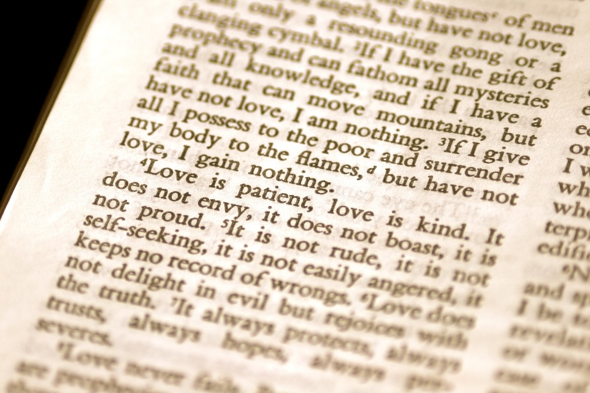
Strength of This Model
The strength of this
model lies in its
emphasis on the
message of the Gospel.
Sometimes the spoken
word eclipses the
true Word of God,
the Word Made Flesh.
We must not only proclaim and witness but also act.
©deepspacedave / Shutterstock.com

Slide 11
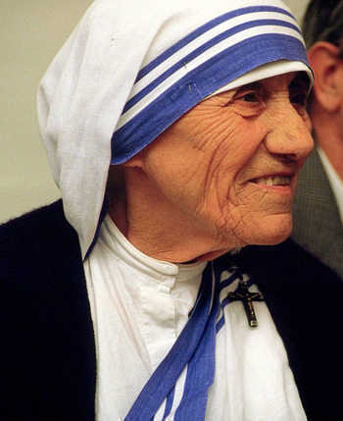
Servant
The servant model shows that the Church is part of the total human family, sharing the same concerns as the rest of humankind.
Just as Christ came into the world not to be served but to serve, so the Church, carrying on the mission of Christ, seeks
to serve the world.
Image in public domain

Slide 12
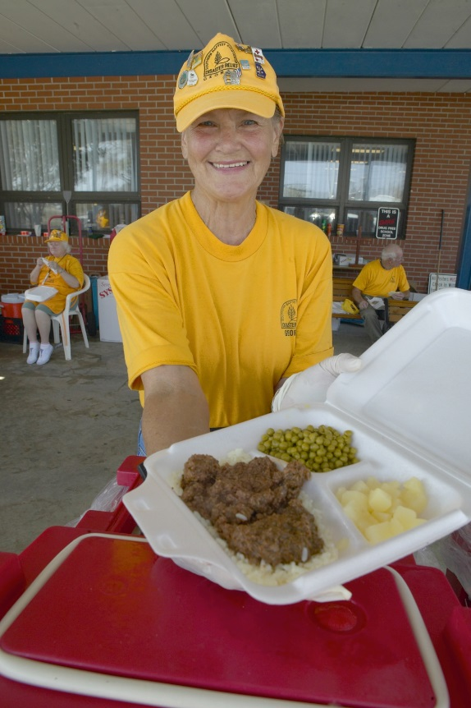
Strength of This Model
The strength of this model lies in its emphasis on serving others, and not simply serving the Church’s self-interests.
Authentic service
includes the ministry
of the Word and
Sacrament.
The concept of service
must keep alive the
distinctive mission and
identity of the Church.
©Joseph Sohm / Shutterstock.com
Notes:
Notes: Interpreted in the light of the Gospel, the Kingdom of God cannot be properly identified with abstract values such as peace, justice, reconciliation, and affluence. The New Testament personalizes the Kingdom. It identifies the Kingdom of God with the Gospel, and both of them with Jesus.

Slide 13
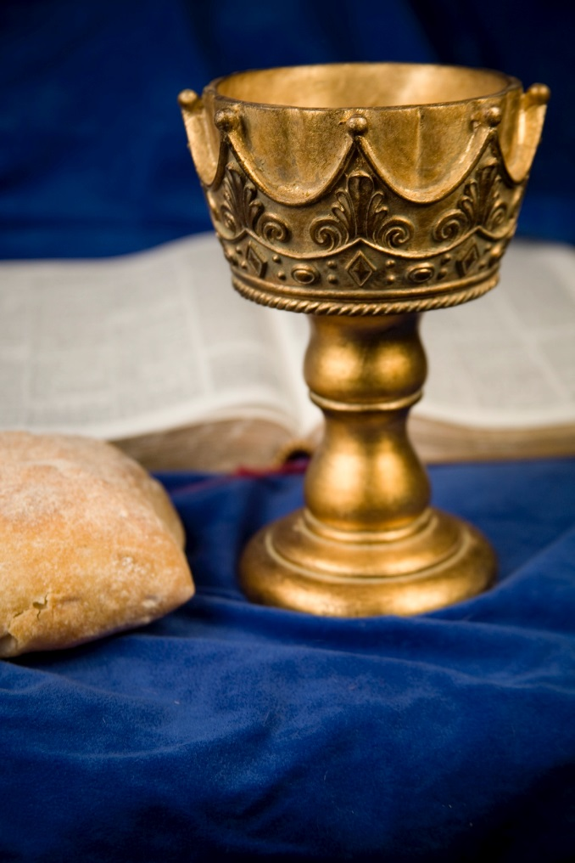
Sacrament
In this model the Church is a sacrament, a sign and transmitter of God’s grace in the world.
© Pears2295/iStock.com

Slide 14
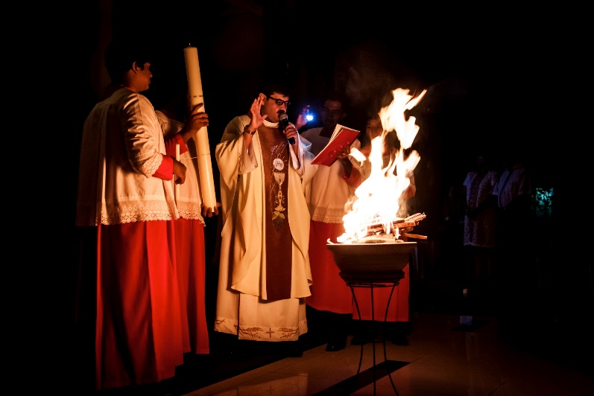
Visible Sign
A sacrament is a “visible sign of an invisible grace.”
The Church truly transmits grace—the favorable presence of God.
Sacraments are never merely individual transactions. Nobody baptizes, absolves, or anoints themselves, and the Eucharist is not to be celebrated in solitude.
©ThamKC / Shutterstock.com
Notes:
Notes: Ask the students to discuss the first bullet before you click for the second bullet. The photo shows the blessing of the New Fire on Holy Saturday, as part of the celebration of the Triduum. During the Triduum we celebrate the Paschal Mystery, the death and Resurrection of Christ. It is from the presence of the Risen Christ in every sacrament that the sacraments receive their power.

Slide 15

Strength of This Model
The strength of this model is that the Church is truly a sign and an instrument of grace to its members and to the world.
©R.Gino Santa Maria / Shutterstock.com

Slide 16

Integrating the Models
Each model of Church offers helpful insights and positive contributions to understanding the role of the Church in the world.
If the best insights are preserved from each model and integrated into one, a stronger vision of the Church is achieved.
©Arcady / Shutterstock.com

Slide 17
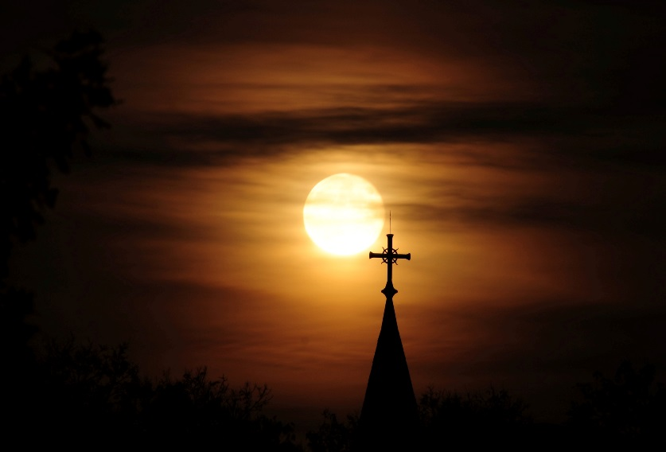
No Model Is Complete
In the end, none of the models is sufficient to address the fullness of God’s call to the Church.
Each model truly highlights and underscores
a vital aspect of the Church.
  ◦ Institution
  ◦ Mystical Body / Communion
  ◦ Herald
  ◦ Servant
  ◦ Sacrament
© Nancy Bauer/ Shutterstock.com

